Slide 1
Classifying Ragas in Indian Classical Music using Neural Network Models
Pruthvi Jitendrabhai Pandya(2311349)
Supervisor: Dr. Richard Sutcliffe
Second Assessor: Prof. Gareth Howells

Slide 2
ObJectives
Apply Neural Network Models: Use CNN, LSTM, and VGG models to classify genres within Indian music, particularly Indian classical music.
Experiment and Evaluate: Conduct experiments using different datasets, including the North Indian Classical Music dataset, genre dataset (GTZAN), and the Ethiopian Kinit dataset, to compare model performance.
Analyze Model Effectiveness: Evaluate the effectiveness of these models in recognizing Indian classical music features, such as Ragas and Talas.
Explore Overlaps in Music Classification: Investigate the overlaps between each Ragas or Nodes to build better music information retrieval (MIR) systems that can handle Indian and Western Classical music with notation-wise or node-wise types.

Slide 3
Background
Context of the work:
The research aims to extend and adapt these advancements in MIR to Indian Classical Music, which presents unique challenges due to its complex structures, improvisational nature, and cultural context. Unlike Western classical music, Indian music relies heavily on improvisation and has nuanced variations in scales, rhythms (Talas), and melodic structures (Ragas). This complexity makes applying existing MIR models challenging but also presents a critical need to create specialized tools that can accurately analyze, classify, and retrieve Indian music data.
Importance: As digital music archives continue to grow, there is an increasing need for tools that can efficiently classify and manage diverse musical genres, including Indian Classical Music. Developing such tools would not only enhance musicology research but also benefit applications such as music recommendation systems, personalized playlist generation, and content-based music search.
Difficulty: The primary challenge lies in adapting existing MIR techniques and models to accommodate the unique features of Indian Classical Music, such as its emphasis on improvisation, non-standardized scales, and the cultural and emotional nuances embedded in its performance traditions. Moreover, existing MIR models have been primarily trained on Western music datasets, which makes direct application to Indian music less effective without significant modification.

Slide 4
Previous work
- Ephrem Afele Retta and Richard Sutcliffe (2023) : There has been research in using these machine learning and deep learning techniques
to classify non-Western music. For instance, Retta et al. [30] in their research have explored creating a database of Ethiopian music. The Music Information Retrieval dataset for Ethiopian Music comprises of 600 sample recordings of Orthodox Tewahedo chants, traditional Azmari songs and contemporary Ethiopian secular music. The authors have classified the music into four well known categoies- Ethiopian Ki˜nits, Tizita, Bati, Ambassel and Anchihoye, leveraging the VGG architechture for classifying the audio clips in the dataset. Based on three different experiemnts, the authors explored the efficiency of 13 Filterbank, Mel-spectrogram, Chroma, or Mel-frequency Cepstral coefficient (MFCC) features for classification, followed by testing the accuracy of the MFCC using varying audio lengths. They also compared the accuracy of four existing models on their music dataset- AlexNet, ResNet50, VGG16 and LSTM wherein the VGG16 had been able to achieve a 93% accuracy rate for genre classification.

Slide 5
Previous work
- Chandan Misra(2022)- There has laos been some previous work done
with Indian classical music. For instance Mishra’s Sangeet XML database wherein the
dataset contains metadata, structural, notational, rhythmic, and melodic information. It
comprises of 116 compositions of the three highest frequent raags i.e. raag Bhairav (42),
Todi (39), and Poorvi (35) published in the book Hindusthani Sangeet Paddhati-Kramik
Pustak Malika.
- Deshpoande et(2018) all in their work on raga recognition in North Indian Classical Music, for instance worked with a dataset consisting of 1200 audio files for six ragas played by four musical instruments. The authors concluded through their work that there is a need to develop another classifier for classifying ragas with the multi-SVM classifier being unable to work for a large raga class. worked on identification of ragas using a Chromagram, with a 92% accuracy achieved with the K-NN and a 91% accuracy for SVM for raga “specified with the graphical visualization of each feature.”

Slide 6
Implementation
The notebook appears to focus on an analysis and classification of Indian classical music using machine learning techniques. It includes steps for training multiple models (such as CNN, LSTM, and VGG16) and evaluating their performance in predicting different music genres or emotional states. The notebook also contains data visualization using confusion matrices and model accuracy/loss plots.

Slide 7
2. Adapted existing code or wrote new code
Adapted Code: Some code cells involve common data visualization and machine learning tasks, such as plotting confusion matrices and model performance, which might be adapted from standard examples or previous work.
New Code: Custom functions (like music_to_lyrics for converting music to lyrics using the Google Web Speech API) indicate that some new code was written specifically for this project and the Tonic Frequency found the nodes by (pydub) library.

Slide 8
3. Computer used:
Google Colab. The notebook is formatted for use in Google Colab, as indicated by its .ipynb format and structure. This implies it was run on a cloud-based platform, utilizing Google Colab's computational resources (e.g., GPU or TPU).

Slide 9
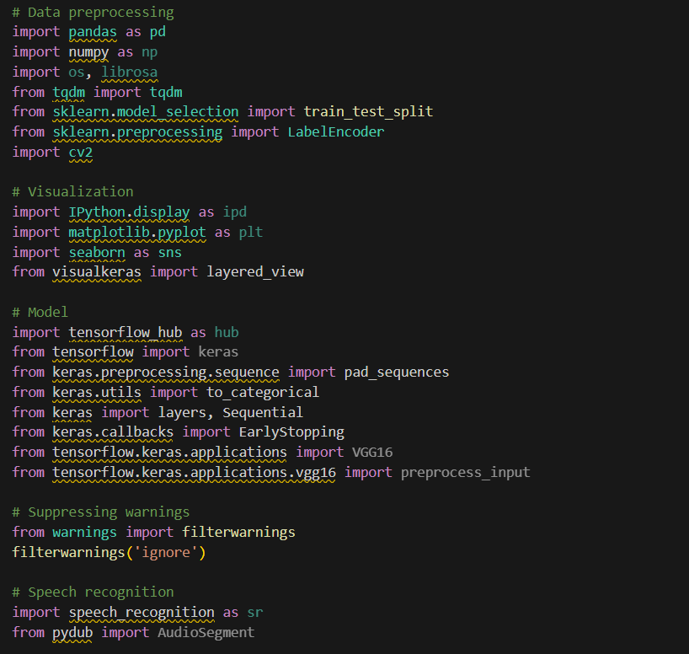
Libraries

Slide 10
4. Language (Python) and version, Packages (Keras, TensorFlow, etc.):
Machine Learning and Deep Learning:
TensorFlow: Provides the core functionality for deep learning models, including layers, optimizers, and loss functions.
Keras: A high-level neural network API integrated with TensorFlow, used to build and train models like CNN, LSTM, and VGG16.
Data Visualization:
Matplotlib: For creating static, animated, and interactive visualizations in Python (e.g., plotting model accuracy and loss).
Seaborn: Built on top of Matplotlib, used for more complex visualizations like heatmaps of confusion matrices.
Data Processing:
NumPy: A fundamental package for numerical computations in Python (e.g., handling arrays and matrices).
Pandas: For data manipulation and analysis, mainly used for handling structured data (tabular data).
Audio Processing:
Librosa: A Python package for music and audio analysis, used for loading audio files, extracting features (e.g., mel spectrograms), etc.
Pydub: A library for audio manipulation (e.g., converting audio formats, resampling).
Speech Recognition:
SpeechRecognition: A library for performing speech recognition, used to convert audio to text using APIs like Google Web Speech.
Utility Libraries:
MLxtend: Provides additional tools and utilities for machine learning, such as functions for plotting confusion matrices.
Scikit-learn (sklearn): A machine learning library that provides tools for data mining, analysis, and model evaluation (e.g., splitting data, calculating metrics).
Specific Imports Identified:
from keras.models import Sequential (for creating models)
from keras.layers import Dense, Conv2D, Flatten, etc. (for defining different neural network layers)
import matplotlib.pyplot as plt (for plotting)
import seaborn as sns (for advanced plotting)
from sklearn.metrics import confusion_matrix (for evaluating classification results)
import numpy as np (for numerical operations)
from pydub import AudioSegment (for audio processing)
import speech_recognition as sr (for converting audio to text)

Slide 11
5. Problems encountered and solutions.
Data Handling: Managing and preprocessing audio data for training machine learning models.
Model Performance: Fine-tuning the models (CNN, LSTM, VGG16) to improve accuracy and reduce loss.
Resource Limitations: Possible limitations in computational resources (e.g., GPU time) while running on Google Colab.
Possible Solutions: Optimizing model architecture, using pre-trained models like VGG16, and employing efficient data handling practices.

Slide 12
Datasets
The dataset is North Indian Classical Music by Kcwaghmare Waghmare[36]. This dataset
has 8 different ragas ( Such as Asawari, Bageshree, Bhairavi, Boopali, Darbari Kanada, Malkauns,
Vrindavan Sarang, and Yaman) and this side the Kaggle folder 80 Wav format Ragas as
well as including instrumental music. But, this Wav Ragas length is 4 to 5 minutes. So, this
program is splitting the data into 30 and 3 Seconds. After this process, the dataset converts into
a larger scale dataset, it’s around 500 plus 30 Seconds of Wav music and 3 Seconds of around
4425 Wav songs with instrumentals.

Slide 13
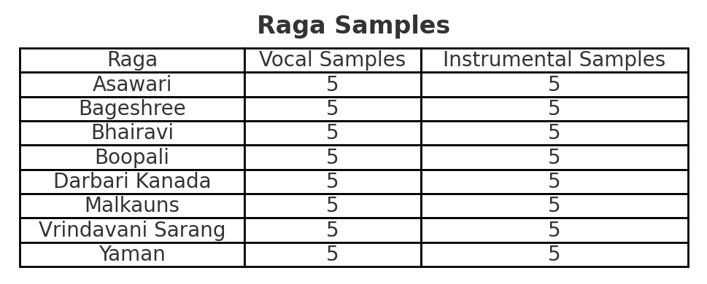
The Ragas included are:
• Asawari
• Bageshree
• Bhairavi
• Boopali
• Darbari Kanada
• Malkauns
• Vrindavani Sarang
• Yaman

Slide 14
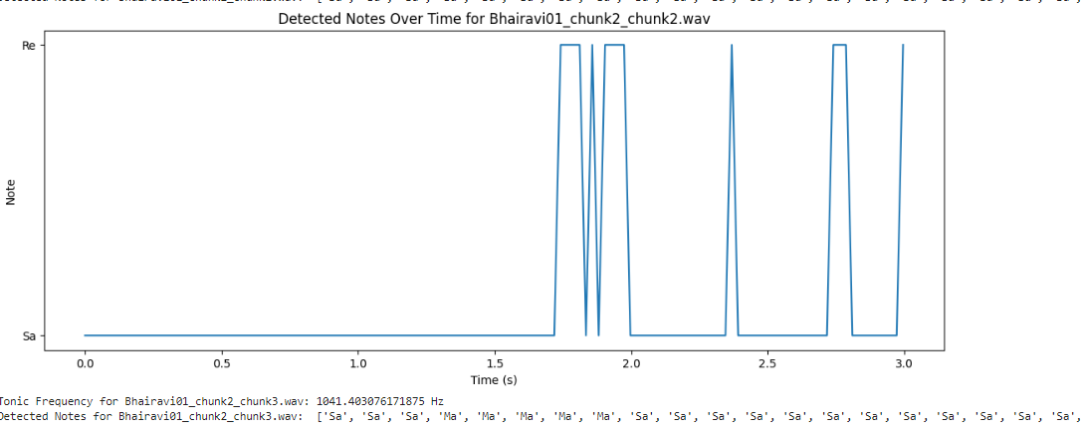
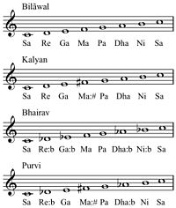
Experiment 1 –Find the Tonic Nodes and Friquency
Aim: Accurate find the Ragas with overlapping images.
This step for music are convert in Ragas or Thaat form like Sa, Re, Ga, Ma.

Slide 15
Experiment 2
Aim: Attempting feature extraction on Indian music dataset using CNN, VGG16 and LSTM models.
Training:
1. Waveform:
Description: A waveform represents the variation in air pressure (amplitude) over time. It is the simplest form of visualizing an audio signal.
Details: The x-axis shows time (in seconds), and the y-axis shows amplitude, which indicates the strength or intensity of the sound at any given moment.
Usage: Waveforms are useful for identifying general patterns in sound, such as when a sound starts and stops, or when there is a significant change in loudness. However, they do not provide information about frequency content (i.e., pitch).

Slide 16
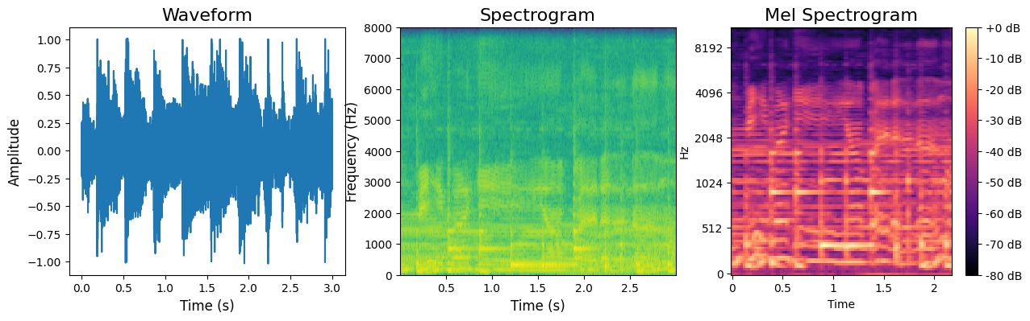
2. Spectrogram:
Description: A spectrogram visualizes how the frequency content of a signal changes over time. It displays the intensity of different frequencies using a color scale.
Details:
The x-axis represents time (in seconds), and the y-axis represents frequency (in Hz).
The color intensity indicates the magnitude (amplitude) of the frequencies at a particular time. Brighter areas represent higher amplitudes.
Usage: Spectrograms are valuable for analyzing the frequency characteristics of audio, such as identifying different musical notes, distinguishing speech from music, or spotting patterns in complex sounds.

Slide 17
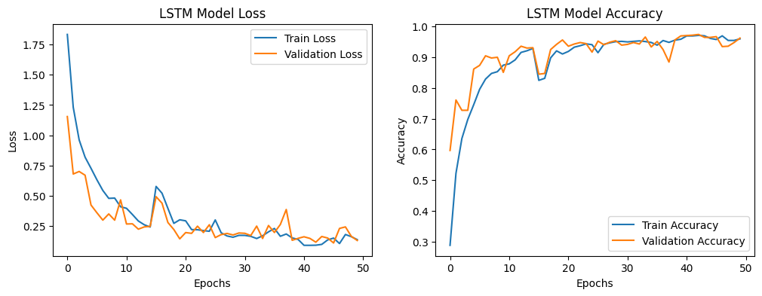
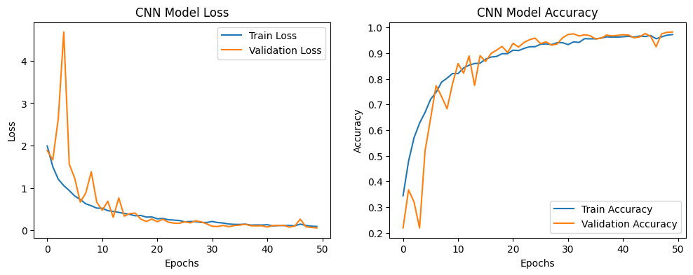
3. Mel Spectrogram:
Description: A Mel spectrogram is a type of spectrogram that uses the Mel scale, which is designed to mimic the human ear's perception of sound. The Mel scale places more emphasis on frequencies that are more perceptible to humans.

Slide 18
VGG16 model’s accuracy and loss over 200 training and testing epochs are
shown. Over the first 10 epochs, the training loss decreases rapidly before plateauing, but
the testing loss stays rather constant. At epoch 100, the testing accuracy reaches its apex,
although the training accuracy increases progressively 14. The model is overfitting to the
training data, as seen by its strong performance on the training set but low performance
on the testing set.
The training and validation performance of an LSTM model over 50 epochs. The represents the loss, where both training and validation loss decrease significantly as the epochs progress, indicating that the model is learning effectively and reducing errors over time. The accuracy, where both training and validation accuracy steadily increase, converging around 95% after about 30 epochs. This suggests that the model generalizes well to unseen data, as there is minimal divergence between training and validation performance. Overall, the LSTM model demonstrates effective training with low overfitting.
The training and validation performance of a CNN model over 50 epochs. The loss, where both training and validation losses decrease rapidly, particularly in the early epochs, and continue to decrease steadily, indicating efficient model learning and error reduction. The accuracy, with both training and validation accuracies improving quickly and converging around 98% by the end of training. The close alignment of training and validation curves suggests that the model has successfully generalized to new data, showing minimal signs of overfitting and achieving high performance.

Slide 19
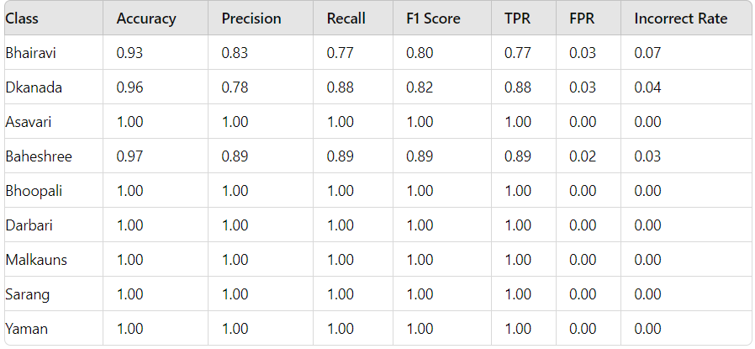
Evaluation: Metrics used (accuracy, F-score, etc.) and rationale.

Slide 20
Conclusions
In this project, we used the North Indian Classical Music dataset, which classifies a set of
recordings in terms of four main scales for Ragas and Talas, and in addition two other datasets
for comparison, GTZAN, a Western music genre dataset, and an Ethiopian Kinit dataset. We
then conducted two experiments. In Experiment 1, two standard models, LSTM and CNN were
trained on these three datasets. The results were good for all models. The Indian dataset is small,
but this experiment is enough to suggest that Ragas can be classified using a neural network
model.
In the second experiment, the VGG model was applied to the three datasets. However, its
performance was not as good as LSTM and CNN on the Indian classical music dataset.
As part of the project, we investigated the essence of ragas, talas, and the complex exchange
of tune and beat. We also examined the overlap between Indian and Western Classical music
which could potentially be used to build MIR systems that can handle both. Thus the project
carries out training experiments as well as expanding our knowledge about how North Indian
and Western classical music interrelate.

