Slide 1
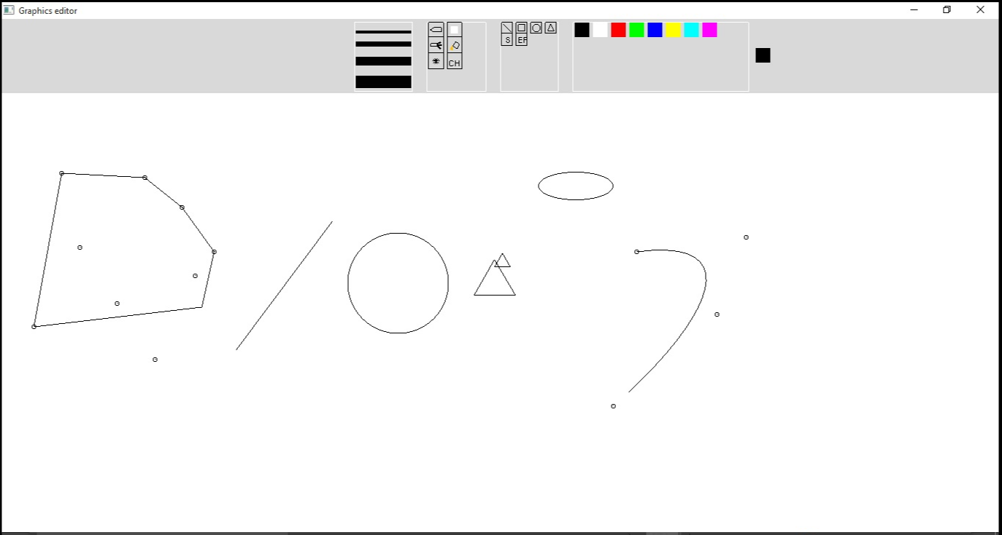
Project Title:- Implementation of Graphics Editor using Opengl.
Presented by:-
Sourav Parmar
Priyanshu Pandey

Slide 2
Functionalities Implemented
Pencil.
Brush.
Draw lines.
Draw polygons ( line,rectangle, triangles etc).
Draw circle.
Draw Ellipse.
Draw curve.
Spray.
Color fill.
Convex Hull.
Erase.

Slide 3
Tools Used
GLUT is the OpenGL Utility Toolkit used for writing OpenGL programs.
It implements a simple windowing application programming interface (API) for OpenGL.
GLUT provides a portable API so you can write a single OpenGL program that works across all PC.
The code is written in C++.

Slide 4
Window Management
glutInit
glutSetColor
glutInitDisplayMode : GL_SINGLE vs GL_DOUBLE
glutInitWindowPosition
glutInitWindowSize: 1028x700
glutCreateWindow
glutMainLoop : Causes the program to enter an event-processing loop.

Slide 5
The Display Callback
glutDisplayFunc(display)
glutMotionFunc(Mouse_Motion_CB)
glutKeyboardFunc(Key_pressed_CB);
glutReshapeFunc(Reshape_Window)
glutMouseFunc(Mouse_pressed_CB)

Slide 6




Creating the UI
Toolbox
Shapebox
Colorpalette
SizeBox

Slide 7
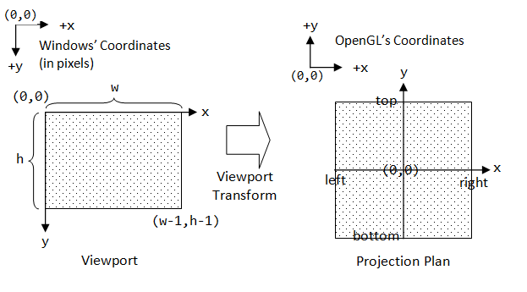
OpenGL Coordinates

Slide 8

Pencil Implementation
(X_{new ,}Y_{new}) and (X_{old}, Y_{old} ) are all initialized to -1 when Pencil tool is selected from the menu options
Both these variables are assigned the current mouse position when Mouse_pressed_CB is called.
With every Mouse_Motion_CB
  (X_{new ,}Y_{new}) are assigned the new (x,y) coordinates.
  GL_LINE is drawn between (X_{new ,}Y_{new}) and (X_{old}, Y_{old} )
  (X_{new ,}Y_{new}) are copied to (X_{old}, Y_{old} )

Slide 9

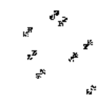
Brush, Eraser and Spray Implementation
Brush works on the same principle as the Pencil.
It is like a thick Pencil i.e. default pixel width large.
Default eraser size if 4x4 pixel.
GL_POLYGON of white color.
For Spray, 50 randomly generated pixels are colored in the vicinity of the current mouse position.

Slide 10
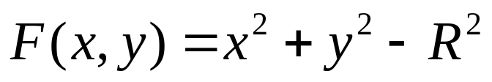



Circle Midpoint Algorithm
draw pixels in this octant
(draw others using symmetry)
x+
(0,-R)
y-
Implicit function for circle
on circle
(-R,0)
(R,0)
inside
outside
(0,R)

Slide 11



Choosing the Next Pixel
decision variable d
(x, y)
(x+1, y)
E
choose E
M
choose SE
SE
(x+1, y-1)

Slide 12
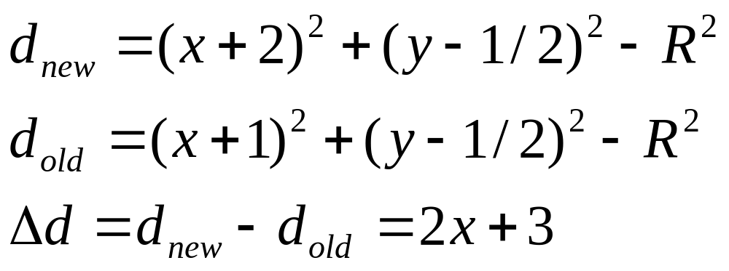
Change of d when E is chosen
(x, y)
(x+1, y)
(x+2, y)
E
M_{old}
M_{new}
SE
(x+1, y-1)
(x+2, y-1)

Slide 13
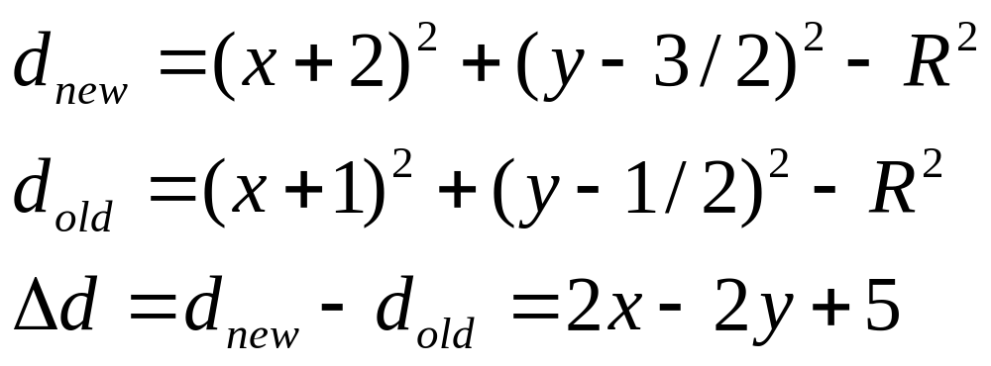
Change of d when SE is chosen
(x, y)
(x+1, y)
E
M_{old}
SE
M_{new}
(x+1, y-2)
(x+2, y-2)

Slide 14
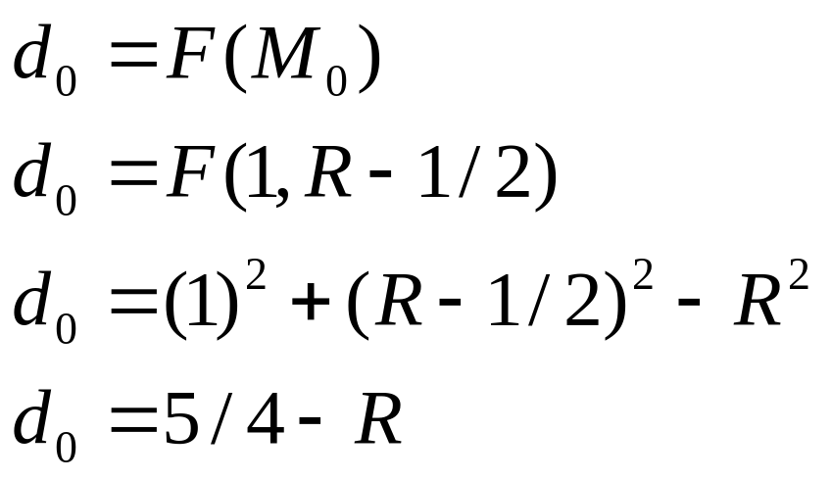
Initial value of d
(0,R)
(1,R)
M₀
(1,R-1)

Slide 15
New Decision Variable
  Our circle algorithm requires arithmetic with real numbers.
  Let’s create a new decision variable h
    h=d-1/4 and hence hstart = 1-R
  Substitute h+1/4 for d in the code.
  Note h > -1/4 can be replaced with h > 0 since h will always have an integer value.

Slide 16
Algorithm
draw circle{
x = 0;
y = R;
h = 1 – R;
setPixel(x,y);
while (y > x) {
if (h < 0) {/* E chosen */h += 2*x + 3; x++; }
else {/* SE chosen */h += 2*(x-y) + 5; x++ ; y--;}
drawpixel(x0, y0, x, y);
}
void drawpixel(int x0, int y0, int x, int y){
renderpixel(x + x0, y + y0);
renderpixel(-x + x0, y + y0);
renderpixel(x + x0, -y + y0);
renderpixel(-x + x0, -y + y0);
renderpixel(y + x0, x + y0);
renderpixel(-y + x0, x + y0);
renderpixel(y + x0, -x + y0);
renderpixel(-y + x0, -x + y0);
}

Slide 17
Ellipse Mid-Point Algorithm
Symmetry between quadrants. There four symmetric points from a single (x,y) point.
Not symmetric between the two octants of a quadrant
Thus, we must calculate pixel positions along the elliptical arc through one quadrant and then we obtain positions in the remaining 3 quadrants by symmetry
  This single point is computed using the ellipseMidpoint formula which is a variation generalizing circle Midpoint algorithm.
plotellipsepoints (xc, yc, x, y){
  renderpixel (xc + x, yc + y);
  renderpixel (xc - x, yc + y);
  renderpixel (xc + x, yc - y);
  renderpixel (xc - x, yc - y);
  }
(-x, y)
(x, y)
r_{y}
r_{x}
(-x, -y)
(x, -y)

Slide 18
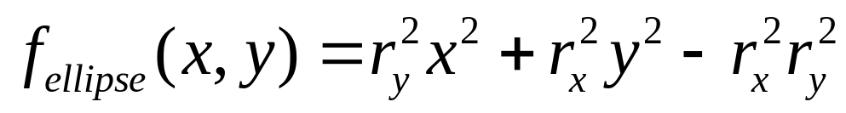
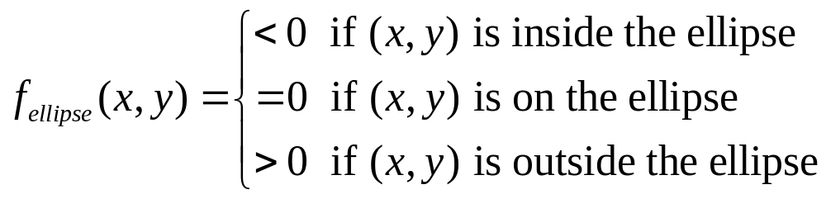
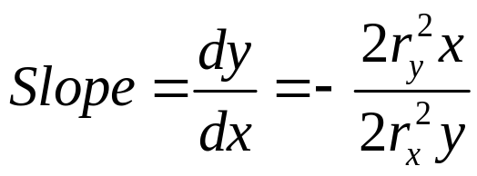
Ellipse Mid-Point Algorithm II
Slope = -1
1
Starting at (0, r_{y}) we take unit steps in the x direction until we reach the boundary between region 1 and region 2.
r_{y}
2
r_{x}
Decision parameter:

Slide 19
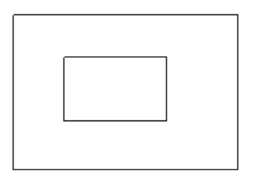
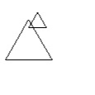

Draw Rectangle, Triangle and Line.
Similar to Pencil, the old and new coordinates are stored in (X_{new ,}Y_{new}) and (X_{old}, Y_{old} ).
GL_LINE_LOOP is completed by connecting the following points : (X_{old}, Y_{old} ) , (X_{old}, Y_{new}) , (X_{new}, Y_{old}) , (X_{new}, Y_{new})
Store (X_{new ,}Y_{new}) and (X_{old}, Y_{old} ). For drawing triangle
Draw an equilateral triangle with above two as the coordinates.
GL_LINE_STRIP is drawn between (X_{new ,}Y_{new}) and (X_{old}, Y_{old} ).

Slide 20
Flood Fill implementation
Start at a point inside a region
Replace a specified interior color (old color) with fill color
Fill the 4-connected until all interior points being replaced
4 way method is implemented with std::stack

Slide 21
Flood Fill Algorithm
floodFill(GLint x, GLint y, float r, float g, float b)
Push (pair(x,y)) on stack
Until stack is not empty
Get top element of stack tos
If pixelcolor tos != newcolor && tos is not marked visited
setPixelColor(tos.x, tos.y, newpixelcolor)
stack.push(tos.x+1 ,tos.y)
stack.push(tos.x ,tos.y+1)
stack.push(tos.x ,tos.y-1)
stack.push(tos.x-1 ,tos.y)
 | X,Y+1
X-1,Y | X, Y | X+1,Y
 | X,Y-1

Slide 22
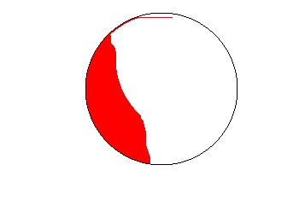
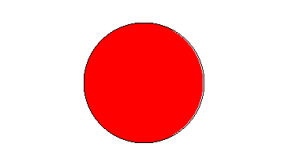
Flood Fill: In Action

Slide 23

Bezier Curve
  Bezier curves are used in computer graphics to produce curves which appear reasonably smooth at all scales
  One method to render Bezier curve is as Bernstein polynomials (functions that define the influence of each control point as a function of t)
The n+1 Bernstein Polynomials of degree n are given as

Slide 24
Bezier curve properties
Interpolate end-points
Tangent at end-points in direction of first/last edge
Curve lies within the convex hull of the control points

Slide 25
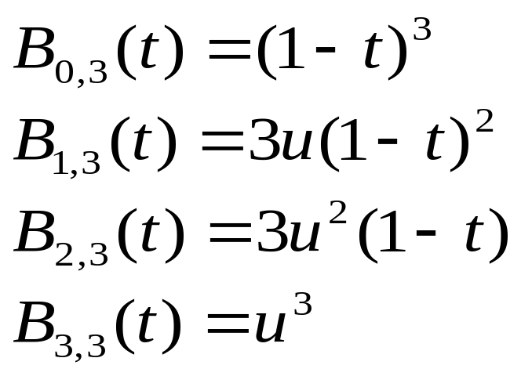
Cubic Bezier Curve Rendering
  Cubic Bezier curves gives reasonable design flexibility while avoiding the increased calculations needed with higher order polynomials.
  Cubic Bezier curves are generated with four control points.
  The four blending functions for cubic Bezier curves (n=3):

Slide 26
Algorithm:
Select control points.
if number of control points equals four then
Find x and y using Bernstein cubic polynomials
Draw GL_LINES with old vertex and new vertex (found using above equation)

Slide 27
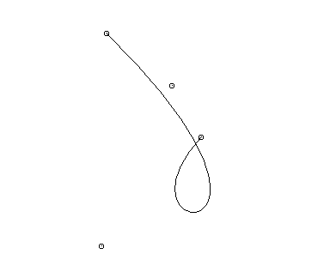
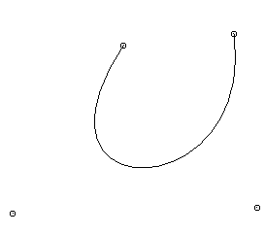
Bezier curve in action

Slide 28
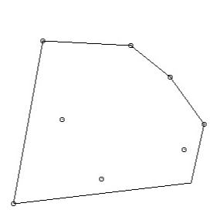
Convex Hull
The convex hull of a set of points is the smallest convex polygon containing the points
A convex polygon is a nonintersecting polygon whose internal angles are all convex (i.e., less than 180 degrees)
In a convex polygon, a segment joining any two lies entirely inside the polygon

Slide 29
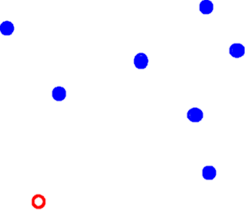
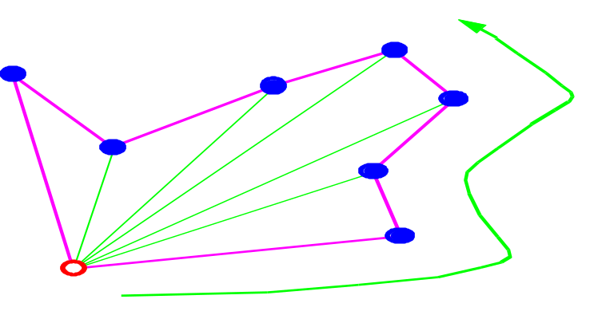
Graham Scan Algorithnm: How does it work
Start with the bottom-left point (anchor point)
Sort the points by their polar angle from the anchor

Slide 30
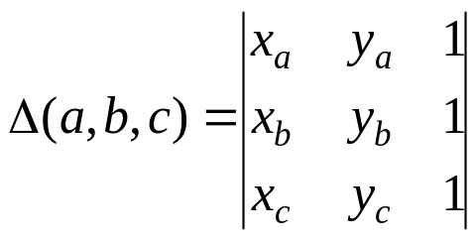
Calculating Orientation
b
c
CW
a
The orientation of three points (a, b, c) in the plane is clockwise, counterclockwise, or collinear
  Clockwise (CW): right turn
  Counterclockwise (CCW): left turn
  Collinear (COLL): no turn
The orientation of three points is characterized by the sign of the determinant Δ(a, b, c)
CCW
c
COLL
b
a

Slide 31
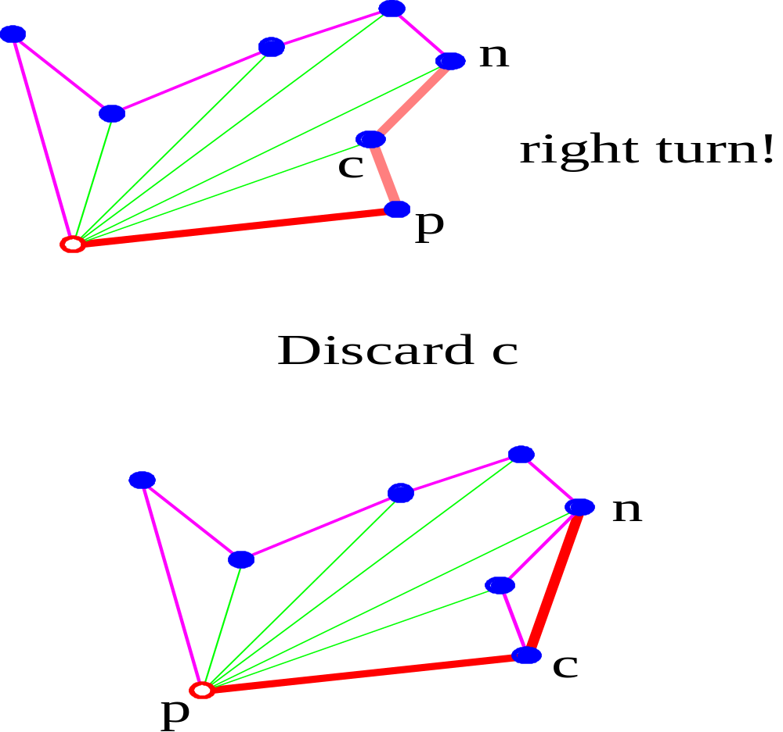

Convex Hull : Graham Scan Algorithnm

Slide 32
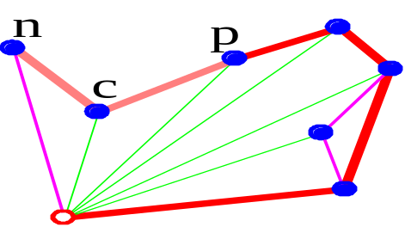
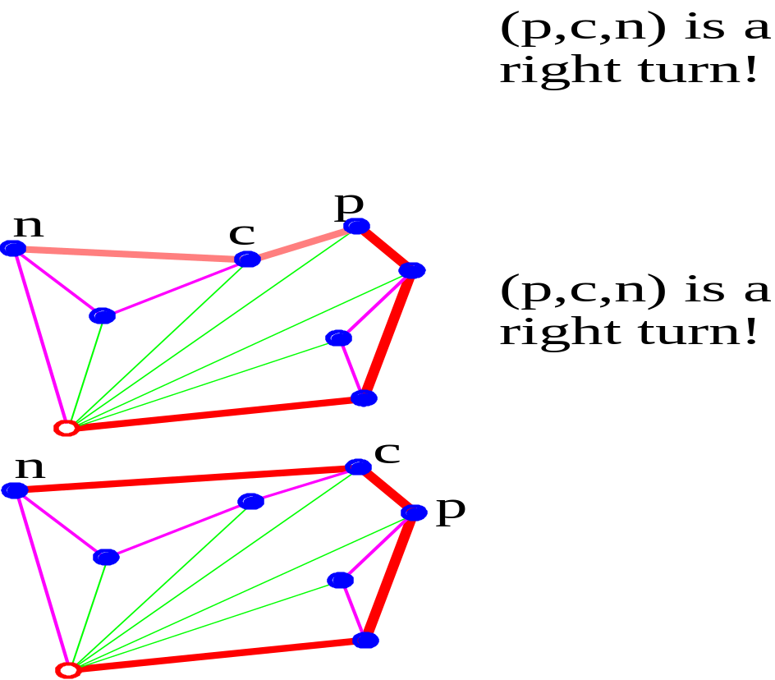
Convex Hull : Graham Scan Algorithnm

Slide 33
Convex Hull : Graham Scan Algorithm
GRAHAM_SCAN(Q)
1.Find p₀ in Q with minimum y-coordinate (and minimum x-coordinate if there are ties).
2.Sort the remaining points of Q by polar angle in counterclockwise order with respect to p₀.
3. TOP [S] = 0 ▷ Lines 3-6 initialize the stack to contain, from bottom to top, first three points.
4. PUSH (p₀, S)
5. PUSH (p₁, S)
6. PUSH (p₂, S)
7. for i = 3 to m ▷ Perform test for each point p₃, ..., p_{m}.
8. do while the angle between NEXT_TO_TOP[S], TOP[S], and p_{i} makes a nonleft turn ▷ remove if not a vertex
9. do POP(S)
10. PUSH (S, p_{i})
11. return S
Connect the points present in the stack in order by GL_LINES.

Slide 34
Demo Time

Slide 35
Future Work
3D Figure.
Selecting Polygons on Canvas.
Translation.
Rotation.
Crop Image.
File Handling.

Slide 36
References
Fundamentals of Computer Graphics 3rd ed. - P. Shirley, S. Marschner (CRC, 2009) WW (1)
http://people.wku.edu/qi.li/teaching/446/cg1_OpenGL.pdf
http://www.glprogramming.com/red/chapter01.html
http://www.mcs.csueastbay.edu/~grewe/CS4840/OpenGL/menu.htm
https://www.opengl.org/resources/libraries/glut/
http://https://www.opengl.org/archives/resources/faq/technical/transformations.htm
https://www.opengl.org/archives/resources/faq/technical/transformations.htm
http://www.tutorialspoint.com/computer_graphics/circle_generation_algorithm.htm
http://rosettacode.org/wiki/Bitmap/Midpoint_circle_algorithm
ftp://ftp.cis.upenn.edu/pub/.../Lecture5.ppt
www.cse.iitd.ernet.in/~amitk/cs201/ConvexHulls.ppt
people.csail.mit.edu/thies/6.046-web/graham.ppt
cs.brown.edu/courses/.../15%20Convex%20Hull.pptx
https://www.youtube.com/watch?v=frrBDwmkQ0E
https://en.wikipedia.org/wiki/B%C3%A9zier_curve

Slide 37
Questions?

