Slide 1
Data Analysis on game usage
Prateek Pushkar Agarawal

Slide 2
Problem statement
To maximize revenue with minimum traffic allocation
Given a dataset with the following variables
created_at
game_id
campaign_id
adgroup_id
country_id
category
revenue
total_adrequests
total_impressions
total_clicks

Slide 3
Analysis
Clickthrough Rate Vs industry standard(FB ads): 4.30% Vs 0.9%*
Impressions/Ad requests ratio: 81.9%
Revenue/Click: 0.002
eCPM: 0.128
The revenue from game ID 32359233 is 5 times more than revenue from game ID 43346372, even though the CTR of game ID 32359233 is 4% less than CTR of game ID 43346372
82% of the total revenue and ~90% of ad requests come from game ID 55107008 and 32359233
Revenue generated by adgroup ID 4 is the maximum and the top 3 groups(4,13,1) generate 61% of the total revenue. However, the top 3 total number of clicks generated by groups (4,1,10) is maximum implying that group 13 has relatively higher conversions to clicks.
*https://instapage.com/blog/key-advertising-metrics

Slide 4
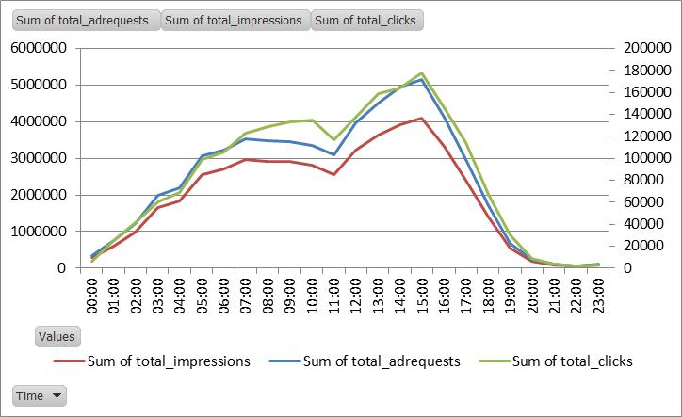
Analysis
Time split of ad requests, impressions and clicks

Slide 5
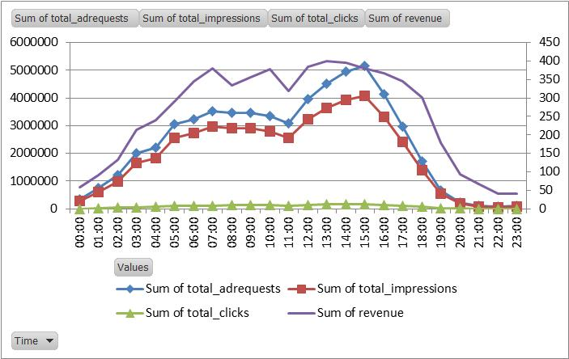
Analysis
Between 00:00hrs and 07:00hrs, 12:00hrs and 15:00hrs the number of ad requests, impressions and clicks rise sharply. However, the rise in number of clicks in not proportional.
There is a sharp decline in the number of requests , impressions and clicks after 15:00hrs leading to decline in revenue.
The requests, impressions and clicks are strongly correlated as shown in the previous chart, with more number of clicks after 06:00hrs

Slide 6
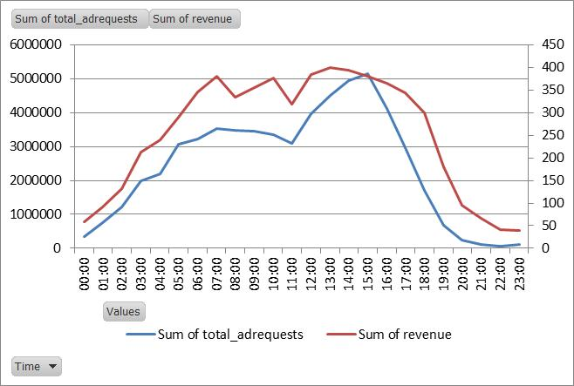
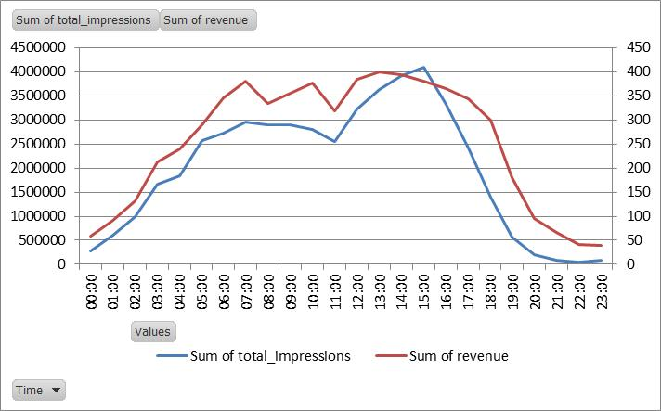
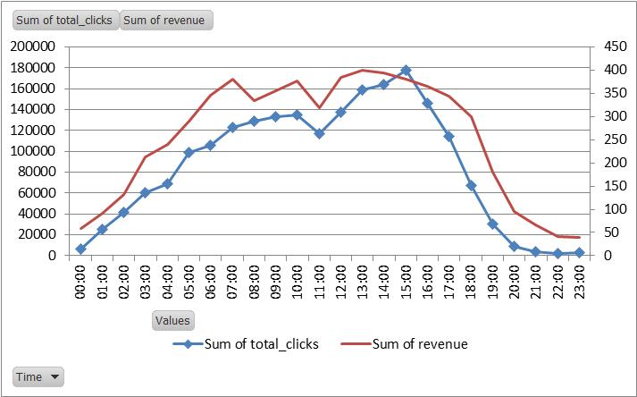
Analysis

Slide 7
Linear Model
Since, a particular variable is to be maximised over other variables, linear regression technique is used to figure out which would be the significant variables contributing to the revenue.
It was found that the there are certain campaigns and adgroups which contribute to the model. Apart from these the total number of ad requests and total number of clicks help in driving positive revenue growth.
Hence, a maximization of these variables will lead to positive growth in the revenue.

Slide 8
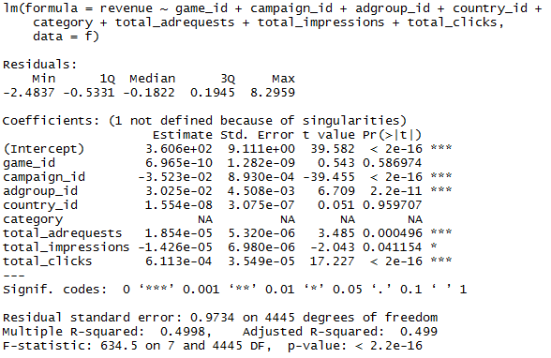
Linear Model

Slide 9
Recommendations
Given that 81.9% of the total ad requests are entertained, and a positive correlation between ad request and ad impression, increasing this value will have positive impact on the overall revenue
For game id 43346372, the clicks/impression is highest however, the revenue is generated is not the highest. This implies that there is a possibility of increasing the revenue with modification in the pricing of the cost of clicks inviting more conversions to generate revenue.
For game id 32359233, the clicks/impression must be increased to have a higher revenue.
Game IDs 19383848, 52065646, 94757439 must have more ad requests so that the impressions are higher in count.
Keeping the user engaged after 15:00hrs will help generate ad requests, impressions, clicks and thereby revenue. This can be done by scaling up the application to countries across different time zones.

