Slide 1
Lending Club Peer 2 Peer Loans
BAD Loan and modeling analysis
Artem akopyan, peter pages, Dimitri pappas

Slide 2
What is Lending Club
A peer-to-peer lending company
Unsecured personal loans between $500 and $40,000
Matches borrowers with investors willing to fund their loans.
Loaned out more than $55 billion

Slide 3
Proposal
Examine Lending Club loans between 2015-2018
Analyze the risk factors by looking at their risk metrics
Create a new model based on our analysis
Source of data - Kaggle.com : https://www.kaggle.com/wendykan/lending-club-loan-data

Slide 4
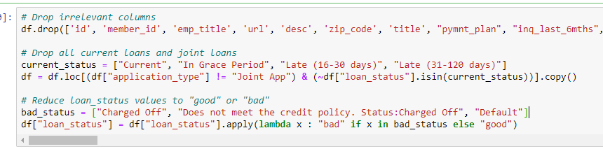
Narrowing the Dataset
The loan table has more than 148 columns and over 2.26 million rows
As a result, variables were narrowed to answer the questions.
Due to the various variables, functions were created to help analyze and plot data more efficiently

Slide 5
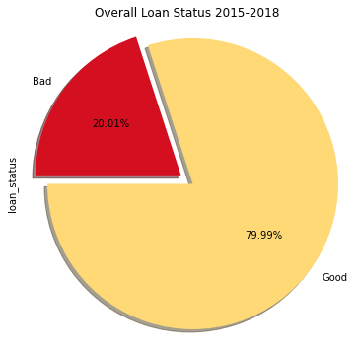
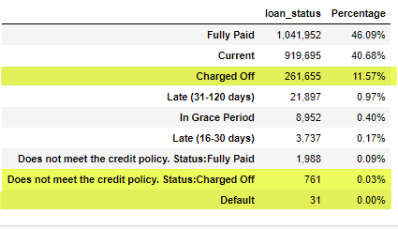
What is a “Bad Loan” ?
Charged Off
Does not meet the credit policy, Status “Charged off”
Default

Slide 6
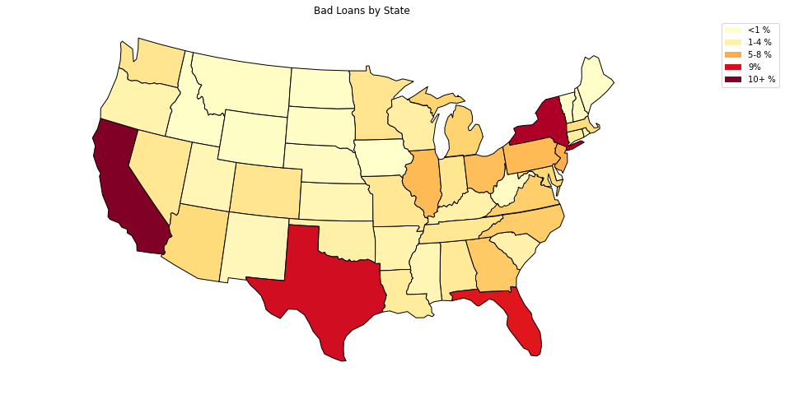
Where are the bad loans?

Slide 7
Risk Probability and Modeling: Strategy
Risk Probability = Percentage of Bad Loans
Analyze a set of independent normalized variables
Extract probability distributions from the data
Come up with quantitative models for categorical and continuous variables
Predict Risk Probabilities
Combine into a Risk Grade

Slide 8
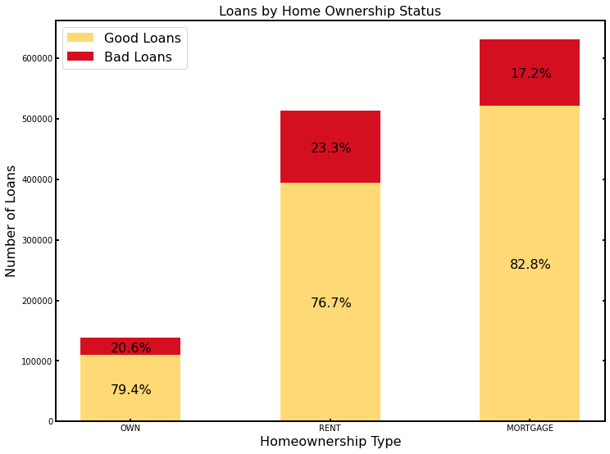
Home Ownership Status
Categorical Variable
Fixed risk probabilities for each category

Slide 9
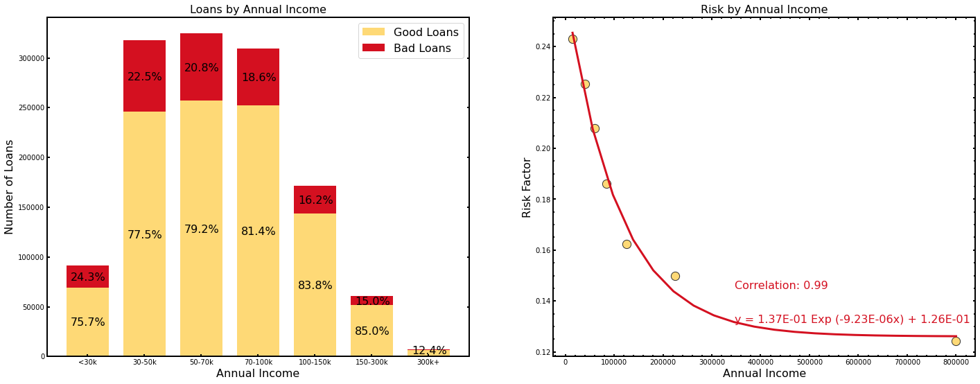
Annual Income
Bin the distribution to obtain meaningful averages
Perform regression analysis on averages

Slide 10
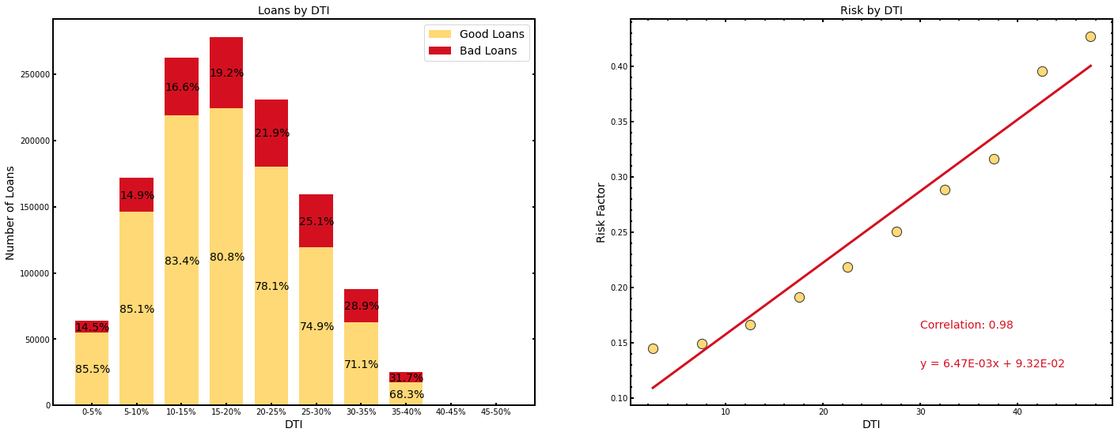
Debt to Income Ratio, DTI (%)
Utilize normalized variables with good correlation
Big range of risk probability variation

Slide 11
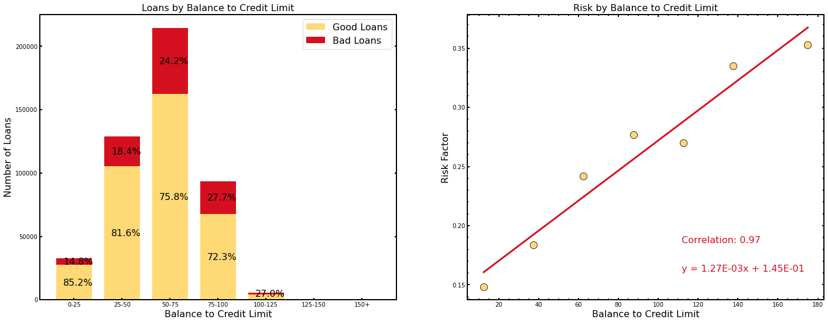
Balance to Credit Limit Ratio (%)
Outliers => Bad Loans

Slide 12
Combining the Risks
Independent Variables? Multiply individual probabilities?
How to deal with NaNs?
Simple approach: Average over the individual probabilities

Slide 13
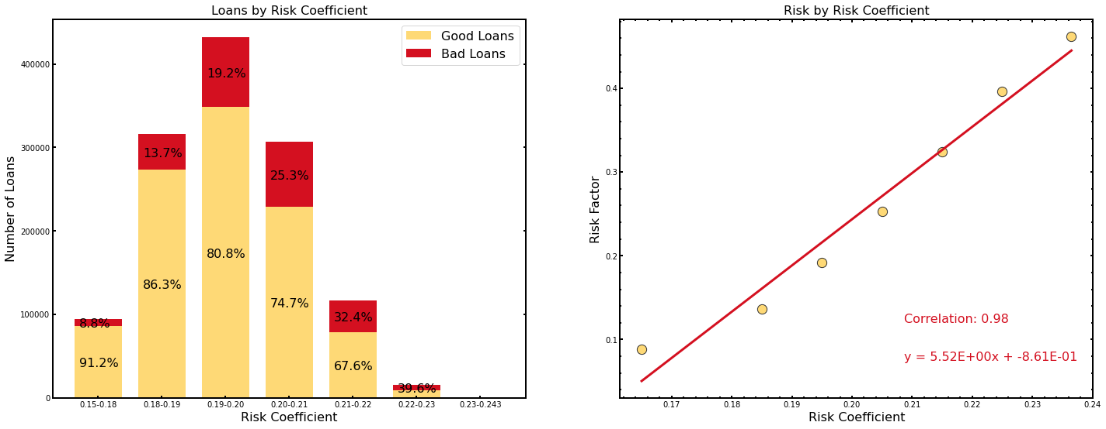
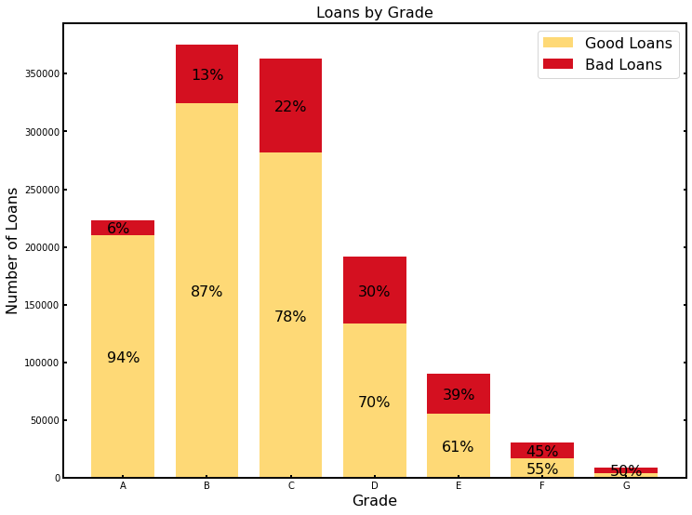
Risks Coefficient vs Lending Club Grade
Misses at small Risk Coeff. (High Quality Loans)
Free to chose cut-off
Otherwise similarly distributed (to a degree)

Slide 14
Risk Probability and Modeling: Conclusion
Limitations of Data Set: no info on credit scores, mortgage payments, etc.
Potentially, Data Set allows to evaluate impacts of risks

Slide 15
Overview of Averages
Interest rate difference of 3.02% between G & B Loans
Average Monthly Income difference is about $600
Demonstrates the need to look at host of factors when assessing a borrower's risk.

Slide 16
Can we replicate & improve their model?
While they generally describe their model, their calculations are proprietary.
Based on our analysis on what factors correlate the best, attempt to create a model using the DSCR calculation.

Slide 17
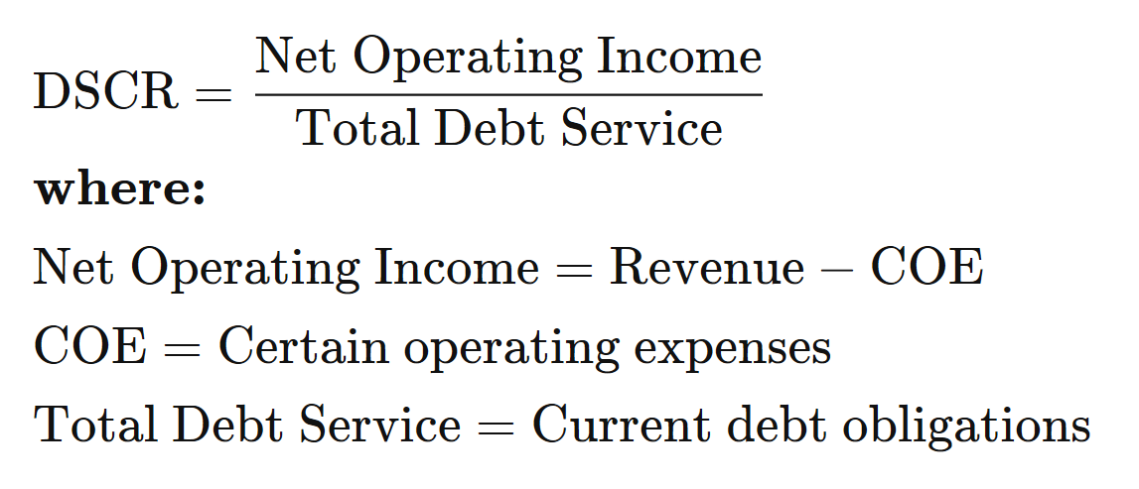
What is DSCR ?
TOTAL DEBT SERVICE: Monthly Payment of New Loan + (Monthly Income *DTI) + (Monthly Income * 40%)

Slide 18
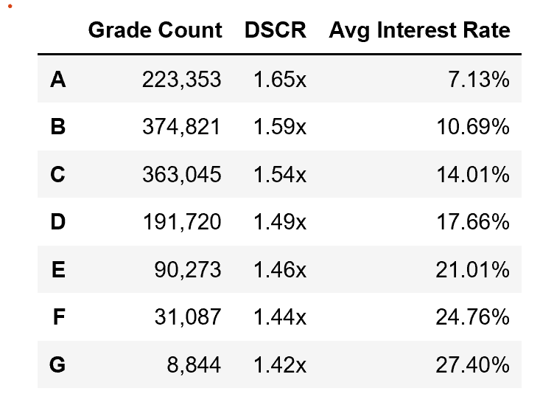
DSCR relation to Grading Model

Slide 19
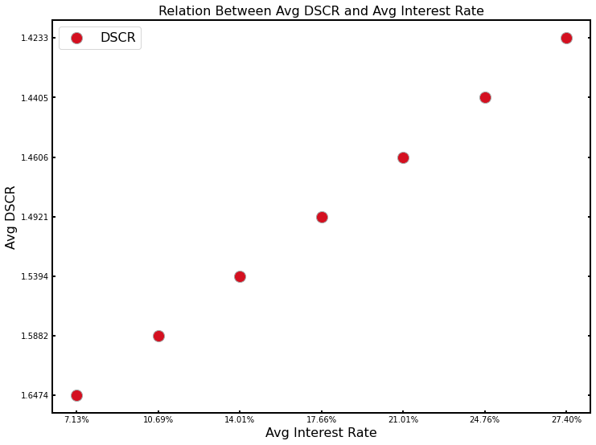
DSCR relation to Interest Rate

Slide 20
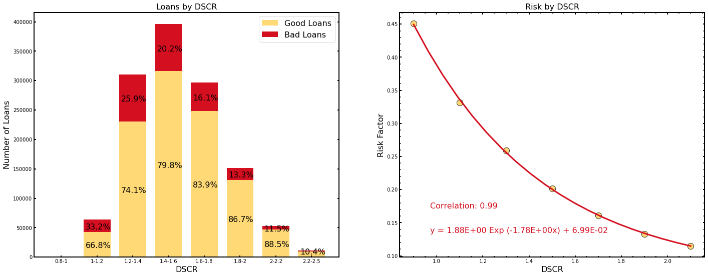
DSCR – Risk Probability and Modeling

Slide 21
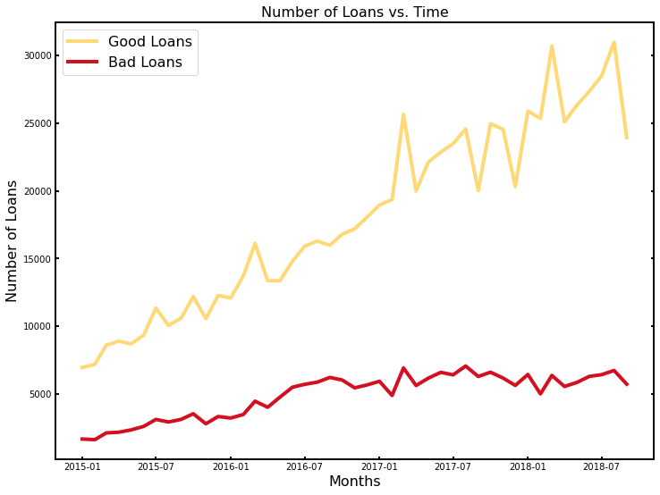
Are there any Macroeconomic implications to the results ?

Slide 22
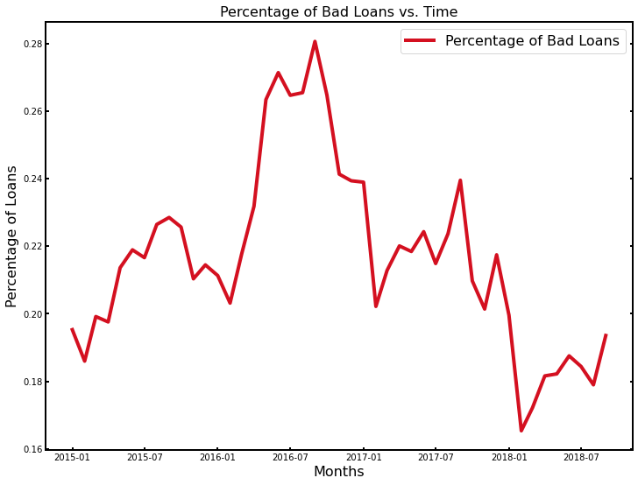
Has the relationship of Bad loans to Total loans remained stable ?

Slide 23
The End…….

