Slide 1
Lending Club Peer 2 Peer Loans
MACHINE LEARNING & FORECAST MODELING
Artem akopyan, peter pages, Dimitri pappas

Slide 2
Review of Lending Club
A peer-to-peer lending company providing unsecured personal loans between $500 and $40,000
Dataset has multiple years of loan data and their outcome
We segmented the loans between “Good” and “Bad” loans.

Slide 3
Using Machine Learning to answer two questions
Can we successfully use machine learning to classify a loan as good or bad based on certain parameters?
Analyze Data
Choose a model, Train data and formulate predictions
Analyze predictions using a Confusion Matrix
Look at Accuracy, Precision, Recall & Specificity metrics
Can we successfully construct a forecast of future loan amounts that will be issued on the P2P platform?
Analyze data to spot trends
Use ARIMA to forecast

Slide 4
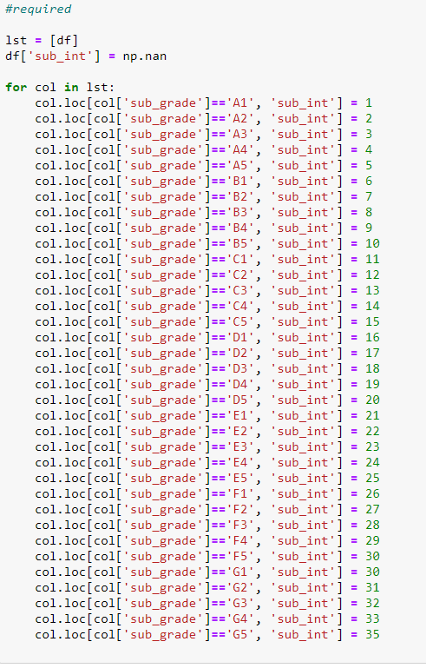
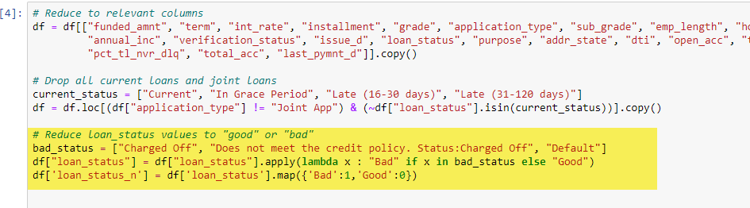
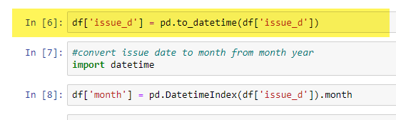
Preparing the Data

Slide 5
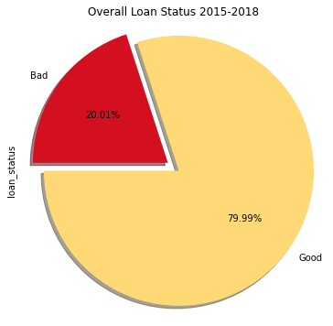
Loan Status Overview
Good Loans: 1026432
Bad Loans: 256711

Slide 6
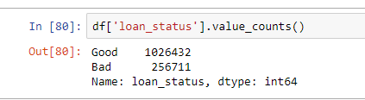

Dealing with imbalanced dataset
Must contend by mitigating the large number of good loans vs bad loans for training
Two approaches:
Filtering out the bad loans and appending the data to itself
Using a classifier’s (like XGBoost) built method of dealing with imbalance
Scale_pos_weight

Slide 7
Choosing a model
Classification Problem
Choose best model & contend with imbalanced dataset
Models:
Logistics Model -> poor results, dataset appended
Decision Tree -> poor choice, dataset appended
Random Forrest -> comparatively decent, dataset appended
XG Boost -> standout results when tweaked. Dataset balanced.

Slide 8
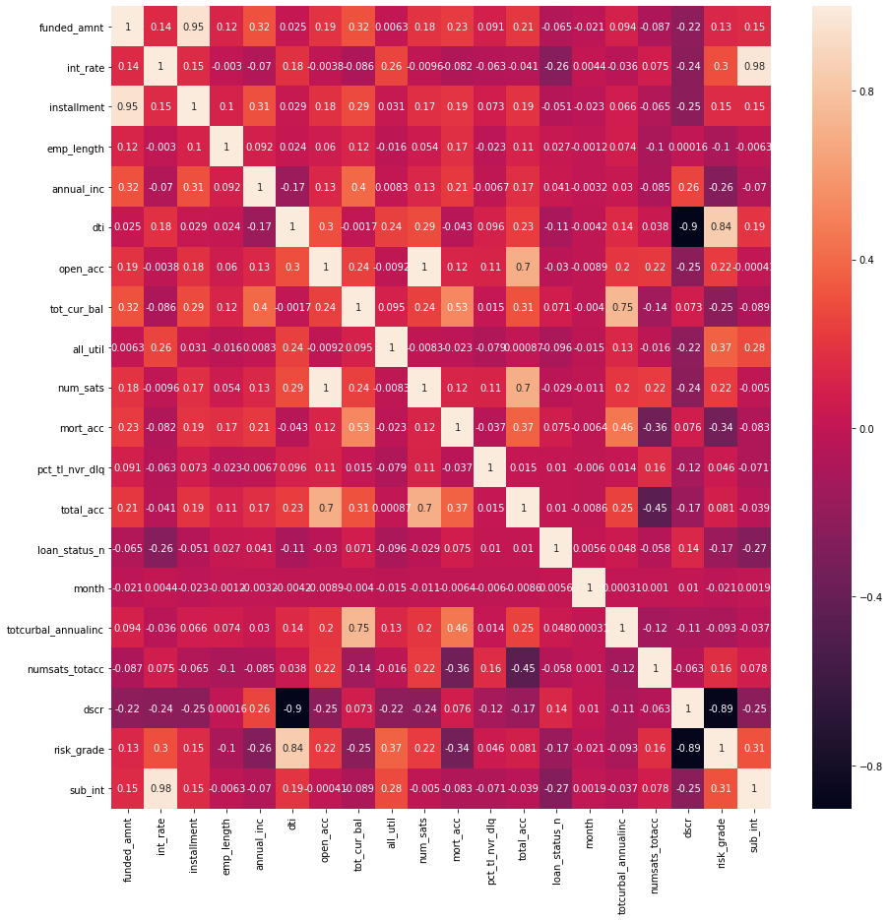
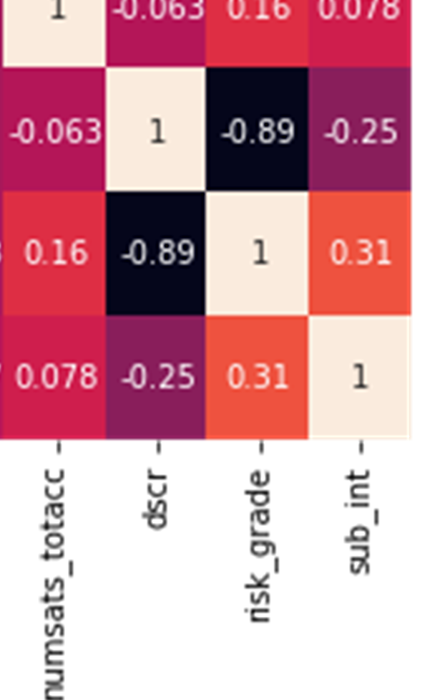
Correlation Matrix on best features
dark = inversely correlated
white = directly correlated
DTI, DSCR, Subgrades(sub_int) best correlation

Slide 9
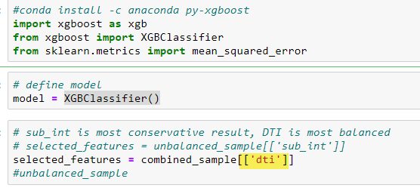
Xgboost Code
Import Libraries
Define Model
Select Features

Slide 10
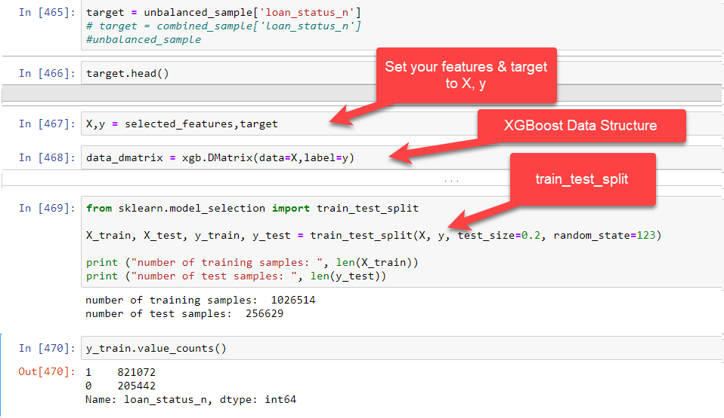
Xgboost Code

Slide 11
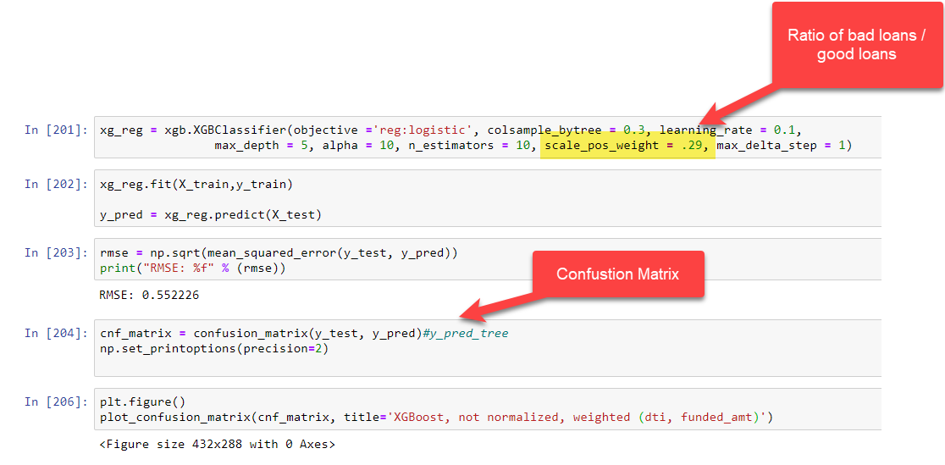


Slide 12
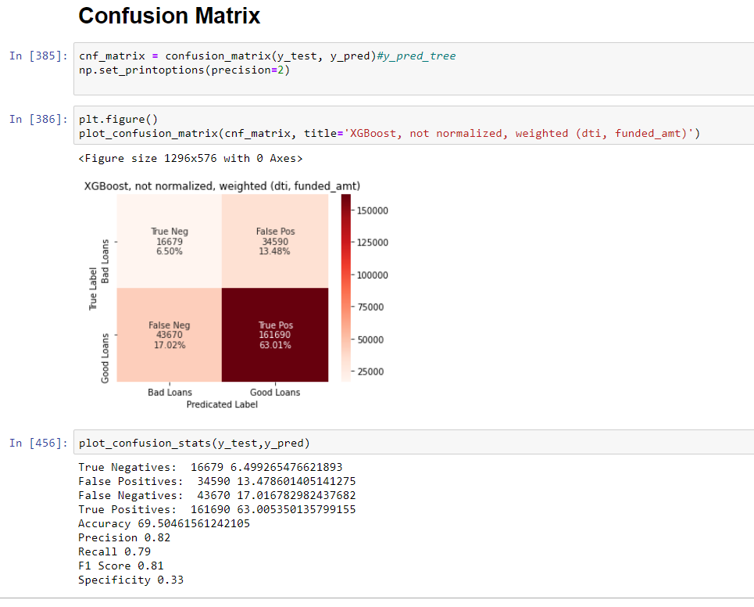

Slide 13
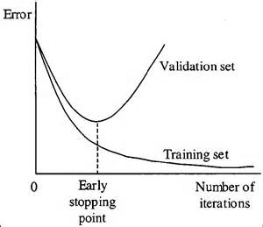
Cross-Validation (KFold Stratified)
Purpose is to prevent overfitting
The goal is to avoid the model from tuning itself to the data but rather generalize the data.
Finds the best stopping point where the divergence of error begins

Slide 14
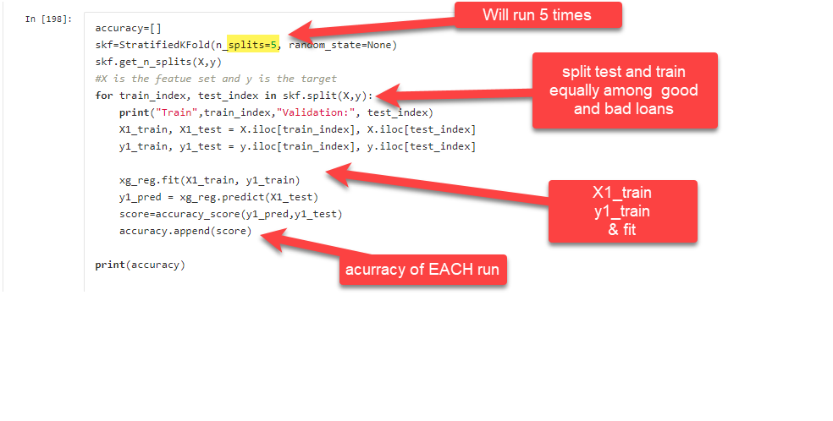
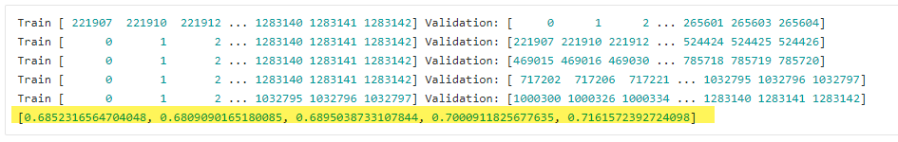
Cross Validation (Kfold Stratified)

Slide 15
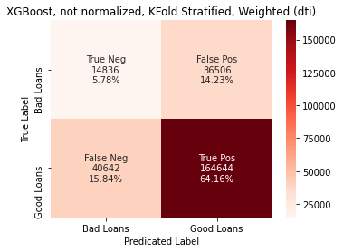
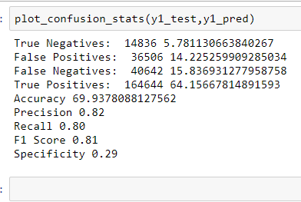
Confusion Matrix (most balanced)

Slide 16
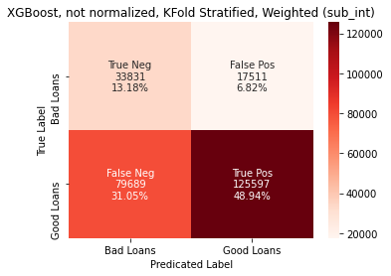
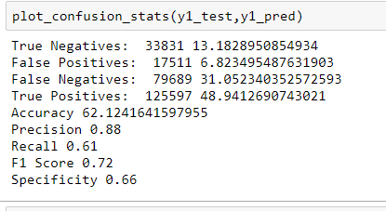
Confusion Matrix (most conservative)
Based on Subgrade(sub_int) as feature.
Reduces False Positive the most
False Positive = Bad loans, labeled Good

Slide 17
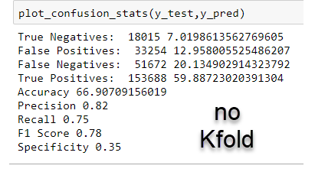
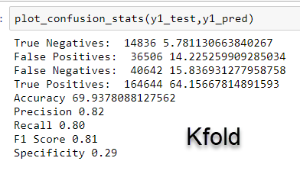
Kfold vs NoKfold
Accuracy: 69% vs 71% with Kfold
FP affect Precision measure
FN affect Recall Measure
Specificity is the True Negative Rate. The model has trouble predicting true negative (Bad Loans)
Best compromise is using XGBoost, applying a weight to the data and using Cross Validiation w/Kfold Stratified

Slide 18
Conclusion
Accuracy is not high enough for a financial loan institutions
Based on Precision, Recall and Specificity scores, the model can not sufficiently label enough bad loans correctly.
The dataset’s imbalanced ratio between good and bad loans had to be mitigated to avoid bias
Was it successful?
The model’s results were moderately improved by cross-validation KFold Stratified.

Slide 19
Question 2: Can we forecast the average loan amount issued?
We’ll be preparing the loan data
Only two columns will be used (Issue_d and funded_amount (avg per month)
Plot the data and spot any trends
Use ARIMA to perform the analysis
The model will be predicting differences of the time series from a timestamp to the previous timestamp

Slide 20
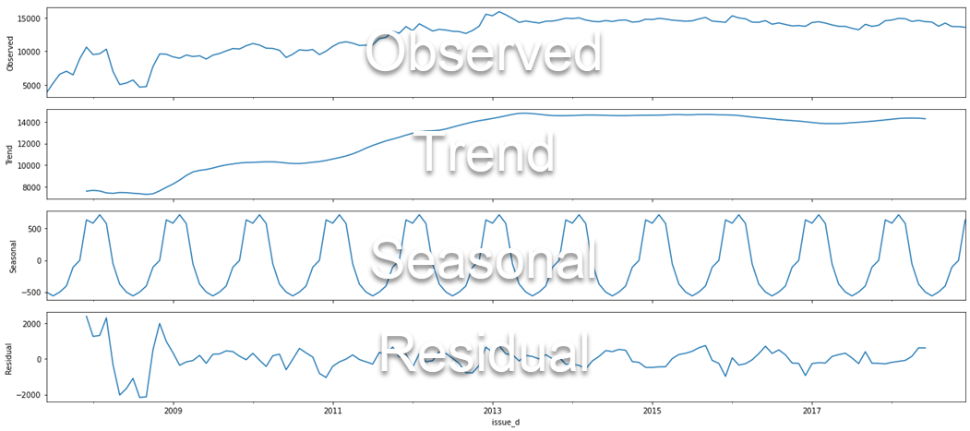
Decomposition

Slide 21
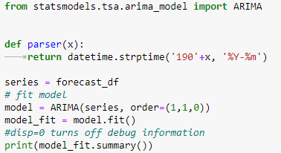
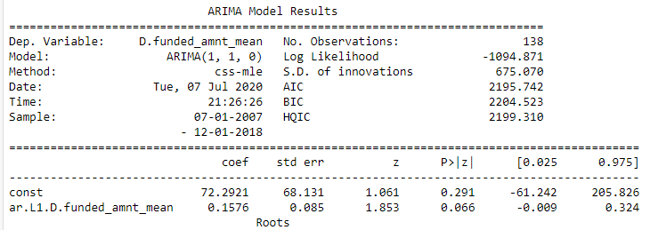
Arima – Autoregressive Integrated Moving Average
Fit (1,1,0)
This sets the lag values to 1 time period for autoregression, uses a difference order of 1 to make the time series stationary and uses a moving average model of 0.

Slide 22
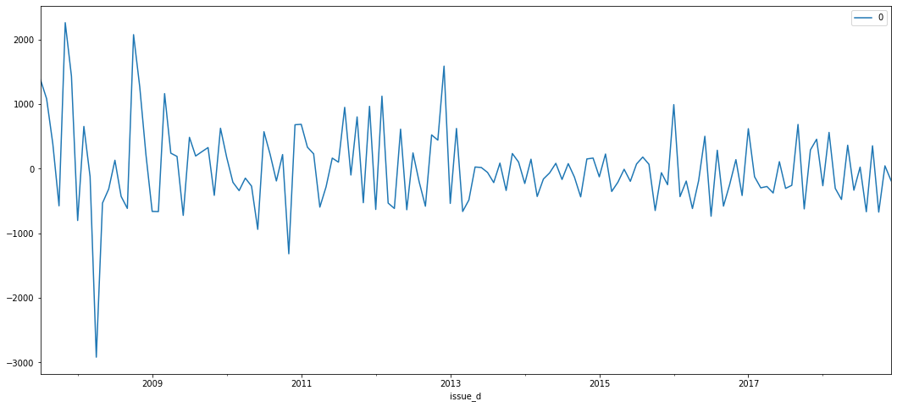
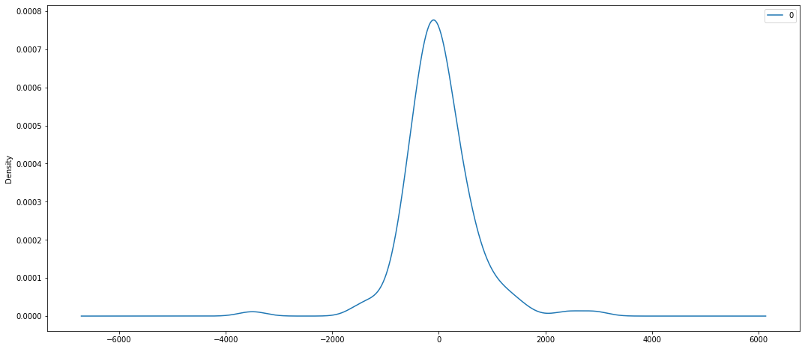
Residuals
Residuals suggest some trend not captured.
Density plot of residual error values suggests errors are normally distributed with no skew

Slide 23
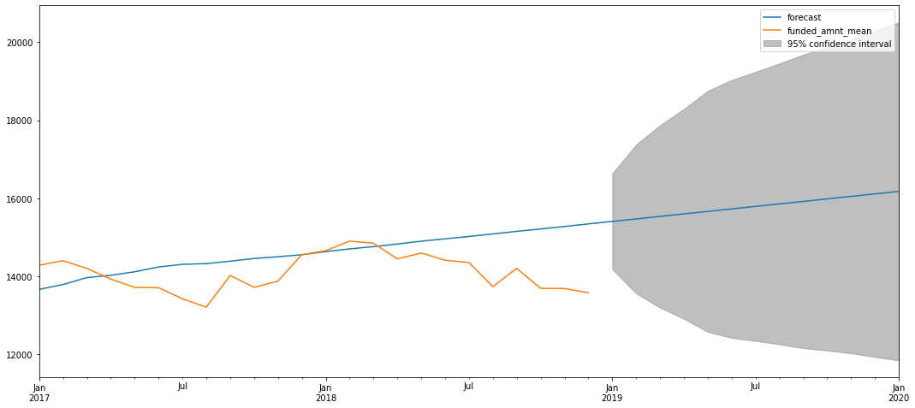
Forecast Plot (2017-2020)

Slide 24
End

