Slide 1
Lending Club Peer 2 Peer Loans
MACHINE LEARNING & FORECAST MODELING
Artem akopyan, peter pages, Dimitri pappas
Notes:
DIMITRI (SLIDES 1 - 8)
For the last project we decided to continue working with our first project’s data set from Peer to Peer loans.
As a review, Peer to Peer is a lending company providing unsecured loans. Unlike a traditional bank, it is individuals that loan the funds to other individuals as an investment. P2P lending club rates the risk of each investment.
The dataset we have has multiple years of loan data and we characterize the loans as either good or bad based on a set of characteristics

Slide 2
Review of Lending Club
A peer-to-peer lending company providing unsecured personal loans between $500 and $40,000
Dataset has multiple years of loan data and their outcome
We segmented the loans between “Good” and “Bad” loans.
Notes:
For the last project we decided to continue working with our first project’s data set from Peer to Peer loans.
As a review, Peer to Peer is a lending company providing unsecured loans. Unlike a traditional bank, it is individuals that loan the funds to other individuals as an investment. P2P lending club rates the risk of each investment.
The dataset we have has multiple years of loan data and we characterize the loans as either good or bad based on a set of characteristics

Slide 3
Using Machine Learning to answer two questions
Can we successfully use machine learning to classify a loan as good or bad based on certain parameters?
Analyze Data
Choose a model, Train data and formulate predictions
Analyze predictions using a Confusion Matrix
Look at Accuracy, Precision, Recall & Specificity metrics
Can we successfully construct a forecast of future loan amounts that will be issued on the P2P platform?
Analyze data to spot trends
Use ARIMA to forecast
Notes:
SLIDE 3
Our goal is to use Machine Learning to answer two questions
Can we classify a loan as good or bad based on our parameters?
(And if time permits) Can we successfully forecast the average loan amounts issued on the P2P platform?

Slide 4
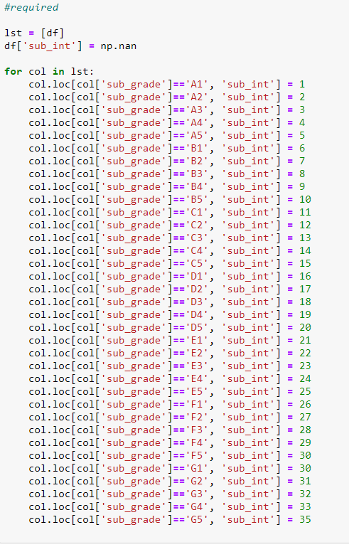
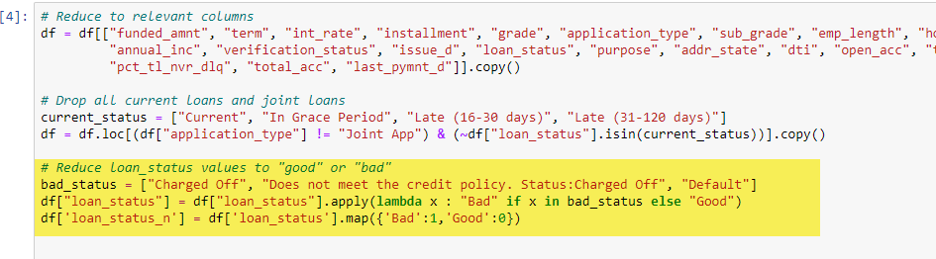
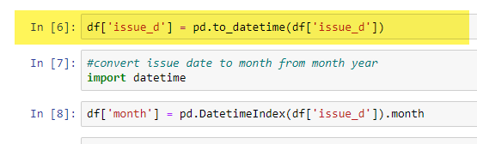
Preparing the Data
Notes:
As we’ve done before, we narrowed the number of columns, classified the loans, added new columns like the Debt Service Ratio and converted the date column to the proper datatype. We also made an integer representation of the 35 loan subgrades.

Slide 5
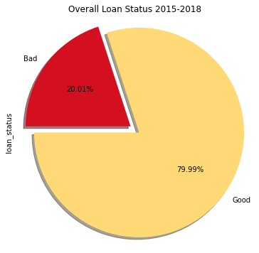
Loan Status Overview
Good Loans: 1026432
Bad Loans: 256711
Notes:
This an overview of the data with respect to good and bad loans. Plotting the counts of each type, we can see a potential balance issue, resulting in sampling bias.

Slide 6
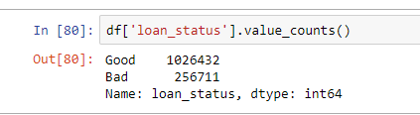

Dealing with imbalanced dataset
Must contend by mitigating the large number of good loans vs bad loans for training
Two approaches:
Filtering out the bad loans and appending the data to itself
Using a classifier’s (like XGBoost) built method of dealing with imbalance
Scale_pos_weight
Notes:
In order to address the datasets imbalance, two approaches were attempted:
- We either filtered out the bad loans and appended the dataset to itself enough times to equal the good loans
- or -
- we used a classifier’s built in parameter to deal with the imbalance.

Slide 7
Choosing a model
Classification Problem
Choose best model & contend with imbalanced dataset
Models:
Logistics Model -> poor results, dataset appended
Decision Tree -> poor choice, dataset appended
Random Forrest -> comparatively decent, dataset appended
XG Boost -> standout results when tweaked. Dataset balanced.
Notes:
We attempted a few machine learning models to answer our question.
After analyzing the data and identifying our classification problem we attempted a logistic regression model but we were unsatisfied by the results.
A Decision Tree was attempted but it was slow and its results were no better.
Thereafter, we tried a Random Forrest, and while the results were slight improvement, it was still too slow.
In the end, we chose XG Boost since it was fast, flexible and gave us the best results.

Slide 8
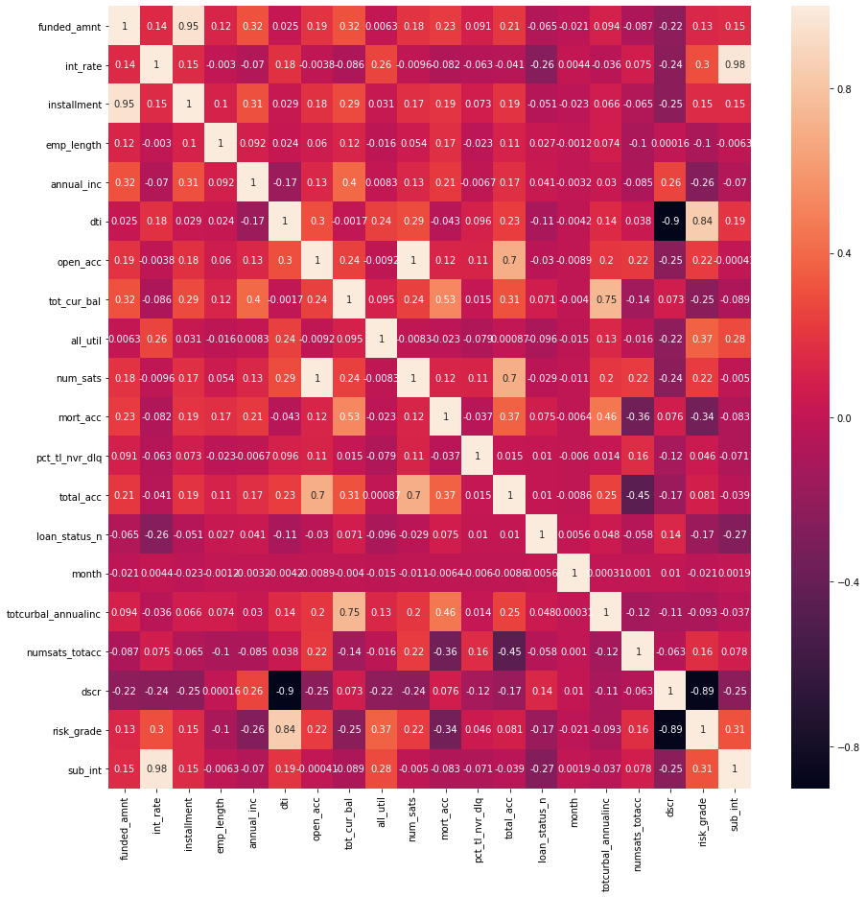
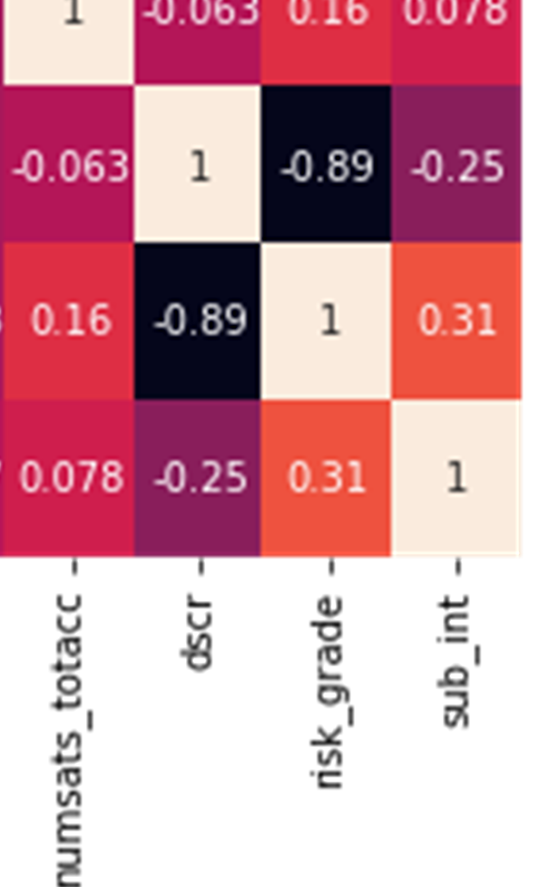
Correlation Matrix on best features
dark = inversely correlated
white = directly correlated
DTI, DSCR, Subgrades(sub_int) best correlation
Notes:
Before modeling we had to decide which features to use. To help us decide, we created a correlation matrix….
WHATEVER YOU WANT, READ THE SLIDE FOR GUIDANCE

Slide 9
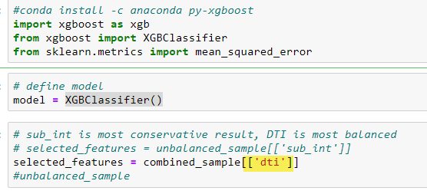
Xgboost Code
Import Libraries
Define Model
Select Features
Notes:
We begin the code by importing libraries, defining the model and selected features. IN this particular case shown, ‘dti’ is selected.

Slide 10
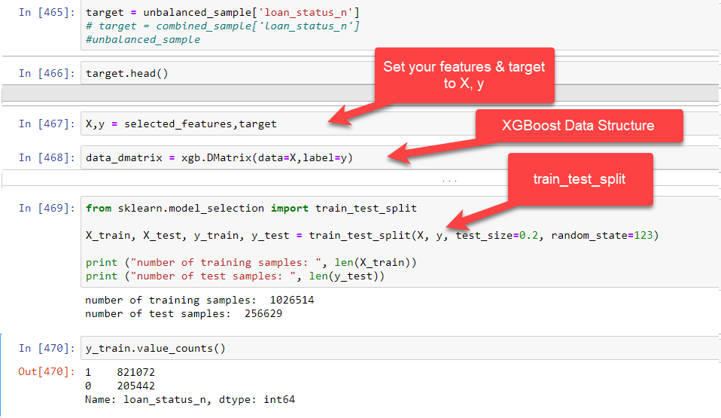
Xgboost Code
Notes:
Here, it's pretty straight forward, the dependent and independent variables are assigned to X,y respectively and both are passed to XGBoost’s data_dmatrix. Thereafter, we initiate the train_test_split function. Below that, we include a couple of print statements detailing the training and test sample sizes to verify the split.
The y_train values are shown to demonstrate the imbalance that we have to deal with.

Slide 11
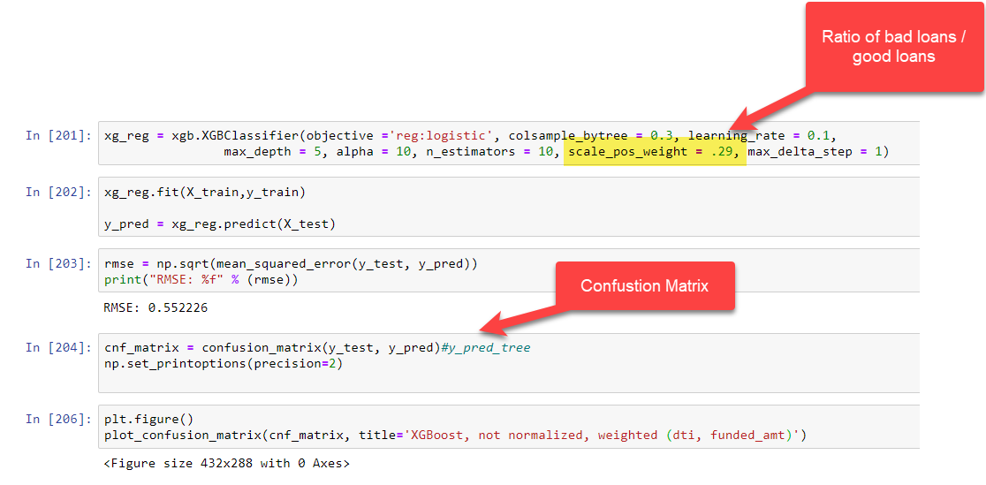

Notes:
In order to reduce the good loan’s influence in the set, we have to reduce its weight.
XGBoost has a parameter called scale_pos_weight which lets you provide a weight for an entire class of examples. In this case, the good loans.
First, we take a baseline by calculating the ratio of bad loans over good loans. That gives us a starting point to set the parameter at .25
We adjusted the ratio manually until a satisfactory result was achieved. After some experimentation we settled on .29.
The rest of the code fits the data, assigns the predictions to y_pred and calculates the mean squared error. Cell 204 is where we calculate and store the confustion_matrix results.

Slide 12
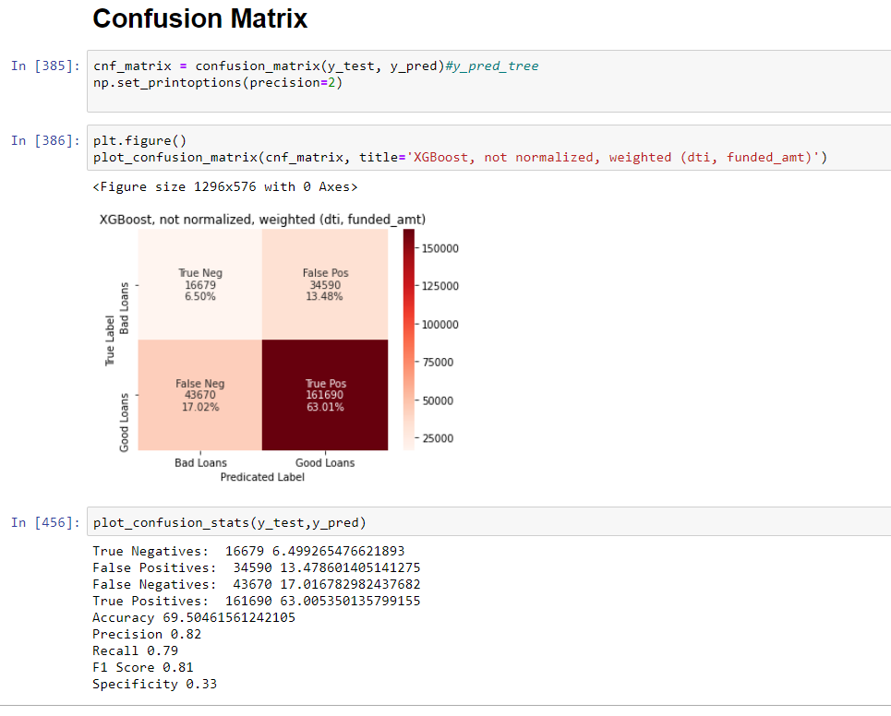
Notes:
In this section we call two functions: one plots the confusion matrix results and the other calculates a series of additional metrics to help interpret those results. We will go into detail on these results in a moment.

Slide 13
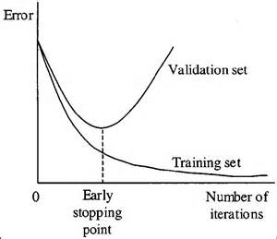
Cross-Validation (KFold Stratified)
Purpose is to prevent overfitting
The goal is to avoid the model from tuning itself to the data but rather generalize the data.
Finds the best stopping point where the divergence of error begins
Notes:
In addition, we utilized a stratified K-fold cross validation procedure to improve predictive capabilities of our model. Cross-validation helps to achieve better testing accuracy by preventing the overfitting of the training data. Stratified K-fold refers to a process where the data is split into a number of "class balanced" (k) "folds" each containing a training and a test set. The model is then trained and its accuracy is evaluated against the test set within each fold. The results allows one to evaluate the ability of the model to predict unseen data and to measure the amount of testing error in each iteration produced by the model

Slide 14
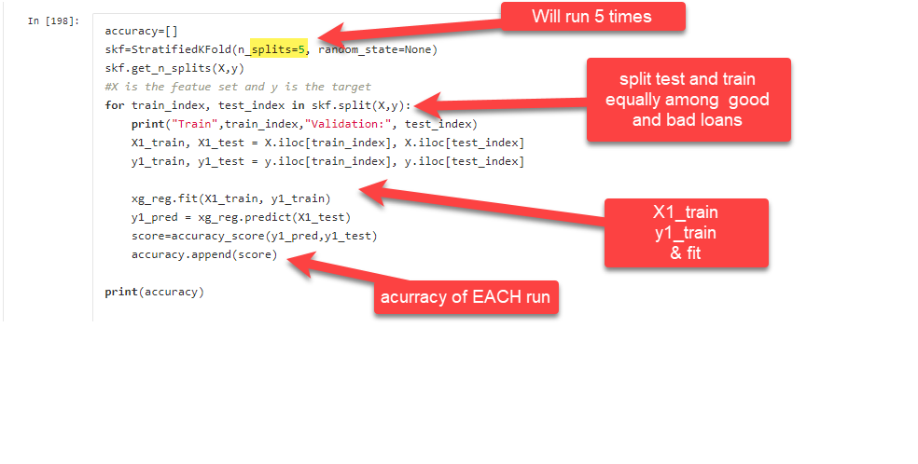
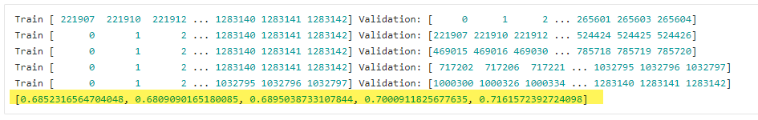
Cross Validation (Kfold Stratified)
Notes:
Here we can see it implemented. n_splits is set to the number of iterations or experiments to run. Instead of using the train_test_ split_method to split the data, we call the stratifiedkfold split method which will go and actively pick out an equal amount of good and bad loans in each iteration. This is a good choice for imbalanced datasets, like ours, and is used in tandem with other data balancing techniques.
Toward the bottom, we can see each Training session and we print the accuracy results of each run. They are the numbers highlighted. Now, Art will discuss our results and the related confusion matrix.

Slide 15
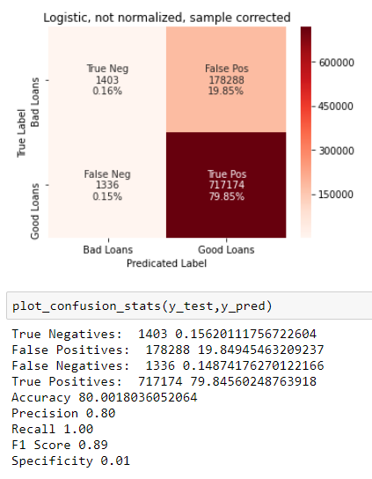
Confusion Matrix (logistics/unbalanced)

Slide 16
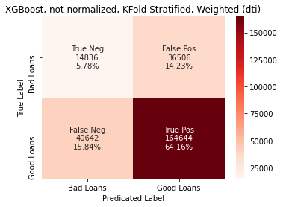
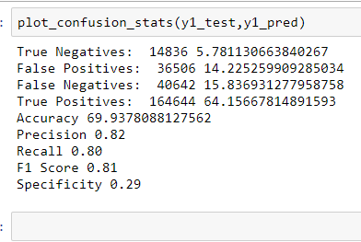
Confusion Matrix (most balanced)
Notes:
A Confusion matrix is used to evaluate the accuracy of a classification. These results show the...
False Positives (Bad Loans predicated as Good), False Negatives (Good Loans predicted as Bad), True Positive (Good Loans predicated accurately)
and True Negative where the model correctly detects and classifies a loan as bad.
Here is our most balanced result, using XGBoost and Kfold Stratifed Cross Validation (detail the numbers)

Slide 17
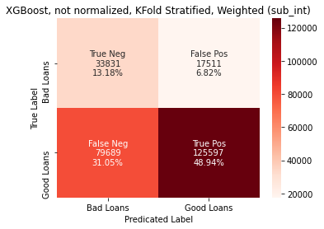
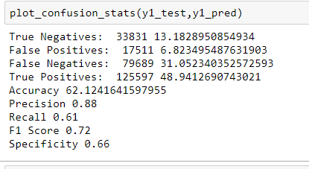
Confusion Matrix (most conservative)
Based on Subgrade(sub_int) as feature.
Reduces False Positive the most
False Positive = Bad loans, labeled Good
Notes:
Here is the most conservative result.
For a loan institution, having False Negatives would be preferable over False Positives. The reason being is that False Positive cost you money! You’re willing to allow a Few False Negatives.

Slide 18
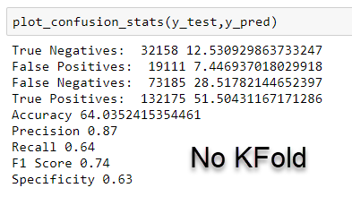
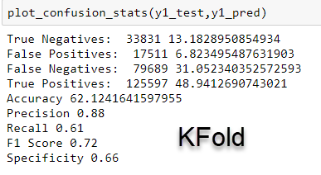
Kfold vs NoKfold
Accuracy: 64% vs 62% with Kfold
Specificity: 63% vs 66% with KFold
Notes:
Kfold vs NoKfold

Slide 19
Conclusion
Accuracy is not high enough for a financial loan institutions
Based on Precision, Recall and Specificity scores, the model can not sufficiently label enough bad loans correctly.
The dataset’s imbalanced ratio between good and bad loans had to be mitigated to avoid bias
Was it successful?
The model’s results were moderately improved by cross-validation KFold Stratified.
Notes:
In Conclusion, despite our efforts, the accuracy of the model is too low for a loan institution, even for one as unique as Peer 2 Peer loans which relies on good risk assessment. The imbalances in our initial training set may have affected the model’s ability to identify bad loans as indicated by the number of false positives and low specificity score. Balance mitigation and Cross-validation did improve the results marginally but not enough.
(discuss how we can improve our results?)
Improvement such as enhanced feature engineering and model tweaking may further improve results.

Slide 20
Question 2: Can we forecast the average loan amount issued?
We’ll be preparing the loan data
Only two columns will be used (Issue_d and funded_amount (avg per month)
Plot the data and spot any trends
Use ARIMA to perform the analysis
The model will be predicting differences of the time series from a timestamp to the previous timestamp
Notes:
Our Second Question relates to whether we can predict future loan amounts issued? We will plot the data, analyze and use ARIMA to forecast.

Slide 21
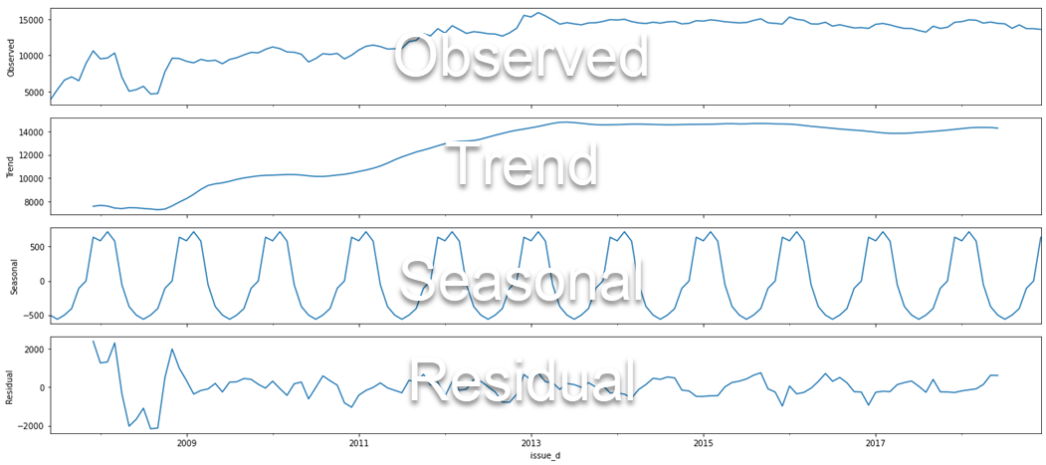
Decomposition
Notes:
As we Decompose the data, we see the overall average loan amount plotted over the entire time frame. We also see the Trend line and Seasonality data. The trend data ,as observed ,begins to flatten while the Seasonal data fluctuates between amounts of -500 and +500. Residuals below show data it couldn’t understand.

Slide 22
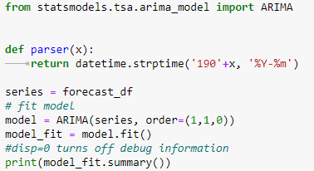
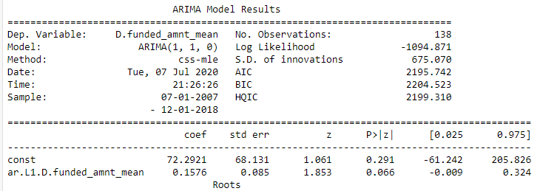
Arima – Autoregressive Integrated Moving Average
Fit (1,1,0)
This sets the lag values to 1 time period for autoregression, uses a difference order of 1 to make the time series stationary and uses a moving average model of 0.

Slide 23
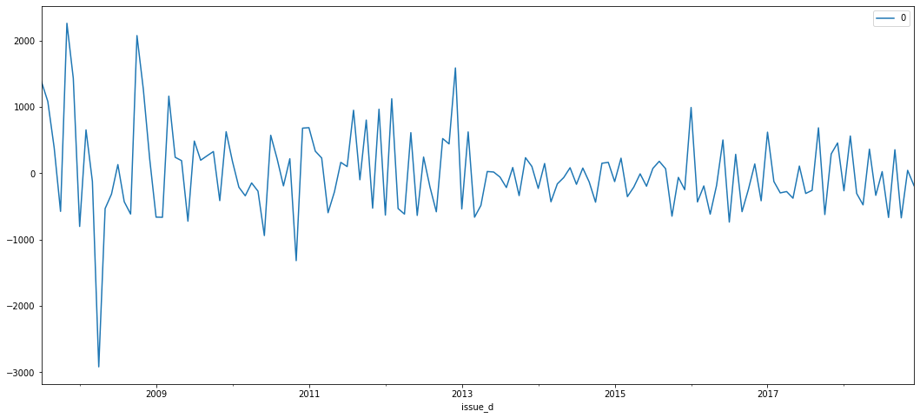
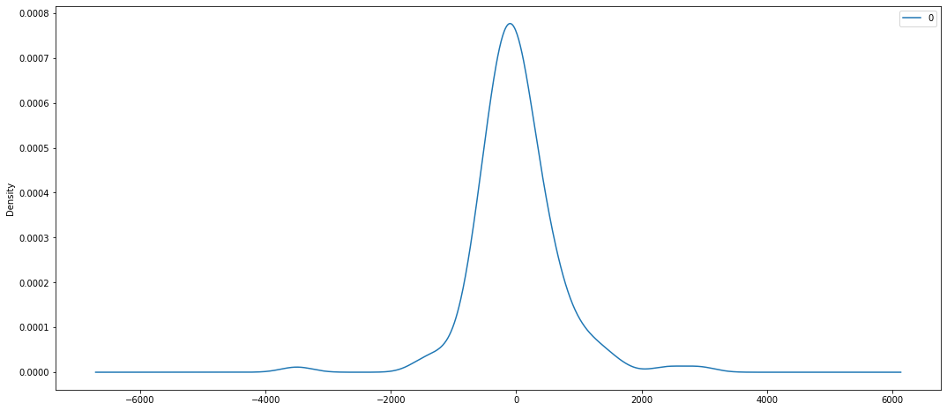
Residuals
Residuals suggest some trend not captured.
Density plot of residual error values suggests errors are normally distributed with no skew

Slide 24
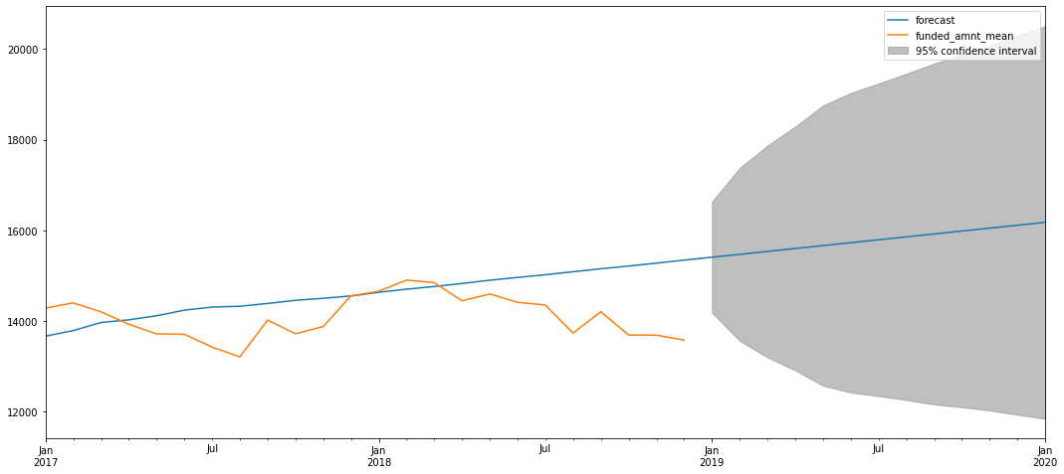
Forecast Plot (2017-2020)
Notes:
After performing ARIMA, we plot the forecast. In this case, we based the start year as 2017 and the end year to 2020. The further out in the future you go, the wider the cone of possible values you have in your forecast. In conclusion, you have a generally upward trend but with a high degree variability.

Slide 25
End

