Slide 1
Using Social Media to Enhance Emergency Situation Awareness
By Prasanna Pai (50132731)
Instructor : Jing Gao

Slide 2
Contents
1. Introduction
2. Motivation
3. Crisis Coordination and Quick Response Process
4. System Architecture
a. Data Capture
b. Burst Detection for Unexpected Incidents
c. Classification
d. Online incremental clustering
e. Geo-tagging and visualization
Summary and Conclusion
Questions

Slide 3
Introduction
Social media has emerged as a focal point for situation awareness for informing about disasters and natural calamities to the people
Media generates numerous user updates and helps in informing authorities about the rescue operations along with keeping other people updated about the emergency situation awareness
People from nearby areas can contribute in emergency situation awareness by helping in real time observations and updates
Also helps the authorities in making best, most informed decisions for aid, rescue and recovery operations
Extracting high speed, real time tweets and Facebook posts and perform analysis for enhancing situation awareness and rescue operations

Slide 4
Motivation
Because of its growing ubiquity, communication rapidity, and cross-platform accessibility, Twitter is increasingly being considered as a means for emergency communication during and after natural disasters
People can still keep a track on the rescue operations through social media in case of physical infrastructure destruction
Haiti Earthquake : the cellular tower bounced back allowing survivors to request help from local first responders and emergency managers to relay important disaster-related information via social media sites.
When earthquakes or aftershocks occurred, people actively broadcast information, wishes, and other messages on Twitter. Manually inspecting these tweets confirms that in the hours after the earthquake, Twitter users local to the crisis were providing on-the-ground information, including expressions of fear, requests for help, and the disaster’s impact on the community

Slide 5
Crisis Coordination and Quick Response Process
It is a dedicated 24/7 facility from the government who work towards national security and natural disaster incident along with rescue and recovery operations
Aim : Hazard monitoring and situation awareness by timely communication of messages involving risks and threats to the concerned authorities
Challenges : watch officers continually monitoring the social media messages to maintain situation awareness about potential incidents, noisy social media data content making it difficult for officers to monitor and analyze such texts, time constraints on officers for monitoring the high volume of messages for awareness
Designing an intelligent system can thus help watch officers more effectively identify situation awareness information of operational and strategically relevance from the large information space of social media within the given time constraints

Slide 6
System Architecture
To overcome language constraints for tweets and noisy user data, integration of several situation data mining techniques including burst detection, text classification, online clustering, and geo-tagging.
Data Capture involves gathering raw tweets from Twitter by integrating the system with use of third party APIs and available streaming software
Data Capture gathers and forwards the raw tweets to PROCESS component which processes the tweets using burst detection, text classification, online clustering, and geo-tagging and send it to VISUALIZATION component for displaying to the users in the order of the priority
This entire system is connected by the INFASTRUCTURE layer which interfaces the components and help in efficient functioning thereby reaching the main aim of the system

Slide 7
Data Capture
Data Capture is done by using Twitter API and interfacing it with third party software for gathering situation related tweets and processing.
In order to obtain the location specific tweets, Twitter’s location based search API is being used

Slide 8

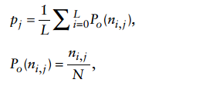
Burst Detection for Unexpected Incidents
To detect whether the word is bursty or not in a given tweet, probability distribution of the tweets including the word in a given time window is considered which can be computed using the given binomial distribution formula :
Where N is the number of tweets, pj is the expected probability of the tweets that contain the word fj in a random time window and is thus the average of the observed probability of fj in all time windows containing fj, L is the number of time windows containing fj
We determine the bursty nature of the tweets by comparing containing the word fj in a given time window with expected probability pj of the word fj in a random window
being higher indicates the bursty nature of tweets for those words

Slide 9
Classification for Impact Assessment
Classification for impact assessment involves for checking the impact of situation so that necessary decision can be done for rescue operations
Statistical classifiers or machine learning techniques such as naive Bayes or Support Vector Machines (SVM) can be used for classification of the tweets
Classification involves removal of stop-words and tokenization of the tweets so that specific words can be analyzed.
Classification can be done using Information Retrieval processes such as unigrams, bigrams, word length, hashtags, usernames of the users tweeting, locations involved in the tweets, tweet forwarding
This entire process of classification is on the basis of feature extraction which marks the base of classification for the tweets

Slide 10

Online Clustering of Topic Discovery
To capture tweets’ textual information, each tweet is represented using a vector of terms weighted using term frequency (TF) and inverse document frequency (IDF). Specifically, a tweet represents a data point in d-dimensional space, Vi = (v1, v2, …, vd), where d is the size of the word vocabulary, and vj is the TF-IDF weight of the jth word in tweet Vi.
Online incremental clustering algorithm can be used in which the first incoming tweet will be classified in a cluster and other incoming tweets will be checked for the similarity with the classified tweets and classified subsequently
Cosine similarity model or Jaccard Similarity model can be used for verifying the similarity of the tweets in their vector forms

Slide 11
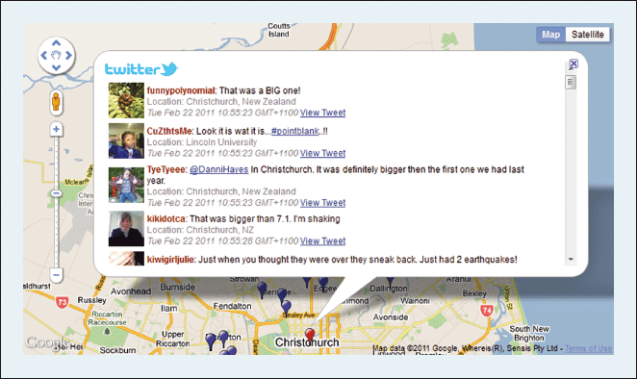
Geo-tagging and Visualization
Geo-tagging can be done in two ways : either by extracting the location coordinates of the tweets (latitude and longitude) and plotting it on Maps or by extracting the user location from his/her Twitter profile and locating it on Maps.
Visualization involves the nature of interface to be displayed to the users which can be done by incremental clustering of the tweets on the basis of their locations and real time updates to/from the users

Slide 12
Conclusion
This system architecture clearly provides useful situation awareness information through a set of tightly integrated components. It can thus provide on-the-ground information from the general public, as reported in Twitter, to help establish and enhance timely situation awareness across a range of crisis types.
Online incremental clustering and classification on the basis of bursty words in the tweets can help in improving the accuracy of this system
This system has been implemented by the Australian Government along with Crisis Coordination Team in Australia and is being considered for future implementations in many other countries worldwide due to its effectiveness in the rescue and security operations

Slide 13


