Slide 1

Recitation 11 – Reinforcement Learning, Open AI Gym
Francis Ogoke
Machine Learning and Artiﬁcial Intelligence 12/02/2022

Slide 2
RL Terminologies Matching
Reward function
Action Space
Transition probability
Policy
Value function
Optimal Policy
Desired output of an RL algorithm
Possible movements/actions at each
state
Gives the expected future discounted
reward of a state
Maps from states to actions
Given a s/a pair, quantiﬁes the
likelihood of entering a new state
Quantiﬁes immediate success of the agent

Slide 3
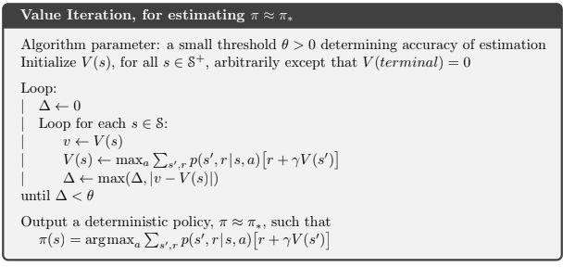
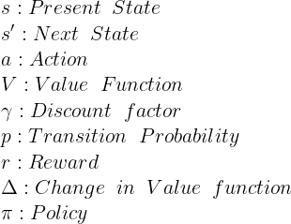
Value Iteration

Slide 4
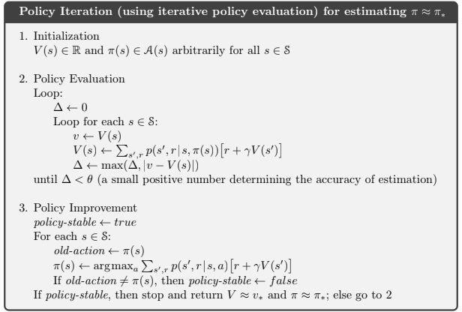
Policy Iteration

Slide 5
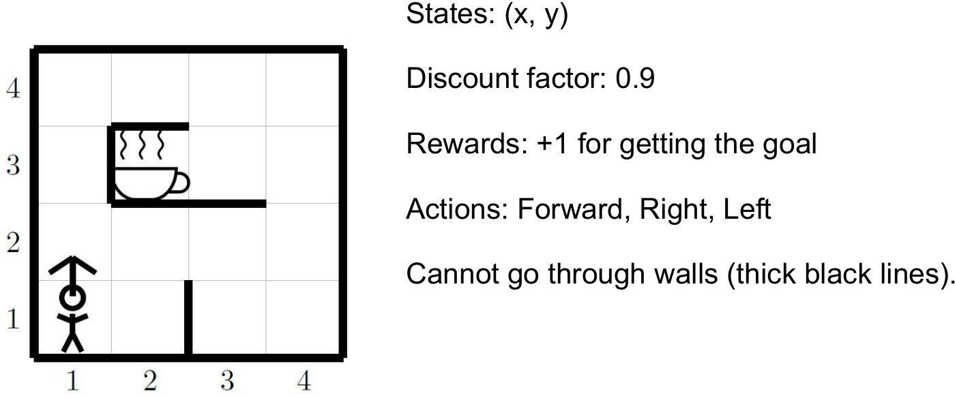
Shortest Path to the Coffee

Slide 6
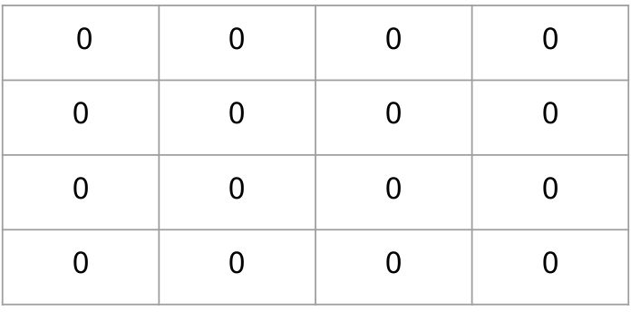
Questions
How many states (|S|) and actions (|A|) are there?
Consider a random policy that takes all actions from state s with equal
probability such that it reaches the coffee mug.
Starting with an initial value function of 0 for all states, apply one synchronous iteration of iterative policy evaluation to compute a new value function V’(s) for each state

Slide 7
Converged value iteration

Slide 8
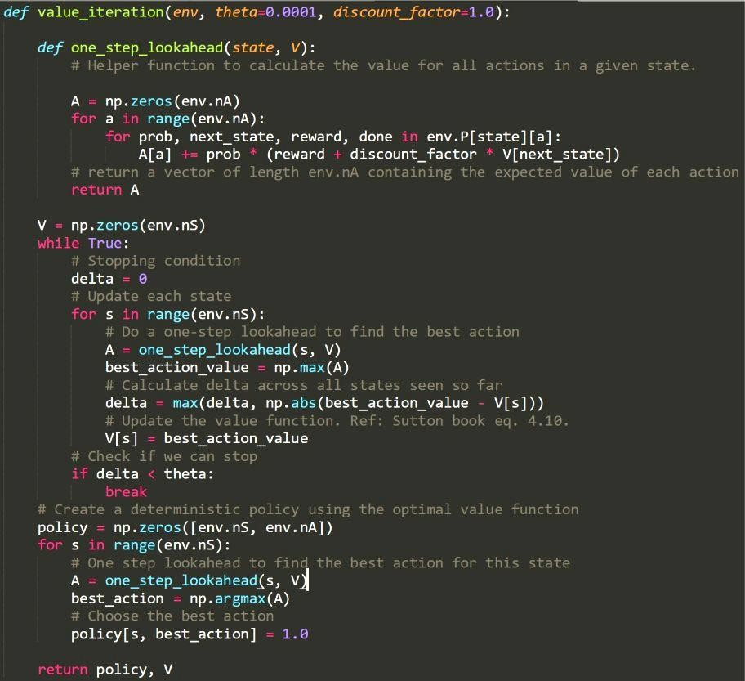
Value iteration
https://github.com/dennybritz/reinforcement-learning/blo b/master/DP/Value%20Iteration%20Solution.ipynb

Slide 9
Content
2
RL Review
About Open AI gym
Example 1: The Cart-Pole environment
Example 2: Mountain-Car environment

Slide 10
Open AI gym
6
A toolbox for RL algorithms
Many pre-deﬁned environments and simple interfaces
Why Open AI Gym?
Benchmark RL algorithms: a simple platform to encourage developing new RL algorithms.
Standardization of environments in publications: a simple tool to reproduce published RL research.

Slide 11
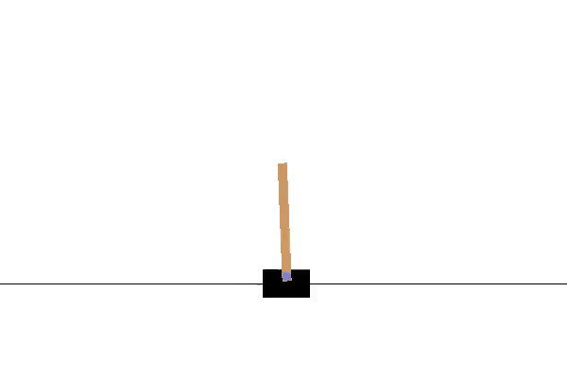
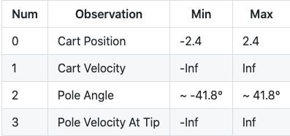
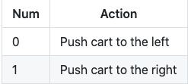
Example 1: Cartpole Environment
7
Environment Description: a pole is attached by an un-actuated joint to a cart, which moves along a frictionless track.
Goal: starting in an upright position, prevent the pole from falling over by controlling the cart’s velocity.
Conditions: pole angle must stay between ±12° to be considered upright and the cart must remain within ±2.4 of the center.
Reward: +1 for each step taken.
Observations and Actions:
Reference: https://github.com/openai/gym/wiki/CartPole-v0

Slide 12
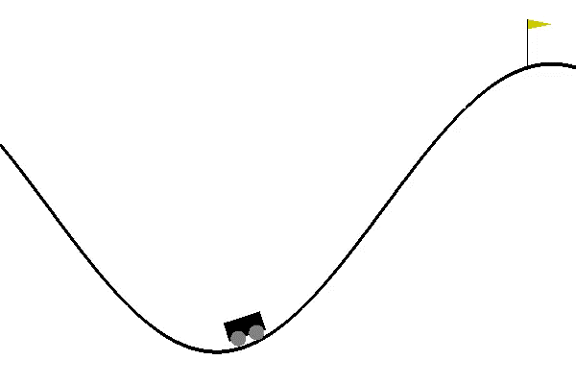
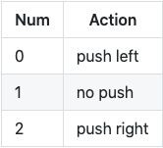
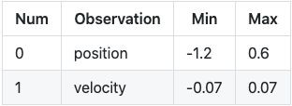
Example 2: Mountain Car Environment
8
Environment Description: a car on a one-dimensional track positioned between two “mountains”.
Goal: drive up the mountain on the right to reach the ﬂag.
Conditions: car’s engine is not strong enough to scale the mountain on the right in a single pass, it needs to build up momentum by going back and forth between the two mountains.
Reward: -1 for each time step until the goal is reached.
Observations and Actions:
Reference: https://github.com/openai/gym/wiki/MountainCar-v0

Slide 13
Resources
9
https://medium.com/@SmartLabAI/reinforcement-learning-algorithms-an-intuitive-overvie w-904e2dﬀ5bbc
https://www.freecodecamp.org/news/diving-deeper-into-reinforcement-learning-with-q-lear ning-c18d0db58efe/
https://spinningup.openai.com/en/latest/spinningup/rl_intro2.html
https://towardsdatascience.com/reinforcement-learning-markov-decision-process-part-2-96 837c936ec3
https://deeplizard.com/learn/playlist/PLZbbT5o_s2xoWNVdDudn51XM8lOuZ_Njv

