Slide 1
Recitation 3
Akshay Antony
Statistics, Maximum Likelihood Estimate, Pandas …
Notes:
Main title: 40 pt. Arial
Presenter Name: 16 pt. Arial
Presenters Title: 16 pt. Arial Italic

Slide 2
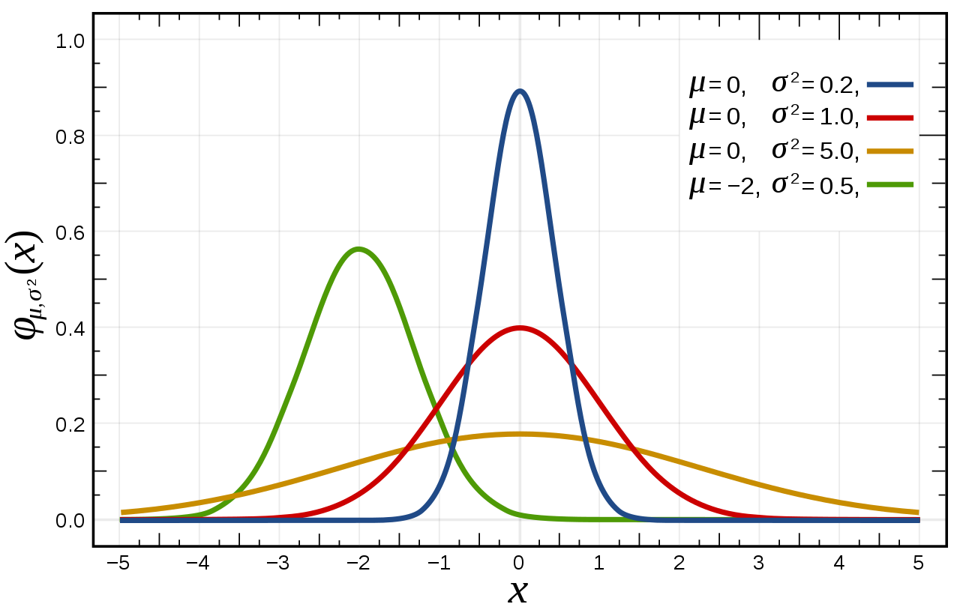
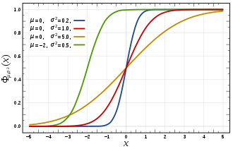


Gaussian Distribution
probability distribution(red is the standard normal distribution) Cumulative distribution function
images taken from: https://en.wikipedia.org/wiki/Normal_distribution

Slide 3
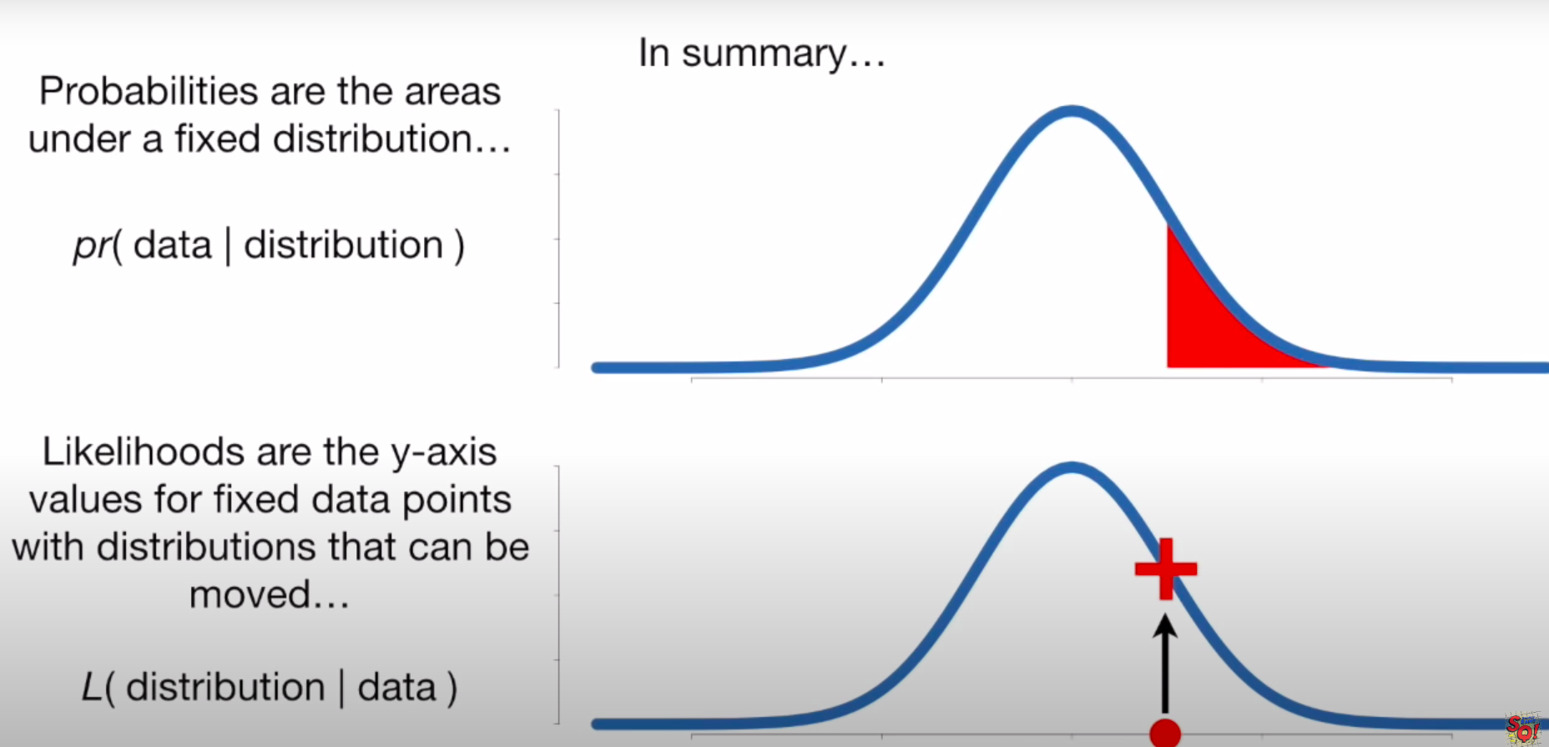
Likelihood vs Probability
Probability
Calculating probability of a certain event or data given the probability distribution
Find probabilities of a certain range given a gaussian distribution
Likelihood
Calculating the best distribution or best characteristics of data given a particular feature value or situation.
Estimating parameters of gaussian given data
[1] https://www.youtube.com/watch?v=pYxNSUDSFH4&t=219s&ab_channel=StatQuestwithJoshStarmer
[2] https://medium.com/swlh/probability-vs-likelihood-cdac534bf523

Slide 4
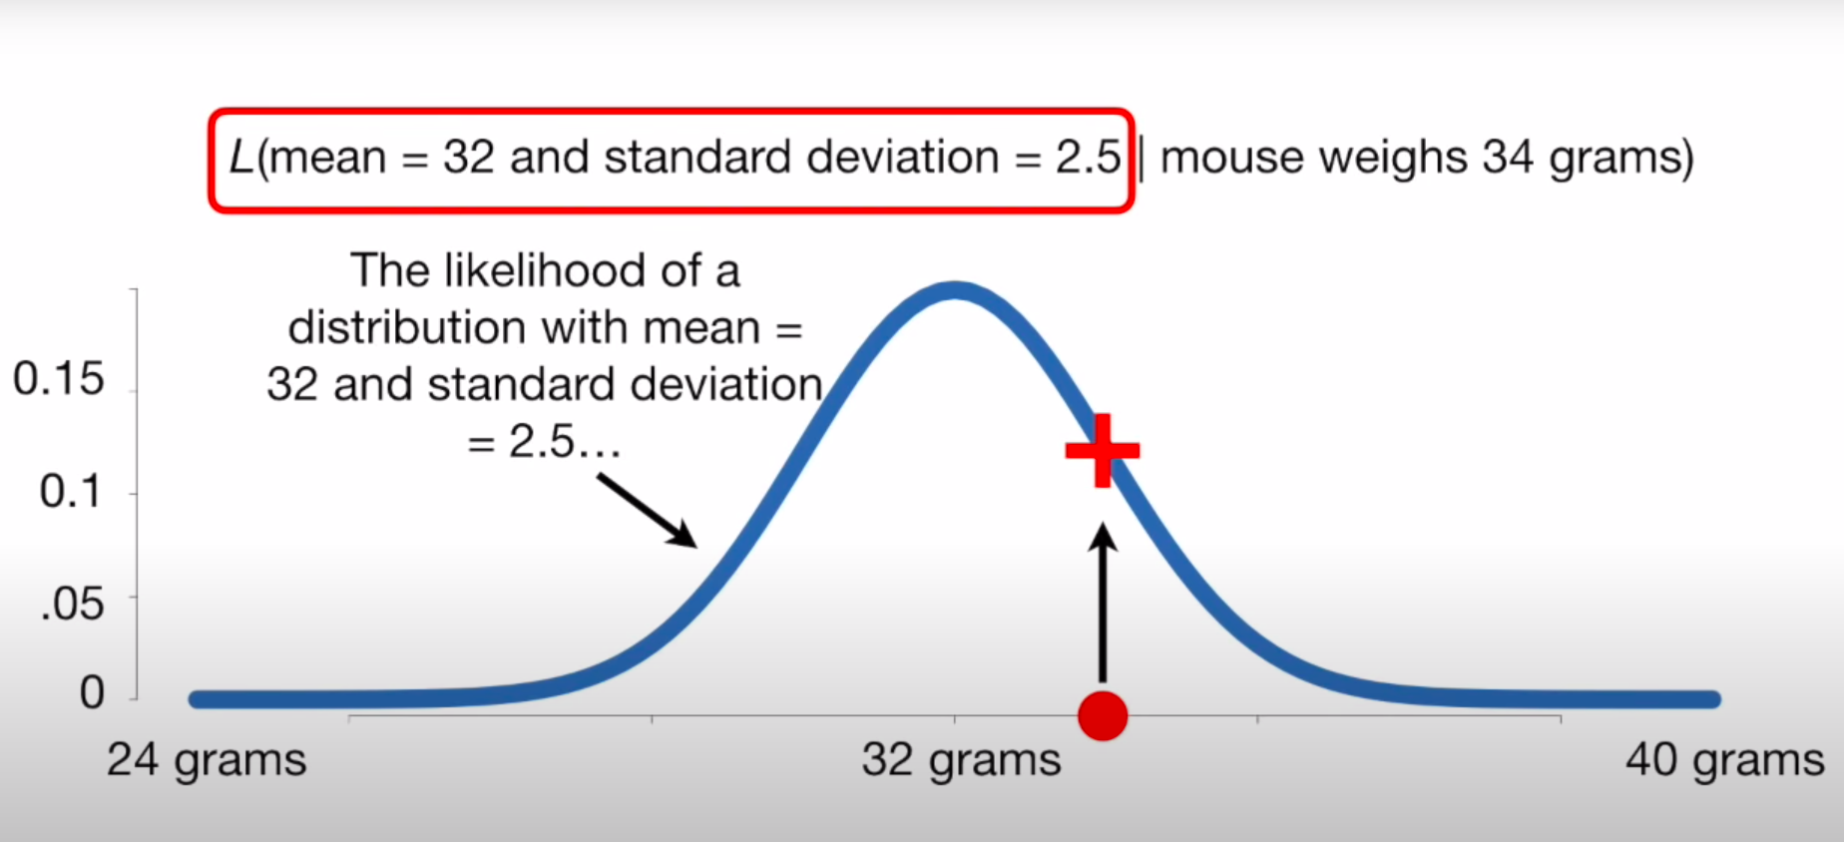
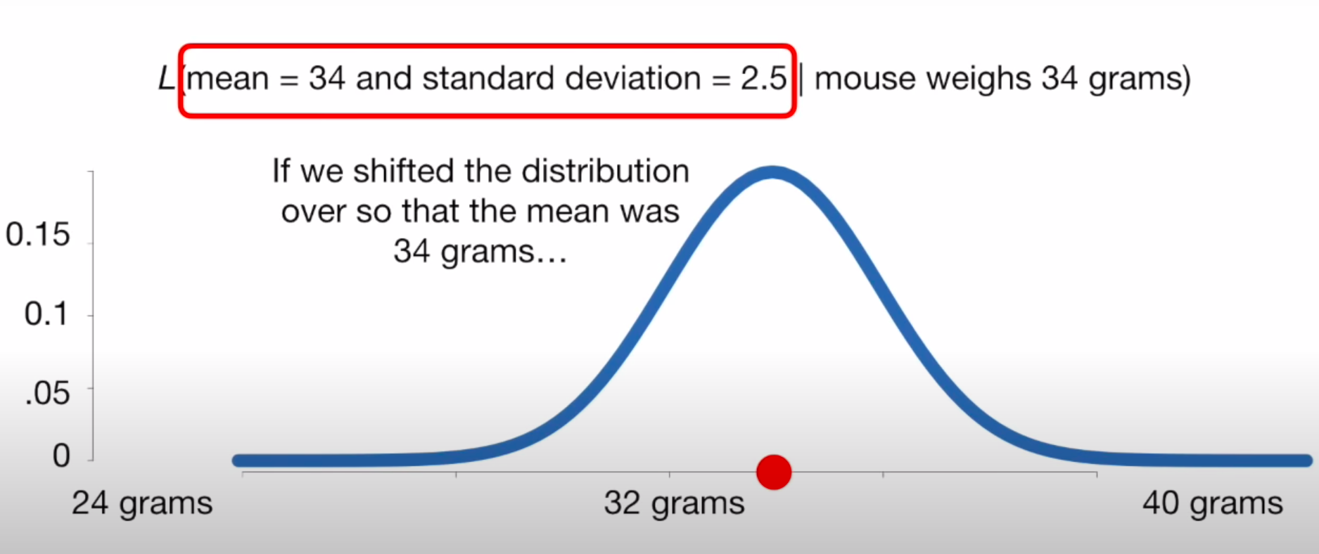
Maximum Likelihood Estimate
Estimating estimating the parameters of an assumed probability distribution, given some observed data.
Achieved by maximizing a likelihood function.
Variables in the optimization are probability distribution parameters
For what mean is the likelihood of a mouse weighing 34 grams maximized?
[1] https://www.youtube.com/watch?v=XepXtl9YKwc&t=293s&ab_channel=StatQuestwithJoshStarmer
[2] https://en.wikipedia.org/wiki/Maximum_likelihood_estimation

Slide 5




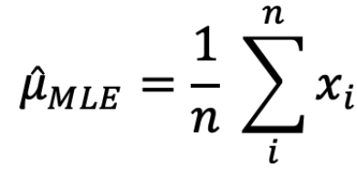
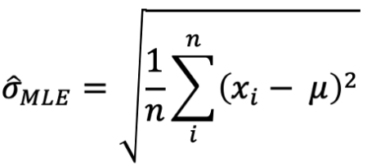

MLE Algorithm
Examples
Independent and Identical
Toss of a coin
Not independent but identical
Sampling without replacement
Independent not identical
Bag containing two coins of different probabilities
For IID data (independent and Identically distributed)
Probability of a random variable does not depend on previous observations
Probability distribution of each random variable is the same
Results for gaussian
[1] https://en.wikipedia.org/wiki/Maximum_likelihood_estimation

Slide 6
Thank You

