Slide 1
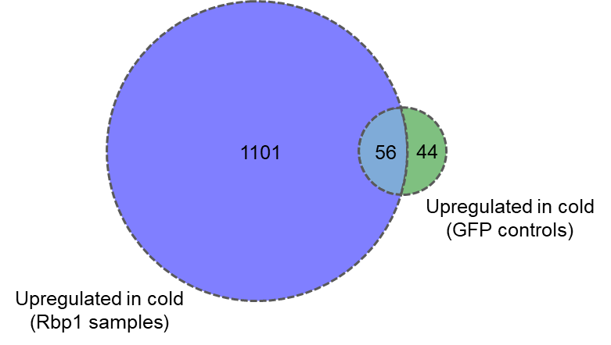
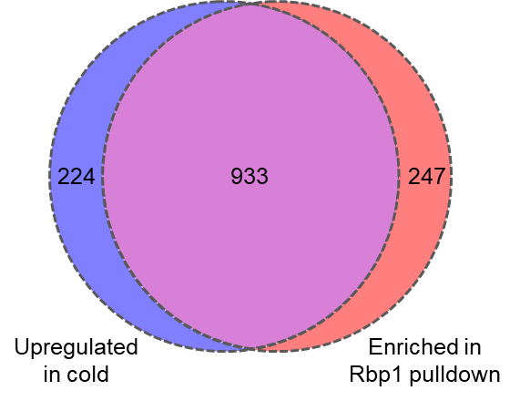
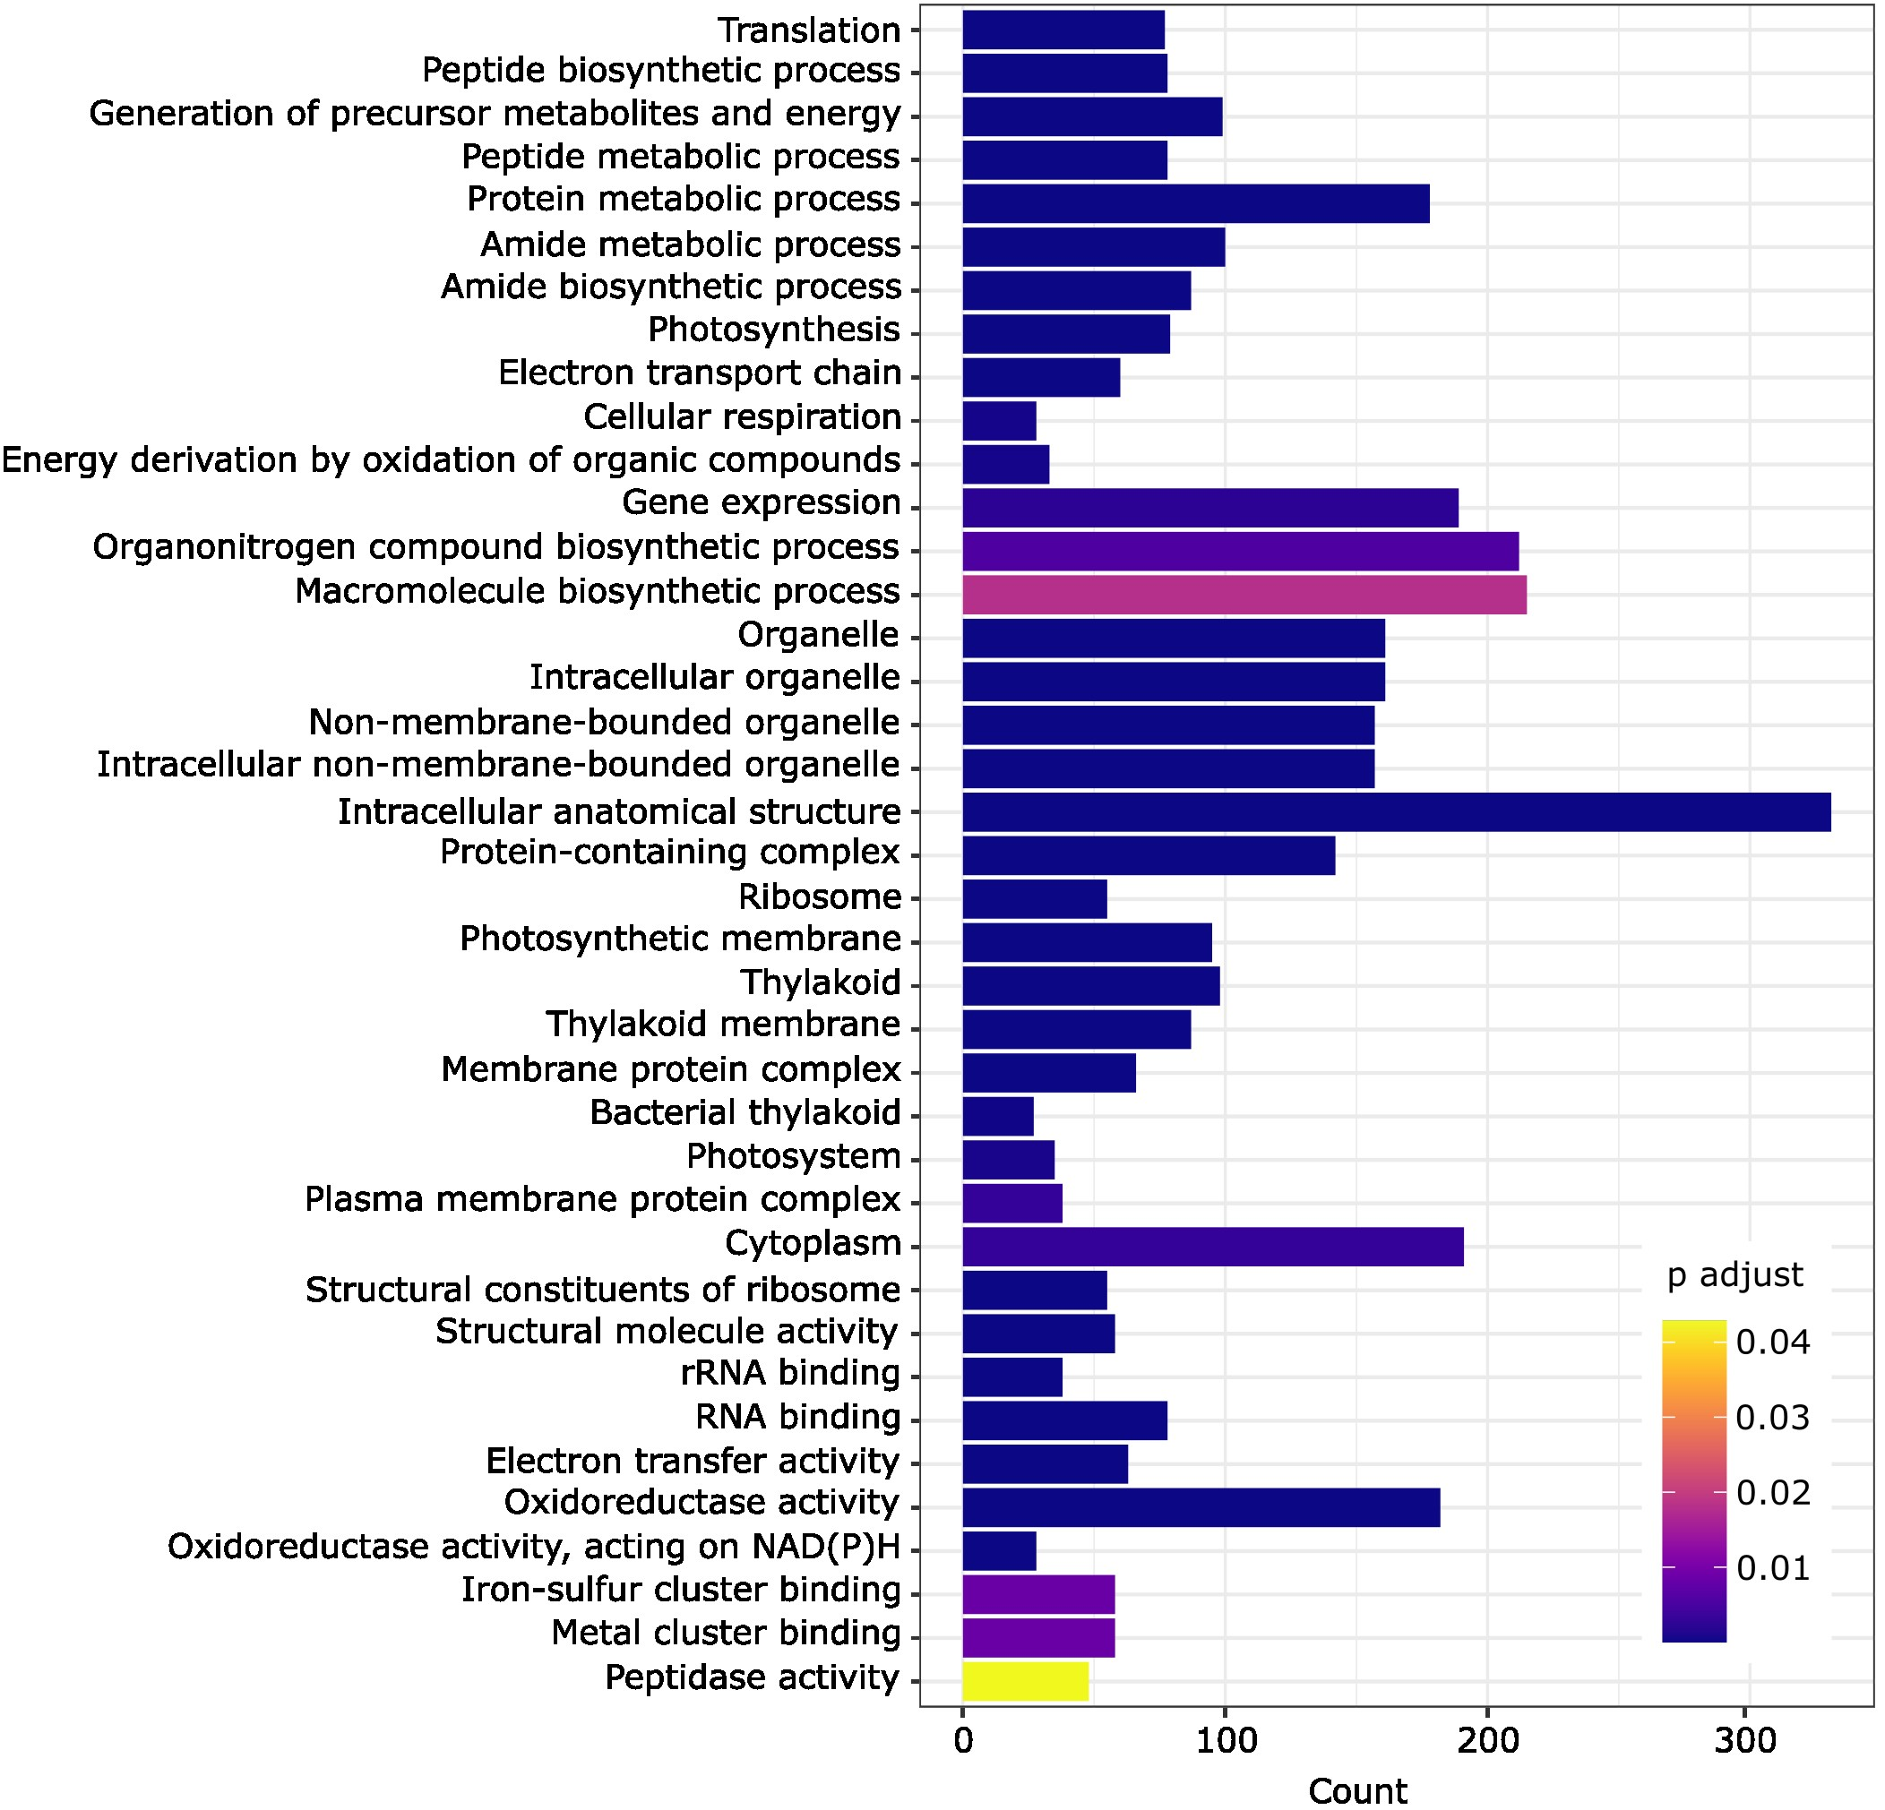
A
B
224
933
247
Upregulated in cold
Enriched in Rbp1 pulldown
C
Tabelle mit RNA features (CDS 5’, 3’ etc.)
1101
56
44
Upregulated in cold (GFP controls)
Upregulated in cold (Rbp1 samples)

