Slide 1
Transcriptome analysis
Samples:
Genotypes (8): field 2019
Time points (3): R5, R5/6 and R6
R5: 8/20/2019
R5/6
R6
Rep: 3
Total samples: 72
Genotype seeds for the transgenes, then extract RNA from seeds.
RNA of ~100 ng is needed for each sample
Illumina sequencing
# | Line | Plot | Plasmid/genes
1 | Thorne | 9 | Wild type
2 | 917-17 | 5 | pPTN1174 (WR1)
3 | 970-1 | 15 | pPTN1248 (WR1+DGAT)
4 | 1053-10 | 2 | pPTN1314 (WR1 + KasII)

Slide 2
Methods
Field 2019, keep the same plants for all works.
Harvest 12 seeds from each plant (as a rep) with three replicates
R5: 8/20
R5/6: 8/27
R6: 9/4
PCR for the positive, and do
RNA extraction
QIAGEN mini kit, QC by gel, and nanodrop
Turbo DNA free kit
Send to UNMC in tubes, in dry ice
Send for sequencing: 9-25-2019 UNMC, Dr Timothy (Chi Zhang)

Slide 3
RNA samples for sequencing (UNMC)
Genotype | Plasmid | Growth stage | R5 |  | R5/6 |  | R6
 |  | Plant | Sample ID | RNA Conc (un/ul) | Sample ID | RNA Conc (un/ul) | Sample ID | RNA Conc (un/ul)
Thorne | Wild type | 1 | A1-1 | 200 | B1-1 | 200 | C1-1 | 200
 |  | 2 | A1-2 | 200 | B1-2 | 200 | C1-2 | 200
 |  | 3 | A1-3 | 200 | B1-3 | 200 | C1-3.N | 200
917-17 | pPTN1174 (WR1) | 1 | A2-1 | 200 | B2-1 | 200 | C2-1 | 200
 |  | 2 | A2-2 | 200 | B2-2 | 200 | C2-2.N | 200
 |  | 3 | A2-3 | 200 | B2-3 | 200 | C2-3.N | 200
970-1 | pPTN1248 (WR1+DGAT) | 1 | A3-1 | 200 | B3-1 | 200 | C3-1 | 200
 |  | 2 | A3-2 | 200 | B3-2 | 200 | C3-2 | 200
 |  | 3 | A3-3 | 200 | B3-3 | 200 | C3-3 | 200
1053-10 | pPTN1314 (WR1 + KasII) | 1 | A4-1 | 200 | B4-1 | 200 | C4-1 | 200
A1, B1, C1 are WT at R5, R5/6, R6 three time point (A1-1, A1-2, and A1-3 are three replicates of A1)
A2, B2, C2, are pPTN1174 (WR1) at R5, R5/6, R6
A3, B3, C3, are pPTN1248 (WR1+DGAT) at R5, R5/6, R6
A4, B4, C4, are pPTN1314 (WR1 + KasII) at R5, R5/6, R6
Seeds at growth stage of R5 R5-6 and R6 were collected, genotyped and bulked in 4 seeds for RNA extraction, using QIAGEN Plant RNeasy kits. Final RNA concentration is of ~200ug/ul. RNA was extracted on September 16 2019 with 260/280~ 2.05-2.17. RNA was check using electrophoresis (next page)

Slide 4
Analysis
We have WT, WR1, WR1+DGAT, WR1+KasII
can we find genes that are regulated by WR1?
Can we find genes that are regulated by DGAT or KasII?
How to use time information?
WR1
KaII
DGAT
WR1 target genes
KASII target genes
DGAT target genes

Slide 5
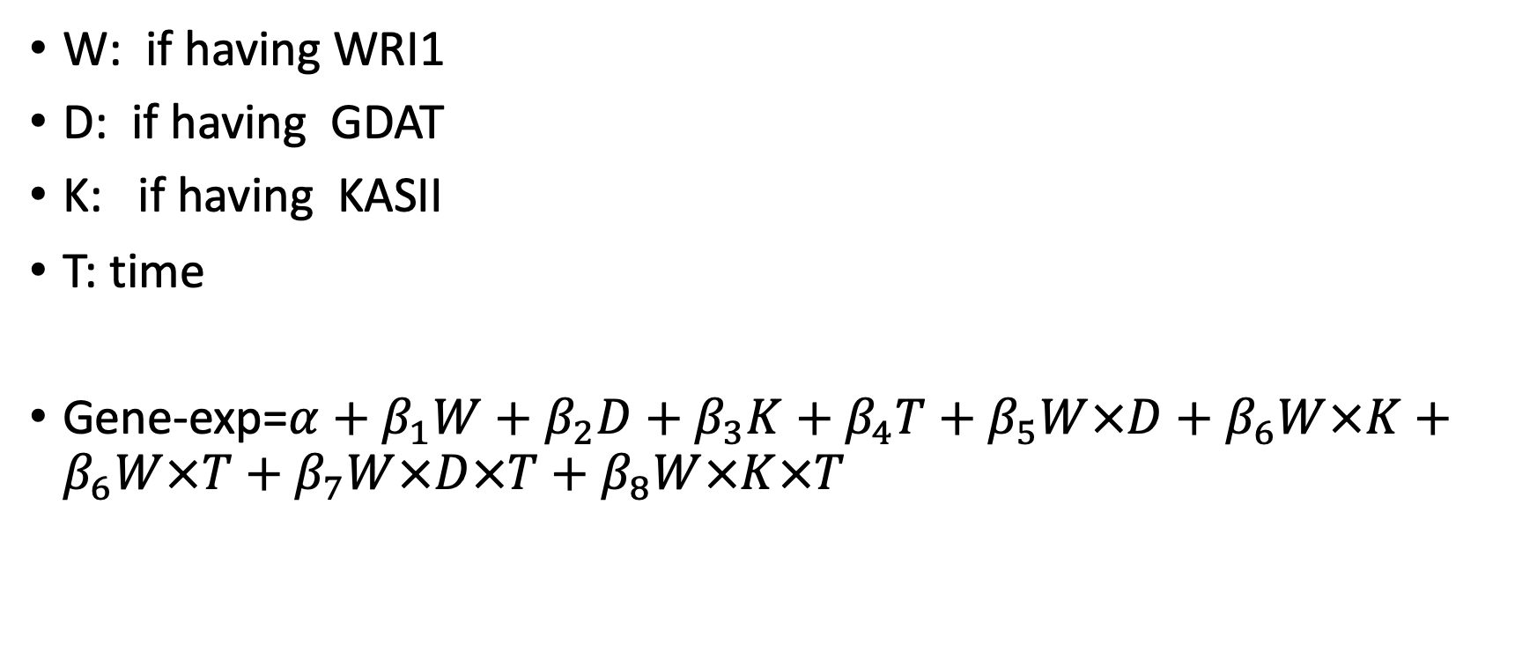
Can we build a new model for these data? The Model
W: if having WRI1
D: if having GDAT
K: if having KASII
T: time
Gene-exp=$α+β_{1}W+β_{2}D+β_{3}K+β_{4}T+β_{5}W×D+$ $β_{6}W×K+$ $β_{6}W×T+β_{7}W×D×T+$ $β_{8}W×K×T$

