Slide 1

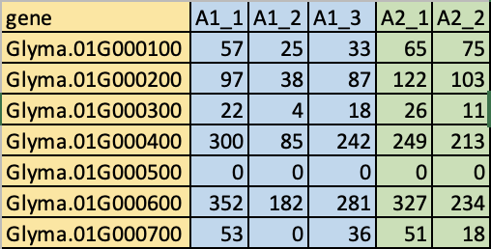
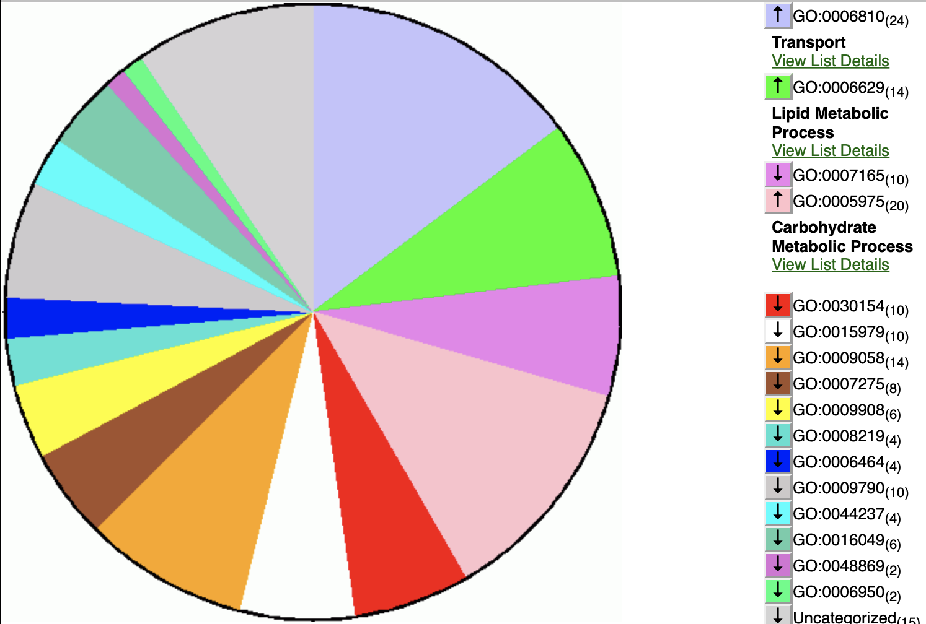
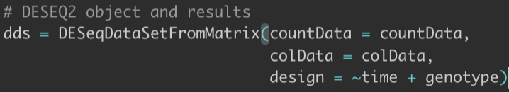
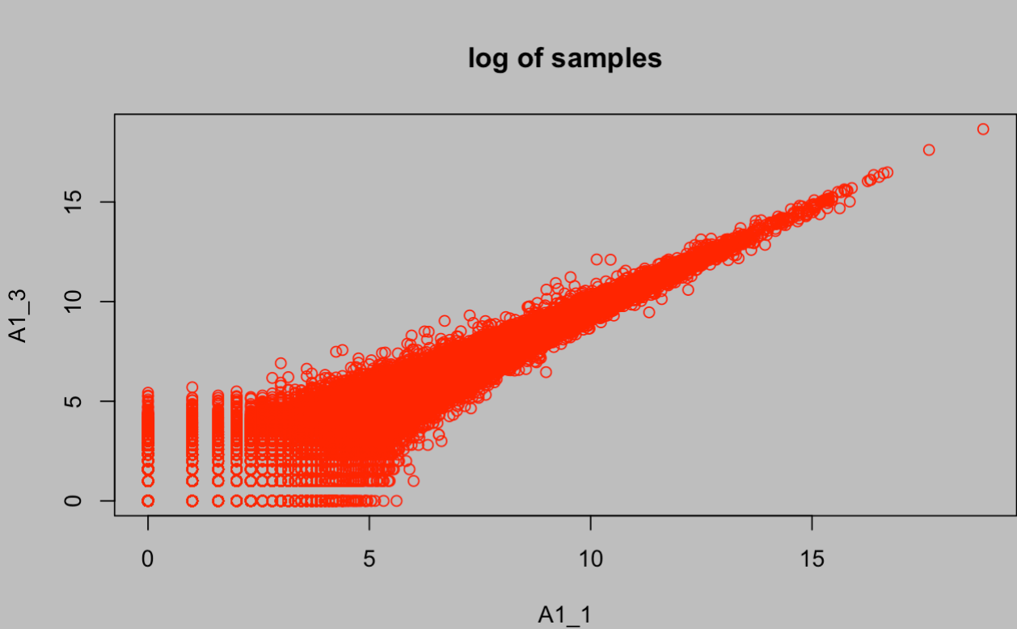
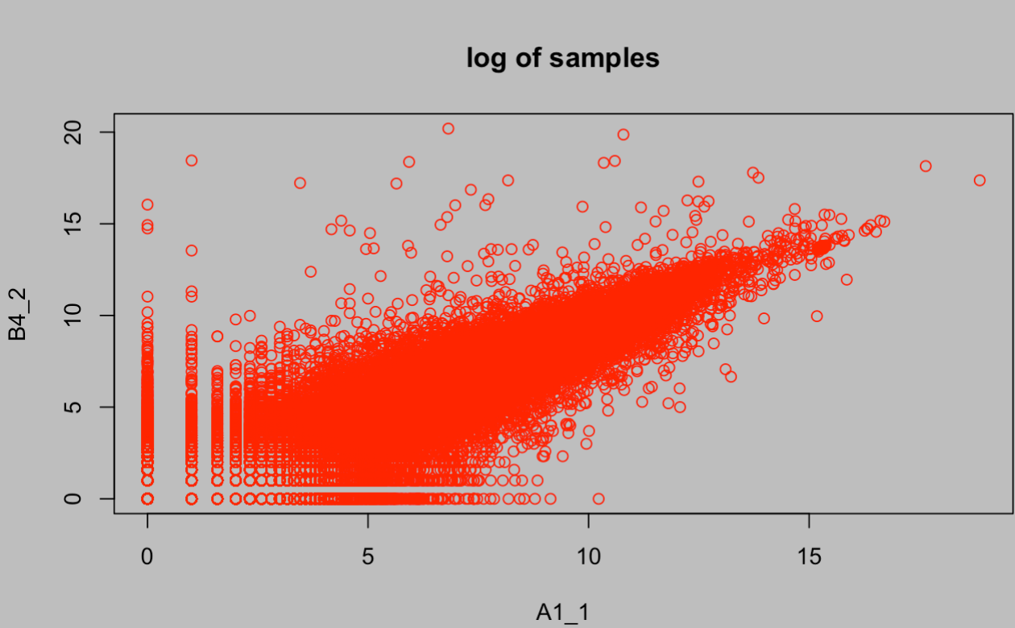
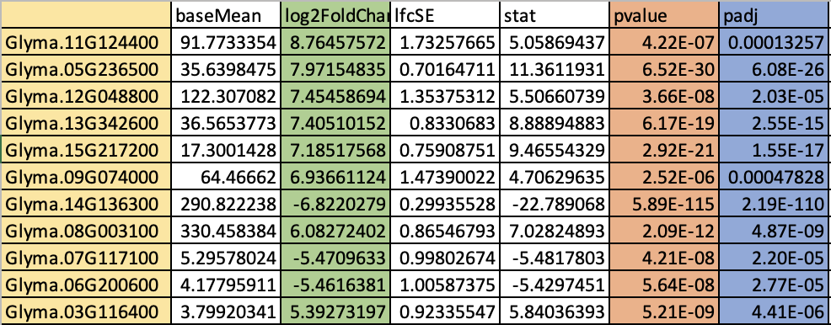
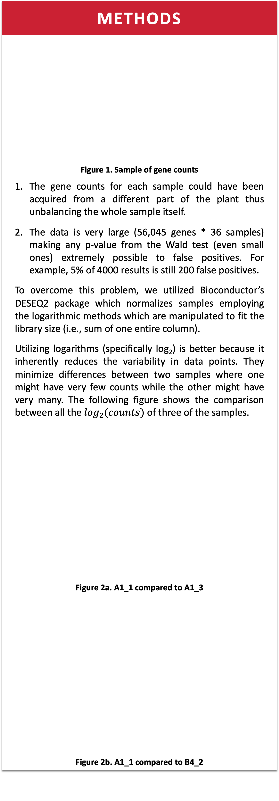
Transcriptome Analysis to Increase Soybean Oil- a Biofuel Source
Pranav Palli¹, Hanh Nguyen², Truyen Quach², Yu Shi³, Thomas Clemente², Chi Zhang³
¹School of Computer Science and Engineering, College of Arts and Sciences, UNL, 68588
²Department of Agronomy and Horticulture, College of Agricultural Sciences and Natural Resources, Center for Plant Science Innovation, UNL, 68588
³School of Biological Sciences, Department of Biochemistry, Center of Plant Science Innovation, UNL, 68588
BACKGROUND
Plants extract carbon dioxide (CO₂) from the atmosphere to synthesize macromolecules such as lipids. These pathways (carbon-capture pathways) directly affect the yield of plants as they grow. In soybeans, possessing an efficient carbon-capture pathway is key to increasing oil yield in seeds by more than 20%. Soybean oil is a potential biofuel source which can replace fossil fuels. While the links between pathways and oil production are known to exist, the interactions between various genes in the pathways (which is crucial to developing soybeans with increased oil) are poorly understood. Gene counts represent the number of times a certain gene is present in the genome in parts per million (ppm). These have varying impact on the plants as for instance, a large count of an oil production gene means that more oil is produced and vice versa. Therefore, an experiment comparing differences in gene counts between various transgenic lines of soybeans was conducted. Specifically, one protein (WR1) and two genes (DGAT & KasII) were isolated as they are known to increase oil synthesis in soybeans. The following table shows the plant lines & their corresponding numbers. Table 1. Plant lines The lines had their gene counts measured (using a high-throughput RNA-Seq tool) at three distinct time-points during the soybean growth process. They are represented by letters as follows: R5 (A)- Beginning seed: pods are 1/8 inches long at one of the four uppermost nodes on the main stem R5/6 (B)- Middle seed: pods with seeds are bigger than beginner seed R6 (C)- Full seed: pod containing a green seed that fills the pod capacity Each plant line has 3 replicas which are represented as an additional number in the name of a sample. For instance, the second replica of a WR1 + DGAT line at R5/6 would be named B3_2. Figure 1 provides more examples.
METHODS
Figure 1. Sample of gene counts The gene counts for each sample could have been acquired from a different part of the plant thus unbalancing the whole sample itself. The data is very large (56,045 genes * 36 samples) making any p-value from the Wald test (even small ones) extremely possible to false positives. For example, 5% of 4000 results is still 200 false positives. To overcome this problem, we utilized Bioconductor’s DESEQ2 package which normalizes samples employing the logarithmic methods which are manipulated to fit the library size (i.e., sum of one entire column). Utilizing logarithms (specifically log₂) is better because it inherently reduces the variability in data points. They minimize differences between two samples where one might have very few counts while the other might have very many. The following figure shows the comparison between all the $\log_{2}(counts)$ of three of the samples. Figure 2a. A1_1 compared to A1_3 Figure 2b. A1_1 compared to B4_2
METHODS (CONT.)
The graphs above show how similar two samples are across all genes. The more clustered the graph is, the more similar the samples are. As we can see the replicates at R5 are genetically much closer than two different plants at different time points. To work, DESEQ2 requires 2 sets of samples & a design model such that it internally knows what to control for and compare. Based on these inputs, it normalizes the values based on the aforementioned methods. In this case, we separated the data into different files such that each file has one control and one experimental set of samples. Table 2 shows the file designations. Table 2. File designations These samples have metadata attached to them internally that indicates genotype and timing. The design formula is the third parameter of the function shown in Figure 3. It utilizes the data and meta data to produce differentially expressed genes who differ only because of the second term (genotype) while controlling for the first term (time). Figure 3. Design formula
RESULTS (CONT.)
After obtaining this list of differentially expressed genes, we used Soybase (a genomics database) to identify the biological function of the identified genes as shown in Figure 5. Figure 5. Biological processes of differentially expressed genes The three largest components are lipid/carbohydrate synthesis and transport which corroborates the idea that WR1 is responsible for increased oil production and maintenance among other functions.
File | Control | Experimental
1 | WT (1) | WR1 (2)
2 | WR1 (2) | WR1 + DGAT (3)
3 | WR1 (2) | WR1 + KasII
# | Line | Plasmid/genes
1 | Thorne | Wild type (WT)
2 | 917-17 | pPTN1174 (WR1)
3 | 970-1 | pPTN1248 (WR1+DGAT)
4 | 1053-10 | pPTN1314 (WR1 + KasII)
CONCLUSION
In addition to the results shared above, we can even explore how the genes change & adapt over time. Differential gene analysis in soybeans can help us find the intricate relations that each gene has on the overall plant and on each other. This can help us construct better plant lines that have an increased oil yield.
RESULTS
The model above controls for the time points while measuring the variance across both the genotypes. After running the data through our design, we obtain results which contain log2FoldChange (difference between log of gene counts) and p-adj (adjusted p-value calculated by the Benjamini and Hochberg method). From the results data, we then eliminated all the genes with a log2FoldChange < 0.7 OR p-adj > 0.005. This ensures that our results are only genes that are very strongly differentially expressed. Figure 4. shows a sample of the filtered results of File 1 from Table 2. Figure 4. Sample of results from WR1 vs. WT
REF/ACKNOWLEDGEMENTS
This work was directly supported by the Nebraska Public Power District through the Nebraska Center for Energy Sciences Research at UNL. Love, M.I., Huber, W., Anders, S. Moderated estimation of fold change and dispersion for RNA-seq data with DESeq2. Genome Biology 15(12):550 (2014) Hadley Wickham, Romain François, Lionel Henry and Kirill Müller (2021). dplyr: A Grammar of Data Manipulation. R package version 1.0.7. https://CRAN.R-project.org/package=dplyr Grant, D., Nelson, R.T., Cannon, S.B. and Shoemaker, R.C. (2010) SoyBase, the USDA-ARS soybean genetics and genomics database. Nucl. Acids Res. (2010) 38 (suppl 1): D843-D846. doi: 10.1093/nar/gkp798
METHODS
We cannot directly compare between the raw counts of samples for two main reasons:

Slide 2
BACKGROUND
Plants extract carbon dioxide (CO₂) from the atmosphere to synthesize macromolecules such as lipids. These pathways (carbon-capture pathways) directly affect the yield of plants as they grow. In soybeans, possessing an efficient carbon-capture pathway is key to increasing oil yield in seeds by more than 20%. Soybean oil is a potential biofuel source which can replace fossil fuels. While the links between pathways and oil production are known to exist, the interactions between various genes in the pathways (which is crucial to developing soybeans with increased oil) are poorly understood.
Gene counts represent the number of times a certain gene is present in the genome in parts per million (ppm). These have varying impact on the plants as for instance, a large count of an oil production gene means that more oil is produced and vice versa. Therefore, an experiment comparing differences in gene counts between various transgenic lines of soybeans was conducted. Specifically, one protein (WR1) and two genes (DGAT & KasII) were isolated as they are known to increase oil synthesis in soybeans. The following table shows the plant lines & their corresponding numbers.
Table 1. Plant lines
The lines had their gene counts measured (using a high-throughput RNA-Seq tool) at three distinct time-points during the soybean growth process. They are represented by letters as follows:
R5 (A)- Beginning seed: pods are 1/8 inches long at one of the four uppermost nodes on the main stem
R5/6 (B)- Middle seed: pods with seeds are bigger than beginner seed
R6 (C)- Full seed: pod containing a green seed that fills the pod capacity
Each plant line has 3 replicas which are represented as an additional number in the name of a sample. For instance, the second replica of a WR1 + DGAT line at R5/6 would be named B3_2. Figure 1 provides more examples.
# | Line | Plasmid/genes
1 | Thorne | Wild type (WT)
2 | 917-17 | pPTN1174 (WR1)
3 | 970-1 | pPTN1248 (WR1+DGAT)
4 | 1053-10 | pPTN1314 (WR1 + KasII)

Slide 3
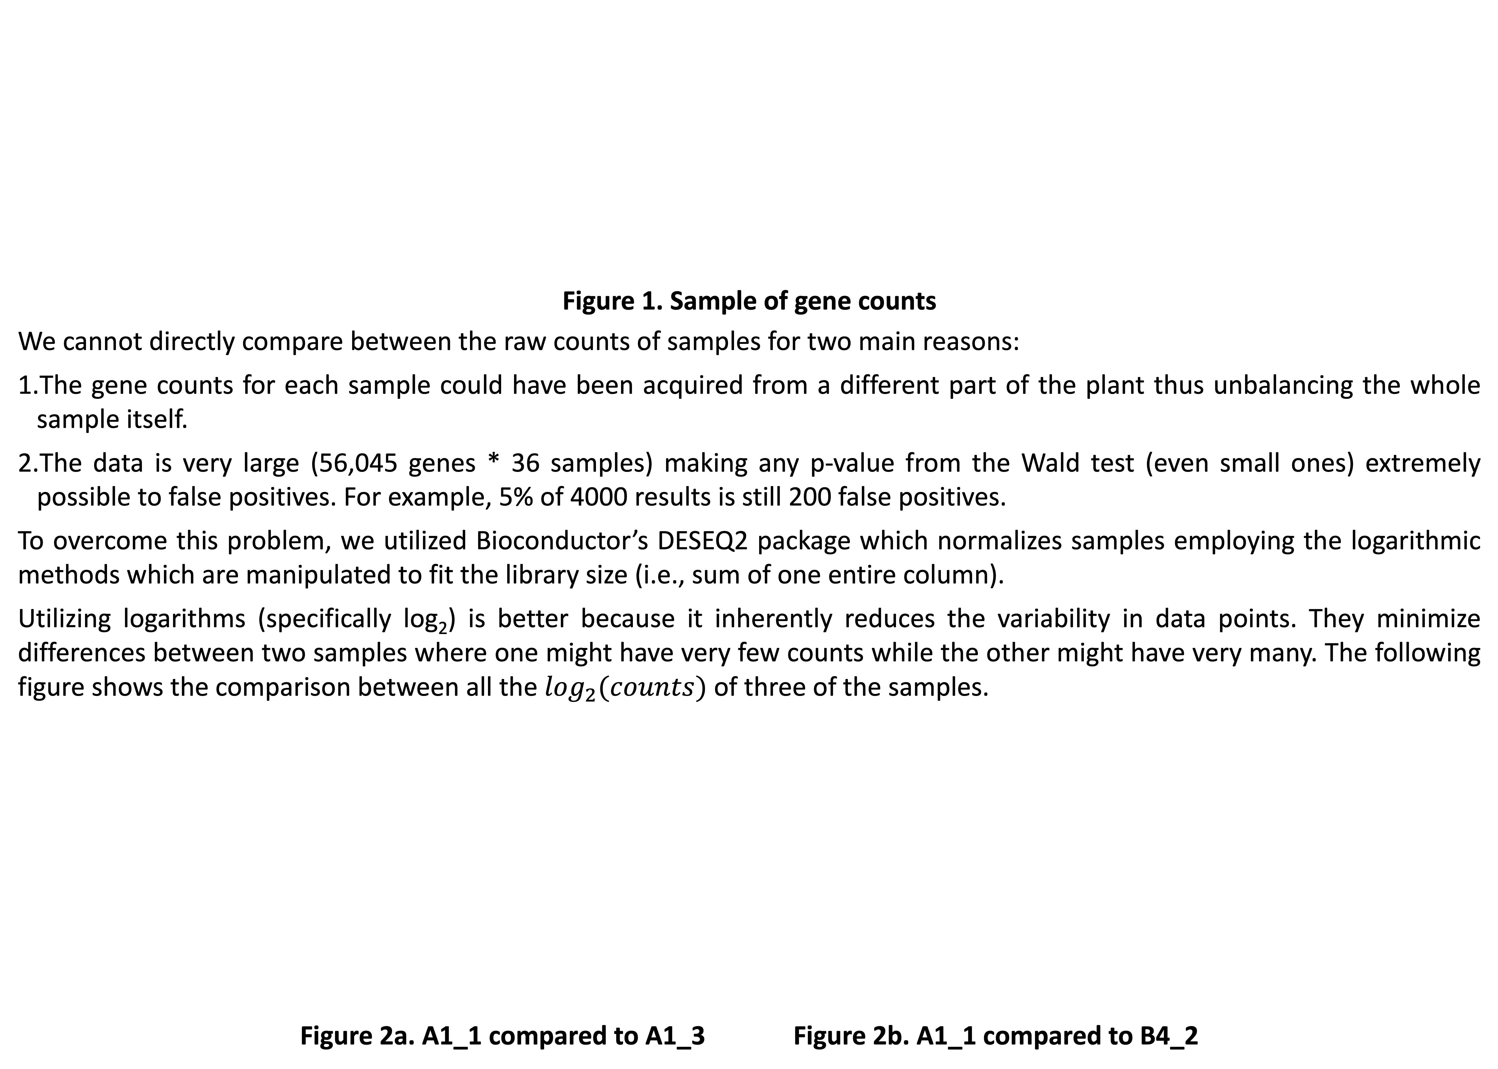
METHODS
Figure 1. Sample of gene counts
We cannot directly compare between the raw counts of samples for two main reasons:
The gene counts for each sample could have been acquired from a different part of the plant thus unbalancing the whole sample itself.
The data is very large (56,045 genes * 36 samples) making any p-value from the Wald test (even small ones) extremely possible to false positives. For example, 5% of 4000 results is still 200 false positives.
To overcome this problem, we utilized Bioconductor’s DESEQ2 package which normalizes samples employing the logarithmic methods which are manipulated to fit the library size (i.e., sum of one entire column).
Utilizing logarithms (specifically log₂) is better because it inherently reduces the variability in data points. They minimize differences between two samples where one might have very few counts while the other might have very many. The following figure shows the comparison between all the $\log_{2}(counts)$ of three of the samples.
Figure 2a. A1_1 compared to A1_3 Figure 2b. A1_1 compared to B4_2

Slide 4
METHODS (continued)
The graphs above show how similar two samples are across all genes. The more clustered the graph is, the more similar the samples are. As we can see the replicates at R5 are genetically much closer than two different plants at different time points. To work, DESEQ2 requires 2 sets of samples & a design model such that it internally knows what to control for and compare. Based on these inputs, it normalizes the values based on the aforementioned methods. In this case, we separated the data into different files such that each file has one control and one experimental set of samples. Table 2 shows the file designations.
Table 2. File designations
These samples have metadata attached to them internally that indicates genotype and timing. The design formula is the third parameter of the function shown in Figure 3. It utilizes the data and meta data to produce differentially expressed genes who differ only because of the second term (genotype) while controlling for the first term (time).
Figure 3. Design formula
File | Control | Experimental
1 | WT (1) | WR1 (2)
2 | WR1 (2) | WR1 + DGAT (3)
3 | WR1 (2) | WR1 + KasII

Slide 5
RESULTS
The model above controls for the time points while measuring the variance across both the genotypes. After
running the data through our design, we obtain results which contain log2FoldChange (difference between log of gene counts) and p-adj (adjusted p-value calculated by the Benjamini and Hochberg method). From the results data, we then eliminated all the genes with a log2FoldChange < 0.7 OR p-adj > 0.005. This ensures that our results are only genes that are very strongly differentially expressed. Figure 4. shows a sample of the filtered results of File 1 from Table 2.
Figure 4. Sample of results from WR1 vs. WT
After obtaining this list of differentially expressed genes, we used Soybase (a genomics database) to identify the biological function of the identified genes as shown in Figure 5.
Figure 5. Biological processes of differentially expressed genes
The three largest components are lipid/carbohydrate synthesis and transport which corroborates the idea that WR1 is responsible for increased oil production and maintenance among other functions.

Slide 6
CONCLUSION
In addition to the results shared above, we can even explore how the genes change & adapt over time. Differential gene analysis in soybeans can help us find the intricate relations that each gene has on the overall plant and on each other. Another aspect of differential analysis we can explore is how the genes change over time. How the most differently expressed genes change over all three time points can tell us the how different genetic treatments are affected over plant-growth. This can help us construct better plant lines that have an increased oil yield.
REFERENCES/ACKNOWLEDGEMENTS
This work was directly supported by the Nebraska Public Power District through the Nebraska Center for Energy Sciences Research at UNL.
Love, M.I., Huber, W., Anders, S. Moderated estimation of fold change and dispersion for RNA-seq data with DESeq2. Genome Biology 15(12):550 (2014)
Hadley Wickham, Romain François, Lionel Henry and Kirill Müller (2021). dplyr: A Grammar of Data Manipulation. R package version 1.0.7. https://CRAN.R-project.org/package=dplyr
Grant, D., Nelson, R.T., Cannon, S.B. and Shoemaker, R.C. (2010) SoyBase, the USDA-ARS soybean genetics and genomics database. Nucl. Acids Res. (2010) 38 (suppl 1): D843-D846. doi: 10.1093/nar/gkp798

