Slide 1
CBC Estimating Copilot
Development Progress Report
September 2026

Slide 2
What is Built (Completed)
The foundational backend and AI architecture is complete:
  Core Architecture: Robust microservices (Platform, Intake, Extraction, Pricing, Quoting, Catalog).
  Database System: Fully modeled database tailored for commercial building components.
  AI Orchestration: Automated background workers for extracting data from PDFs using AI.
  Testing & Reliability: 985+ automated tests passing, ensuring a stable foundation.

Slide 3
What is Currently Being Developed
Focus has shifted to the user interface and business rules:
  Web Application: Building out the interactive web portal (Dashboard, Bids, Catalog, Price Books).
  Connecting UI to AI: Wiring the frontend screens to securely communicate with our automated backend.
  Business Logic: Gathering final data from stakeholders (e.g., specific hardware adders) to fully unlock automated pricing.

Slide 4
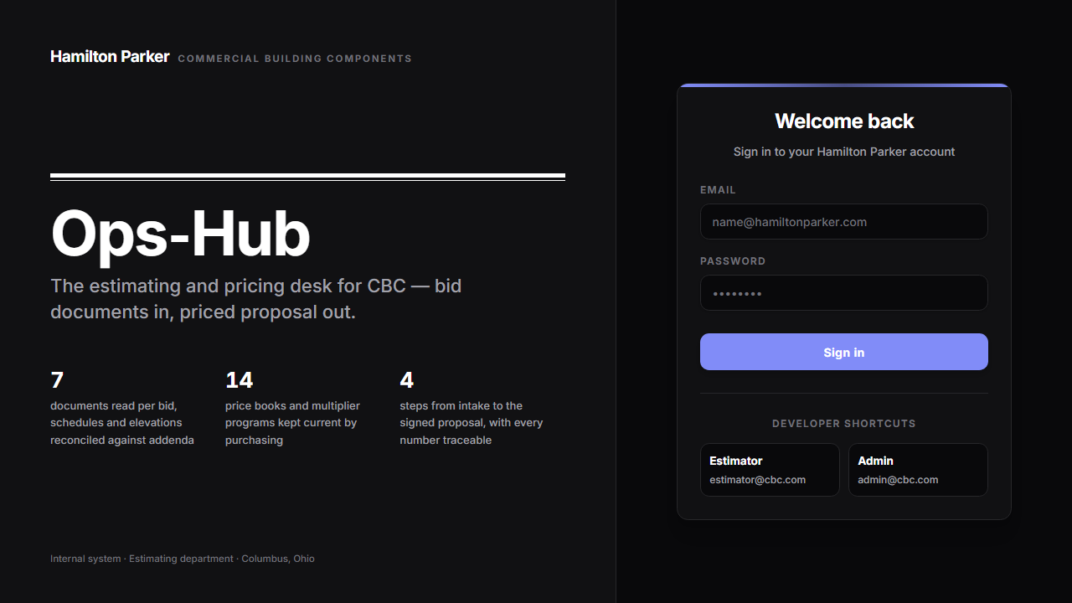
Web Portal Preview

