Slide 1


Exploring Powerline Networking for the Smart Building
Pat Pannuto
ppannuto@eecs.umich.edu
Prabal Dutta
prabal@eecs.umich.edu

Slide 2
The Smart Building: How and Why?
Better understanding of “resource” utilization and quality
  Resources: Space, power, lighting, etc...
Instrument a building with sensors
  Occupancy
  Lighting
  AC Load Monitoring
  ...
Notes:
What benefits do we get from a “Smart” building
Most everything is over-engineered: Bridges to hold more than their load, transistors to last well beyond their lifetime... Buildings to hold more people than are inside them??
It is hard to optimally use a building.
Not just space, but
Power distribuition
Fair to assume 3 sets of 20 offices use same power?
If we have data, we can use the data to understand a building's usage
But we need data → sensors

Slide 3
Example: UofM Music School
Needs to understand and optimize use of practice rooms
  Occupancy
  Temperature
  Humidity
Deployment
  Epic + sensors + BLIP + Battery
  Adds sensor lifetime: 6 months+?
Wireless #1 power draw: Idle listening
Notes:
A recent deployment at the University of Michigan, the music school has a couple hundred students, but a limited number of practice rooms
How to optimize? Need data!
Sensor networking is reaching a point where it's “fairly easy” to “spin up” a sensor to poll the data you're interested in
Sensors need power, usual solution is a battery, batteries have a limited lifetime – now your sensor does too. Adding a solar panel doesn't fix the situation; how long can a sensor report “no light here” with a solar panel?

Slide 4
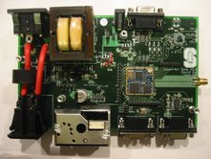
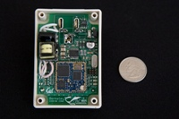
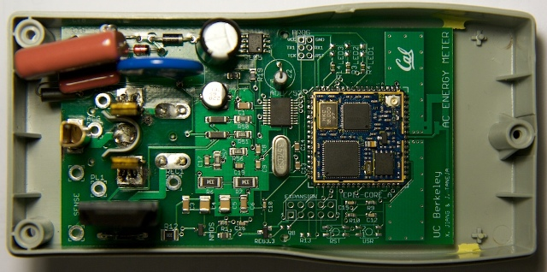
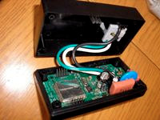
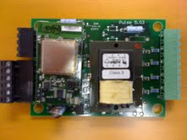

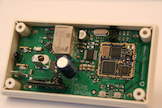
Why not network growing cadre of plug load meters over power lines?
Lots of AC meters: UCB, Stanford, Arch Rock, JHU, Colorado School of Mines, etc.
All use one interface for sensing, another for power, but…could
  Use PLC to network
  Remove meters from crowded spectrum
  Lets usage follow

Slide 5
Powerline Communications (PLC) is better suited than wireless
Power is ubiquitous in buildings
PLC is informative technology
  Learns building topology
(Functionally) PLC is
  Single hop
  Fully connected
Notes:
With this in mind, we argue that PLC is better suited as a sensor net backbone in modern buildings
In a building, power is ubiquitous and readily available, adding a sensor to a room is as easy as plugging it in
As I will show later in this talk, PLC by the nature of the technology infers more information about a building
PLC networks are fully connected, massively simplifying routing / etc. Current sensor networks have to build a wireless mesh and then figure out how to route packets to the edge node connecting the sensor net to the collection system / station
This also make PLC networks much faster at covering large geographic distances.

Slide 6
PLC History
Technology | PHY Speed | Modulation | Application Space
X10 | 20 bps | ASK | Home Automation
Insteon | 2,880 bps | BPSK | Home Automation
Ariane | 30 kpbs | FSK | Building Automation
HomePlug 1.0 | 14 Mbps | OFDM | IPoP
HomePlug AV | 200 Mbps | OFDM | IPoP
Current PLC deployments are in the home, not buildings
Notes:
It is interesting now to briefly examine the history of PLC. The idea of sending data over powerlines is not new; indeed the first technology – X10 – emerged in the 1960s.
This first technology used the 60Hz AC wave as a carrier; inducing small voltage changes on the zero-crossing of the AC sine wave. As technology improved, however, the AC wave quickly transitioned from, “free, simple, common, synchronous carrier” to “noise”
In the early 1990s, Insteon revealed its technology. X10's extremely low data rate and other limitations made it difficult to control more than 10 lights easily; Insteon's technology pushed this envelope enough to allow for modern home automation enthusiasts to control their entire homes, but not much more
Ariane controls, founded around the turn of the century, is much like Insteon, another iterative improvement achieving about an order of magnitude improvement in transmission speed.
The radical change came around 2003 with the introduction of the HomePlug 1.0 standard, the first PLC technology fast enough to facilitate modern high speed communications over powerlines
A few years later, HomePlug AV iterated again, making PLC technology competitive in speed with wireless technology
It is on these latter two technologies – HomePlug 1.0 and HomePlug AV – that the rest of this talk will focus

Slide 7
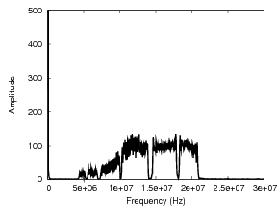
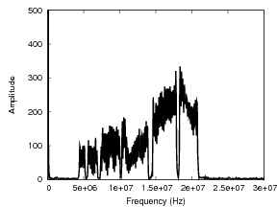
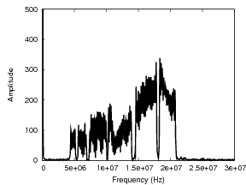
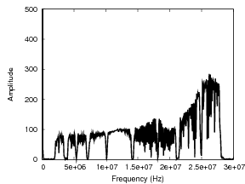
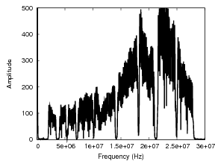
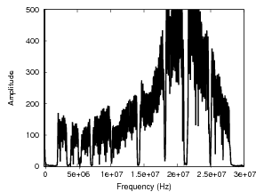
Understanding PLC
HomePlug AV HomePlug 1.0
Powerstrip “Strong” “Weak”
Notes:
First, we briefly examine the limits of PLC. Here we are comparing two different PLC modems – a Netgear running the HomePlug 1.0 standard and a ZyXEL running the HomePlug AV standard – and observing the spectra they produce under various conditions. The ZyXEL modems were capable of indicating a “weak” connection, an idea I will return to later on in this talk
In the first column, the two modems are connected via a powerstrip; requiring very little effort – that is, low amplitude – to establish a connection
In the second column, a strong connection is established in a real-building setting. This connect is crossing from one side of the CSE building at Michigan to another
In the third column, we see what was indicated to be a “weak” connection. We observe the spectra of the weak connection to be nearly identical that of the strong connection, which indicates that the modem was likely transmitting at full or near full power to establish the strong connection and was unable to boost power more in the weak connection case.

Slide 8
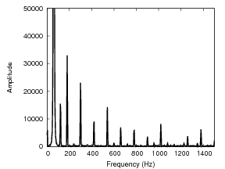
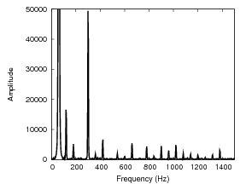
PLC in a Home vs a Building:
The Good
Student's Apartment
CSE Building

Slide 9
PLC in a Home vs a Building:
The Bad
Homes: simple
  One “power domain”
  Supply:
    120V
    1 phase + neutral
  Outlet:
    120V
    1 phase + neutral
All outlets can “see” each other
Buildings: complex
  Multiple “power domains”
  Supply:
    480V
    3 phase, no neutral
  Outlet:
    120V
    1 phase + neutral
Outlets in the same room cannot “see” each other!

Slide 10
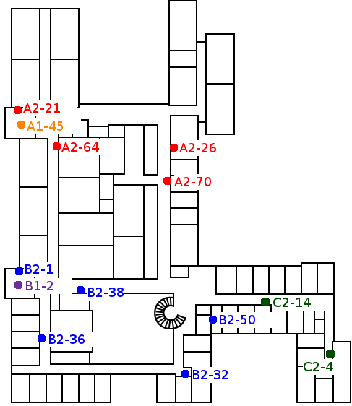
The Experiment
Plug into outlets “round-robin” and see what's connected
Node names match blueprints
  These will be important soon

Slide 11
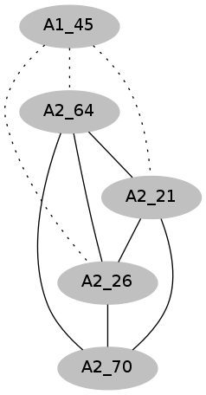
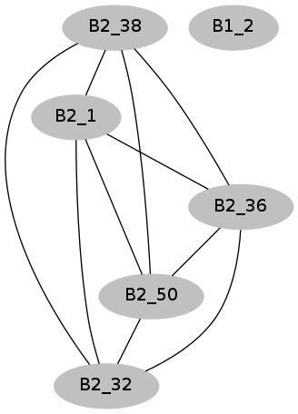
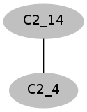
Observed Connectivity

Slide 12
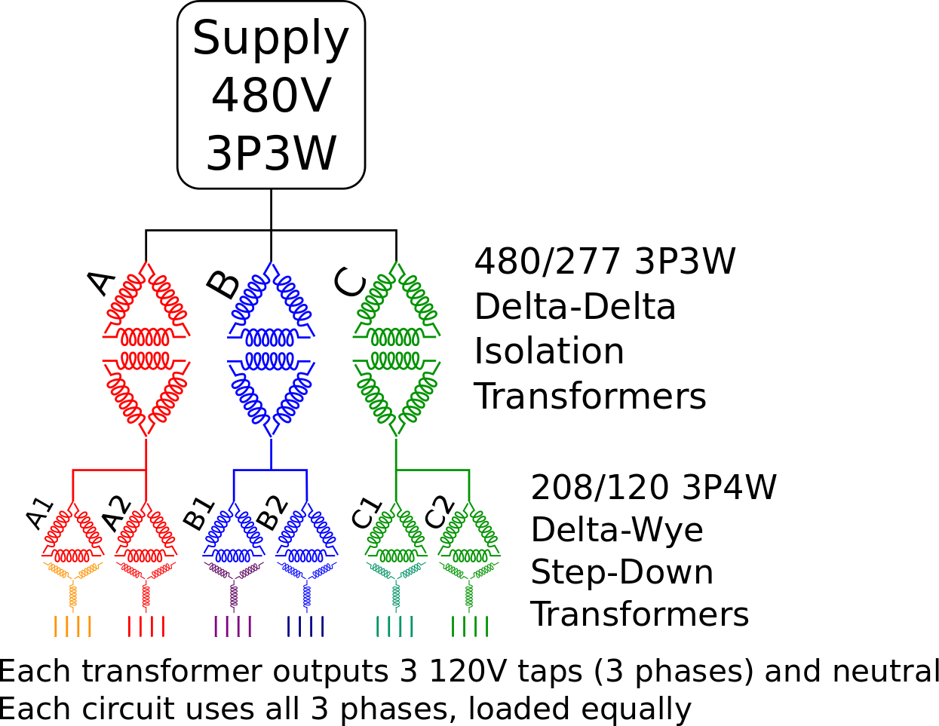
CSE Power Distribution

Slide 13
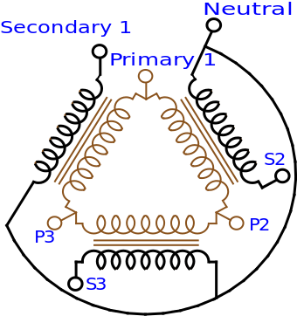
Delta-Wye Transformer
Adds a neutral reference to 3-phase power
One Neutral for all 3 phases
  Likely why PLC works
Image c/o Wikipedia

Slide 14
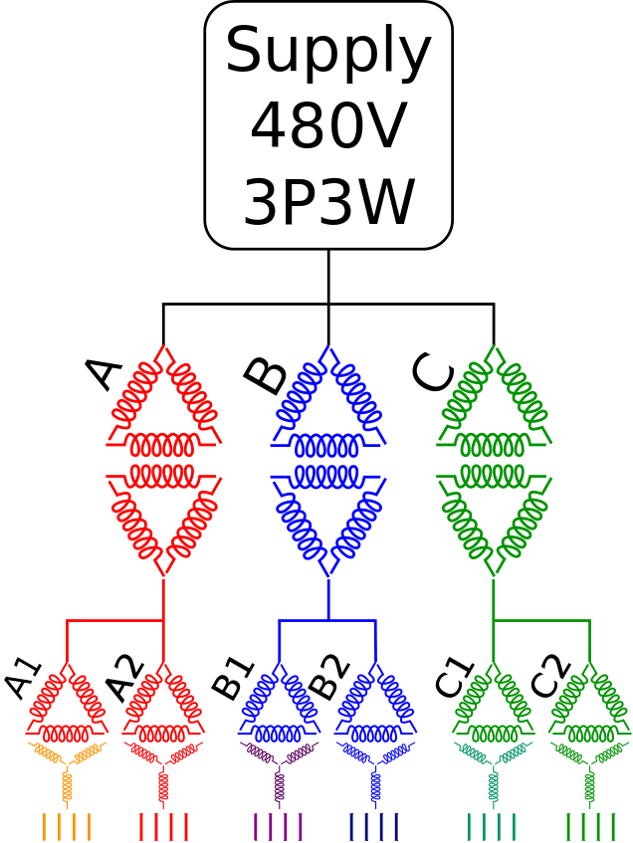
Observed Connectivity Explained

Slide 15
Result: Connectivity → Topology
Power distribution can be counter-intuitive
  Two outlets in the same room may be on different power networks
PLC connectivity reveals power distribution topology
But...
  Now we have disjoint subnetworks

Slide 16
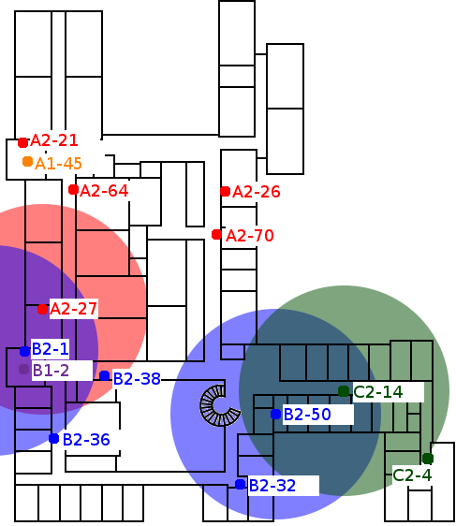
Using Wireless to Bridge the Gaps
PLC connectivity is orthogonal to geography
  Two outlets that could not electrically “see” each other can physically “see” each other

Slide 17
Future Work:
Taking it One Step Further
Add wireless and PLC to every outlet
  Removes idle listening requirement for other sensors
  PLC network become wired and wireless sensor network backhaul
Weird Topology
  Mesh? Route? ...how?

Slide 18
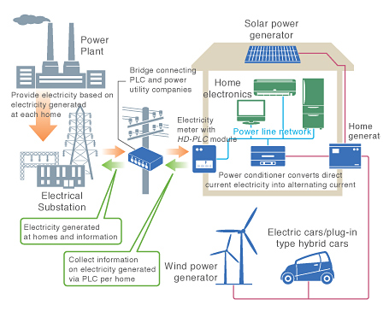
Looking ahead: PLC for deep demand response of Smart Buildings
Future Smart Grid
  Bi-directional data exchange between bldg sources/sinks and utility systems
  Dynamic response based on local grid conditions
PLC networks
  Enable “data follows wires”
  Reduce virtual/physical gap, need to keep two in sync
  Auto-discover loads and topology, even if they move
  Simplify mapping of virtual load “names” to physical load “locations”

Slide 19
Conclusions
PLC is feasible as a sensor network backhaul
  If subnetworks can be connected
Commercial buildings are more electrically complicated than homes
PLC cannot cross transformers
  But can cross phases
  And sometimes connects wirelessly (!)

Slide 20
Questions?
Pat Pannuto
ppannuto@eecs.umich.edu
Prabal Dutta
prabal@eecs.umich.edu

