Slide 1

THE ANALYSIS OF SOFTWARE DEVELOPMENT
WAS
(WAN ACCESS SECURITY)
“AN IMPLEMENTATION OF PORT KNOCKING”
Professor :
Dr Dimitriu Georgios
Graduate Students:
Pantelakis Panagiotis
Mitrou Georgios
Λαμία, Ιούνιος 2018
The University of Thessaly
School of Science
JOINT POSTGRADUATE STUDIES PROGRAMME:
Computer and Telecommunication System Security, on Large Scale Data Management Systems and Simulation

Slide 2
SECTIONS
1. INTRODUCTION
2. TECHNICAL THEORY
3. BASIC PORT KNOCKING
4. THREATS
5. ANALYZING IN DEPTH
6. CONCLUSION

Slide 3
1. INTRODUCTION
1.1 A Short History of Network Security
An important problem in the domain of network security is the plethora of services running on networked machines.
The open ports allow any user to connect to those services and attempt to attack them in any one of countless ways.
Over the years, we have seen many improvements to protocols and even the network stack itself with the aim of making them more resistant to attack.
One primary concern was the notion of authentication, to which there are many solutions, a popular one being the requirement for users to enter a username and password before a service can be used.

Slide 4
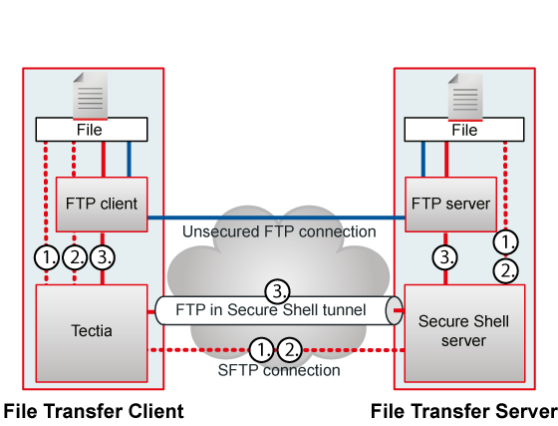
1. INTRODUCTION
1.1 A Short History of Network Security

Slide 5
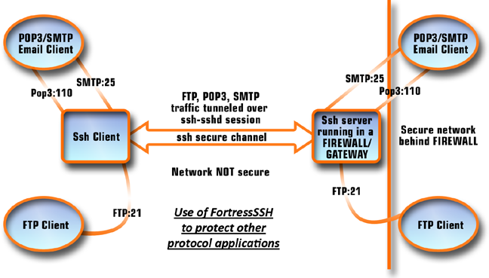
1. INTRODUCTION
1.1 A Short History of Network Security

Slide 6
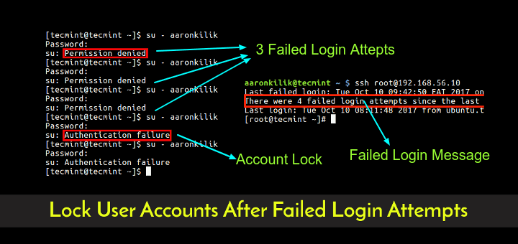
1. INTRODUCTION
1.1 A Short History of Network Security

Slide 7
1. INTRODUCTION
1.2 Enter Port Knocking
One major difficulty in protecting networked machines (especially those running services) is that they are, for the most part, visible and happy to disclose information to anyone who asks.
If a hacker finds a corporate FTP server, he can connect to it and it will gladly tell him exactly what version of what FTP software it is running (if the FTP server hasn’t been hardened, which is usually still the case). He can then use this information to check whether or not that version of the software is vulnerable to a particular attack which would give him root (admin) access to the server machine (or attempt to brute force the username and password).

Slide 8
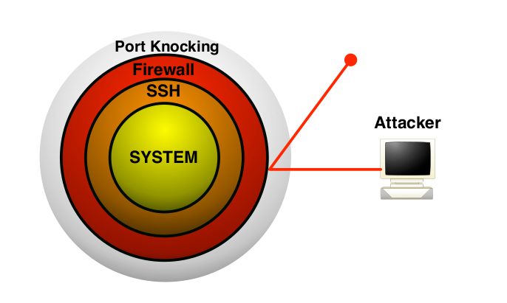
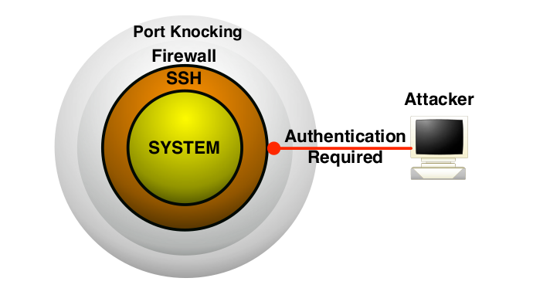
1. INTRODUCTION
1.2 Enter Port Knocking

Slide 9
2. TECHNICAL THEORY
2.1 Networking
Port Knocking schemes are, for the most part, network security methods for authorizing them to use a specific service (this may include performing an action on the protected machine).
2.1.1 Ports
A port is a virtual door (represented by a 16-bit integer) which allows the computer to keep track of which pieces of data are destined for which application or service. A computer has 65535 ports.
Many ports, especially those within the 0-1023 range, are reserved for use with specific services. The vast majority of web servers, for example, run on port 80. There exist many services with their own port numbers such as File Transfer Protocol (port 21), SSH (port 22) and the Post Office Protocol (port 110). Although these port numbers are ‘reserved’ for those services, it is still possible to run a web server, for example, on port 22,

Slide 10
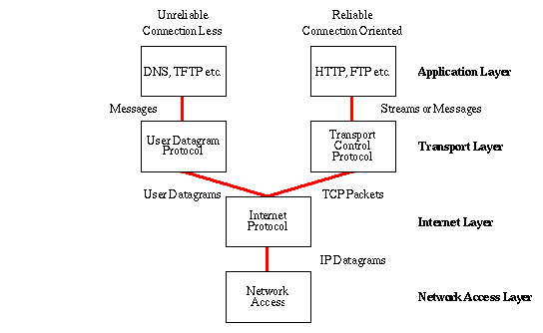
2. TECHNICAL THEORY
2.1.2 TCP, UDP and ICMP
TCP, UDP and ICMP are three of the most important networking protocols used regularly in modern networks.

Slide 11
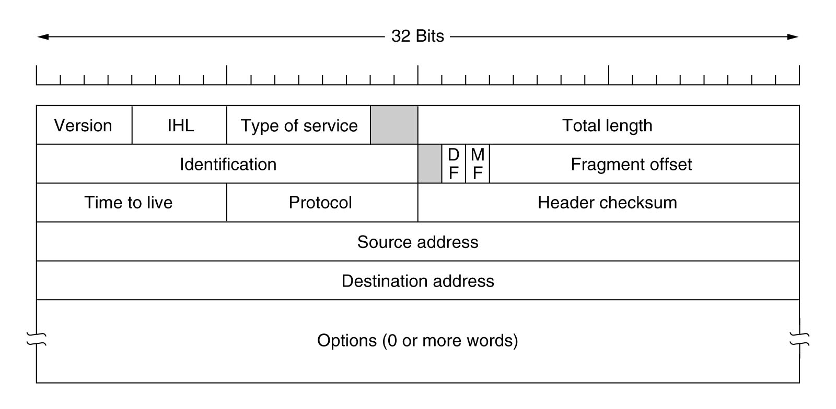
2. TECHNICAL THEORY
2.1.2 TCP, UDP and ICMP
IP Header
struct ip is defined in <netinet/ip.h>, which is a reasonably standard header on UNIX systems.
struct iphdr is defined in <linux/ip.h>. This header (and structure) are Linux-specific, and will not be present in other operating systems.

Slide 12
2. TECHNICAL THEORY
2.1.2 TCP, UDP and ICMP
Transmission Control Protocol (TCP) is a stateful protocol that allows the two machines to create a connection between themselves and exchange information. Such a connection is established by performing the ‘Three-Way Handshake’.
This can be compared to making a telephone call: the initiator dials the number, the receiver picks up and says “Hello?”, at which point the initiator also says “Hello!”, and the conversation can begin until it is ended by either end.
Most applications, such as Email, Web Browsing, and File Transfers, use TCP connections to transfer information.

Slide 13
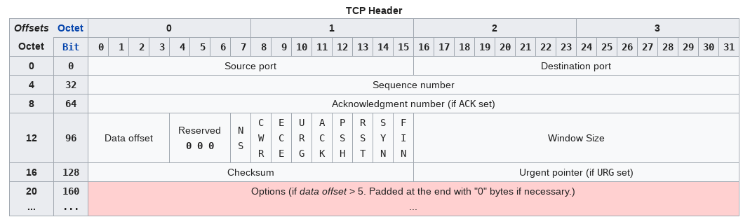
2. TECHNICAL THEORY
2.1.2 TCP, UDP and ICMP
Transmission Control Protocol (TCP) structure

Slide 14
2. TECHNICAL THEORY
2.1.2 TCP, UDP and ICMP
Transmission Control Protocol (TCP) structure
was_tcp_structs.h
struct tcp_header
{
unsigned short int th_sport;
unsigned short int th_dport;
unsigned int th_seq;
unsigned int th_ack;
unsigned char th_x2:4, th_off:4;
unsigned char th_flags;
unsigned short int th_win;
unsigned short int th_sum;
unsigned short int th_urp;
};

Slide 15
2. TECHNICAL THEORY
2.1.2 TCP, UDP and ICMP
The opposite of TCP is the User Datagram Protocol (UDP) which is stateless and so no formal connection is established between communicating hosts.
This can be compared to a postal letter: the sender writes a letter and sends it off to its destination. The letter might arrive at its destination, or it might not, either way the sender will not receive any confirmation. A host sending UDP packets to another host will receive no acknowledgement as to whether or not the packets have been received, this makes UDP a lot faster than TCP, although far less reliable. UDP is suitable for applications which require a rapid rate of transmission, and where reliability is not of up-most importance, such as Audio/Video Chat.

Slide 16
2. TECHNICAL THEORY
2.1.2 TCP, UDP and ICMP
The Internet Control Message Protocol (ICMP) is one of the core protocols of the Internet protocol suite, and is used by networked computers to send error messages, for example when a specified port cannot be reached. In the case that a service is not available or a host cannot be reached, there are a number of ‘control messages’ that end hosts or intermediate routers can use in order to inform other devices of these errors. Applications do not tend to use the ICMP protocol directly (except for the ping command), but in certain cases ICMP can be used to transmit small amounts of information within the data field of the ICMP packet.

Slide 17
2. TECHNICAL THEORY
2.1.3 Three-Way Handshake
The Three-Way Handshake is the protocol that computers use in order to establish a TCP connection with each other.
1. The initiating machine will send a ‘Hello’ (formally called a SYN) packet to a specified host on a specified port. For example, if you browse to http://www.foo.com, your computer will first send the server a SYN packet on port 80 (the default web server port) to the server at www.foo.com. If port 80 is not open on the web server, then your client will not receive a reply (and the connection will fail).
2. However, if port 80 is open, then the web server is listening and will reply to the client with a SYN/ACK packet, acknowledging that it received the first (SYN) packet and requesting a confirmation to complete the connection.
3. Finally, the client will send back an ACK packet, signalling that it confirms the connection

Slide 18
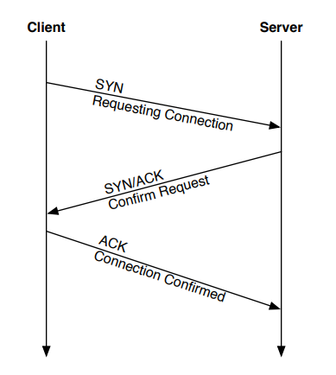
2. TECHNICAL THEORY
2.1.3 Three-Way Handshake

Slide 19
2. TECHNICAL THEORY
2.1.4 Firewalls
Firewalls are an essential network component when it comes to controlling the flow of access in networked environments.
Firewalls can be either hardware, which sits on a network between a trusted side and an untrusted side or software, which runs on the hosts themselves.
In both cases the purpose of the firewall is to provide a logical barrier to prevent unauthorized or unwanted communications between different areas of a computer network.
The ‘Access Control’ mechanisms offered by a firewall rely on a set of administrator defined rules, which are then applied to each and every packet flowing through the firewall. The default rule, which helps satisfy the principle of least privilege, is the ‘default deny’ rule where all traffic is rejected unless explicitly allowed. In this manner, one can be sure that no access is allowed except for the rules that specify an ‘allow’ condition.

Slide 20
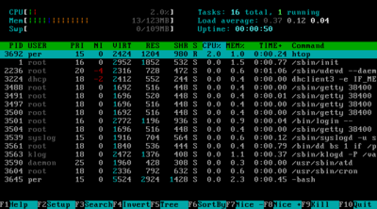
2. TECHNICAL THEORY
2.2 Processes
A process is an instance of a computer program that is being executed. It contains the program code and its current activity. Depending on the operating system (OS), a process may be made up of multiple threads of execution that execute instructions concurrently.

Slide 21
2. TECHNICAL THEORY
2.2 Processes
2.2.1 fork()
System call fork() is used to create processes. It takes no arguments and returns a process ID. The purpose of fork() is to create a new process, which becomes the child process of the caller. After a new child process is created, both processes will execute the next instruction following the fork() system call. We can distinguish the parent from the child by testing the returned value of fork():
If fork() < 0, the creation of a child process was unsuccessful.
If fork() == 0 to the newly created child process.
If fork() > 0, the process ID of the child process, to the parent. The returned process ID is of type pid_t defined in sys/types.h. Normally, the process ID is an integer. Moreover, a process can use function getpid() to retrieve the process ID assigned to this process.

Slide 22
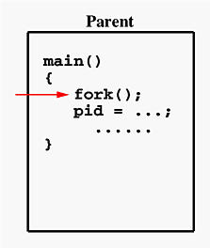
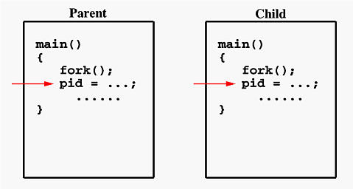
2. TECHNICAL THEORY
2.2 Processes
2.2.1 fork()

Slide 23
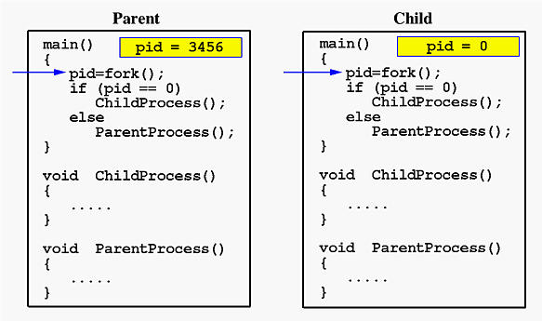
2. TECHNICAL THEORY
2.2 Processes
2.2.1 fork()

Slide 24
2. TECHNICAL THEORY
2.2 Processes
2.2.2 setsid()
setsid() creates a new session if the calling process is not a process group leader. The calling process is the leader of the new session, the process group leader of the new process group, and has no controlling terminal. The process group ID and session ID of the calling process are set to the PID of the calling process. The calling process will be the only process in this new process group and in this new session.

Slide 25
2. TECHNICAL THEORY
2.3 Signals
A signal is a software interrupt delivered to a process. The operating system uses signals to report exceptional situations to an executing program. Some signals report errors such as references to invalid memory addresses; others report asynchronous events, such as disconnection of a phone line.
void was_app_signals( int sig );
signal(SIGHUP, was_app_signals);

Slide 26

2. TECHNICAL THEORY
2.4 Daemons
Daemons work in the background and (usually...) don't belong to a TTY that's why you can't use stdout/stderr in the way you probably want. Usually a syslog daemon (syslogd) is used for logging messages to files (debug, error,...).

Slide 27
2. TECHNICAL THEORY
2.4 Daemons
Steps of creation
- fork off the parent process & let it terminate if forking was successful. -> Because the parent process has terminated, the child process now runs in the background.
- setsid - Create a new session. The calling process becomes the leader of the new session and the process group leader of the new process group. The process is now detached from its controlling terminal (CTTY).
- Catch signals - Ignore and/or handle signals.
- chdir - Change the working directory of the daemon.
- umask - Change the file mode mask according to the needs of the daemon.
- close - Close all open file descriptors that may be inherited from the parent process.

Slide 28
2. TECHNICAL THEORY
2.4 Sockets
socket() creates an endpoint for communication and returns a file descriptor that refers to that endpoint. The file descriptor returned by a successful call will be the lowest-numbered file descriptor not currently open for the process.
The domain argument specifies a communication domain; this selects the protocol family which will be used for communication.
int fd = socket(AF_INET, SOCK_RAW, IPPROTO_TCP);
while(1)
{
if(read(fd, read_buffer, tcp_BUFFER_SIZE) > 0)
...

Slide 29
3. BASIC PORT KNOCKING
The concept of port knocking has been the topic of heated debates in the security community, with large numbers of posts being posted on technology and security site Slashdot.org.
The security community has yet to find a good place for port knocking, but at the same time cannot reach the conclusion that port knocking is insecure or useless. The ongoing discussions about port knocking tend to revolve about what it is exactly that the mechanism tries to achieve.
When it comes down to it, port knocking’s primary aim is to provide an extra layer of protection through the use of authentication.
Port Knocking attempts to fill the void by adding (not replacing) a layer of security, which can be used to authenticate users before they are given access to a service.

Slide 30
3. BASIC PORT KNOCKING
A port knocking daemon sits on the server and watches packets as they are dropped, waiting for a sequence of packets arriving at a predetermined set of ports in order. The client who wishes to connect to the server sends SYN packets (the first packet in a TCP connection) to the predetermined ports in order, for example: ports 100, 110, 120, 130.
The server will receive these packets and drop them silently, however, the port knocking daemon will see these incoming packets and recognise the valid ‘knock’ on the ports.
Once the proper ports have been knocked on, the daemon can execute any predetermined action, for example: open port 22 (SSH) for the IP that knocked. The user who knocked can then connect to the protected machine, and if set up properly, can knock on ports 200, 190, 180, 170 in order to close port 22.
Most good implementations, however, simply close the port automatically after a given amount of time.

Slide 31
3. BASIC PORT KNOCKING
1. Concealment: the server’s firewall is set to DROP all packets and so a scanning or probing attacker will have no clues as to whether or not the server exists, let alone what services it is running.
2. Service Protection: services running on the host (such as SSH) are protected from attacks on unpatched vulnerabilities. One important aspect of this port knocking feature is the fact that it can actually protect against 0day attacks, which are considered extremely difficult to defend against. Even if an attacker possesses an exploit for a vulnerable version of a service running on the protected server, they have no way to mount an attack and deliver that exploit, as all ports on the server are closed to the attacker.
3. User Authentication: by watching the incoming traffic for a predetermined knock, which essentially acts as a secret key known only to the users trusted to use the protected server, the port knocking daemon is able to authenticate the user at the other end before allowing them to connect to any (potentially vulnerable) services.

Slide 32
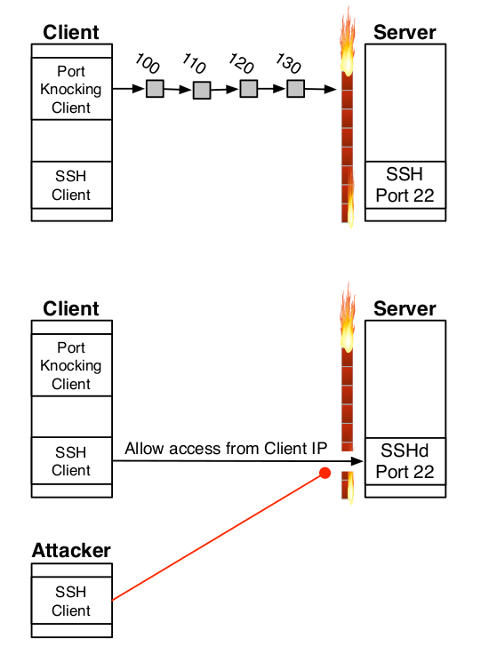
3. BASIC PORT KNOCKING

Slide 33
4. THREATS
Server: this machine is the one protected by port knocking and runs a completely closed Firewall, and a port knocking or SPA daemon capable of executing commands on the server (such as manipulate firewall rules).
Client: this machine will be attempting to connect to the server by providing the correct knock sequence (or authorization packet).
Eve (attacker): is a passive eavesdropper. She has the ability to observe all of the interactions between the Client and the Server but can not modify data in transit between the two.
Mallory (attacker): is an active attacker. He has the ability to sit between the Client and the Server on the network and watch and manipulate the traffic flowing between them.

Slide 34
4. THREATS
Trudy (attacker): this attacker has no access to any protocol exchanges between the Client and the Server, and thus has no ability to observe nor modify to those exchanges. Trudy must attempt to compromise the Server by other means. This is the most common type of attacker.
Trent: this machine is a Trusted Third Party (TTP) which can be used to send traffic from the Client to the Server via another route, thus bypassing Eve and/or Mallory. Note: this is not always possible depending on the position of Eve and/or Mallory on the network!

Slide 35
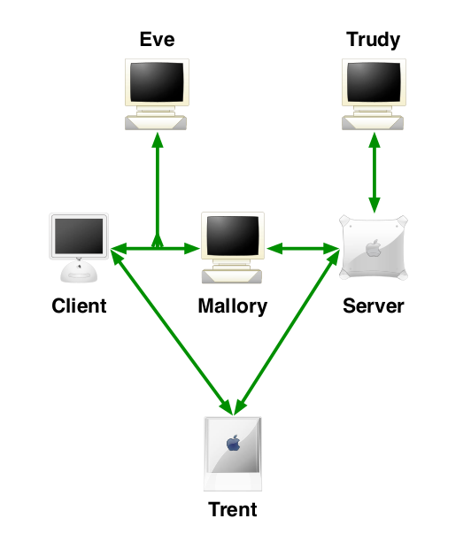
4. THREATS

Slide 36
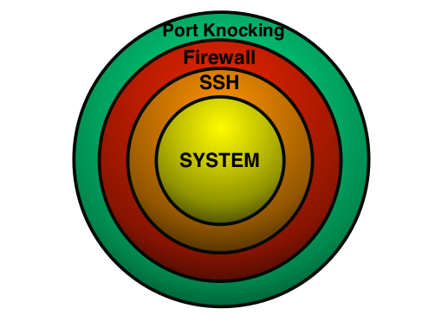
5. ANALYZING IN DEPTH
The problem with networked services is that they are potentially vulnerable to attack, for example, by exploiting bugs in their code, or to simple dictionary attacks.
For these reasons, port knocking allows the services to be hidden from the world, until a valid authenticated user attempts to connect. In this configuration, the firewall is set to drop all traffic silently until a port is opened by the port knocking daemon.

Slide 37
5. ANALYZING IN DEPTH

Slide 38
5. ANALYZING IN DEPTH
Security through Obscurity
“Security through Obscurity” is when the details about a security implementation or mechanism are hidden, in order to protect the mechanism from being analysed and flaws discovered, which may enable the mechanism to be compromised in some manner.
“If I take a letter, lock it in a safe, hide the safe somewhere in New York, then tell you to read the letter, that’s not security. Thats obscurity. On the other hand, if I take a letter and lock it in a safe, and then give you the safe along with the design specifications of the safe and a hundred identical safes with their combinations so that you and the worlds best safecrackers can study the locking mechanism – and you still can’t open the safe and read the letter – thats security.”, Bruce Schneier

Slide 39
5. ANALYZING IN DEPTH
Two main types of port knocking daemons used in implementations:
• Log Readers: Traditional port knocking schemes have the option to read IP headers of the dropped packets in the firewall logs. The firewall logs are in a standard format, and since the daemon is only interested in which IP knocked, and which port it knocked on, it would be difficult to attempt to corrupt the port knocking daemon by crafting a malicious SYN packet.
• Packet Sniffers: Most port knocking and SPA daemons, use packet sniffers (such as libpcap) which allow them to read incoming knocks straight off the wire. This is necessary, in the case of single packet authorization, as the daemon must have access to the payload of the knock packet, and not just the headers. Due to the fact that the daemon is reading the actual packet content and then parsing it to obtain the enclosed knock, it could be possible to create a malicious packet with the aim of exploiting the single packet authorization daemon.

Slide 40
5. ANALYZING IN DEPTH
Because the ethernet card must be in promiscuous mode, the daemon that implements the port knocking, must run as a privileged user, otherwise the read command will return error due to unsufficient privileges.

Slide 41
6. CONCLUSIONS
What is port knocking? Port knocking is essentially an extension of defence in depth - another layer in our security onion - and another tool in the security specialist’s box of tricks which aims to perform a very specific task.
The two primary concerns that remain with port knocking schemes are denial of service and man in the middle attacks. As with any protocol, there are indeed ways to perform DoS attacks on port knocking, although in certain cases this may actually be preferable as it results in a more secure machine.

Slide 42
SECTIONS
1. INTRODUCTION
2. TECHNICAL THEORY
3. BASIC PORT KNOCKING
4. THREATS
5. ANALYZING IN DEPTH
6. CONCLUSION

Slide 43

THANK YOU!!!

Slide 44
THE ANALYSIS OF SOFTWARE DEVELOPMENT
WAS
(WAN ACCESS SECURITY)
“AN IMPLEMENTATION OF PORT KNOCKING”
Professor :
Dr Dimitriu Georgios
Graduate Students:
Pantelakis Panagiotis
Mitrou Georgios
Λαμία, Ιούνιος 2018
The University of Thessaly
School of Science
JOINT POSTGRADUATE STUDIES PROGRAMME:
Computer and Telecommunication System Security, on Large Scale Data Management Systems and Simulation

