Slide 1
Technical overview of single-cell transcriptomics methods.
1. collecting single cells.
2. general scRNA-seq methods for plate / C1 formats: template-switch versus T7.
3. droplet-based scRNA-seq: Drop-Seq / InDrop / 10x platforms.
4. Combinatorial indexing approaches for scRNA-seq.
5. Integrated multi-omics approaches.
Sébastien Smallwood – FMI
{BC}² conference 2017

Slide 2
SUPeR-Seq
F.Tang 2009
Quartz-Seq
Template-Switch Based
PCR amplification of “full length” cDNA
T7-based
Linear amplification of cDNA
STRT-seq
SmartSeq
CEL-seq
CEL-seq2
MARS-seq
BAT-seq
C1
SmartSeq2
SCRB-seq
MATQ-seq
C1
InDrop
sNuc-Seq
Div-Seq
Drop-Seq
10x
DroNc-Seq
Combinatorial indexing
Nanowells
sci-RNA-seq
Seq-Well
SPLiT-seq
STRT-seq-2i

Slide 3
SUPeR-Seq
F.Tang 2009
Quartz-Seq
Template-Switch Based
PCR amplification of “full length” cDNA
T7-based
Linear amplification of cDNA
STRT-seq
SmartSeq
CEL-seq
CEL-seq2
MARS-seq
BAT-seq
C1
SmartSeq2
SCRB-seq
Many methods, many “copies”
common / specific issues…
little extensive comparisons…
MATQ-seq
InDrop
C1
sNuc-Seq
Div-Seq
Drop-Seq
10x
DroNc-Seq
Combinatorial indexing
Nanowells
sci-RNA-seq
Seq-Well
SPLiT-seq
STRT-seq-2i

Slide 4
Collecting single cells
Plate format
FACS (cells + nuclei) directly in lysis buffer.
Accurate (96+384 plates), if good prep low doublets assumed.
Enrich for specific populations with known markers.
Mouth pipetting under microscope for very precious samples (e.g. early embryos).
Accurate, even if doublets can be hard to discard.
Low throughput + time consuming + skills.
Combination with Patch-clamp for neurons.
Laser Capture Microdissection.
Plates / strips with isolated single cells can be stored at -80C in lysis buffer.
C1
Cells captured directly on the microfluidic chip.
Possibility to visualise the cells in “high” definition on the chip (fluorescent marker?)
Cells have to be “healthy” + size restrictions.
Capture rate low -> not so compatible with rare cells.
Past (?) issues with doublets…..
Droplet-based
Cells are encapsulated in oil droplets using microfluidics devices.
Capture rate: Drop-seq: low | InDrop: very high with optimisations | 10x ~40-50%
Doublets rate can be relatively high: 1-5%.
Ongoing 2017: can be used with fixed cells: very useful.
compatible with nuclei from fresh / frozen tissues: neuro+++ (DropNc-Seq / 10x?)

Slide 5
Template-Switch Based
PCR amplification of “full length” cDNA
T7-based
Linear amplification of cDNA
STRT-seq
SmartSeq
MARS-seq
CEL-seq
CEL-seq2
C1
C1
SmartSeq2
SCRB-seq
MATQ-seq
InDrop
sNuc-Seq
Div-Seq
Drop-Seq
10x
DroNc-Seq
Combinatorial indexing
Nanowells
sci-RNA-seq
Seq-Well
SPLiT-seq
STRT-seq-2i

Slide 6
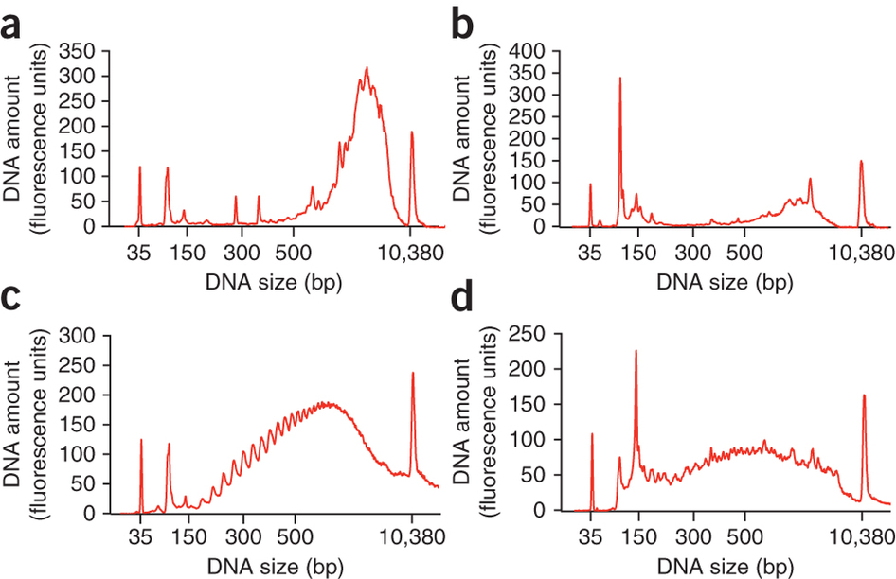
Template-Switch Based approaches with plate format: SmartSeq2
Cell Lysis and Poly-A capture (ERCC)
AAAAAAAA
TTTTTTTT-(PCR)
RT + Template-Switch
Single tube
(PCR)-GGG
AAAAAAAA-(PCR)
(PCR)-
CCC
TTTTTTTT-(PCR)
PCR preamplification using (PCR)
18-19 cycles depending on cell type
(PCR)-GGG
AAAAAAAA-(PCR)
(PCR)-CCC
TTTTTTTT-(PCR)
Purification
Intact mRNA
Degraded mRNA
Picelli et al. Nat. Methods 2013

Slide 7
Template-Switch Based approaches with plate format: SmartSeq2
Cell Lysis and Poly-A capture (ERCC)
AAAAAAAA
TTTTTTTT-(PCR)
RT + Template-Switch
Single tube
(PCR)-GGG
AAAAAAAA-(PCR)
(PCR)-
CCC
TTTTTTTT-(PCR)
PCR preamplification using (PCR)
18-19 cycles depending on cell type
(PCR)-GGG
AAAAAAAA-(PCR)
(PCR)-CCC
TTTTTTTT-(PCR)
Purification
Illumina library preparation using Nextera XT
(PCR)-GGG
AAAAAAAA-(PCR)
(PCR)-CCC
TTTTTTTT-(PCR)
P5
P7
Picelli et al. Nat. Methods 2013
i5
i7

Slide 8
Template-Switch Based approaches: SmartSeq2 / STRT-Seq / SCRB-Seq
SmartSeq2
(PCR)-GGG
AAAAAAAA
CCC
TTTTTTTT-(PCR)
STRT-Seq
(PCR)—(UMIs)GGG
AAAAAAAA
CCC
TTTTTTTT-(PCR)
SCRB-Seq
(PCR)-GGG
AAAAAAAA
CCC
TTTTTTTT-(UMIs)-(BC)-(PCR)
SmartSeq2: full length / no UMIs / ~300 cells per week
STRT-Seq: 5’ sequencing / UMIs / ~300 cells per week
SCRB-Seq: 3’ sequencing / UMIs / ~1000 cells per week
sNuc-Seq / Div-Seq -> SmartSeq2 on nuclei…
Islam et al. Genome Research 2011 | Soumillon et al. bioRxiv 2014

Slide 9
Template-Switch Based
PCR amplification of “full length” cDNA
T7-based
Linear amplification of cDNA
STRT-seq
SmartSeq
MARS-seq
CEL-seq
CEL-seq2
C1
C1
SmartSeq2
SCRB-seq
MATQ-seq
InDrop
sNuc-Seq
Div-Seq
Drop-Seq
10x
DroNc-Seq
Combinatorial indexing
Nanowells
sci-RNA-seq
Seq-Well
SPLiT-seq
STRT-seq-2i

Slide 10
T7 Based approaches – Plate format
CEL-Seq2
Hashimshony et al.
Genome Biology 2016
Cell 1
AAAAAAAA
AAAAAAAA
Cell 2
TTTTTTTT-BC1-UMI-P5-T7
RT
TTTTTTTT-BCn-UMI-P5-T7
AAAAAAAA
TTTTTTTT-BC2-UMI-P5-T7
Cell n
AAAAAAAA
2d strand synthesis
TTTTTTTT-BCn-UMI-P5-T7
AAAAAAAA-BCn-UMI-P5-T7
TTTTTTTT-BCn-UMI-P5-T7
Pool all cells
+ purification
T7 ivt
Linear amplification
P5
P7
UMI-BC
i7
BCn-UMI-P5
BCn-UMI-P5
BCn-UMI-P5
PCR and indexing
AAAAAAAA-BCn-UMI-P5-T7
TTTTTTTT-BCn-UMI-P5-T7
RNA purification
P7-NNNNNN
RT +
Integration of
Illumina “P7”
BCn-UMI-P5
BCn-UMI-P5
BCn-UMI-P5
BCn-UMI-P5

Slide 11
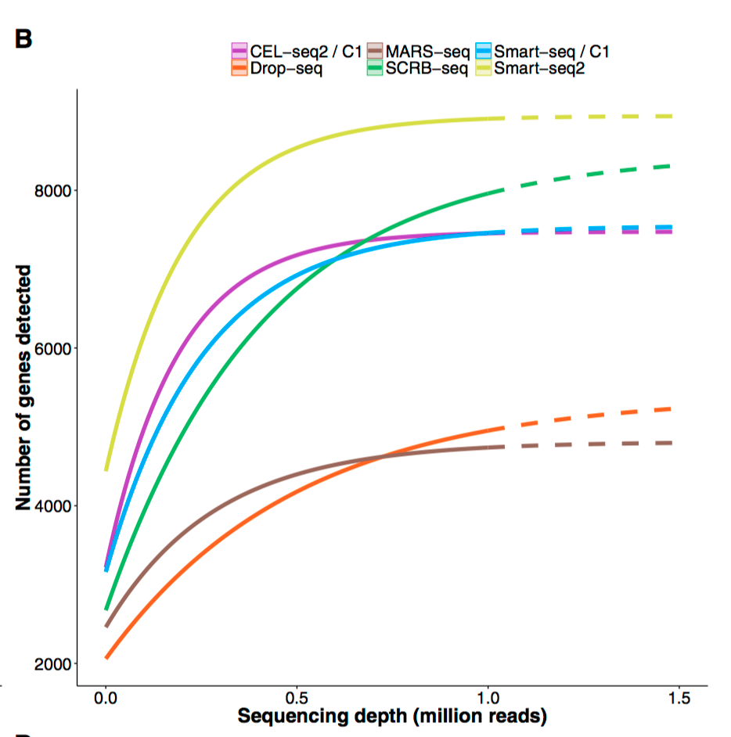
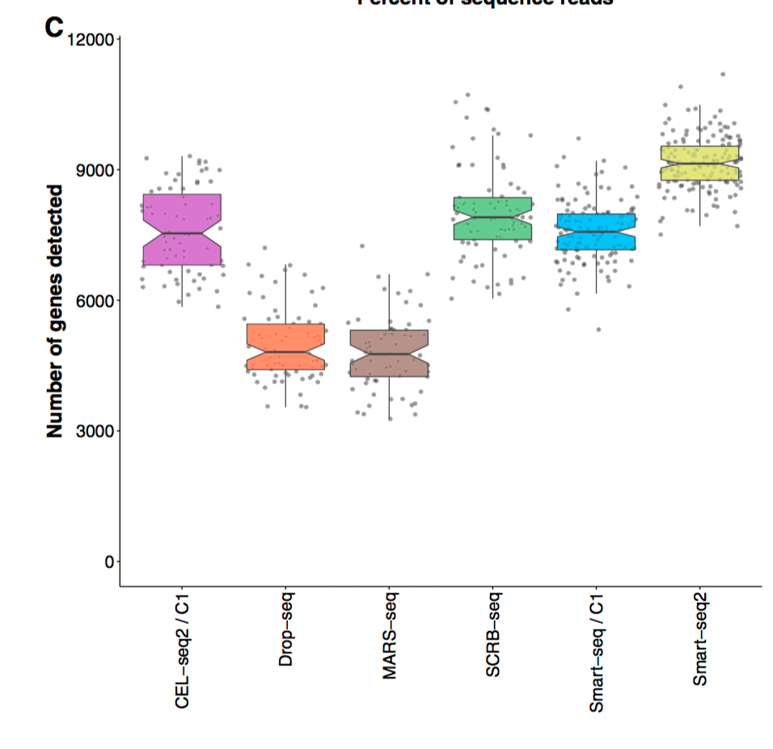
Pros & Cons of Template-Switch versus T7.
Template-switch based:
Pros: Fast, easy and reliable. Single tube until preamp: safe for precious samples.
Cons: mRNA capture depends on poly-A and Template-switch efficiency.
PCR amplification -> biais. Nextera -> fast but not 100% reliable / loss of complexity
T7 based:
Pros: Linear Amplification. mRNA capture depends only on poly-A.
Cons: Longer and more complex protocols.
Pooling and purification of samples before amplification -> loss of material
-> Both approaches are valid. Key is mRNA capture and RT efficiency. Rest is “less” crucial
Ziegenhain et al.
Mol. Cell 2017

Slide 12
Template-Switch Based
PCR amplification of “full length” cDNA
T7-based
Linear amplification of cDNA
STRT-seq
SmartSeq
MARS-seq
CEL-seq
CEL-seq2
C1
C1
SmartSeq2
SCRB-seq
MATQ-seq
InDrop
sNuc-Seq
Div-Seq
Drop-Seq
10x chromium
DroNc-Seq
Combinatorial indexing
Nanowells
sci-RNA-seq
Seq-Well
SPLiT-seq
STRT-seq-2i

Slide 13
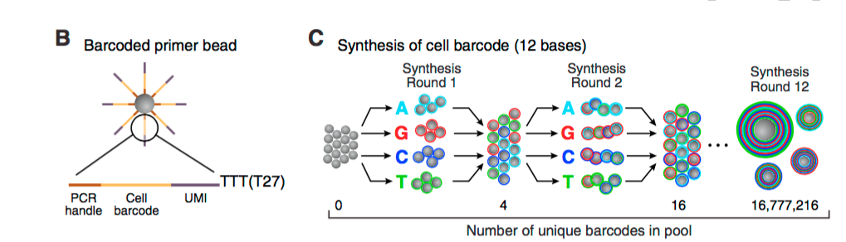
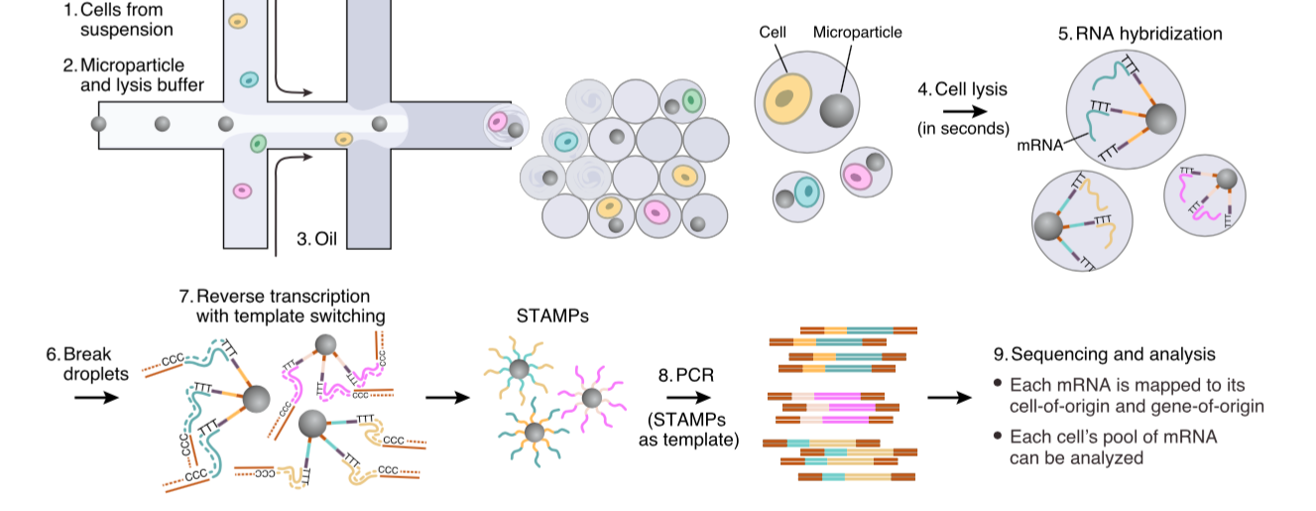
Drop-seq: Template-switch Based
SCRB-Seq
(PCR)-GGG
AAAAAAAA
CCC
TTTTTTTT-(UMIs)-(BC)-(PCR)
Drop-seq
barcodes
Macosko et al. Cell 2015

Slide 14
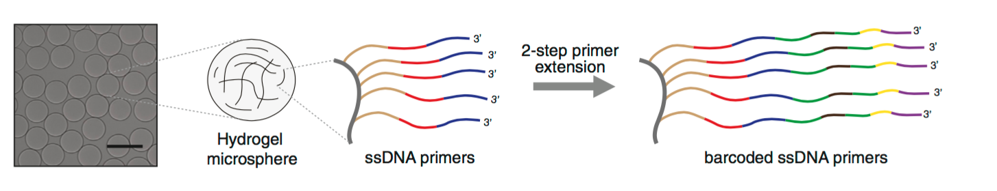
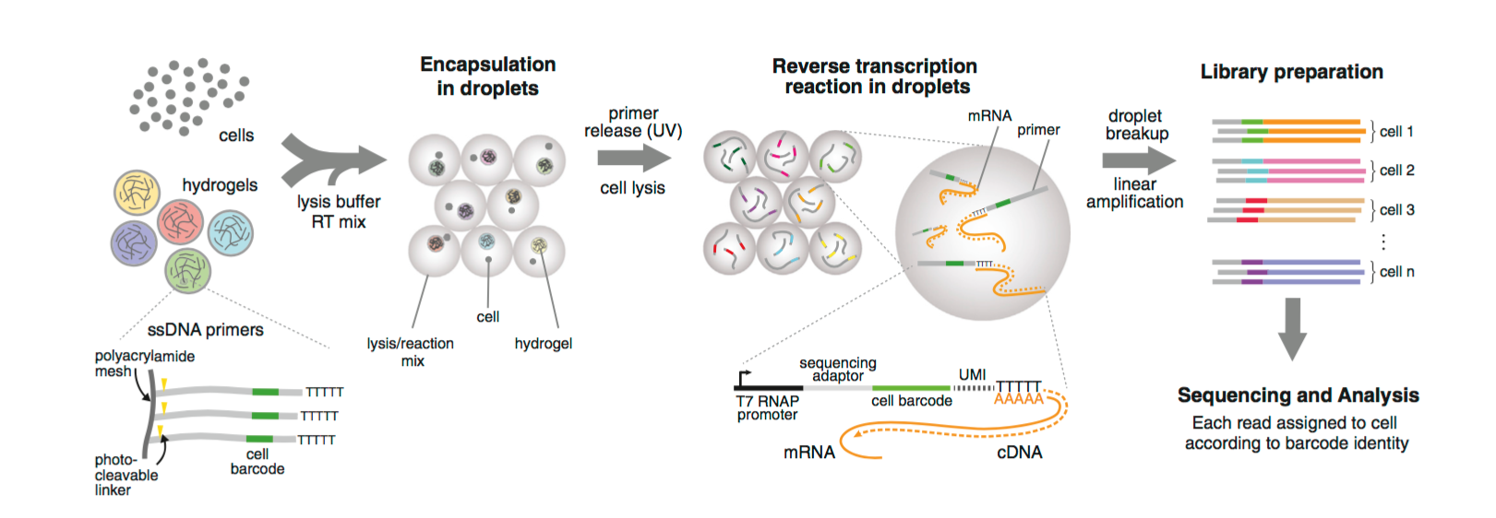
InDrop: T7-based
Klein et al. Cell 2015

Slide 15
Drop-seq versus InDrop
Drop-seq:
Pros: Widely adopted as beads barcodes / chips commercially available.
Cons: RT outside droplets - issue with ”ambient” RNA (cells BC with low UMIs)
High variability between set-ups…good and bad datasets out-there...
Capture rate low.
InDrop:
Pros: Quality is better than Drop-seq
Gel beads + RT within droplets (higher sensitivity).
High capture rate.
Cons: Very challenging to make gel beads and barcodes (robotics helpful).
Microfluidics chips to be “made” (2 types of chips)
Now commercial solutions available, but 10x ...

Slide 16
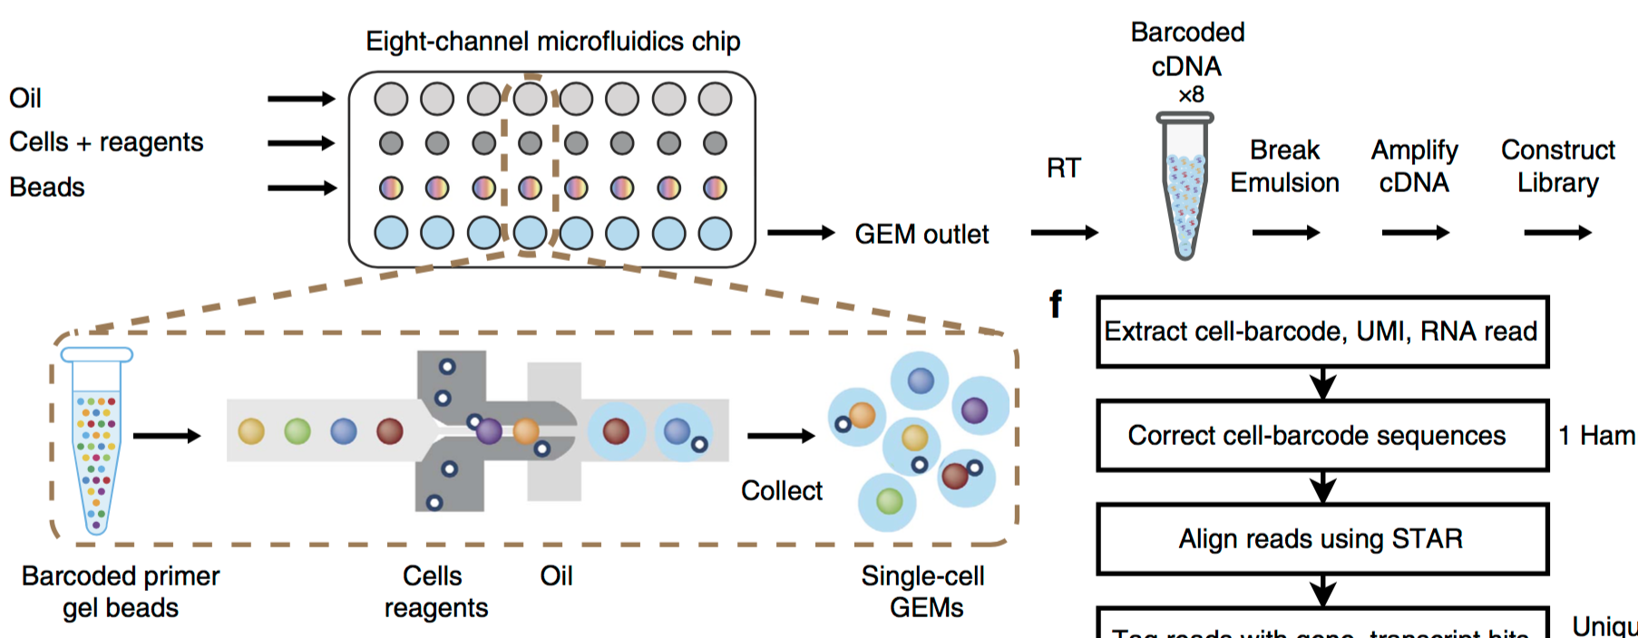
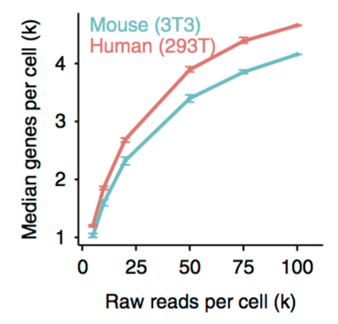
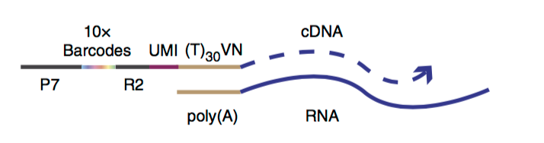
10x Chromium: a combination of Drop-seq and InDrop.
Gel beads + RT in droplets + template-switch approach
Zheng et al. Nat. Communications 2017

Slide 17
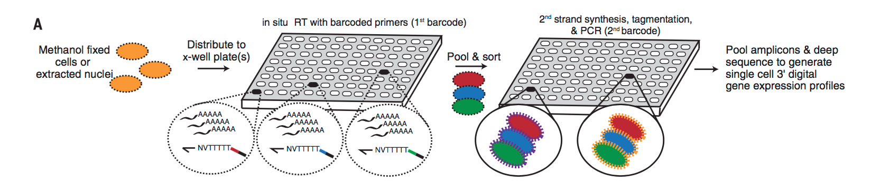
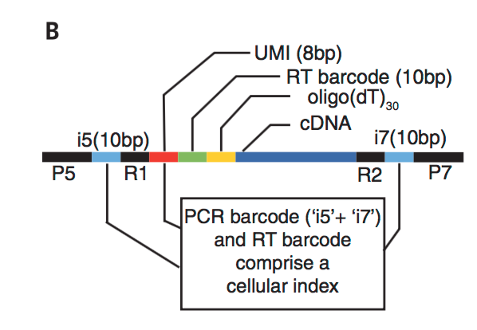
scRNA-seq using combinatorial indexing approaches:
sci-RNA-seq
~4500 genes per mouse cell (3T3) - similar to 10x chromium….(?)
Can process 1,000s of cells per experiment (potential for 10,000s-100,000s)
Cao et al. Science 2017

Slide 18
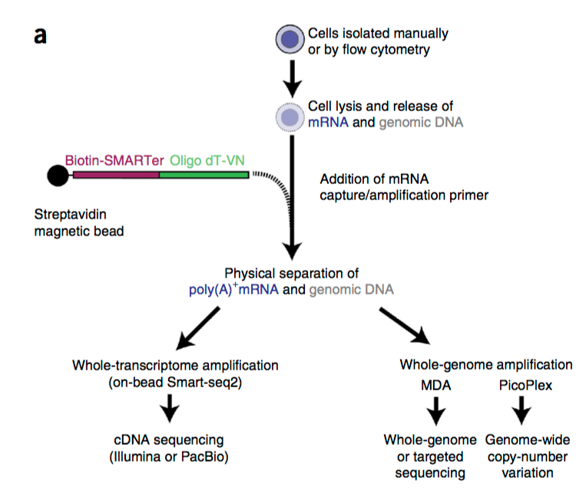
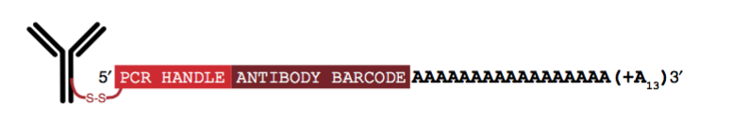
Integrated multi-omics approaches.
multi-layer information from the same single cell.
G&T-seq
CITE-seq: cellular proteins / epitopes + transcriptome
Stoeckius et al. Nat. Methods 2017
gDNA sequencing
scBS-Seq => transcriptome + DNA methylation
scNOME-Seq => transcriptome + DNA methylation + nucleosome positioning
Macaulay et al. Nat. Methods 2015
Smallwood et al. Nat. Methods 2014
Clark et al. bioRxiv 2017
Integrated multi-omics approaches are the future….
Transcriptome + DNA methylation
+ open chromatin / TF binding (ATAC-seq)

