Slide 1
Lesson Learned “Developing a predictive model for text prediction”
Paracchini Pier Lorenzo
Notes:
Who I am – short introduction
SI sector Statoil, Software Generalist with a passion for Agile and Data Science (new)
Quick overview of the data science specialization (Coursera, JHU)
“This Specialization – 10 modules - covers the concepts and tools you'll need throughout the entire data science pipeline, from asking the right kinds of questions to making inferences and publishing results. In the final Capstone Project, you’ll apply the skills learned by building a data product using real-world data. At completion, students will have a portfolio demonstrating their mastery of the material.”
Main focus of this presentation
Share the experience/ lesson learned developing a predictive model for text prediction

Slide 2



The Challenge: Build an app for «next word» prediction
“Around the world, people are spending an increasing amount of time on their mobile devices for email, social networking, banking and a whole range of other activities. But typing on mobile devices can be a serious pain. ”
When someone types:
“I went to the …”
the application should presents three options for what the next word might be. For example, the three words might be “gym”, “store”, “restaurant”.
Notes:
Overview of the Challenge
This is the Data Science Capstone project – the last module of the Data Science Specialization at Coursera (Massive Open Online Courser) created by JHU in partnership with SwiftKey.
The intention is to challenge students to create a usable/public data product that can be used to practice acquired skills from the previous modules and build up some real experience with realistic challenges.
Describe the challenge
The project involves developing a predictive model of text using a really large,unstructured database of the English language the HC corpora.
Some useful links
https://www.jstatsoft.org/article/view/v025i05
https://cran.r-project.org/web/views/NaturalLanguageProcessing.html
https://www.coursera.org/course/nlp

Slide 3



The Supporting Data (Corpora): 3 corpus – twitter (tweets), news and blogs English language
“Large databases comprising of text in a target language are commonly used when generating language models for various purposes.”
Blogs
899.288 blogs
2.360.148 tweets
News
1.010.242 news
Notes:
http://www.corpora.heliohost.org/
HC corpora is a collection of corpora for various languages freely available to download. The corpora have been collected from numerous different webpages (web crawler), with the aim of getting a varied and comprehensive corpus representing the current use of the respective language. Using many different types of sources, such as newspapers, magazines, (personal and professional) blogs and Twitter updates.
The corpora used for the Capstone project is a subset of the HC corpora – see numbers.
Note!! Number of entries as tweets, number of entries as blogs, number of entries as news.

Slide 4


The Process
Week#1:
Overview, Understanding the Problem & Getting the data
Week#2:
Exploratory Data Analysis & Modeling
Week#7 & #8:
Submission & Evaluation
Milestone Report
Product (shinyApp)
Week#3:
Prediction Model
Week#6:
Product Presentation Deck
Prediction Model Evaluation
Slide Deck
Week#4:
Creative Exploration
Week#5:
Product Design & Development
Prediction Model Evaluation
Notes:
The process used for doing the actual work is following the Cross Industry Standard Process for Data Mining, commonly known by its acronym CRISP-DM. It was a data mining process model (conceived in 1996/ 1997) that describes commonly used approaches that data mining experts use to tackle problems. Polls conducted at one and the same website (KDNuggets) in 2002, 2004, 2007 and 2014 show that it was the leading methodology used by industry data miners who decided to respond to the survey.[

Slide 5
Understanding the challenge Foundation of Statistical NLP
What do I need to do to solve the challenge at hand?
What type of data structure do I need to
create language models?
Uni-grams
Basic Models
(MLE) n-grams
model
Bi-grams
N-grams
Model Evaluation
Perplexity
Practical Issues
Overfitting
Zeros
Improved Models
Smoothing
Backoff
What type of issues do I need to be aware of?
And how can I avoid them?
Notes:
A more high level overview of the language model domain. Data structures, common issues and their work aorund …..

Slide 6
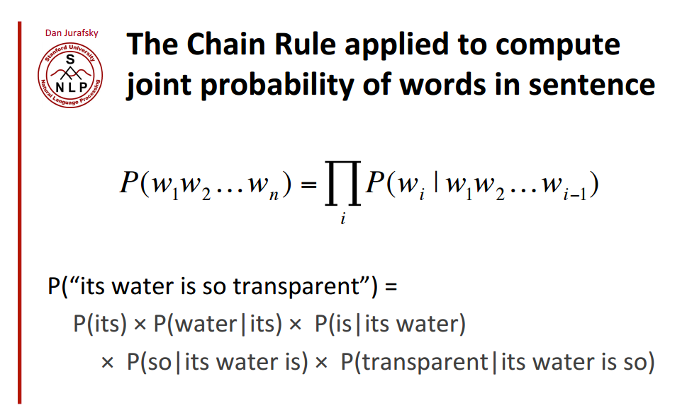
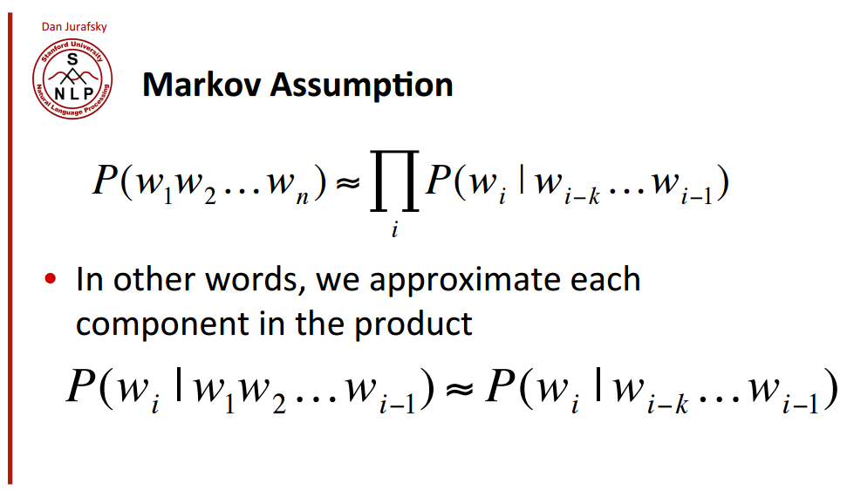
Understanding the challenge Foundation of Statistical NLP
Based on the provided Corpora
(Probabilistic)
Language Model
P(S) = P(w1, w2, .., wn) or P(wn|w1,w2,..,wn-1)
(Probabilistic)
N-gram Model
Notes:
The Challenge is to find the most probable next word given that the user has entered or given a sequence of words …
A probabilistic language model allows to assign a probability/ score to a sentence or a sequence of words and can be used to resolve the given problem: predict the most probable words given part of a sentence (text prediction)
How can we estimate the probability of a word w given a history h or the probability of the sentence S?
One possible approach is to use the Chain Rule of probability (general product rule) – which permits the calculation of the joint distribution of a set of random variables using only conditional probabilities. The chain rule shows the link between computing the joint probability of a sequence of words and computing the conditional probability of a word given previous words.
Instead of computing the probability of a word given all of the previous words (complex), we can just approximate the history by just considering the last few (k) words (Markov Assumption and the n-gram model).

Slide 7
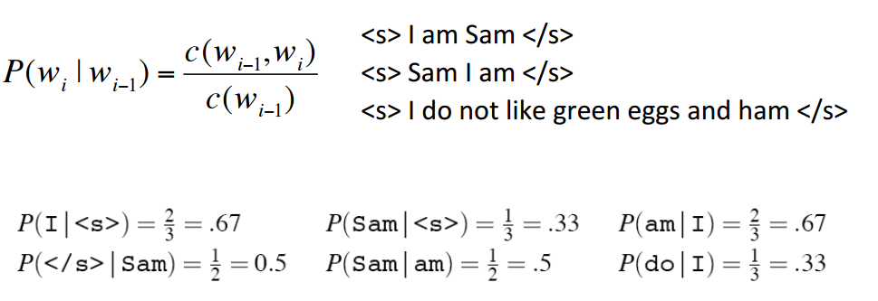
An example: Bi-gram Model (Markov Assumption)
P(S) = P(w1, w2, .., wi) = P(w1|<s>) P(w2|w1) P(w3|w2) ...
MLE
Corpus
Understanding the challenge Foundation of Statistical NLP
Notes:
The Maximum Likelihood Estimate (MLE)

Slide 8



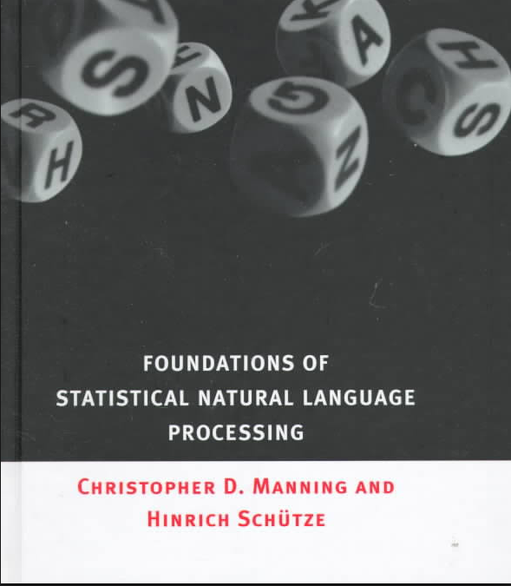
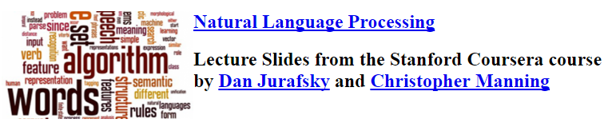
Understanding the challenge Foundation of Statistical NLP - References

Slide 9


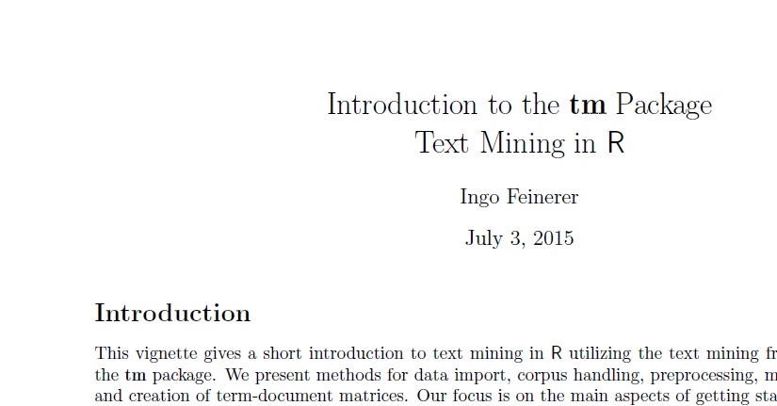
Understanding the challenge Technology Support
[Technology] R packages
For
Natural Language Processing
Package Vignettes
Notes:
There are lots of packages available for Natural Language Processing – which one is the best for the challenge at hand? Based on the needed data structure
tm package – text mining package for the creation of the TDM/ DTM and the TFM
RWeka for supporting splitting into sentences (Sentence Isolation) and Tokenization (custom rules)

Slide 10
Data Understanding & Preparation
How to read the data?
The Corpora is quite big and
R uses in-memory data structure ….
Splitting the data & Exploring the data…
Is there anything peculiar in the available data? What should I look for?
Data preparation [Feature Engineering]
What do we need to do on the data in order to get required features to be used to create the models? Uni-grams, bi-grams, tri-grams and n-grams?
Identify preliminary Ingestion Process….
Identify steps to clean and prepare the required data (iterative development)….
How to increase the % of corpora?
Used to create the “processed” data
From 5% to 60% - a learning experience ….
See Data Exploration Report

Slide 11
The Ingestion Process: the basic flow
Reduce Term Document Matrices (TDM) to Term Frequency Matrices (TFM) for unigrams, bigrams and trigrams.
Example for unigrams:
Term, Frequency
the, 477030
10% of the original corpora for creating the language model (random sampling).
Removing short entries – less than 50 chars.
Adding start/ end sentence markers
Removing gremling (encoding issue)
Removing some contractions (u, r, u.s, ...)
Removing links, «RT»
Random Sampling
Sentence Isolation
Cleaning
Create TDM
Transform TDM to TFM
CORPORA
Splitting up each entry (tweet, news, blog) into separate sentences.
Create the Term Document Matrices (TDM)
*tolower
*remove profanity words
*remove numbers
* remove punctation (except apostrophe)
* tokenize in n-grams
For unigrams, bigrams and trigrams
Notes:
Iterative development – the current knowledge shapes the past and the future.

Slide 12
The Ingestion Process: increasing the % of corpora used
Merging the TFM
Basic Flow - Create TFM #1
10%
TFM
based on 60% Corpora
CORPORA
10%
Basic Flow - Create TFM #..
10%
Basic Flow - Create TFM #6
Random Sampling
Using specific seeds for reproducibility
See Ingestion Report
Notes:
One of the big challenge is how to process this amount of data in a “reasonable” amount of time – profiling in R of functions used to clean/ process the data becomes sth that need to be done.
What works well with a limited dataset, it is not sure that it is going to work well with a bigger dataset (e.g. reducing the TDM/DTM to a TFM)
Why 10%? Fail & try … More than 10% ….. Taking a lot of time to ingest the data so the idea was to keep small chunk and run parallel process in order to reduce the overall ingestion time.

Slide 13
Modelling & Evaluation
Test dataset for evaluation
20% of the corpora (testing dataset) <-> ad-hoc non biased dataset
Another dataset for optimization
20% of the corpora (optimization of linear interpolation)
Which model can be used?
Identify the possible models to be used (experiment) & implement them
(use a TDD approach to save time – unit test the created models)
Model Evaluation & Optimization
How to evaluate the model? How to optimize the model?
Which one is the best model?
How to optimize the model for a mobile app? Memory/ processing constraints?
Notes:
When evaluation the models and optimizing the models – new knowledge is created on the original corpora and such knowledge is going to be used for improve the ingestion process. Adding new cleaning steps – covering new patterns that were overlooked before.
During the model evaluation – you will start to experience some of the common problems with language models – overfitting and zeroing. Model will be improved accordingly in order to overcome such limitations.
It is a iterative process by nature. The learning of today will affect the artefacts made yesterday – in order to evolve them. It could go on and on forever but there is a time constrain and a certain point you need to acknowledge that it could be improve but this is good enough.

Slide 14
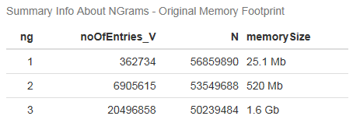
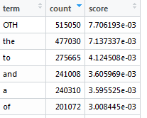
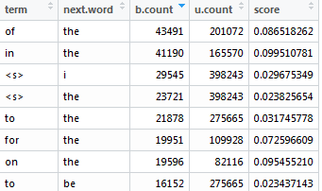
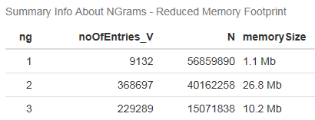
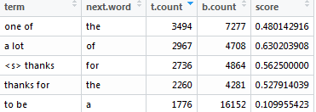
The Model Creation ....
Calculate the «Stupid» backoff score and create an ad-hoc data structure representing the language the model.
TFM
(input)
«Stupid» backoff Algorithm
Language Model
(output)
Reduce TFM
(input) Term Frequency Matrices (TFM) for unigrams, bigrams and trigrams.
(Output) the language model
Reducing the vocabulary in order to decrease the memory footprint of the model

Slide 15



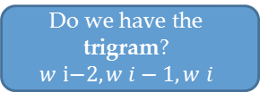
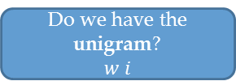

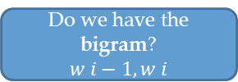
The Language Model: «Stupid» backoff....
Do we have the trigram?
$$w \text{i}\text{−2}, w i−1, w i$$
$$\frac{count\left(w \text{i}\text{−2}, w i−1, w i\right)}{count(w i−2, w i−1)}$$
[yes]
[no]
Do we have the bigram?
$$w i−1, w i$$
$\frac{count\left(w i−1, w i\right)}{count(w i−1)}$ * 0.4
[yes]
[no]
Do we have the unigram?
$$w i$$
$\frac{count\left(w i\right)}{N}$ * 0.4* 0.4
[yes]
«OTH» has been introduces when reducing the unigram vocabulary size. All left out unigrams have been associated to «OTH».
[no]
$\frac{count\left(OTH\right)}{N}$ * 0.4 * 0.4
Different models have been implemented: n-grams (n = 1,2,3), linear interpolation (n-grams, n = 1,2,3) with Good Turing smoothing and "Stupid" backoff (with no discount). The model evaluations has been done using the perplexity measurement and an ad-hoc testing dataset (around 40 sentences).
The "Stupid" backoff model was the one able to minimize the perplexity measurement.

Slide 16
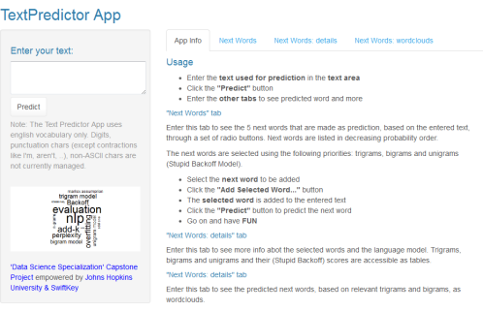


The Technology Stack
R markdown
shinyapp
RStudio
Rpres
base {pkg}
OpenNLP
ggplot2
tm
wordcloud
Rweka

Slide 17
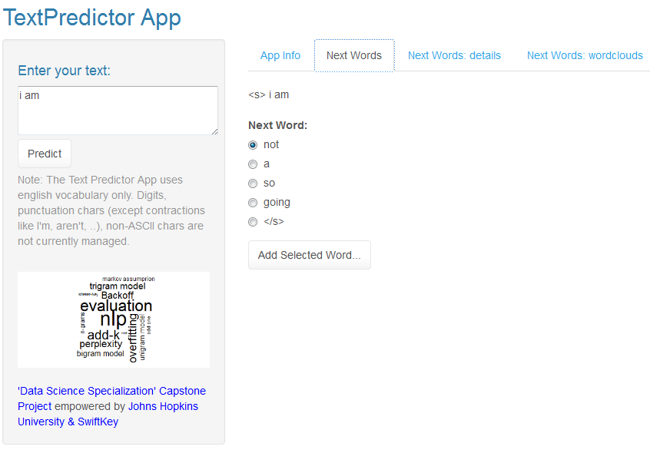
Basic Info on how to use the App
(probable)
Next Words – 5 most likely
Details (from the model) about the predicted next words
[Message Area] Area where to type your message ...
Next Word Wordclouds (for bigrams & trigrams)
Predicted Next Words (ordered by decreasing score)
A next word can be selected/ added using «Add selected Word...» button/ or can be manually entered in the [Message Area].
So a new prediction for the next word can be done.
To make a prediction for next words

Slide 18
Live Demo
Notes:
https://pparacch.shinyapps.io/TextPredictorApplication/

Slide 19

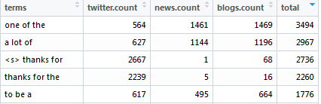
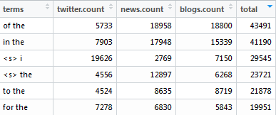
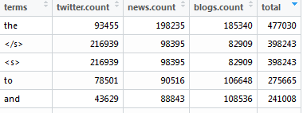
The Ingestion Pipeline – part 1
Uderstanding the data
Exploratory Analysis
Data Structures
(performance, memory footprint)
Cleaning the data
Preparing the data
Term
Frequency
Matrix
CORPORA
Memory Footprint
1-G: 25.1 Mb
2-G: 520 Mb
3-G: 1.6 Gb

Slide 20
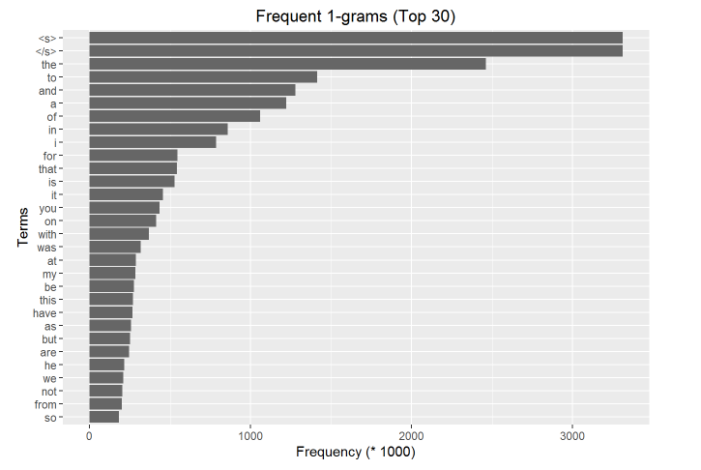
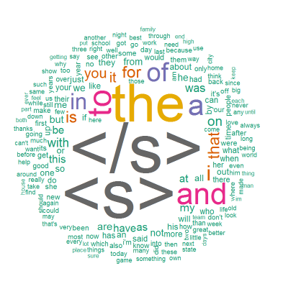
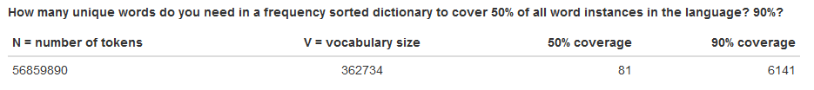

Slide 21
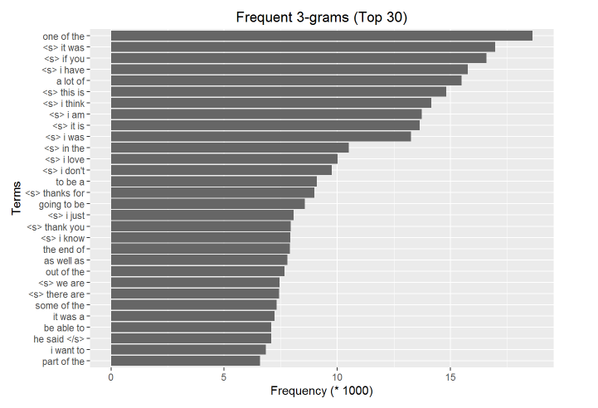
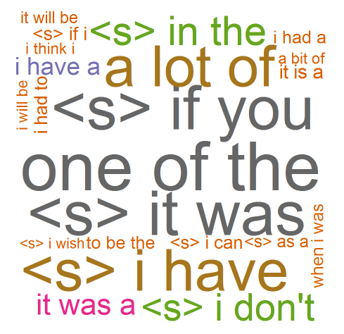
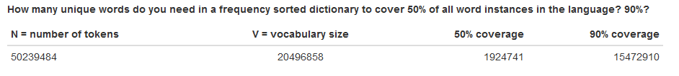

Slide 22
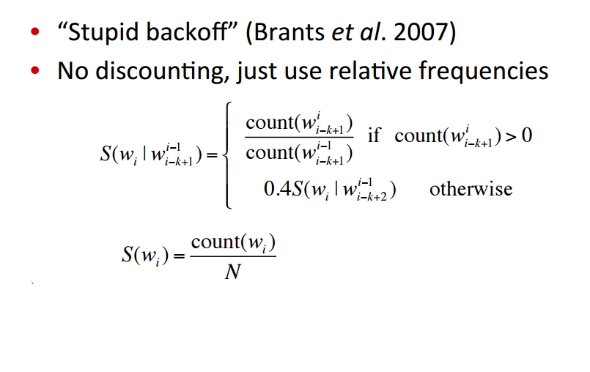
The Model creation – part 2
Models: strategy
Model Impl. & Tuning
Model Evaluations
Language Model
Algorithm
Term
Frequency
Matrix
Language
Model
Memory Footprint
Small when moving into the app (e.g. Mobile, web)
Memory Footprint (small)
1-G: 1.1 Mb (90%)
2-G: 26.8 Mb (75%)
3-G: 10.2 Mb (30%)

