Slide 1


Inside CIBC’s GenAI Transformation:
From 500 to 25,000
Empowered Employees
AUGUST 11-13, 2025
MGM GRAND, LAS VEGAS

Slide 2

Agenda
WHAT IS CIBC AI
PRIMARY USE CASES
KEY STATS
LESSONS LEARNED
Key features and roadmap
How are our employees using the tool to be more productive?
Adoption rates, usage profiles, running costs
Key challenges, benefits, and costs to run this platform

Slide 3
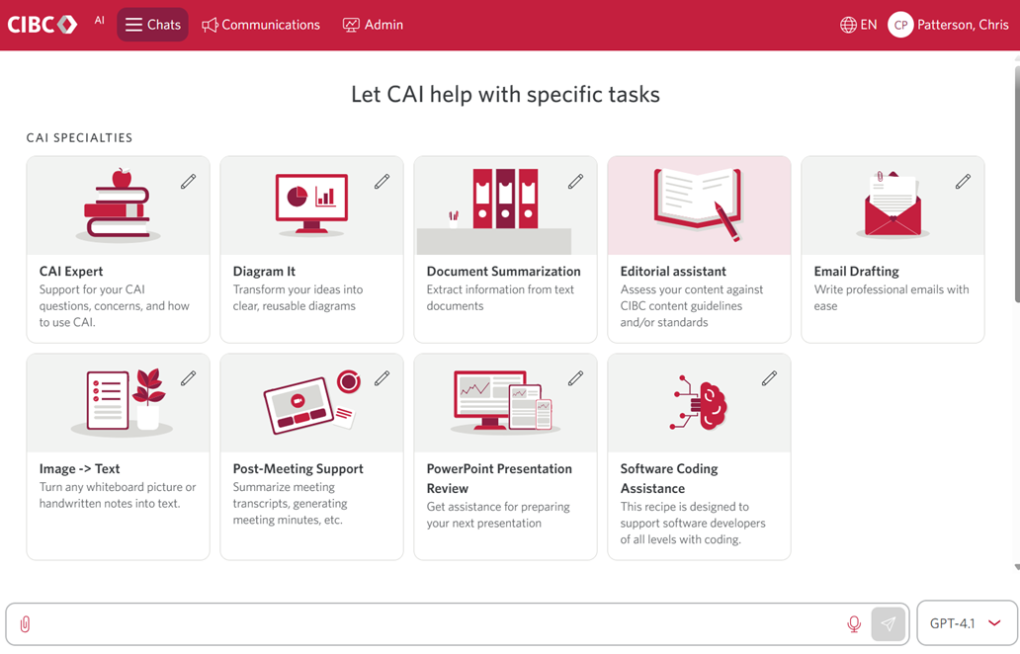
What is CIBC AI?
Built for CIBC, by CIBC: A secure GenAI platform for our entire bank
Democratized access to world’s best LLM’s (OpenAI GPT4.1 & O3)
Powering productivity: Already saved 600,000+ employee hours
One platform, endless workflows: Automates tasks from simple to highly sophisticated
Easy-to-use: Custom “agent” marketplace—no prompt engineering required

Slide 4
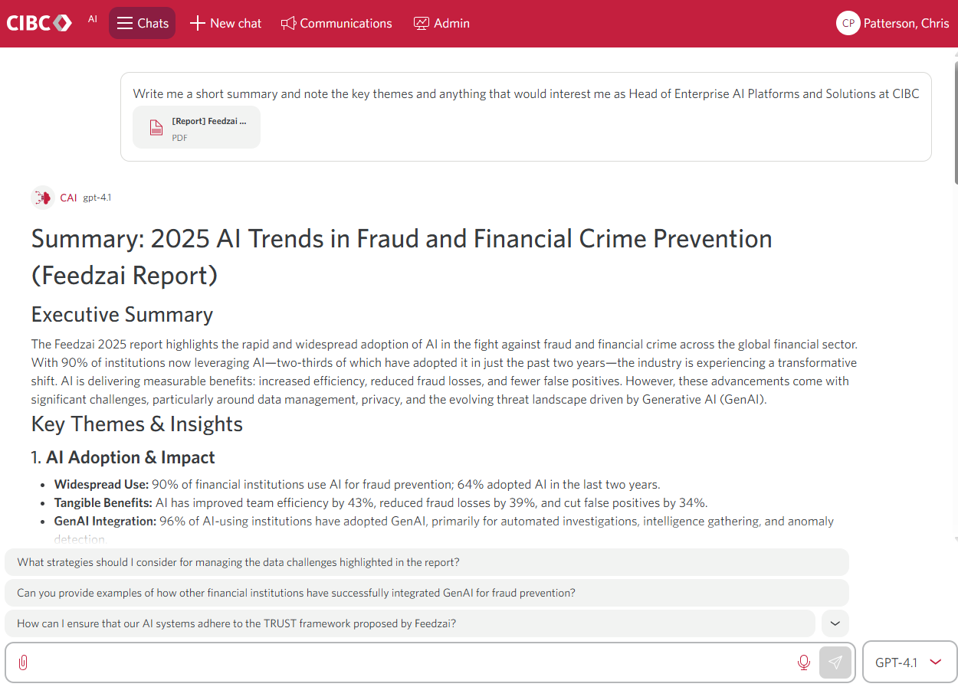
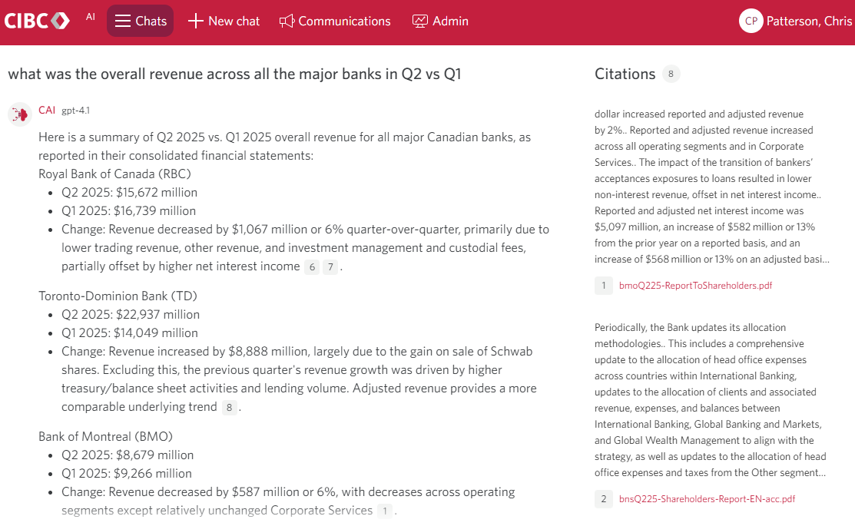
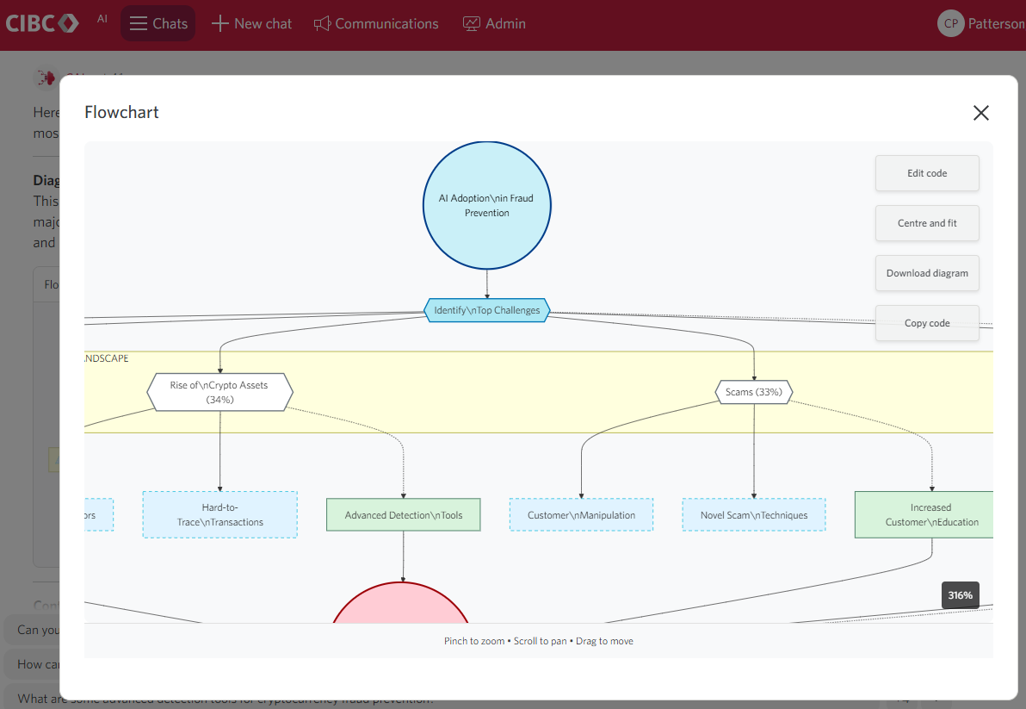
What is CIBC AI?
Document Summarization
Writing and Responding to Emails
Reviewing Materials
Drawing Diagrams
Generating Product Mockups
Infinitely more use cases – only limited by your imagination

Slide 5
Roadmap
Notetaker Bot: Launching in the coming months, the Notetaker Bot will seamlessly join meetings to generate concise summaries, actionable insights, and automated action tracking—helping teams stay organized and focused on outcomes.
Team Workspace: We are enhancing team-based collaboration with a shared, AI-driven workspace. This platform will be anchored in relevant project materials and provide access to intelligent agents capable of executing meaningful tasks, accelerating project delivery.
Realtime Audio: By integrating advanced voice models, we aim to elevate the employee experience and deliver real-time AI support during both internal and client-facing meetings—enabling more dynamic and informed conversations.
Agents: Agentic AI represents the next frontier in generative AI. We are developing a robust foundational layer to enable AI agents with true autonomy, empowering them to take initiative and drive value across our organization
What exciting new features are planned for the coming year?

Slide 6
Primary
Use Cases
Automating repetitive administrative tasks, such as summarizing reports, emails, and handling data entry, to free up time for more valuable work
Generating first drafts of a wide variety of business documents—from design documents and reports—using AI to jump-start and streamline writing processes
Rapidly searching and retrieving information from vast enterprise data sources, allowing employees to find policies, procedures, and other documents with precision and context
Beyond simple text: CIBC AI produces diagrams and even functional
UI prototypes allowing our product teams to ideate new products and features in real time.
Leveraging an agent marketplace to easily access, create, and share automated AI workflows that standardize and speed up common business processes across teams
Powering Lines of Business with tailor-made AI solutions including Marketing, Retail, Corporate & Investment Banking, Legal & Compliance and many others
How are our employees using this software?

Slide 7
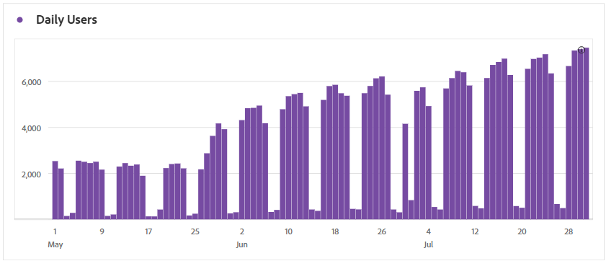
Key Stats
Daily Users
How many unique employees use this tool each day?
24,000+
7500+
1000+
Employees that have logged in since launch
Unique daily users
Employees that use CIBC AI at least once per day

Slide 8
Key Stats
Productivity
Hours saved per month (total)
How many employee work hours are reclaimed each month through this tool’s impact?
600,000+ Hours
Target: 1,000,000
Number of hours saved since start of our fiscal period (November 1st, 2024) to date: July 31st, 2025.
Aiming to finish the year with over 1M of hours of productivity gained

Slide 9
AI Fluency Levels
Key Stats
AI Fluency
A measure of an employee’s ability to understand, use, and innovate with AI confidently and responsibly
Novice: New to AI tools, with minimal experience and basic understanding
Intermediate: Comfortable with AI basics and using tools more regularly.
Practitioner: Consistent, effective AI user applying solutions to real tasks.
Expert (Key Target for all staff over time): Highly skilled, maximizing AI features and driving innovation.
Professor: AI leader and mentor, setting best practices and guiding others.

Slide 10
Average Productivity Lift
Key Stats
Impact of Fluency
20 Hours
Experts save 20 hours of time each month on average using CIBC AI
Expertise takes time, but the benefits are material
3-4 Months
Expertise takes time – on average a new users takes between 3 to 4 months to achieve expert level

Slide 11
Monthly LLM Costs
Key Stats
Costs
LLM Capabilities continue to improve, and costs continue to go down.
$37k LLM Costs
25B Tokens Used
Trivial costs considering the impact this product has had. Average cost per user is approximately $1.35 with an Expert user averaging around $5.50 per month.
Equivalent to over 230,000 books (300 pages) of data consumed and produced by AI.

Slide 12
Lessons Learned
After running this platform for 1 year – from pilot to production – what are some key insights we learned?
Adoption takes time
AI Fluency drives outcomes
Costs & Benefits are Exceptional
Don’t expect your employees to immediately adoption and change their ways of working – change is hard
Training Was Key – Having all employees take mandatory training prior to receiving access has set beginners up for early success.
Our community-driven approach to upskilling has enabled us to meet employees at their current skill levels. By offering a variety of engagement methods—including AMAs, town halls, train-the-trainer sessions, and classroom-style learning—we’ve ensured flexibility and accessibility in how we support staff development.
Developing expertise with LLMs requires time and patience, as it represents a new way of working. However, once employees adapt their behaviors, they will begin to see measurable results.
LLMs enable near-instant responses to work requests, significantly increasing productivity. By embracing this new way of working, employees can accomplish far more than was previously possible.
In just one year, LLMs have evolved from basic Q&A models to systems capable of deep reasoning.
The ongoing reduction in LLM runtime costs is democratizing access to advanced intelligence, making it available to everyone, anytime.

Slide 13
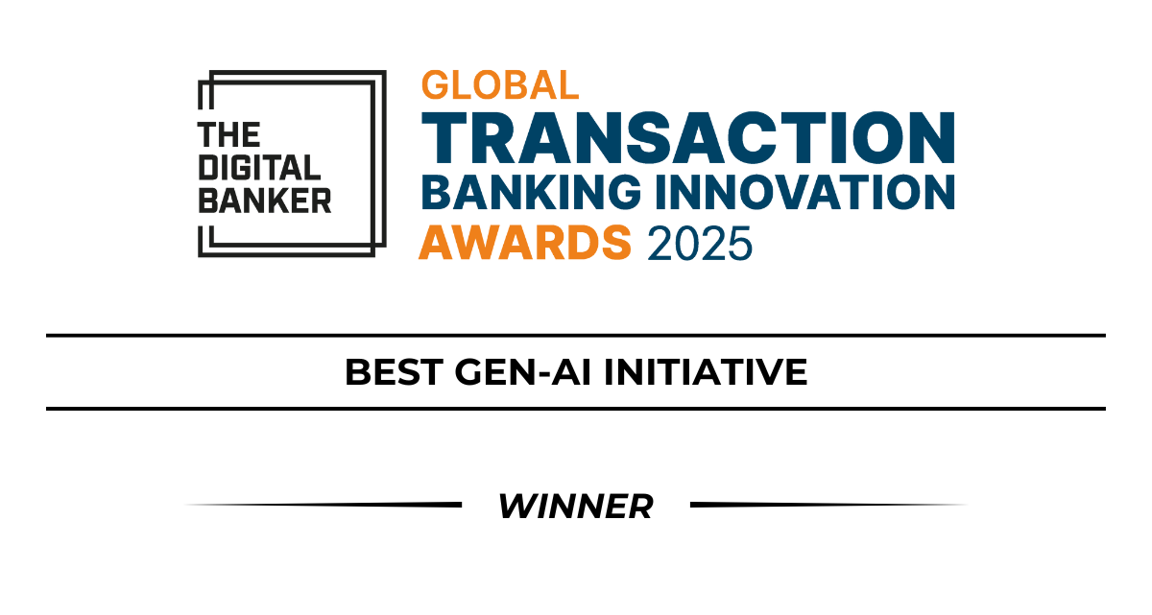
AWARD
WINNING
Second year in a row CIBC has been awarded “Best GEN-AI Initiative”
“
It's been tremendous watching the uptake of CAI across our bank and how it has helped simplify routine tasks for team members, better enabling them to focus on delivering value to our clients”
– Dave Gillespie, Executive Vice-President, Infrastructure, Architecture and Modernization, CIBC

Slide 14

Thank You!
Chris Patterson
Chris.Patterson@cibc.com

