Slide 1
EENG 860 Machine Learning Mid Term Exam
Paridhi P Nigam
1301148
Group 5

Slide 2
For the first 45 most discriminating STE features between MDD and BD – Comparison of performance of 5 different classifiers: Naïve Base, Decision Tree, Random forest, Linear discriminate analysis, and Quadratic discriminate analysis using 5-fold cross-validation starting from having only one feature and increasing the number of features to 2(the first two features), …until all 45 features are used.

Slide 3
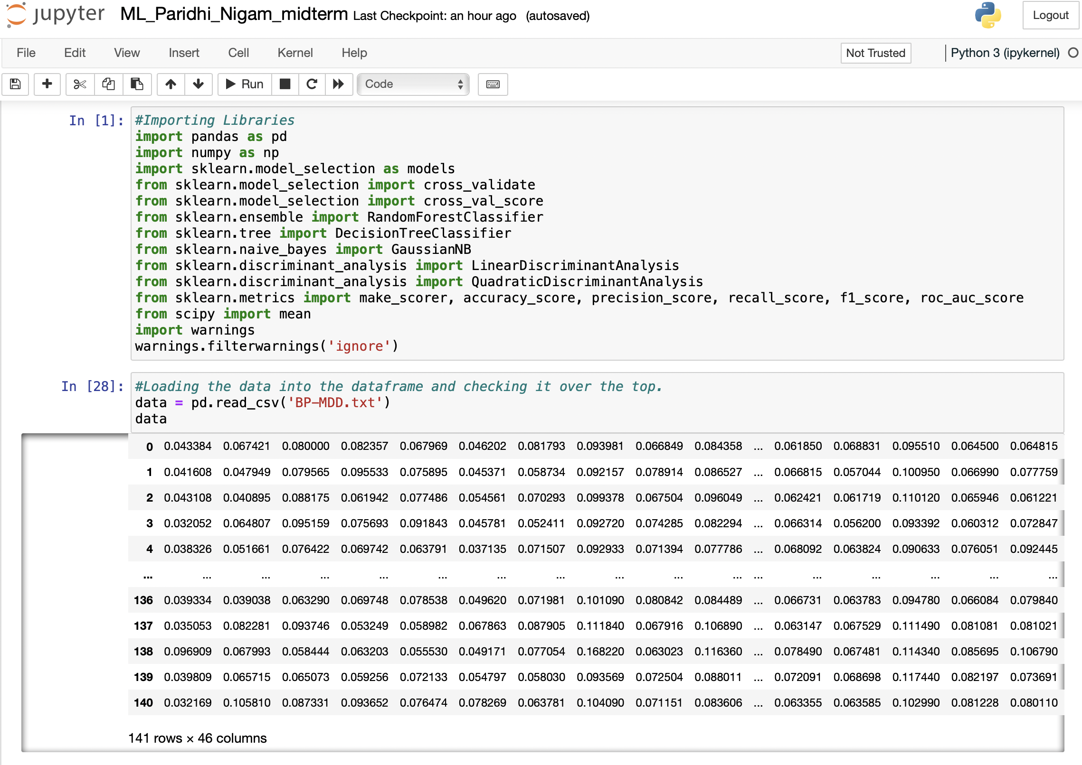
Importing models, metrics, libraries. Then loading data and filtering it

Slide 4
As the data does not have any columns in it so will add columns as feature that we will use in the model.¶
creating the column_name list and loading it with feature_1, feature_2, .. , feature_45 and appending BD/MDD
Checking if list is the required list we need or not using for loop
Naming the columns in the dataframe using the list.
Removing the BD/MDD value from the list so that we can use the list to iterate on features only later on.
Loading up the models and running a 5 fold cross validation on each model 100 times to get Precision, Accuracy, F1 score, Sensitivity, specificity and AUC values from the data.
Taking list of models to load into score value dataframes
Creating empty dataframes for all the scoring value required.

Slide 5
Creating a dictionary to input in cross value validation to get all these scores returned.
Loading X values and y values for the models.
Taking empty lists of all the scores with respect to the models that we will perform on the data.
These list will store the value of the scores we get from cross validation.
Looping columns in the column_name list
Loop for 100 iterations of cross validation
Calculating mean for each dictionary score values using keys and values.
Appending values of dictionary into the respective lists to store all 45 feature data together.
Inputing all the list data into the respective dataframes for each score values into their respective model columns.
Remvoing null column in the dataframes created as a duplicate value.

Slide 6
- Plotting graphs for each of the score calculated after all iterations and analyzing which is the best model out of all.

Slide 7
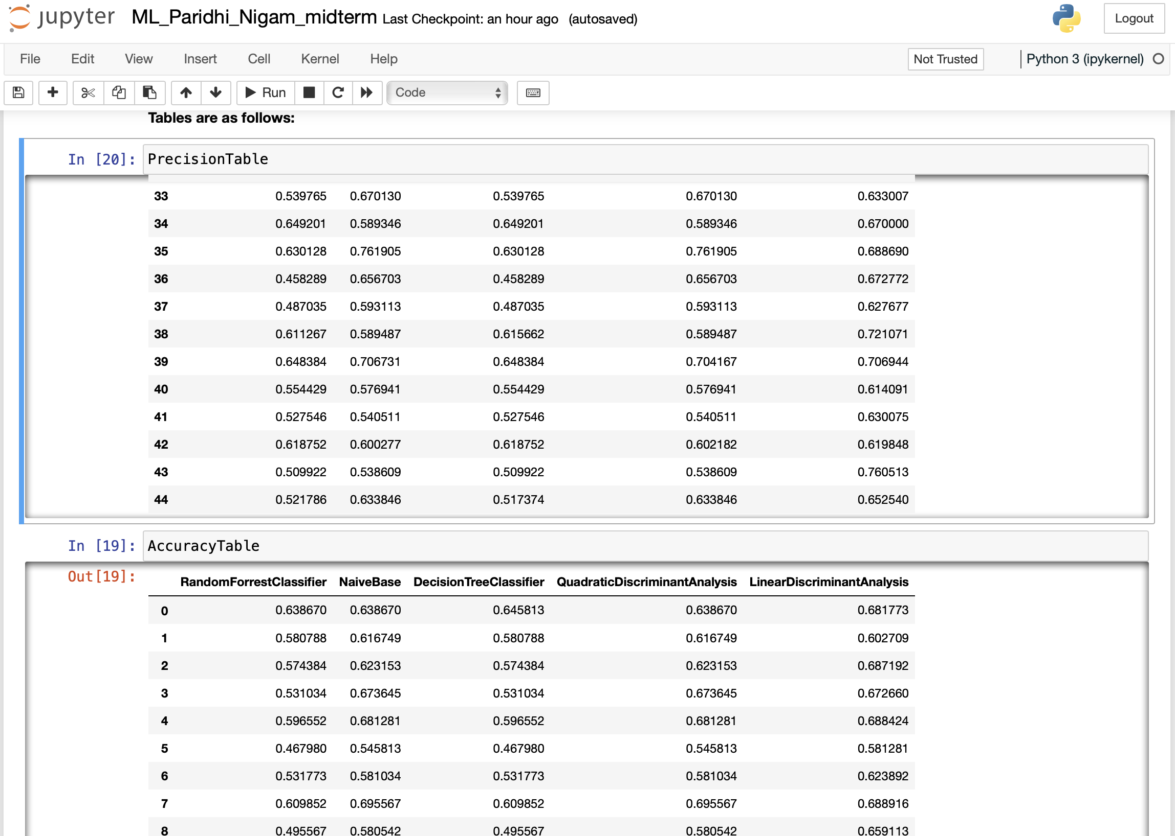

Slide 8
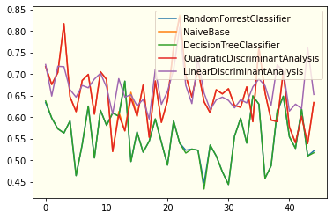
Graph- Precision

Slide 9
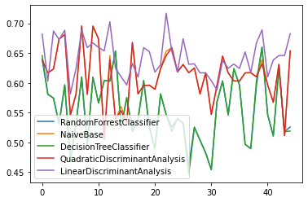
Graph-Accuracy

Slide 10
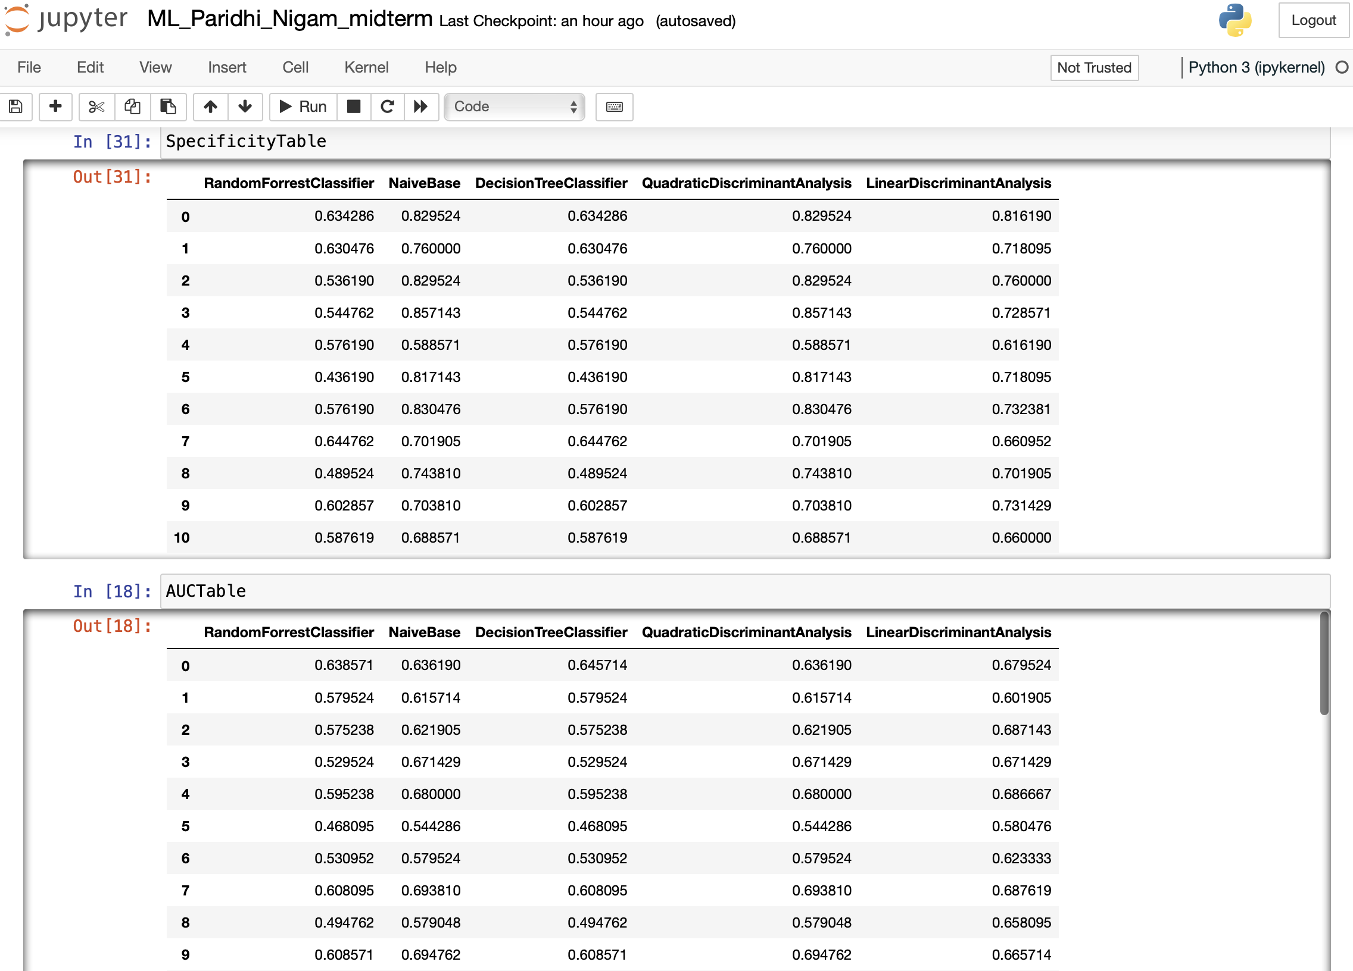

Slide 11
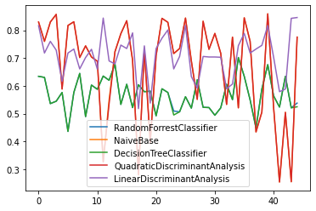
Graph- Specificity

Slide 12
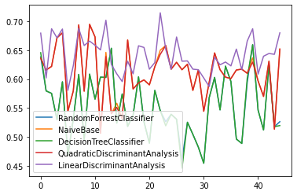
Graph- AUC Table

Slide 13
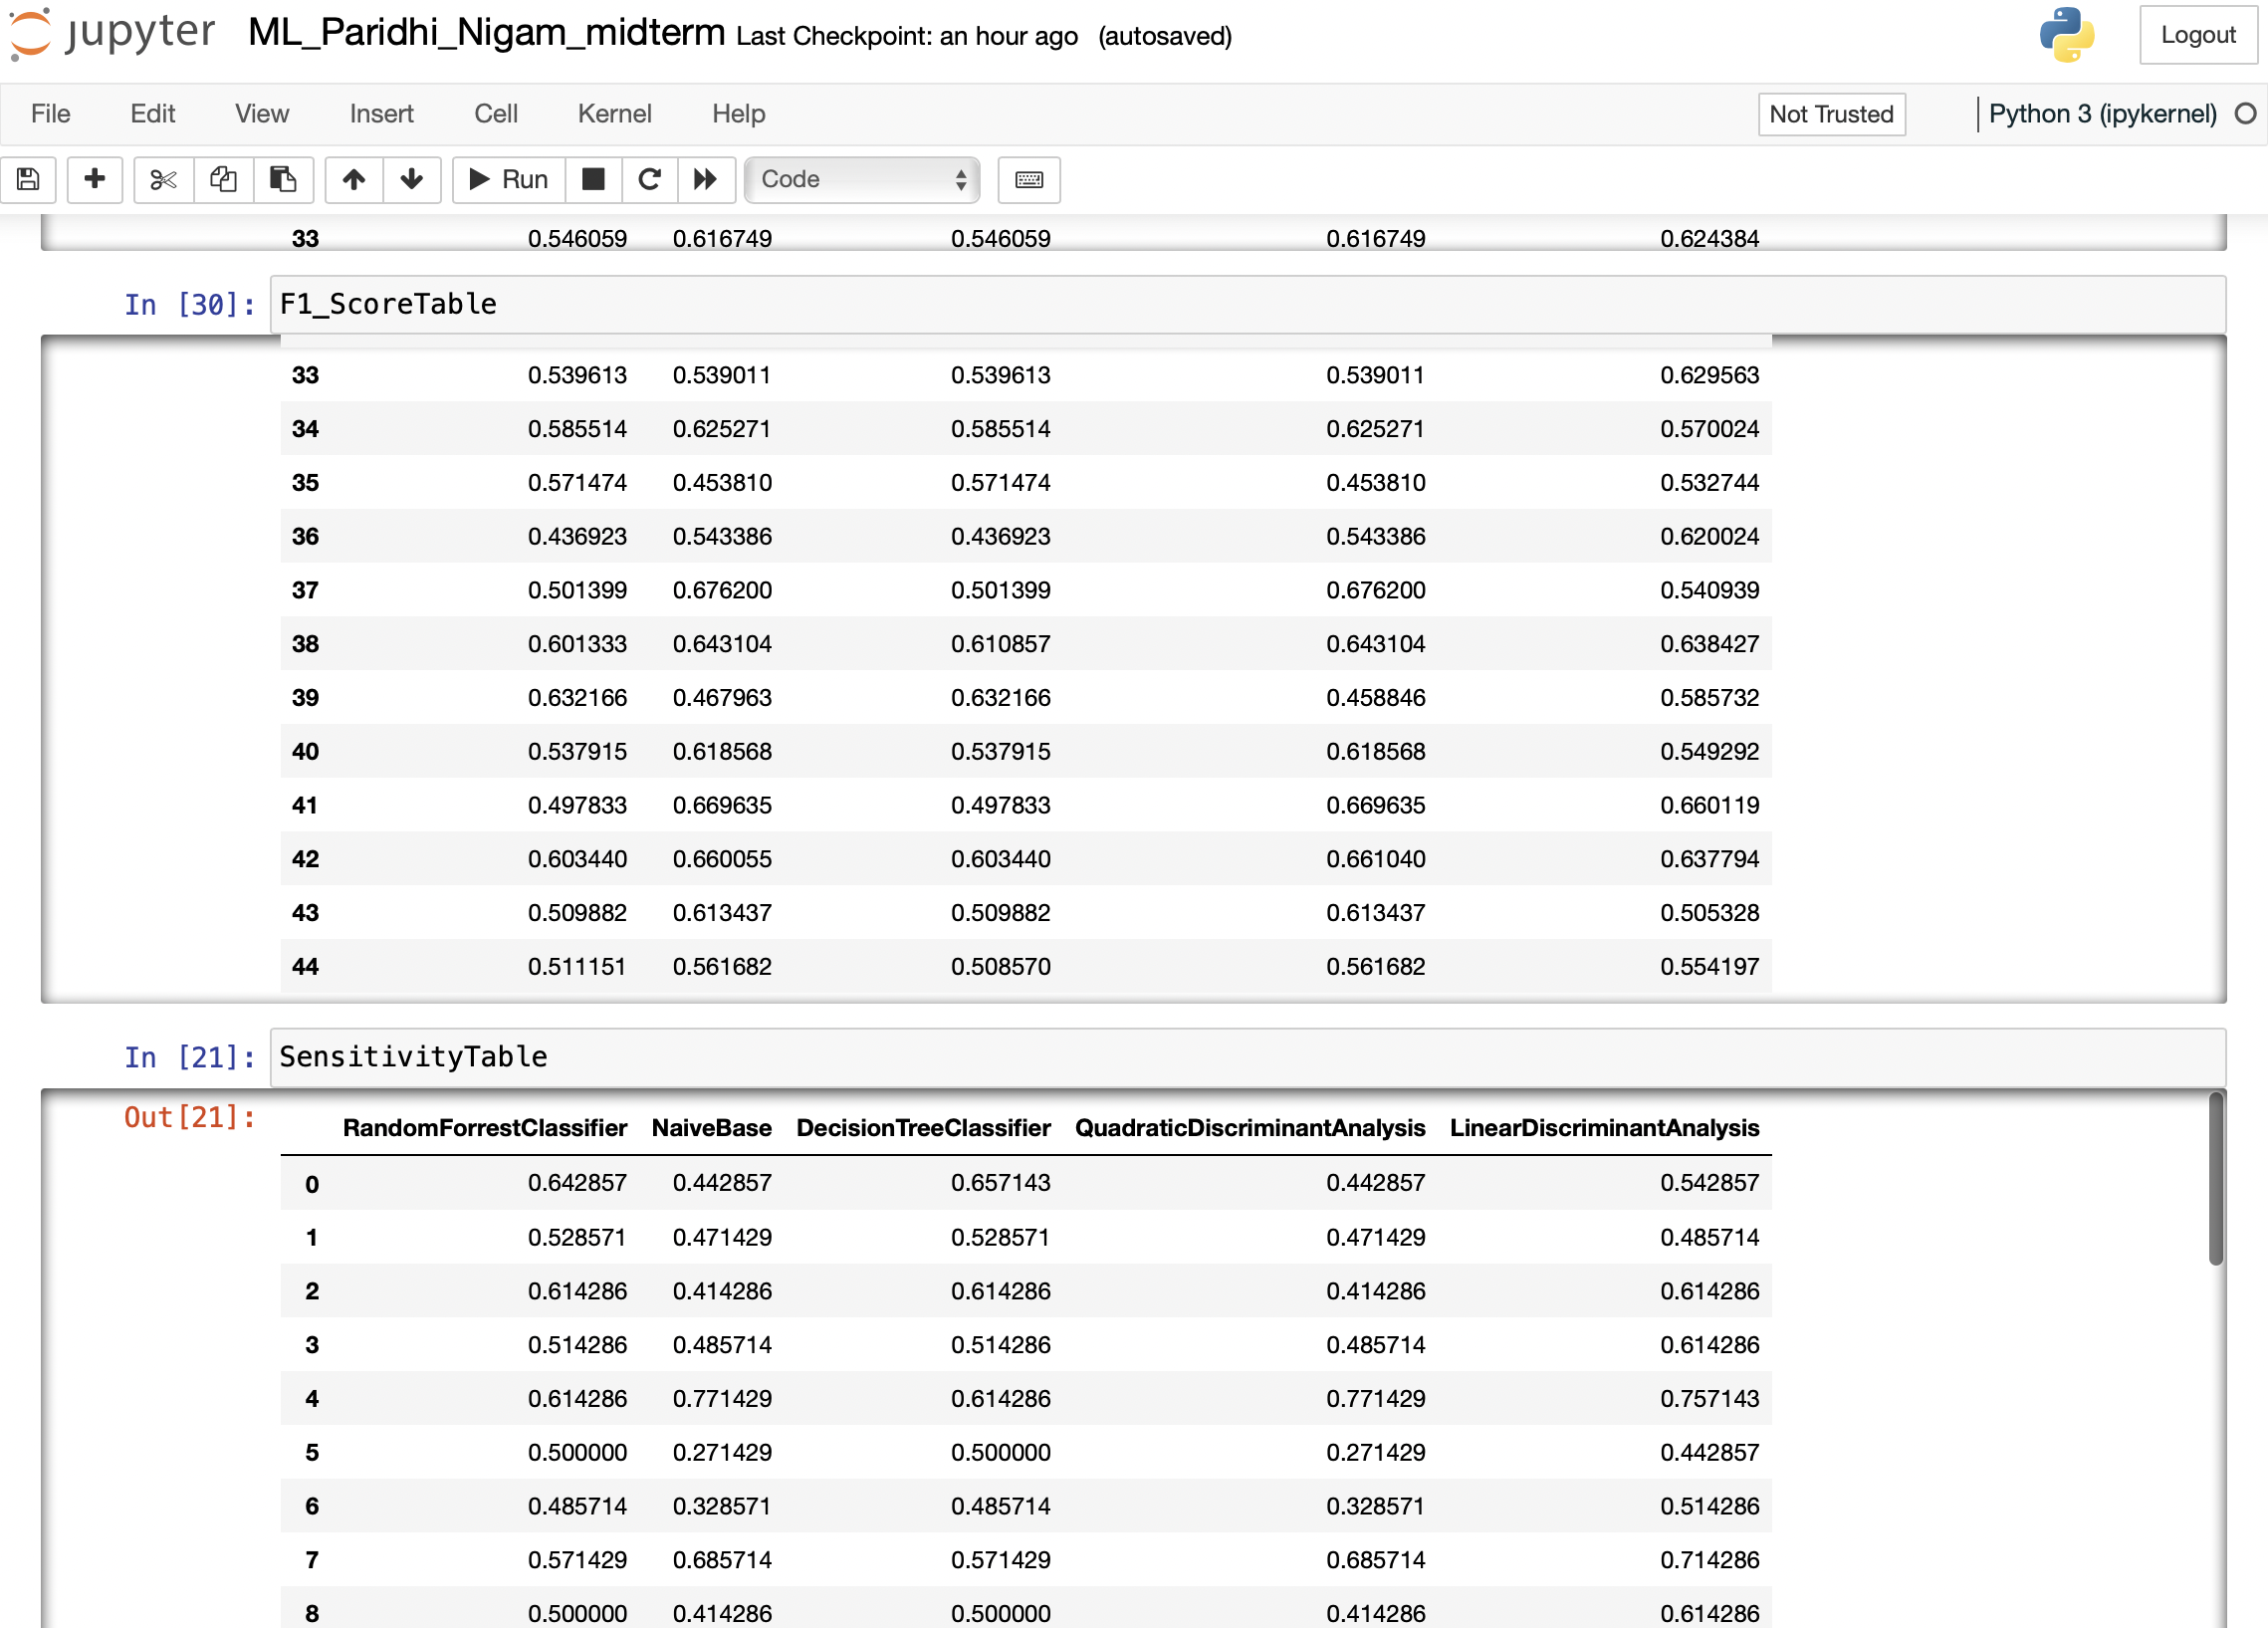

Slide 14
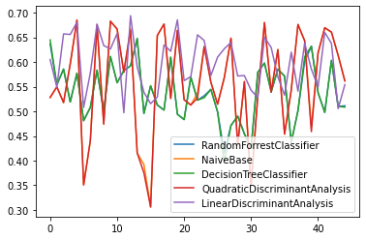
Graph- F1 Score

Slide 15
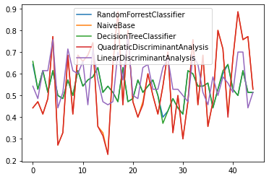
Graph- Sensitivity

Slide 16
Scores after calculating average out of the accuracy table for each model
Random Forrest Classifier: 0.5531855500821018
Naïve Base: 0.6110071154898744
Decision Tree Classifier: 0.5528735632183909
Linear Discriminant Analysis: 0.6103721948549535
Quadratic Discriminant Analysis: 0.6426217843459222

Slide 17
Conclusion
According to the scores calculated i.e after checking all the values of the models –
Discriminant analysis model Is the best from all of five models
While Decision Tree Classifier gives the least accuracy.

