Slide 1
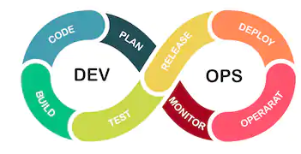
introducing DevOps
Prashant Parihar

Slide 2
Agenda
Introduction
Why Devops
Devops LifeCyle
DevOps Tools
VM vs Containers
Why Containers
Introduction to Docker
Understanding Docker Engine and Architecture
Docker Hub
Docker Installation
Docker Commands – Image Creation/Containerization
Docker Compose & Volumes

Slide 7
introducing DevOps
Prashant Parihar

Slide 8
introducing DevOps
Prashant Parihar

