Slide 1
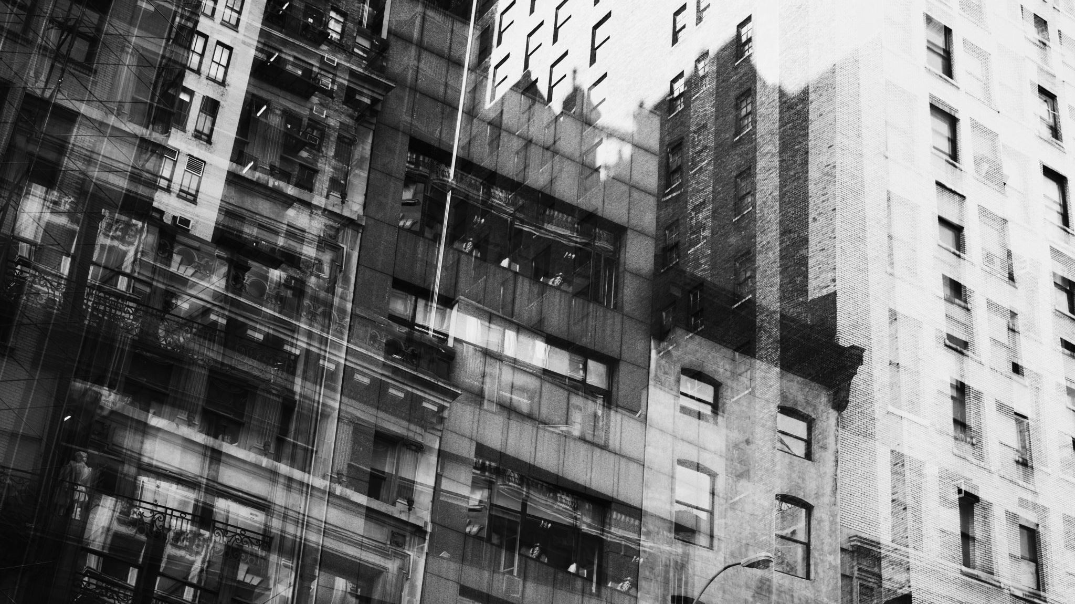
Crime in Vancouver Data of crimes in Vancouver (Canada) from 2003 to 2017
BDAT 1004 DATA PROGRAMMING
PRO. ROSHAN SHAHU
GROUP 6

Slide 2
Project Summary
Data Source and Extraction Date:
The dataset originates from the Vancouver Open Data Catalogue.
The data extraction occurred on July 18, 2017.
Temporal Span and Record Count:
The dataset encompasses a time range from January 1, 2003, to July 13, 2017.
It comprises a total of 530,652 individual records.
Coordinate System and Conversion:
The original dataset employs UTM Zone 10 coordinates, utilizing columns X and Y.
Additionally, Latitude and Longitude values were incorporated.
These geospatial coordinates were transformed through a dedicated spreadsheet.
Google Trends Data Overview:
The supplementary Google Trends dataset offers insights into search term popularity.
It quantifies the frequency of a specific search term concerning the total search volume.

Slide 3
Project Summary
Search Term "Crime" in British Columbia:
The Google Trends data specifically focuses on the search term "crime" within the geographic region of British Columbia.
Google Trends Scoring System:
Google Trends employs a scoring system where 100 denotes the zenith of popularity for a given term.
A score of 0 signifies minimal popularity, representing less than 1% of the peak value.
Intermediate values provide a relative perspective on the popularity of the term over time.
Access to Original Google Trends Data:
The unaltered Google Trends data pertaining to the search term "crime" in relation to British Columbia can be accessed through this provided link:
[Google Trends Data for "Crime" in British Columbia](https://trends.google.com/trends/explore?date=2004-01-01%202017-06-30&geo=CA-BC&q=crime).

Slide 4
Project Summary
In summary, the dataset originates from the Vancouver Open Data Catalogue, collected on July 18, 2017. It contains a substantial number of records spanning from 2003 to mid-2017, with coordinates both in UTM Zone 10 and Latitude-Longitude formats. The Google Trends dataset supplements this with relative search term popularity data, exemplified by the "crime" term in British Columbia, utilizing a standardized scoring system.

Slide 5
Team Members
Parth Maheshbhai Patel – 200534327
A versatile developer proficient in both front-end and back-end development, specializing in creating comprehensive profile information solutions.
Yash Jigneshkumar Mistry – 200553103
A seasoned data analyst adept in front and back-end responsibilities. Specializes in deriving valuable insights from varied datasets to drive informed decision-making.

Slide 6
Team Members
Binay Sanjaybhai Patel – 200558474
Experienced full-stack Python developer proficient in front and back-end development, adeptly crafting comprehensive profile information for individuals.
Aakanksha Dineshbhai Patel – 200533845
A proficient business analyst with extensive expertise in IT and data analysis. Proficient in both front and back-end development, providing valuable and perceptive solutions.

Slide 7
Team Members
Rajvi Chavda – 200537026
Experienced IT project manager adept at leading complex initiatives. Proficient in front-end and back-end development, ensuring successful project outcomes.

Slide 8
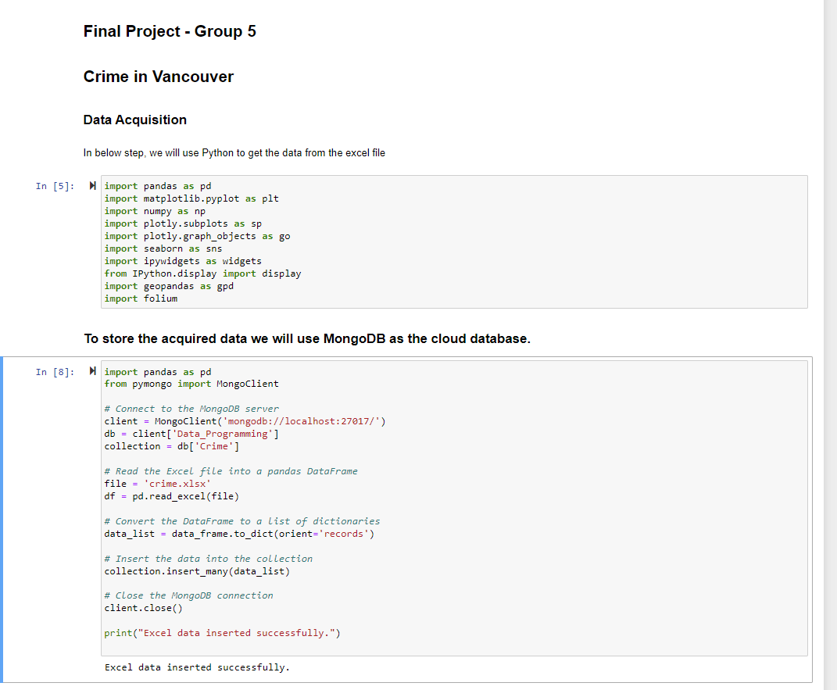
Gathering and Retaining Information
The process of retrieving data from a CSV file located on a local computer and then structuring it within a pandas data frame is comparable to methodically organizing information into a structured table.
This structured data was subsequently integrated into a MongoDB database, serving as an intelligent storage repository, enabling streamlined data storage and retrieval. This integration supported purposeful data utilization and management, empowering us to extract valuable insights and elevate our project's effectiveness.

Slide 9
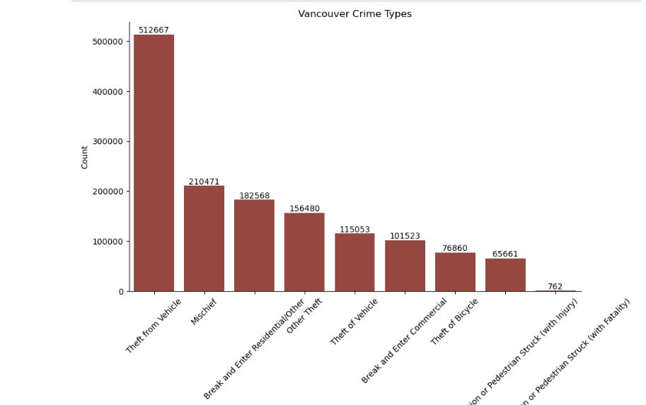
Visualization
Different types of crime committed in Vancouver:

Slide 10
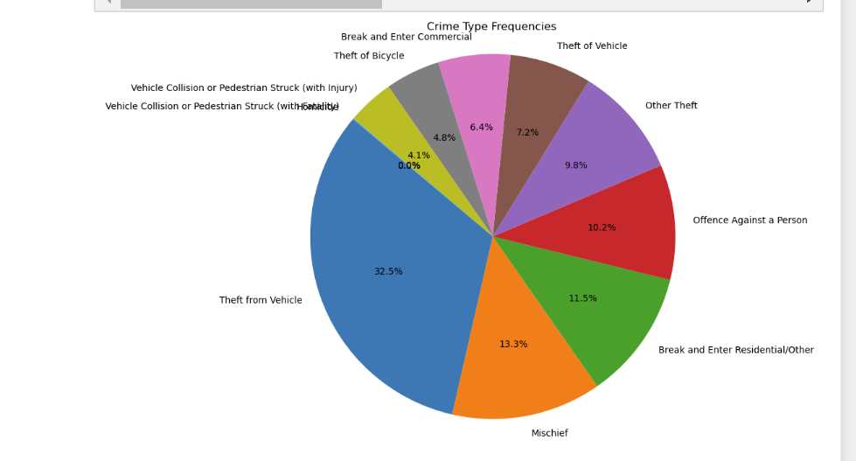
Visualization
During the period from 2003 to 2017, which year witnessed the highest frequency of criminal incidents?

Slide 11
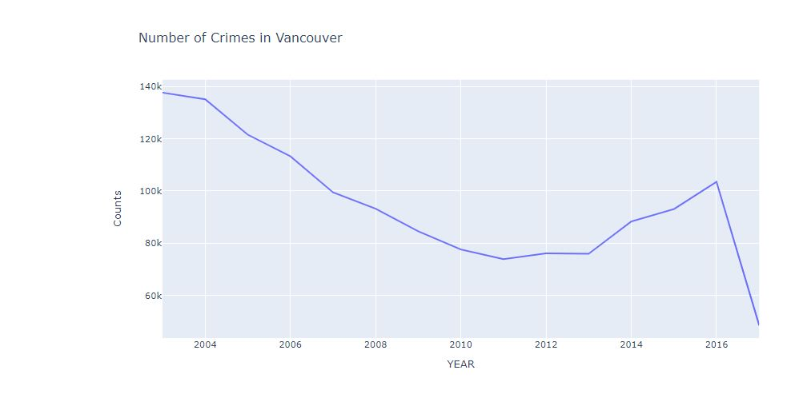
Visualization
During the period from 2003 to 2017, which year witnessed the highest frequency of criminal incidents?

Slide 12
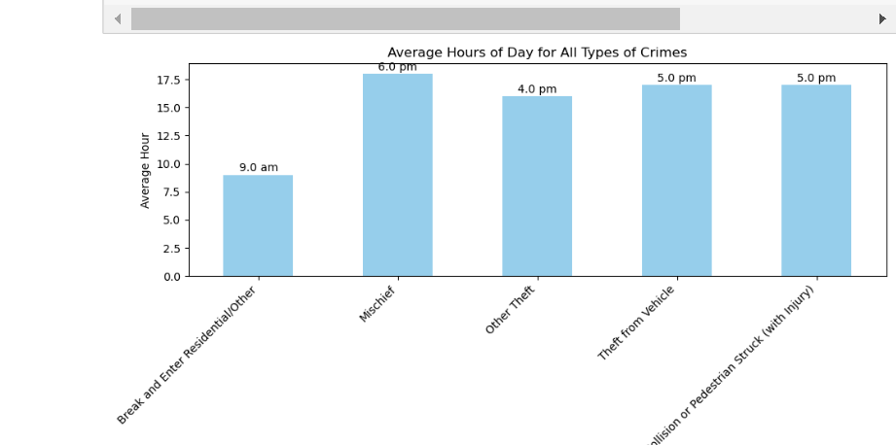
Visualization
What is the most frequently occurring type of crime during specific times of the day?

Slide 13
Thank you
Group 6

