Slide 1
Big Data Problems

Slide 2
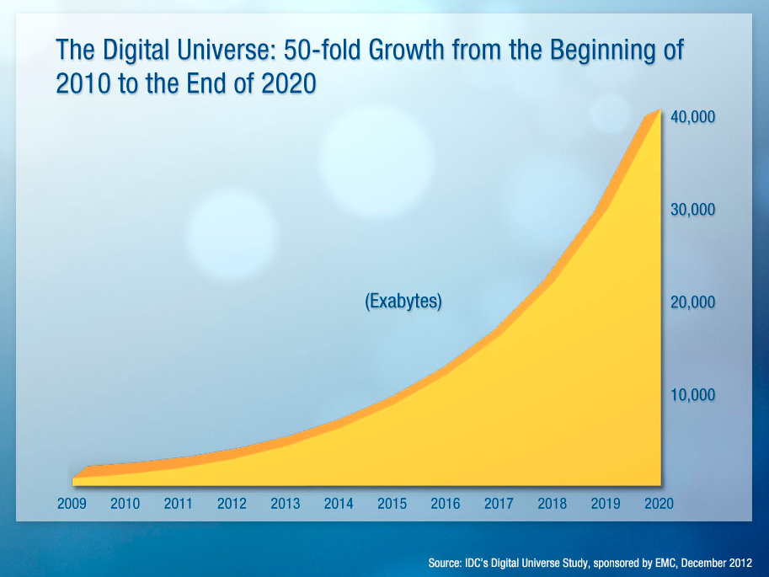
Unstoppable Information Growth
Notes:
Good post with infographics
http://practicalanalytics.wordpress.com/2012/12/11/20-must-read-infograhics-on-big-data/

Slide 3
Big Data Sources
Trans-actions
Business Systems
Social Media
Twitter
Sensors
Instrumented Devices
Docu-ments
Text
Facebook
Blogs
Images
Sound
Video

Slide 4
Big Data Characteristics
Big Data
Volume
Variety
Velocity
Veracity
Notes:
Volume: Enterprises are awash with ever-growing data of all types, easily amassing terabytes—even petabytes—of information.
Turn 12 terabytes of Tweets created each day into improved product sentiment analysis
Convert 350 billion annual meter readings to better predict power consumption
Velocity: Sometimes 2 minutes is too late. For time-sensitive processes such as catching fraud, big data must be used as it streams into your enterprise in order to maximize its value.
Scrutinize 5 million trade events created each day to identify potential fraud
Analyze 500 million daily call detail records in real-time to predict customer churn faster
Variety: Big data is any type of data - structured and unstructured data such as text, sensor data, audio, video, click streams, log files and more. New insights are found when analyzing these data types together.
Monitor 100’s of live video feeds from surveillance cameras to target points of interest
Exploit the 80% data growth in images, video and documents to improve customer satisfaction
Veracity: 1 in 3 business leaders don’t trust the information they use to make decisions. How can you act upon information if you don’t trust it? Establishing trust in big data presents a huge challenge as the variety and number of sources grows.

Slide 5
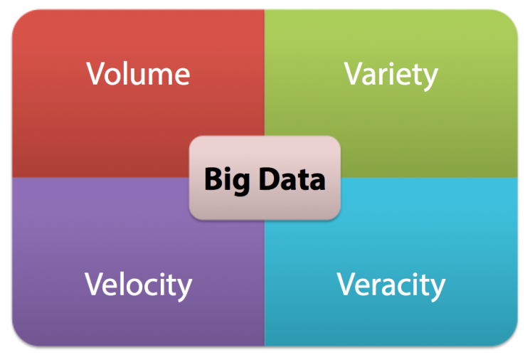
Big Data Workflow
Acquire
Analyze
Manage
Integrate
Visualize
Share
Store
Businesses need to see value from the Big Data chain
Execute in time and cost-effective manner

Slide 6
Problems in Capitalizing on Big Data
More data than we are used to handle
Not always extremely high volumes
Data is unstructured
Data does not fit into conventional storage
Data arrives quickly, may have very narrow usefulness window
So much data – but not sure what to analyze!
Integrate new data with the conventional systems
Lack of knowledgeable people to process, manage, and analyze data
Organizational silos

Slide 7
Structured and Unstructured Data Sources
Structured Data Sources
Existing databases
ERP/CRM/BI systems
Inventory
Supply chain
Unstructured Data Sources
Server logs
Search engine logs
Browsing logs
E-Commerce records
Social media
Voice
Video
Sensor data

Slide 8
Relational Databases and Big Data
Relational Database
Today - Doable, but expensive and slow
Volume is out of reach
Cost / Performance
Processors
Disks
1M
x1000
1B
x1000
1T
x1000
1Q
x1000
…HUGE!!!
Notes:
Bringing down both the response time and the cost. Go beyond the capabilities of relational databases.

Slide 9
Dealing with the Big Data Problems
New processing approaches
Map Reduce algorithm
New data technologies
Hadoop
Spark
NoSQL stores
Stream processing
There is no one silver bullet!

