Slide 1
Hadoop, MapReduce & HDFS

Slide 2
A Common Pattern for Processing Large Data
Key/Value pairs
Load a large set of records onto a set of machines
Extract something interesting from each record
Shuffle and sort intermediate results
Aggregate intermediate results
Store end result
"Map"
"Reduce"

Slide 3
The MapReduce Programming Model
"Map" step:
Input split into pieces
Worker nodes process individual pieces in parallel (under global control of the Job Tracker node)
Each worker node stores its result in its local file system where a reducer is able to access it
"Reduce" step:
Data is aggregated (‘reduced” from the map steps) by worker nodes (under control of the Job Tracker)
Multiple reduce tasks can parallelize the aggregation
₃
Notes:
3

Slide 4
MapReduce Example: Word Count
dog cat bird
dog, 1
cat, 1
bird, 1
dog, 1
dog, 1
dog, 1
dog, 1
dog, 4
pets.txt
pet_freq.txt
dog cat bird
dog cat bird
dog dog cat
dog, 4
cat, 3
bird, 2
dog cat bird
dog, 1
cat, 1
bird, 1
cat, 1
cat, 1
cat, 1
cat, 3
dog dog cat
dog, 1
dog, 1
cat, 1
bird, 1
bird, 1
bird, 2
Map
Shuffle
Reduce
WordCount is the "Hello World" of Big Data
You will see various technologies implementing it
A good first step to compare the expressiveness of Big Data tools

Slide 5
Separation of Work
Programmers
Map
Reduce
Framework
Deals with fault tolerance
Assign workers to map and reduce tasks
Moves processes to data
Shuffles and sorts intermediate data
Deals with errors

Slide 6

Introducing Apache Hadoop
Open source framework for processing large amount of data on cheap, unreliable clusters
Inspired by Google technologies, implemented in Java
From the onset, designed to scale
Popular in companies that deal with large amounts of data
Often in PB size
Useful as a cost-effective solution for less than PB problems as well!

Slide 7
Two Key Aspects of Hadoop
MapReduce framework
How Hadoop understands and assigns work to the nodes (machines)
Hadoop Distributed File System = HDFS
Where Hadoop stores data
A file system that spans all the nodes in a Hadoop cluster
It links together the file systems on many local nodes to make them into one big file system

Slide 8
Storing Data for MapReduce
Data needs to be stored on multiple machines
We should be able to store any kind of data
Problem:
These machines can fail
Data should not be lost!
The idea:
Distributed, reliable storage
The solution: Hadoop Distributed File System (HDFS)

Slide 9
Hadoop Distributed File System
Data broken into blocks
1
2
3
4
5
6
7
8
9
Master Node
Node 1
Node 2
Node n
1
5
…
2
Name Node
3
7
4
6
9
8
Data is replicated across the nodes

Slide 10
Hadoop Distributed File System: Replication
Data broken into blocks
1
2
3
4
5
6
7
8
9
Master Node
Node 1
Node 2
Node n
1
5
5
1
…
2
Name Node
2
3
7
1
4
6
9
2
8
6
Knows where are the blocks
A piece of data (block) replicated 3 times

Slide 11
Hadoop Distributed File System (HDFS)
Data is:
Split into blocks
Distributed across the machines in the cluster
Each block is replicated 3 times
Machines in the cluster are cheap and unreliable
HDFS resides on top of a native file system
Block size is typically 64 or 128 MB
Follows the idea of the Google File System (GFS)

Slide 12
HDFS Sweet Spot
Smaller number of large files
Files typically > 100MB
Ideal applications read the data from the beginning to the end
Minimize the cost of seek
Files are typically not updated
No random access!
Append operation added later
Default replication: 3

Slide 13
HDFS Command Line API
Example:
hadoop fs -cat hdfs://nn1.example.com/file1
Similar to shell commands for manipulating files, with some additions hadoop fs –cmd args
copyFromLocal, copyToLocal, put, get, cat, cp, mv, rm, …

Slide 14
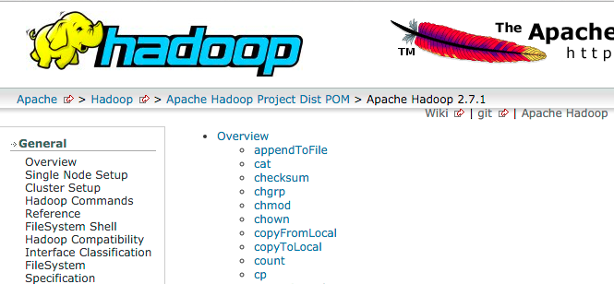
HDFS File System Shell Reference
https://hadoop.apache.org/docs/current/hadoop-project-dist/hadoop-common/FileSystemShell.html

Slide 15

File Formats…
Text / CSV / TSV
Popular, easy to process
Sequence
Binary, similar to CSV
Often used for intermediate results.
JSON records
Not JSON files!
Records are a natural boundary for splitting
Apache Avro
Multi-purpose, carries metadata, splittable, mature
https://avro.apache.org/

Slide 16


…File Formats
RC (Record Columnar)
First columnar format, has compression, no schema evolution
Apache ORC (Optimized RC)
Self-describing type-aware columnar file format
Improved Hive performance for RC
https://orc.apache.org/
Apache Parquet
Modern columnar format, column compression
https://parquet.apache.org/
Notes:
ORC users: Facebook, Yahoo

Slide 17
Which File Format to Choose?
Choose by your use cases! No format is optimal
Major distributions prefer different formats
Cloudera: Parquet
Hortonworks: ORC
Columnar formats:
Fast to read
Slow to write
CSV
Fast to write, slow to read

Slide 18
NameNode
Manages the metadata for the HDFS
Must remain accessible
Install on a more reliable machine than the data notes
Metadata is held in RAM
Make sure the NameNode machine has a lot of RAM!
Secondary NameNode
It is not a backup!
It handles some housekeeping tasks

Slide 19
DataNodes
Stores data in standard files
NameNode is required to access the data in the HDFS cluster
NameNode knows which blocks are needed to assemble a file
Programs read data from DataNode directly
Files are split into 64 or 128MB blocks
Blocks make for easier management
Map and Reduce jobs run on data nodes
We send the programs to the data, instead the other way around!

Slide 20
Map and Reduce Tasks Running on Nodes
User programs are copied to all nodes
Master Node
Node 1
Node 2
Node n
Map
Map
Map
Job Tracker
Reduce
Reduce
Reduce
1
5
…
2
Name Node
3
7
4
6
9
8

Slide 21
Logical MapReduce Example: Word Count
Content of Input Documents
map(String key, String value):
// key: document name
// value: document contents
for each word w in value:
EmitIntermediate(w, "1");
reduce(String key, Iterator values):
// key: a word
// values: a list of counts
int result = 0;
for each v in values:
result += ParseInt(v);
Emit(AsString(result));
Hello World Bye World
Hello NoSQLNow
Map 1 emits: < Hello, 1> < World, 1> < Bye, 1> < World, 1>
Map 2 emits: < Hello, 1> < NoSQLNow, 1>
After shuffle
Reduce (final output):
< Bye, 1> < NoSQLNow, 1> < Hello, 2> < World, 2>

Slide 22
Typical MapReduce Uses
Term Frequency
Indexing
Sorting
Searching
Parallel document conversion
ETL
Machine Learning (ML) → Mahout ML library
Recommendation, Clustering, Classification
Multiple MapReduce flows can be integrated together

Slide 23
How To Create MapReduce Jobs?
MapReduce in Java
Low level, very flexible
Time consuming development
Streaming API
Typically done in Python or Ruby
Much simpler than Java, some performance loss
Hive
A SQL-like language for Hadoop
Pig
Data flow language
Scalding
Scala library for Hadoop, based on Java Cascading library

Slide 24
MapReduce in Java
Low level API
Full control over MapReduce details
This could be a good choice if you are building tools for Hadoop
More productive approaches:
Hive
Pig
Scalding

Slide 25
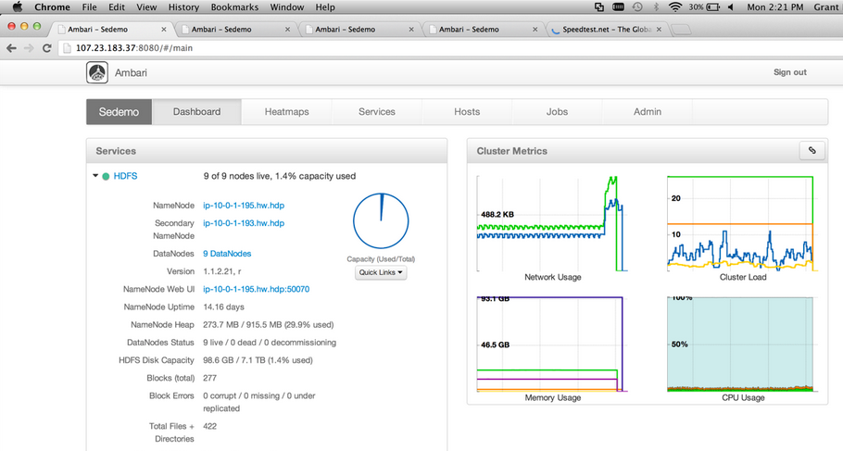
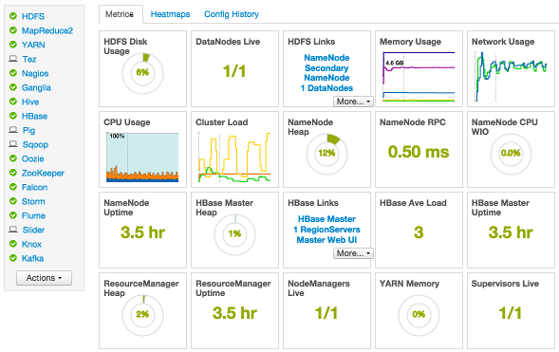
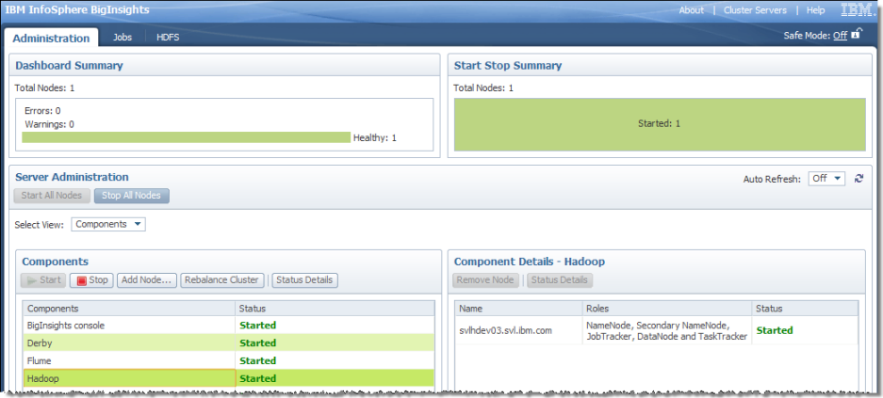
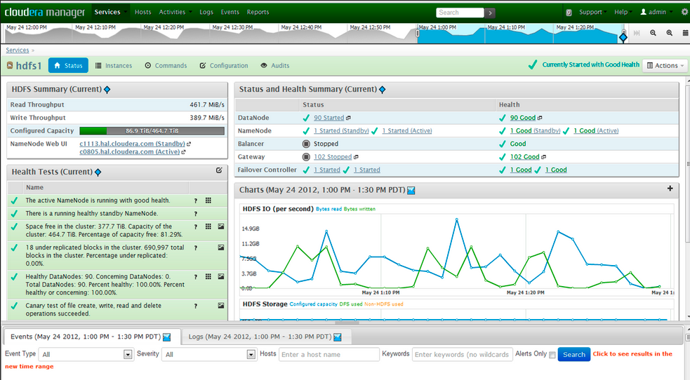
Hadoop Management Tools
Graphically manage cluster, jobs, HDFS
Vendor dependent
Sample administration tasks
Start/Stop Servers
Add/Remove Servers
Server Status Details (Log)

Slide 26
Hadoop: Summary of Characteristics
Easy To Scale
Data Agnostic
Fault Tolerant and Self-Healing
Extremely Flexible

