Slide 1
Hadoop Ecosystem

Slide 2

HBase
Columnar database
Distributed, sorted map datastore
Flexible schema
Columns can be added on the fly
Wide tables
Horizontally scalable
Good for sparse data
Transactions – single row only
Handles ~1PB of data
Millions of queries/second

Slide 3
HBase Features
Built on top of HDFS
Compression
In-memory column families
Bloom filters
Bulk loading
Zookeeper as the coordinator for the cluster
Tables can be input/output for MapReduce jobs
Access through Java, Pig, Hive, REST, Avro, Thrift
SQL layer on top: Phoenix
APIs in many languages

Slide 4
HBase API
Get
Put
Delete
Scan
IncrementColumnValue
MapReduce Source and Sink

Slide 5
HBase Data Model
Column family: ~ table
Sparse, multi-dimensional map
(row, column, timestamp) → cell
Region: contiguous set of lexicographically sorted rows
Unit of scalability
HBase does have JOIN
Denormalization is the common workaround
Schema design is essential
Bloom filters automatically generated
Very fast for misses: non-existing keys

Slide 6
When To Use HBase
Random read and write needed
High speed
Access pattern known in advance
Data model is simple

Slide 7

Zookeper
Distributed coordination service
Uses a shared hierarchical namespace of data registers
Loosely coupled
Fault tolerance
Automatic failover, uses majority voting
Fast
All reads are from memory
Widespread
Many modern distributed technologies depend on it

Slide 8
Zookeeper Common Uses
Configuration management
Cluster management
Who is available?
Distributed synchronization
Naming service
Client rebalancing, leader election
Simple, but highly reliable data registry

Slide 9
Zookeeper Architecture
Hierarchical file system
Atomic
Consists of znodes
Byte arrays
Persistent
Ephemeral
Watchers
Pub-sub architecture
Started as a Hadoop subproject, now a top level Apache project

Slide 10
HCatalog
Centralized metadata service
Enables interoperability of Pig, Hive, MapReduce
Database-like abstractions + schema evolution
Abstracts data formats and data location
Part of Hive

Slide 11

Sqoop
Tool for automated database import/export for Hadoop
RDB
Some NoSQL
Uses database metadata for structure definitions
Transfers data in parallel

Slide 12

Flume
Distributed streaming tool for collecting, aggregating and moving large amounts of log data
Horizontally scalable, centrally managed
Tunable data reliability
Push and pull sources
Many data sources
Tail of a file, program output, logs, Twitter, AMQP, IRC, …
Many data outputs
HDFS, Hbase
Decorators: process data in flight

Slide 13
Some Common Hadoop Systems
Amazon Elastic Map Reduce (EMR)
Cloudera
Google BigQuery
Hortonworks
IBM BigInsights
MapR
Microsoft HDInsight

Slide 14
YARN: Yet Another Resource Negotiator
Hadoop Map Reduce V1 issues:
Multi-tenancy
Map Reduce V1 has a very simple approach to assigning tasks to nodes
It is difficult for multiple applications to share the cluster
We wish to manage multiple jobs on a cluster
Difficult to scale beyond 4,000 nodes
Cascading failures, network flooding
YARN is an internal reorganization in Hadoop V2
API compatible with Hadoop V1

Slide 15
Resource Management with YARN
Pig
Hive
HBase
Storm
Solr
Spark
Cascading
&
Scalding
Other
YARN
HDFS
Yarn: A common resource management for applications
Scalability
Improved cluster utilization
Workloads other than map reduce
Map reduce as a user-land library: open for innovation

Slide 16
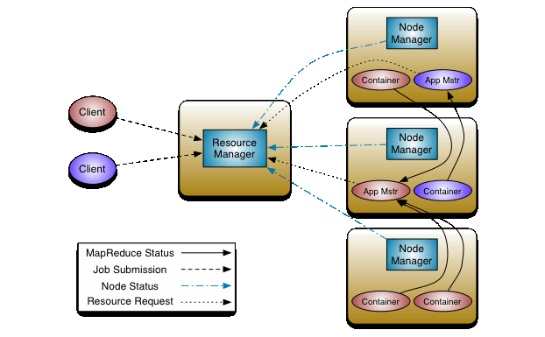
YARN: Execution of Tasks
Resource Manager = Scheduler + Application Manager

Slide 17

Apache Tez
API and framework for interactive and high-performance batch applications
Runs on top of YARN
Organizes map reduce into a directed acyclic graph of tasks
Includes dynamic reconfiguration of execution graph
Used by Pig, Hive
They become interactive!
Using Tez is easy: set hive.execution.engine=tez;

Slide 18
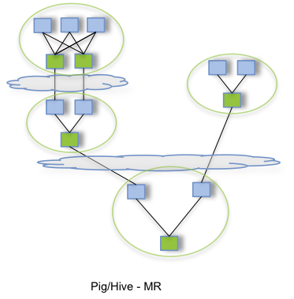
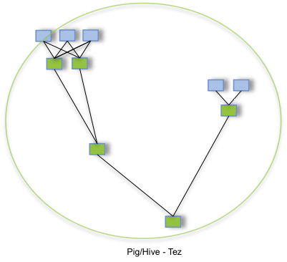
Tez vs. Map Reduce in Execution
Map reduce needs multiple jobs
Tez need just one job

Slide 19
Tez Benefits
Better performance
Better predictability
Less overhead and queuing delays
Better utilization of resources
Reduced load on HDFS
Reduced unnecessary writes
Reduced network usage
Higher programmer productivity
Less or no time spent optimizing Hadoop programs

Slide 20




Beyond Classical Hadoop: Spark & Flink
Spark
MapReduce
Tez
Flink

Slide 21
Apache Spark
Important Features
In Memory Data
Resilient Distributed Datasets (RDDs)
Datasets can rebuild themselves if failure occurs
Rich set of operators
Efficient:
10x (on Disk) -100x (In Memory) faster than Hadoop MR
2 to 5 times less code (Rich APIs in Scala/Java/Python)

Slide 22
Apache Spark
Batch
(Apache Spark)
Interactive
(Apache SQL)
Streaming
(Spark Streaming)
Fast to run: in-memory storage
Easy to develop

Slide 23

Spark Execution Model
Slave
Data Cached
in RAM/Disk
Task
Master
Slave
Result
Task
Data Cached
in RAM/Disk
Result
Task
Task
Result
Result
Slave
Data Cached
in RAM/Disk
Data Cached
in RAM/Disk
Slave

Slide 24
Apache Flink Stack
MRQL
Gelly
Dataflow
Table
Hadoop MR
ML
Cascading
Table
SAMOA
Dataflow
DataSet
DataStream
Streaming Dataflow Runtime
Local
Remote
YARN
Tez
Embedded

Slide 25
Apache Flink Characteristics
Execution:
Programs compiled into an execution plan
Plan is optimized
Executed
Design goals:
High performance
Hybrid batch and streaming runtime
Simplicity for the developer
Rich libraries
Integration with many systems
Flink is similar to Spark, but with different internals:
Streaming is the native architecture, batch is a special case of a finite stream

Slide 26

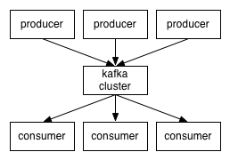
Apache Kafka
Publish-subscribe messaging
Fast
Scalable
Durable
Distributed
Kafka is not part of Hadoop, but commonly used to bring data into Hadoop/Spark

Slide 27
Kafka Use Cases
Messaging
User activity tracking
Metrics
Log aggregation
Stream processing
Event sourcing

Slide 28




Integrating Relational, Streams, and Hadoop
Traditional
Warehouse
Traditional / Relational Data Sources
Database &
Warehouse
At-rest data analytics
Results
Streams
Non-Traditional / Non-Relational Data Sources
Event System
In-Motion Analytics
Ultra Low Latency Results
Varied data formats
Big Data
Massive Scale
Semi-structured, unstructured...
Hadoop
Batch oriented data analytics
Results

Slide 29
Conclusion
Hadoop ecosystem is diverse and growing
Zookeper
Yarn
Tez
HCatalog
Sqoop
Flume
HBase
Spark
Flink

