Slide 1
Hive Overview

Slide 2

Not That Kind

Slide 3
What is Hive?
Apache Hive is a data warehouse infrastructure built on top of Hadoop for providing data summarization, query, and analysis
Provides a SQL-like language called HiveQL
Best suited for applications where data is relatively static and fast response times are not required
Abstraction over MapReduce
Internally HiveQL is converted into Map and Reduce tasks in Hadoop
Developed to make programming MapReduce jobs easier than using Java
Project originally started by Facebook in 2008

Slide 4
Pig vs. Hive
Both were developed as independent projects
Pig is a procedural data flow language (Pig Latin) where Hive has a declarative language (HiveQL)
Hive is a good choice:
when you want to query the data
if you are familiar with SQL
when you have structured data
Pig is a good choice:
for Extract -> Transform -> Load
preparing your data so that it is easier to analyze
when you have a long series of steps to perform
when you have unstructured data
Both compile to MapReduce jobs

Slide 5
Hive Components
Hive runs on top of Hadoop
The hive command line interface can be used to type in statements one at a time or run Hive scripts
An optional HiveServer can be installed that allows remote client to submit requests to Hive
HiveServer is built on top of Apache Thrift
Access using JDBC and ODBC are also provided
Hive web interface (HWI)
All Hive installations require a metastore service which Hive uses to store table schemas and other metadata
By default, Hive uses a built in Derby SQL server
For clusters, MySQL or PostgresSQL are recommended

Slide 6
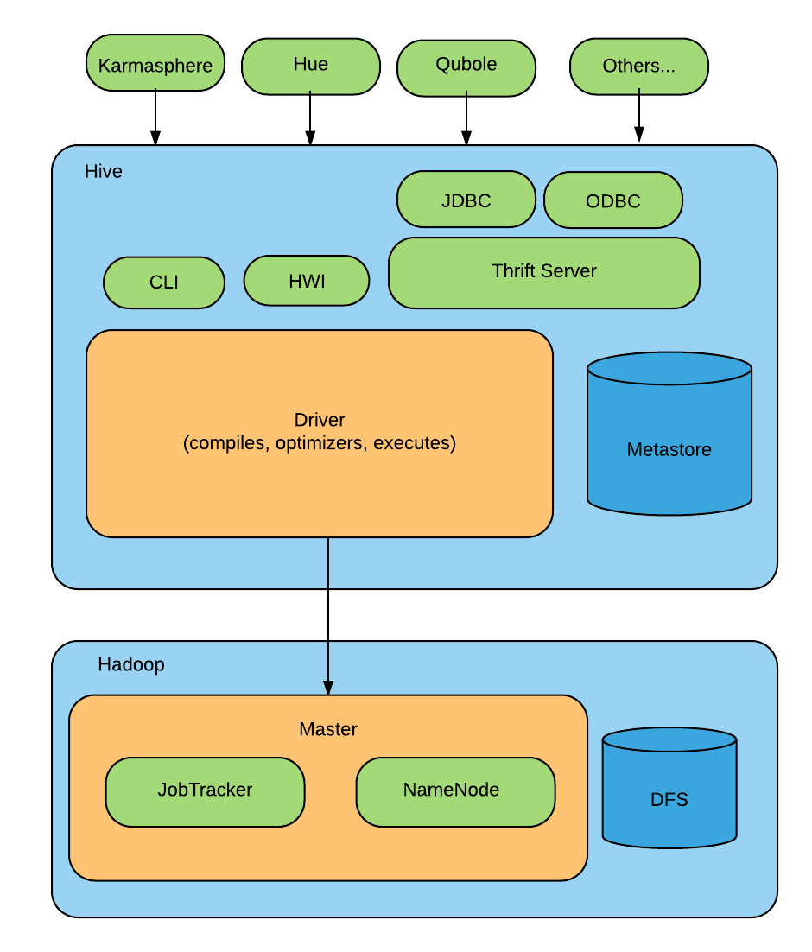
Major Hive Modules

Slide 7
HiveQL
HiveQL is the Hive query language
Based on SQL but does not fully conform to any ANSI SQL standard
Hive does not support row-level inserts, updates, and deletes
Hive does not support transactions
Hive adds some extensions to provide better performance in the context of Hadoop
Like Pig, Hive supports User Defined Functions (UDF)

Slide 8
Create Database
The Hive concept of a database is a collection of tables
Hive creates a top level directory for each database with files for tables contained within
If you don't specify a database, the default database is used
hive> CREATE DATABASE sales;
You can see databases that exist with
hive> SHOW DATABASES;
default
sales
hive> SHOW DATABASES LIKE 's.*';
sales

Slide 9
Create Database Continued
You can override the desired location for the database
hive> CREATE DATABASE sales
> LOCATION '/my/preferred/directory';
You can add a descriptive comment to the database which will be shown by the DESCRIBE DATABASE command
hive> CREATE DATABASE sales
> COMMENT 'Holds all sales tables';
You can associate key value properties with the database but their only function is to provide added information to the output of DESCRIBE DATABASE EXTENDED <database>
hive> CREATE DATABASE sales
> WITH DBPROPERTIES ('creator' = 'John Doe', 'date' = '2016-01-01');

Slide 10
Use Database
The USE command sets a database as your working database
hive> USE sales;
After you USE a database, commands like SHOW TABLES; will list the tables in that database
To find out what database is currently in use by the CLI, use set hive.cli.print.current.db=true

Slide 11
Drop Database
To drop a database
hive> DROP DATABASE IF EXISTS sales;
The IF EXISTS clause is optional and suppresses a warning if sales doesn't exist
Hive won't permit you to drop a database if it contains tables
Drop the tables first
Append CASCADE keyword to the command which will cause Hive to drop the tables in the database first
When a database is dropped, its directory is also deleted

Slide 12
Alter Database
You can set key-value pairs in the DBPROPERTIES for a database using the ALTER DATABASE command
No other metadata about the database can be changed including its name and directory
hive> ALTER DATABASE sales SET DBPROPERTIES ('edited-by' = 'Joe Dba');
There is no way to unset or delete a DBPROPERTY

Slide 13
Creating Tables
CREATE TABLE IF NOT EXISTS human_resources.employees (
name STRING COMMENT 'Employee name',
salary FLOAT COMMENT 'Employee salary',
subordinates ARRAY<STRING> COMMENT 'Names of subordinates',
deductions MAP<STRING, FLOAT>
COMMENT 'Keys are deduction names, values are %s',
address STRUCT<street:STRING, city:STRING, state:STRING, zip:INT> );
You can prefix a database name if creating a table in a database that you are not currently "using"
If you add the option IF NOT EXISTS, Hive will silently ignore the statement if the table already exists
Useful in scripts that should create a table the first time they run

Slide 14
Copy Schema
You can copy the schema but not the data of an existing table
hive> CREATE TABLE IF NOT EXISTS human_resources.employees2 LIKE human_resources.employees;

Slide 15
Alter Table
Most table properties can be altered with ALTER TABLE
ALTER TABLE modifies table metadata only – it's up to the user to make sure that the actual data is correct
hive> ALTER TABLE log_messages RENAME TO logmsgs;
You can rename a column, change its position, type, or comment
hive> ALTER TABLE log_messages CHANGE COLUMN hms hours_minutes_seconds INT AFTER severity
You can add new columns to the end of the existing columns
hive> ALTER TABLE log_messages ADD COLUMNS (
app_name STRING COMMENT 'Application name',
session_id LONG COMMENT 'Session id');

Slide 16
Delete or Replace Columns
ALTER TABLE log_messages REPLACE COLUMNS (
hours_mins_secs INT,
severity STRING,
message STRING );
This statement will remove all existing columns and replaces them with the specified columns

Slide 17
Managed vs. External Tables
Hive has a concept of managed and external tables
For a managed table, Hive controls the lifecycle of the data
Hive stores the data for the table in a subdirectory under the directory defined by hive.metastore.warehouse.dir
When the managed table is dropped, Hive deletes the data in the table
By default, the CREATE TABLE command creates a managed table

Slide 18
External Tables
Suppose you have data that is created and primarily used by another tool like Pig
You may want to run queries against it but not give Hive ownership of the data
You can define an external table that points to that data but doesn't take ownership of it
When you drop an external table, the data is not deleted although the Hive metadata for that table will be deleted

Slide 19
Create an External Table
CREATE EXTERNAL TABLE IF NOT EXISTS stocks (
exchange STRING,
symbol STRING )
ROW FORMAT DELIMITED FIELDS TERMINATED BY ',',
LOCATION '/data/stocks';
The EXTERNAL keyword tells Hive this table is external and the LOCATION clause is required to tell Hive where it is located

Slide 20
Partitioned, Managed Tables
Partitioning tables can have performance benefits and helps organize data in a logical fashion
Imagine that you work in a multinational company and HR runs queries with WHERE clauses that restrict results to a particular country
CREATE TABLE employees (
name STRING,
salary FLOAT
address STRUCT<street:STRING, city:STRING, state:STRING, zip:INT>
)
PARTITIONED BY ( country STRING, state:STRING );

Slide 21
Partitioned Table Storage
Partitioning tables changes how Hive structures the data storage
The previous example would create subdirectories reflecting the partitioning structure
...
.../employees/country=CA/state=AB
.../employees/country=CA/state=BC
...
.../employees/country=US/state=AL
.../employees/country=US/state=AK
...

Slide 22
Performance
The partition keys are country and state in this case and behave like regular columns
SELECT * from employees WHERE country = 'US' and state = 'TX';
Now Hive only has to scan the contents of one directory even if we have thousands of country and state directories
For very large data sets, partitioning can dramatically improve query performance

Slide 23
External Partitioned Tables
Partitioning external tables gives you a way to share data with other tools while still optimizing query performance
Suppose there are log files that need to be analyzed and a day's worth of log data is the correct size for a partition
CREATE TABLE IF NOT EXISTS log_messages (
hours_minutes_seconds INT,
severity STRING,
message STRING )
PARITIONED BY (year INT, month INT, day INT)
ROW FORMAT DELIMITED FIELDS TERMINATED BY '\t';

Slide 24
Adding a Partition to External Table
For an external table, partitions are added separately to specify the location
ALTER TABLE log_messages ADD PARTITION(year = 2016, month = 1, day = 2) LOCATION 'hdfs://server/data/log_messages/2016/01/02';
Like non-partitioned external tables, Hive does not own the data and does not delete data if the table is dropped

