Slide 1
HCatalog

Slide 2
Hive Metadata
We have seen the advantages of using a SQL-like language to analyze data in a Hadoop cluster but there are other benefits Hive provides
The Hive metadata separates data producers, consumers, and administrators
Producers can add a new column to the data without breaking data reading applications
Administrators can relocate data to change the format without breaking the consumers or producers
Other tools like Pig and MapReduce don't require this metadata but they can benefit from its existence

Slide 3
Hadoop Ecosystem
Most users do not use only one tool in the Big Data world
For example
You might use Pig for ETL processing and then Hive for data analytics
The data load process might require loading from an external source where a Java MapReduce job is required but then you would like to analyze the results in another tool
Wouldn't it be convenient to share the metadata between all these tools?

Slide 4
HCatalog
HCatalog makes Hive metastore available to other tools
Pig
MapReduce
Sub-component of Hive
hcat - command line tool for users who do not use Hive to operate on the metastore
Notification service so that other tools (like Oozie) can be notified when new data becomes available in the warehouse
REST interface for external data access
WebHCat – web server for interacting with the Hive metastore

Slide 5
Interfaces to Other Tools
How do you access the metastore from other tools?
MapReduce
HCatInputFormat – read data stored in Hive's data warehouse
HCatRecord – interact with records
HCatOutputFormat – write data to Hive's data warehouse
Pig
HCatLoader – read data stored in Hive's data warehouse
HCatStorer – write data to Hive's data warehouse
And of course, from Hive you have direct access to its metadata

Slide 6
Supported File Types
HCatalog supports reading and writing files in any format for which a serializer/deserializer can be written
By default, HCatalog supports
RCFile
CSV
JSON
SequenceFile
ORC

Slide 7
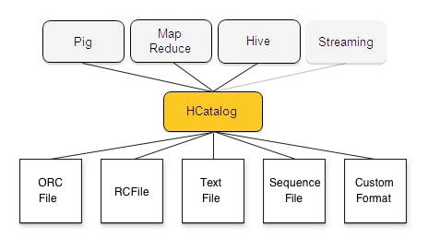
Supported Interfaces

Slide 8
Command Line
For users that are not Hive users, hcat is a command line utility provided to interact with the metastore
Unlike the hive CLI, hcat does not allow commands that result in a MapReduce job being spawned
Some operations that are not supported
SELECT
CREATE TABLE AS SELECT
INSERT
LOAD
ALTER INDEX REBUILD
ALTER TABLE CONCATENATE
ANALYZE TABLE
EXPORT TABLE
IMPORT TABLE

Slide 9
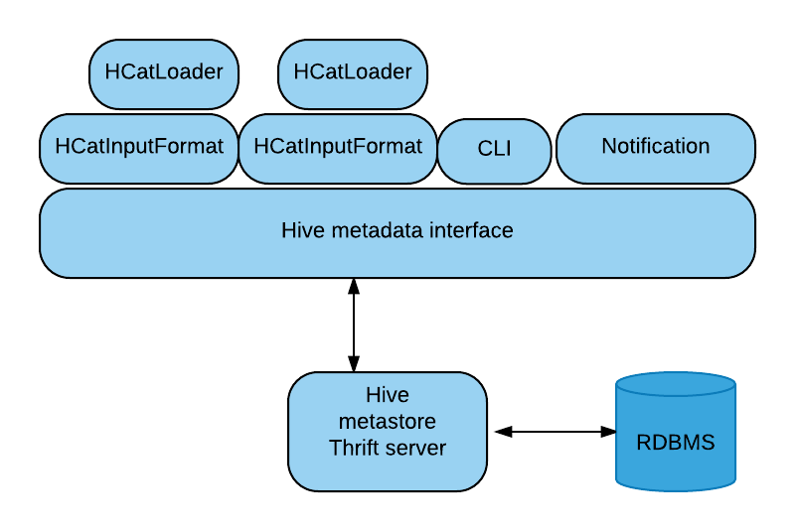
HCatalog - Architecture

