Slide 1
Scalding Overview

Slide 2
Overview
Scala for Big Data
Example of collection processing in Scala
Word Count in Scalding
Scalding building blocks

Slide 3
Big Data with Scala – Why Bother?
Power and expressiveness
Few lines of code
A real, modern programming language
Great collection library
The ideas can be applied to Big Data
Functional programming language
Suitable for parallelization
Extensible language
Domain Specific language
JVM
Use all of the Java ecosystem

Slide 4
Implementing Big Data in Scala
Scala as a choice for Big Data infrastructure:
Spark
Flink
Scalding
Kafka
…
Scalding users:
Twitter, LinkedIn, eBay, Spotify, Etsy, AirBnB, Tumblr,…
Scala is the main language for Spark
Expect further growth!

Slide 5
Scala WordCount: A Plain Memory Version
object WordCountInMemory extends App {
val text =
"""Hello, it's me, I was wondering
|If after all these years you'd like to meet to go over everything
|They say that time's supposed to heal, yeah
|But I ain't done much healing
|"""".stripMargin
val wordCount = text
.split(" ") // Array[String]
.map(word => (word, 1)) // Array[(String, Int)]
.groupBy(_._1) // Map[String,Array[(String, Int)]]
.map(a => (a._1, a._2.map(_._2).sum)) // Map[String,Int]
println(wordCount)
}

Slide 6
Scala: A Strongly Typed Language
object WordCountInMemory extends App {
val text =
"""Hello, it's me, I was wondering
|If after all these years you'd like to meet to go over everything
|They say that time's supposed to heal, yeah
|But I ain't done much healing
|"""".stripMargin
val wordCount = text
.split(" ") // Array[String]
.map(word => (word, 1)) // Array[(String, Int)]
.groupBy(_._1) // Map[String,Array[(String, Int)]]
.map(a => (a._1, a._2.map(_._2).sum)) // Map[String,Int]
println(wordCount)
}

Slide 7
Scalding: Word Count Example (Runs on Hadoop!)
class WordCountShort(args: Args) extends Job(args) {
def tokenize(text: String): Array[String] = {
text.toLowerCase.replaceAll("[^a-zA-Z0-9\\s]", "")
.split("\\s+")
}
TypedPipe
.from(TextLine(args("input")))
.flatMap(tokenize(_))
.groupBy(word => word)
.size
.write(TypedTsv(args("output")))
}
We will try this out in a lab!

Slide 8
Running in Local Mode
Use sbt run command
Options:
--local
--hdfs
Run as:
run com.example.WordCountShort --local --input data/hello-adele.txt --output data/hello-adele-word-count.tsv

Slide 9



Scalding Building Blocks
Scalding
Cascading
Hadoop
Scalding internally uses Cascading, a Java library for Hadoop MapReduce
You will see log message related to Cascading when you run Scalding programs

Slide 10
What is Cascading?
Java API for Hadoop
Based on the concept of pipes
No need to understand the details of MapReduce API
Much easier than regular Hadoop API
It can be run locally or in a cluster
Connectors:
HDFS
Files
RDB
NoSQL (Cassandra, MongoDB, HBase)
In memory databases
Scalding inherits all of these!

Slide 11
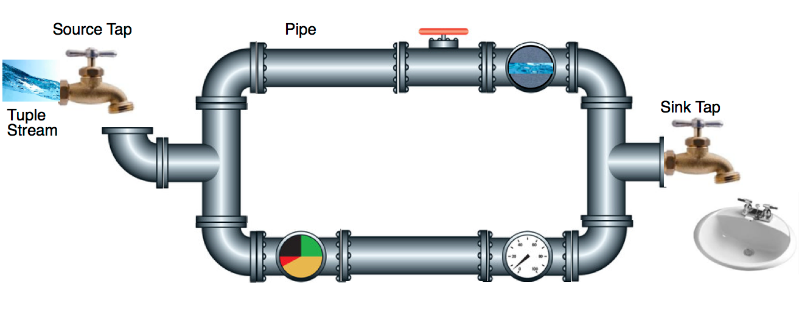
The Idea of Pipes in Cascading
Data flows through pipes are parallel!
Running on multiple machines on the Hadoop cluster

Slide 12
Scalding as a Scala DSL
Scalding developers work at the level of collections
A higher level than Cascading pipes
Rich set of operations
Few lines of code
Often 5x shorter!
MapReduce becomes like a low level assembly
We are working on a higher, more productive level
Optimizations can be done by tools
Can access the full power of the Scala language
Goes far beyond Hive and Pig

Slide 13
Running on Hadoop Cluster
Assemble the Scalding program in a jar
Run the program in the same way as you would a plain Java MapReduce program.
$ hadoop jar myjar.jar com.twitter.scalding.Tool \ mypackage.MyJob --hdfs \ --input /data/set1/ \ --output /output/res1/
The run will purge the output folder!

Slide 14
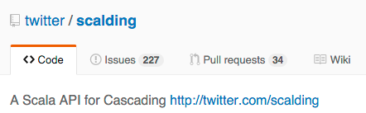
The Scalding Project
https://github.com/twitter/scalding
Code
Documentation
Wiki
Useful resources:
http://stackoverflow.com/search?q=scalding
https://groups.google.com/forum/#!forum/cascading-user
https://groups.google.com/forum/#!forum/scalding-dev

