Slide 1
Scalding Matrix API Overview

Slide 2
Why Another Matrix Library?
Why matrices?
Many analytical, graph, and machine learning problems can be solved with matrix computations
Standard matrix libraries: limited by RAM amount
Scalding provides all standard matrix operations
Scalding handles Big Data matrices:
Matrices are huge → larger than the memory
Big Data matrices are typically sparse
We'll do just a short overview here

Slide 3
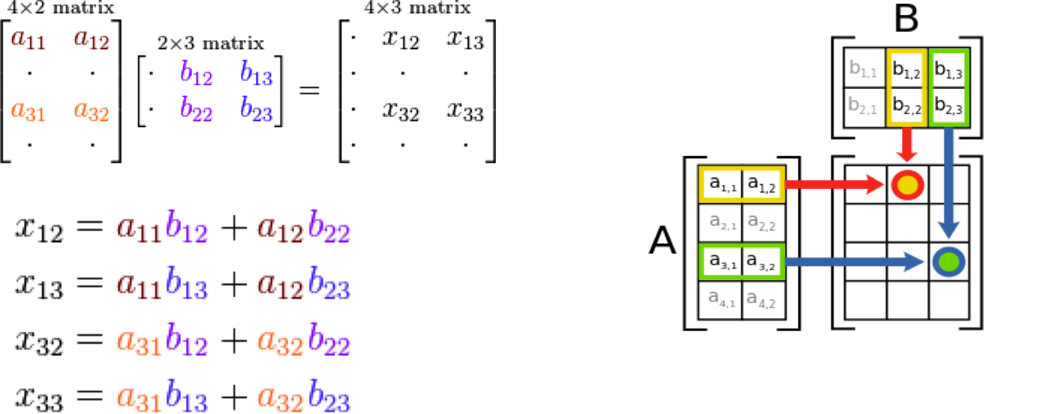
A Quick Refresher: Matrix Multiplication
Source: Wikipedia

Slide 4
Useful Matrix Computations in Big Data
Graph processing
Jaccard coefficient: for set-based similarity
K-Means clustering algorithms
Text similarity
Term frequency/inverse document frequency: TF-IDF

Slide 5
Scalding Matrix Representation
Matrix representation:
A collection of triples (row index, column index, value)
Hints:
no of rows, columns, non-zero values, skewness
Matrices as pipes!

Slide 6
Matrix Representation
Types for rows and columns: any comparable would do
Common types: Long, String
Benefit: we can use labels
Instead of mapping between numbers and labes
val interestsMatrix = Tsv( args("input") ).read.toMatrix[String,String,Long]
('geo, 'movie_genre, 'freq)

Slide 7
The "Hello World" of Graph Analytics: Outdegrees
import com.twitter.scalding._
import com.twitter.scalding.mathematics.Matrix
class GraphOutDegreeJob(args: Args) extends Job(args) {
import Matrix._
val adjacencyMatri = Tsv("data/graph.tsv", ('user1, 'user2, 'rel))
.read
.toMatrix[Long, Long, Double]('user1, 'user2, 'rel)
// each row i represents all of the outgoing edges from i
// by summing out all of the columns we get the outdegree of i
adjacencyMatrix.sumColVectors.write(Tsv("data/outdegree.tsv"))
}
Source: Scalding GitHub

Slide 8
Summary
Big Data matrix computation
Matrices are treated as pipes
Triplet representation – good for sparse matrices
Rows and columns can be labels
Many advanced problems can be solved with matrix computation

