Slide 1
Fundamentals of HBase

Slide 2
Overview
What is HBase?
History of HBase
Relationship to BigTable
Major Components
Client API
MapReduce
CAP Theorem

Slide 3
What is HBase?
Top level Apache project
Distributed, horizontally scalable, non-relational database
Runs on top of Hadoop file system (HDFS)
Column based database
Supports linear scalability, automatic failover, automatic sharding
HBase tables can be used as input and output for Hadoop MapReduce jobs
API can be accessed in a number of different ways

Slide 4
Google BigTable
In 2006, Google published a paper titled BigTable: A Distributed Storage System for Structured Data
"Bigtable is a distributed storage system for managing structured data that is designed to scale to a very large scale: petabytes of data across thousands of commodity servers.
… a sparse, distributed, persistent multi-dimensional sorted map."

Slide 5
BigTable in Production
BigTable has been in production since 2004 at Google and powers almost all of their services
Search (of course!)
Gmail
Google Earth
Google Finance
Google Analytics
AdSense
AdWords
and more..
BigTable runs against Google File Sytstem (GFS) which is analogous to Hadoop Distributed File System (HDFS)

Slide 6
How does HBase fit in?
HBase was created in 2007 at Powerset
Implementation based on BigTable paper
Initially a Hadoop sub project in 2008
Became an Apache top level project in 2010
HBase 1.0.0 released in February 2015
Used by major web companies
Facebook for messaging
LinkedIn
Neflix
Spotify
and more!

Slide 7
Components of HBase
Client library (API)
At least one Master Server
Responsible for load balancing of regions to region servers
Uses Apache Zookeeper, a distributed coordination service which is its own open source project
Many Region Servers
Can be added or removed while system is running
Responsible for all read and write requests

Slide 8
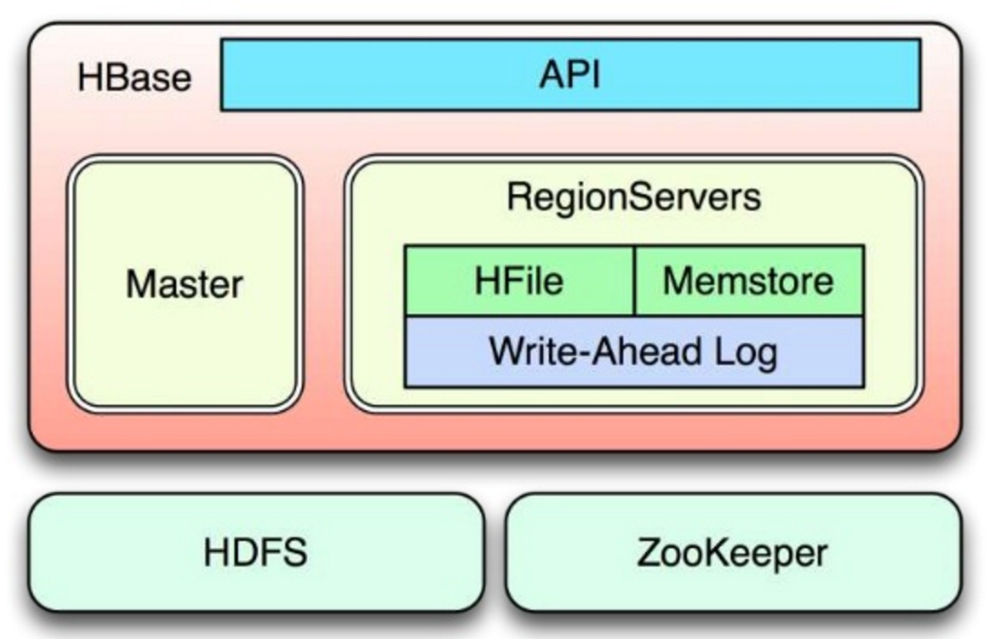
HBase Components

Slide 9
Client API
HBase is written in Java and so is the client API
Primary client interface is in the org.apache.hadoop.hbase.client package
Access to HBase is possible in virtually every other language as well
REST
Thrift (developed by Facebook)
Apache Avro
Thrift and Avro are RPC layers and may be considered if the verbosity of plain text with REST is an issue
HBase ships with auxiliary servers for all three

Slide 10
MapReduce
In addition to real time queries with client API, HBase has tight integration with Hadoop MapReduce framework for data analysis
Client access through the org.apache.hadoop.hbase.mapreduce package
MapReduce is designed to process terabytes of data in a scalable way
Performance scales linearly with the number of physical machines added through a divide and conquer approach

Slide 11
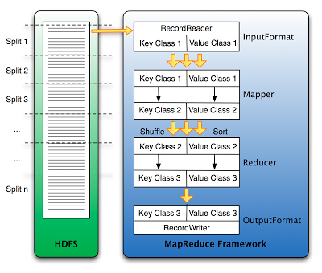
HBase MapReduce Diagram

Slide 12
CAP Theorem
CAP Theorem also known as Brewer's theorem states that it is impossible for a distributed computer system to provide all three of the following guarantees:
Consistency – all nodes see the same data at the same time
Availability – a guarantee that every request receives a response about whether it succeeded or failed
Partition tolerance – the system continues to operate despite arbitrary partitioning due to network failure

Slide 13
NoSQL Databases
The current NoSQL databases achieve different combinations of the CAP theorem
CA – Single site cluster, all nodes are always in contact. When a partition occurs, the system blocks
CP – Some data may not be accessible, but the rest is still consistent/accurate
AP – System is still available under partitioning, but some of the data returned may be inaccurate
HBase is a CP type system

Slide 14
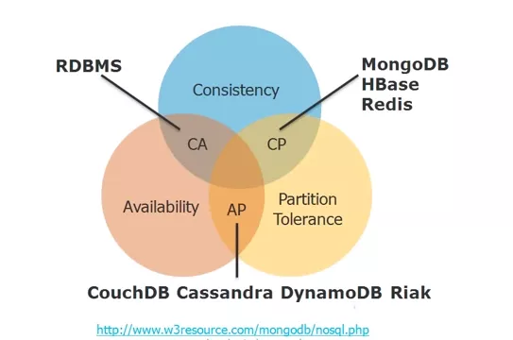
CAP Illustrated

