Slide 1
Understanding HBase Table Structure and Architecture

Slide 2
Tables, Rows, Columns, and Cells
HBase is a column oriented database.
The most basic unit is a column
One or more columns form a row which is uniquely addressed by a row key
A number of rows form a table
Each column may have multiple versions and each value is contained in a separate cell
Tables can be grouped into namespaces which can help the organization of your application

Slide 3
Row Keys
Row keys are unique and sorted lexicographically
Lexicographical sorting is done on a binary level, byte by byte, from left to right
For example, this would be the order of rows in an example table:
row-1
row-10
row-11
row-2
row-22
row-3
row-abc

Slide 4
Row Keys (continued)
Knowing that row keys will always be sorted this way can be used to your advantage!
You have a built in "primary key" like behavior like a RDBMS
Row keys can be any arbitrary array of bytes and not necessarily human-readable

Slide 5
Column Families
Columns can be grouped into column families which is a way to organize columns of related data
Columns in a column family are stored together in the same low-level storage file
Column families must be defined up front when the table is created and there are flaws in the current implementation that limit the number to the low tens
No limit on number of columns in a column family – this could be in the millions

Slide 6
A Table in HBase
 | Row Key | Column Family 1 |  |  | Column Family 2 |  |  |  | …
 |  | colA | colB | colC | colA | colB | colC | colD
Region 1 | axxx | val |  | val | val |  |  | val
 | …
 | gxxx | val |  |  | val | val | val
Region 2 | hxxx | val | val | val | val | val | val | val
 | …
 | jxxx | val
Region 3 | kxxx | val |  | val | val |  |  | val
 | …
 | rxxx | val | val | val | val | val
 | sxxx | val |  |  |  |  | val | val

Slide 7
Cells
Each column may have multiple versions of each cell
Every cell is either implicitly time stamped by the server or you can set it explicitly
Different versions of a cell are stored in decreasing timestamp order which means the newest value is always read first
The number of versions of a cell is configured by the user
The cell value is an unlimited array of bytes – the client must handle converting it to a meaningful type

Slide 8
Adding It All Together
Putting all these concepts together, you can express access to data in HBase as:
(Table, RowKey, Family, Column, Timestamp) -> Value
Access to row data is atomic and includes any number of columns being read or written to
Access is strictly consistent – each concurrent reader and writer can make safe assumptions about the state of the row
No further transactional guarantee that spans multiple rows or across tables
No JOINs!

Slide 9
Region Servers
Regions are the basic element of availability and distribution of tables. They are contiguous ranges of rows stored together.
Initially there is one region per table
When you exceed the user defined size, the region is split into two at the middle key
Each region is served by one region server and each of these servers can serve many regions
Splitting is analogous to autosharding in other databases
The process of splitting is close to instantaneous!

Slide 10
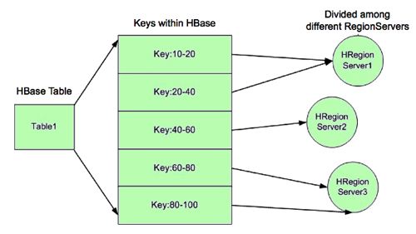
Region Server Diagram

Slide 11
Zookeeper
HBase is comprised of one master server and many region servers
Apache Zookeeper is a separate open source project and the master server uses this to assign regions to region servers
Comparable system is Google's Chubby for BigTable
Critical component – without it, HBase is not operational

Slide 12
HFile
Data is stored in HFiles which are persistent and ordered immutable maps from keys to values
Default block size is 64 KB but can be configured
Store files are saved in the Hadoop Distributed File System (HDFS)
When data is updated, it is written to a write-ahead log (WAL) and then stored in an in-memory store
When the memory store exceeds a maximum value, it is flushed as an HFile to disk
After the flush, the commit logs are discarded up to the last unflushed modification

Slide 13
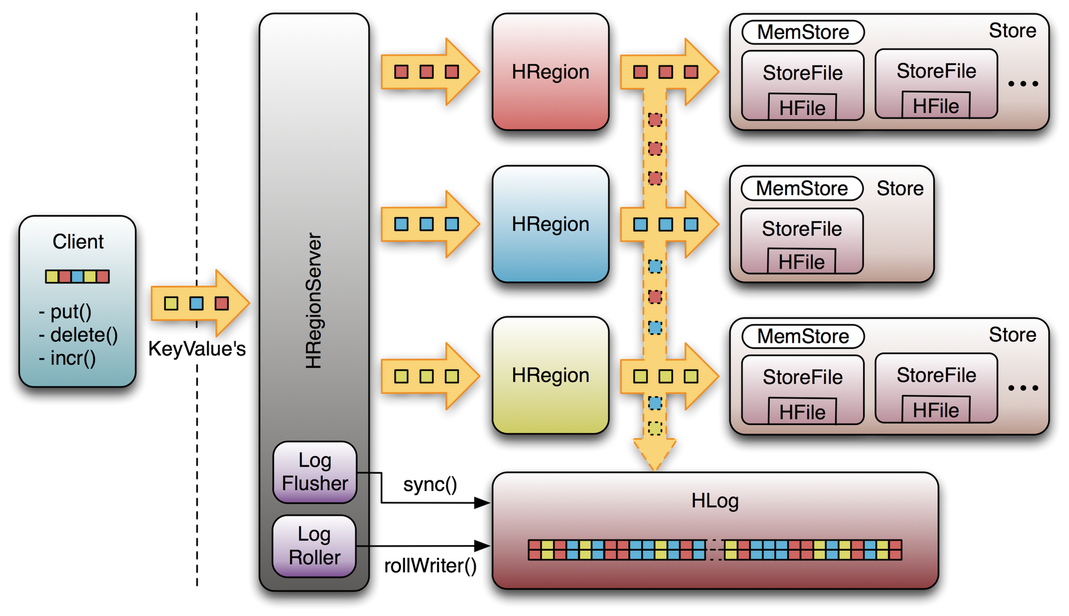
WAL Illustrated

Slide 14
Deleting Data
HFiles are immutable! You can not delete values immediately
When a delete request is issued, a tombstone marker is written to indicate that the key has been deleted
During retrieval, the delete markers mask out the actual values from clients
The data is actually deleted during the compaction process which is an internal housekeeping process that will trigger about once every 24 hours (or manually via an API call)

Slide 15
Data Model Recap
Table – has many rows
Row – atomic key/value container, with one row key
Column Family – divide columns into physical files
Column – a key in the k/v container inside a row
Timestamp – long milliseconds, sorted descending
Value – a time-versioned value in the k/v container

Slide 16
Data Model Recap
Table – has many rows
Row – atomic key/value container, with one row key
Column Family – divide columns into physical files
Column – a key in the k/v container inside a row
Timestamp – long milliseconds, sorted descending
Value – a time-versioned value in the k/v container
Row keys, column names, values: arbitrary bytes

Slide 17
Data Model Recap
Table - has many rows
Row – atomic key/value container, with one row key
Column Family – divide columns into physical files
Column – a key in the k/v container inside a row
Timestamp – long milliseconds, sorted descending
Value – a time-versioned value in the k/v container
Row keys, column names, values: arbitrary bytes
Table and Column Family: printable characters

Slide 18
Data Model Recap
Table - has many rows
Row – atomic key/value container, with one row key
Column Family – divide columns into physical files
Column – a key in the k/v container inside a row
Timestamp – long milliseconds, sorted descending
Value – a time-versioned value in the k/v container
Row keys, column names, values: arbitrary bytes
Table and Column Family: printable characters
Timestamp: long integers

Slide 19
Recap Continued
Every "cell" (the time-versioned value of one column in one row) is stored fully qualified with its full row key, column, family, column name on disk

