Slide 1
Bulk Loading With HBase

Slide 2
Getting Data Into HBase
How do you efficiently get data into HBase?
If your data is not huge (yet)
MapReduce job outputting results to HBase
Client APIs
But what if you have a LOT of data to import?

Slide 3
Clues That Bulk Loading is Appropriate
If you have any of these issues, bulk loading is probably the right choice for you
You are tweaking the HBase MemStore size to use most of your memory
You are using bigger Write Ahead Logs or bypassing them entirely
Your compaction and flush queues are in the hundreds
Your garbage collection is out of control
Your latency becomes unacceptable when you import data
Using bulk loading can help avoid these issues

Slide 4
What is Bulk Loading?
In terms of HBase, bulk loading is the process of preparing and loading HFiles directly into the RegionServers
This process bypasses the normal write path completely which avoids the issues previously discussed
The process is similar to ETL (extract, transform, load)

Slide 5
Two Bulk Load Methods
There are two main strategies for performing a bulk load in HBase
ImportTsv
Custom MapReduce job with TableOutputFormat

Slide 6
ImportTsv
HBase ships with a MapReduce job called ImportTsv
By default it imports tab separated values but you can specify a different separator character such as "," or "|"
ImportTsv has two usages:
Loading data from HDFS directly into HBase via Puts (not bulk loading!)
Creates HFiles that can then be be loaded via completebulkload

Slide 7
completebulkload
completebulkload iterates through the HFiles produced by ImportTsv and determines which region the file belongs to
Contacts the appropriate RegionServer which moves the HFile to the storage directory and makes it available to other clients
If a region is split after the files were created, the tool will automatically split the HFile into pieces according to the new boundaries
This process is not efficient so you should not delay the time between preparing a bulk load and importing it into the cluster

Slide 8
ImportTsv Continued
ImportTsv is good for prototyping but it interprets everything as strings and doesn't allow you to manipulate fields at transformation time
The importtsv.bulk.output specifies where HFiles will be written in HDFS. Without specifying this option, ImportTsv will write directly to HBase via the normal write path

Slide 9
Second Bulk Load Strategy
Custom MapReduce job
More advanced imports will require this strategy
More control over data than ImportTsv allows
So how does it work?

Slide 10
Extract the Source Data
First, you must extract the data from the original source
Text files
Export from some other database
HBase doesn't manage this part of the process
Once you have the files containing your data, upload them to the HDFS connected to HBase

Slide 11
Transform the Data into HFiles
For most input types, you write a custom Mapper for a MapReduce job
The Mapper emits the row key as the Key and either a KeyValue, Put, or Delete as the Value
The Reducer is handled by HBase and is configured by using HFileOutputFormat2.configureIncrementalLoad()
Sets the number of reduce tasks the match the current number of regions
Sets the reducer up to perform the appropriate sorting (KeyValueSortReducer or PutSortReducer)
One HFile will be created per region in the output folder
You need at least twice the amount of disk space available than the size of the original data set!

Slide 12
Load the files into HBase
Once you have the HFiles in an output folder, the last task is to load them into HBase
Use the LoadIncrementalHFiles.doBulkLoad API
This is the same API used by the completebulkload utility
You pass doBulkLoad() a location in HDFS to the files and it will load each file into the appropriate RegionServer

Slide 13
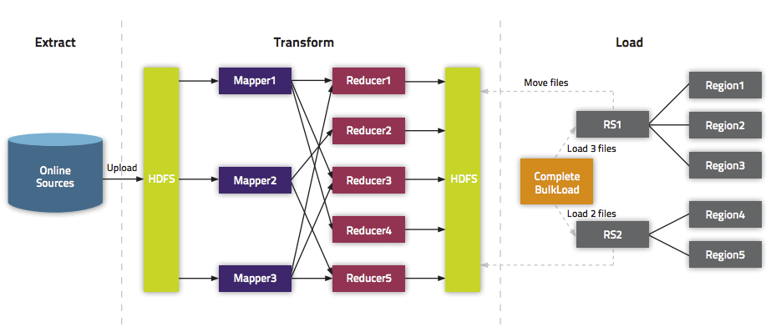
Bulk Load Illustrated
Illustration from Cloudera

