Slide 1
Stay Safe App
Prashant Patel
Prof. Irwin

Slide 2
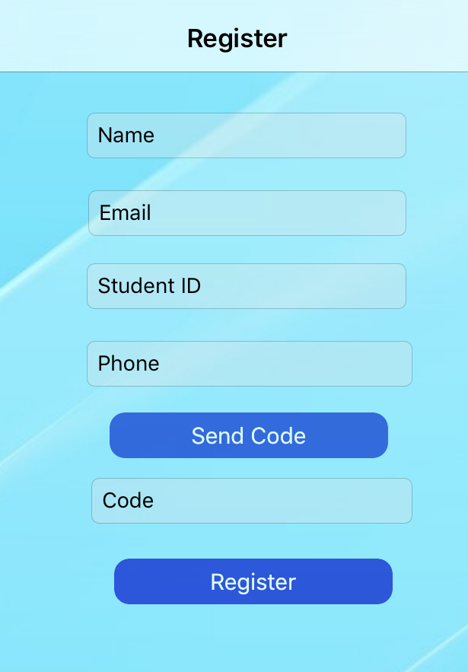
Functionalities
Registration
- Clearing fields on click.
- Splash Start Screen.
- SMS Code Verification.
- Saving the user’s identity to avoid
re- login – NSUserDefaults –
setPersistent Domain.

Slide 3
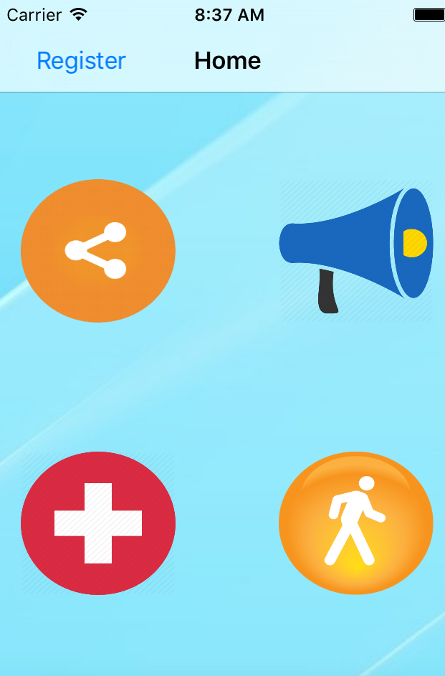
Functionalities (Contd)
Home Screen
- Directly Pops out without login in
again.
- Clear Icons.
- Disabled Back button if
already registered.

Slide 4
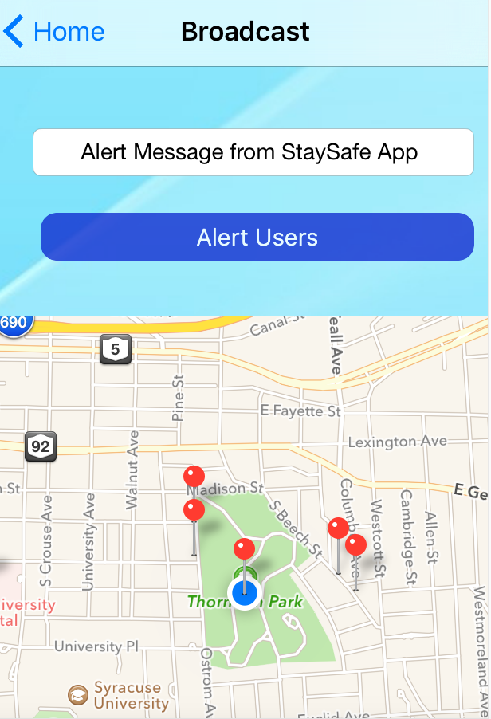
Functionalities (Contd)
Broadcast
- Allows to access user location.
- Start storing user’s location.
- Shows nearby users within 5 mile
radius.
- Defaulted Alert Text field to quickly send
alert within 5 miles Radius.
- Alerts provided via SMS.
- Apple Maps with Annotation, pins and pictures.

Slide 5
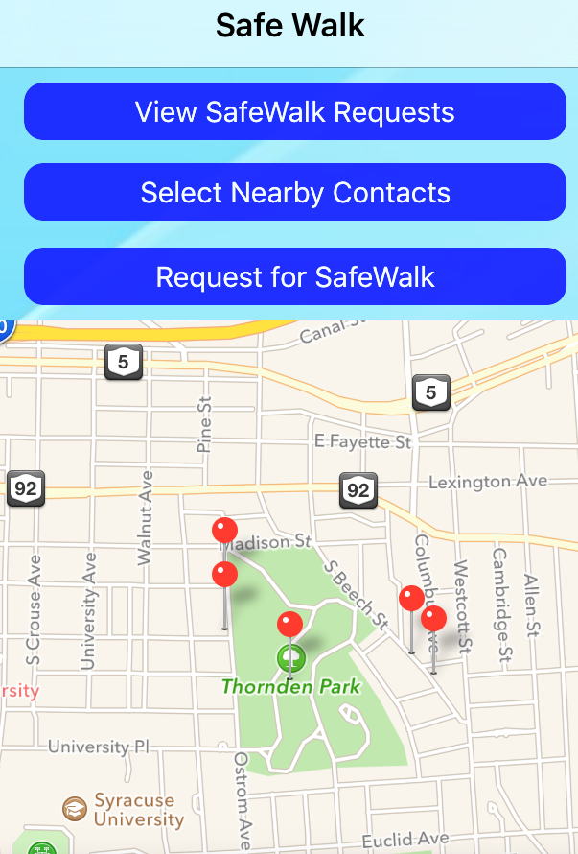
Functionalities (Contd)
Safe walk
- Allows to access user location.
- Contact list access.
- *Sort the Contact List according to Distance.
- Once selected from the Contact List,
Requested user is notified via SMS.
- .

Slide 6
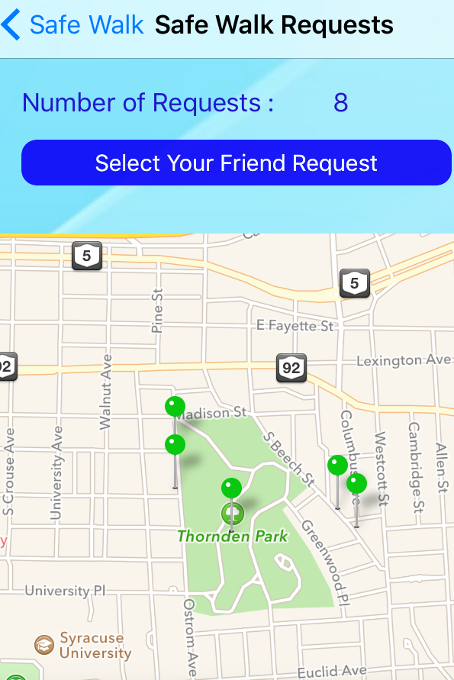
Functionalities (Contd)
Safe walk Request
- Shows Total number of requests.
- Can switch between multiple request
via dropdown.
- *Once the requested user watches his friend walk,
he/she will be notified via SMS.

Slide 7
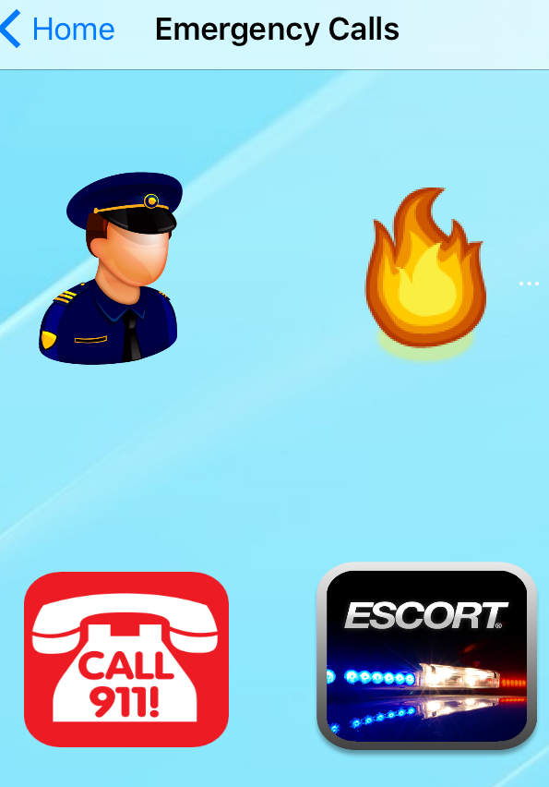
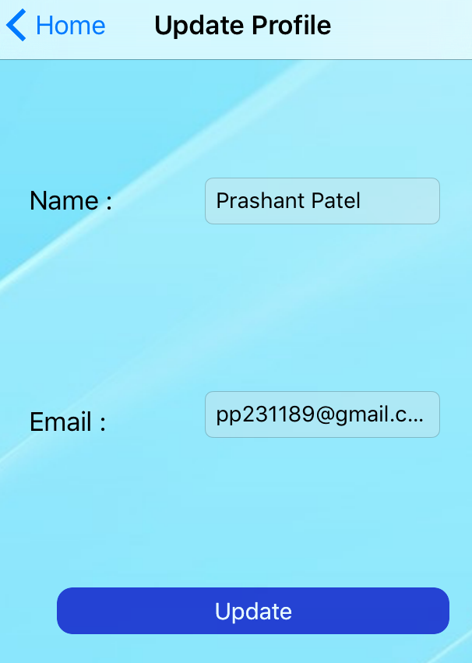
Functionalities (Contd)
Emergency Calls and Update Profile

Slide 8
Development
Map API – Annotations, Pins.
GPS.
Contact List access.
Light weight REST API’s rather than Parse DB.
Multi-threading.
Use of Semaphore for Blocking operations.
Quick Access.
Calling.

Slide 9
Layered Architecture
Repository Design Pattern - https://msdn.microsoft.com/en-us/library/ff649690.aspx
Controllers
Repository
Data Access Object
REST APIs
Value Object
JSON Query

