Slide 1
Are Men Healthier Than Women?
Parth Patel

Slide 2
Variables of Interest
Age (years, continuous variable)
Older people tend to be less healthy
BMI (cm/kg2, continuous variable)
Those with 18.5-24.9 are classified as healthy
Systolic Blood Pressure (mmHg, continuous variable)
Less than 120mmHg are classified as healthy
Cholesterol (discrete categorical variable)
Those with high cholesterol are less healthy
Glucose (discrete categorical variable)
Those with high glucose are less healthy
Presence of cardiovascular diseases (binary)

Slide 3
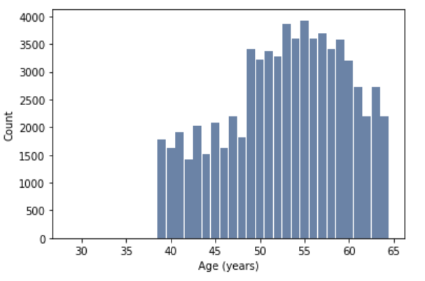
Histogram of age

Slide 4
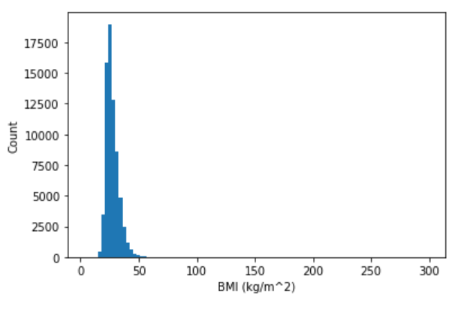
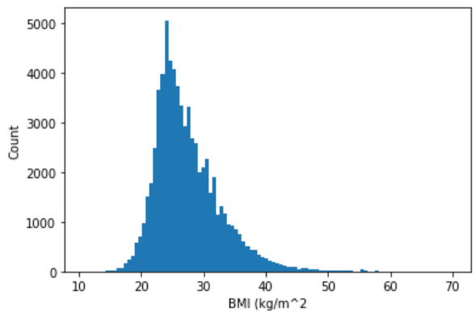
Histogram of Body Mass Index (BMI) unclean vs cleaned data

Slide 5
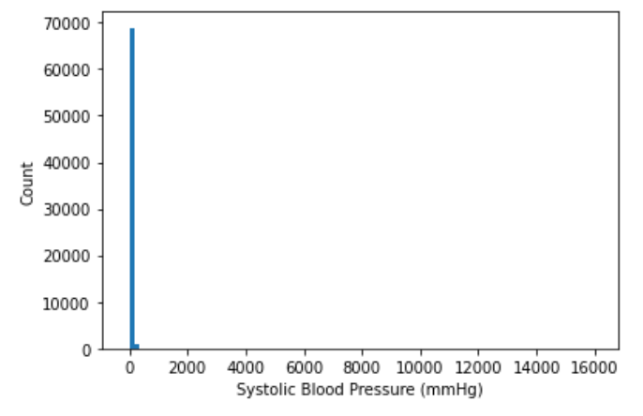
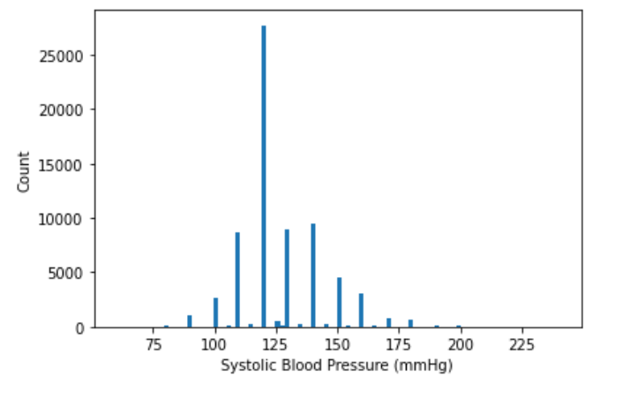
Histogram of Systolic Blood Pressure (sbp) unclean vs cleaned data

Slide 6
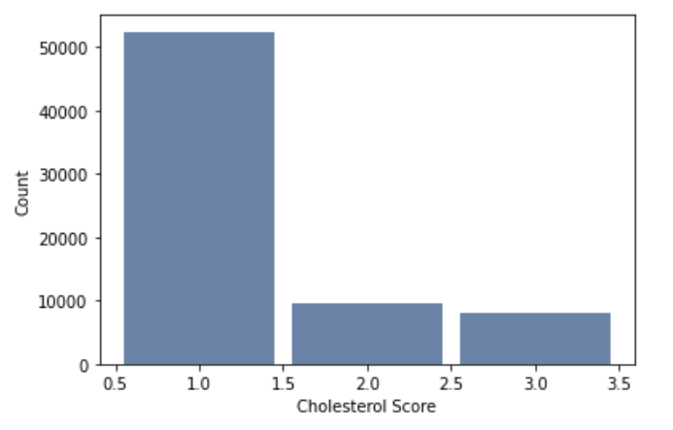
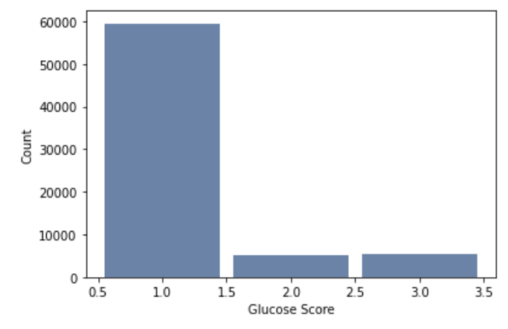
Histogram of Cholesterol and Glucose Scores

Slide 7
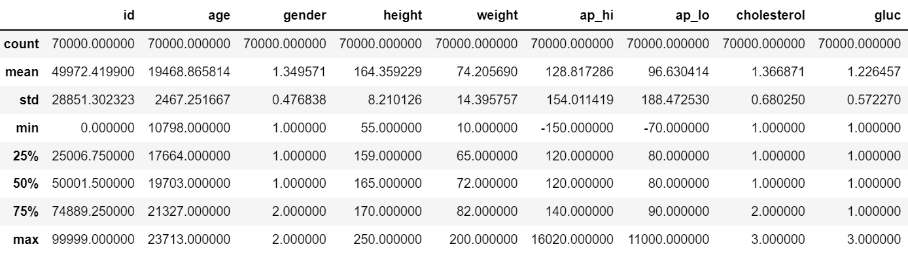
Summary of Variables
Age, Glucose Score (gluc), and Cholesterol Score had no outliers
Systolic Blood Pressure (ap_hi) and Body Mass Index had outliers
Extreme outliers were removed based on appropriate medical ranges

Slide 8
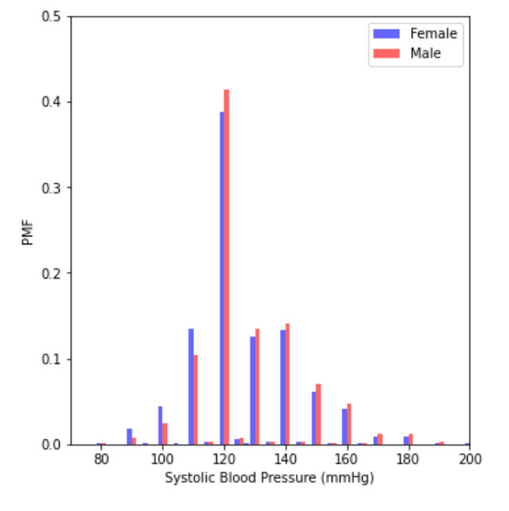
PMF: Female vs Male SBP
PMF shows that males seem to have larger occurrences of higher SBPs while females have larger occurrences of lower SBPs

Slide 9
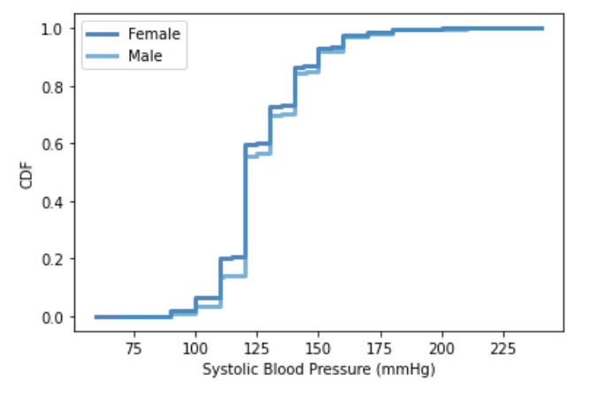
CDF
The CDF shows a clearer pictures of females having lower SBPs then males. People with lower SBPs have less cardiac issues and tend to be healthier. This graphs shows that females are healthier than males

Slide 10
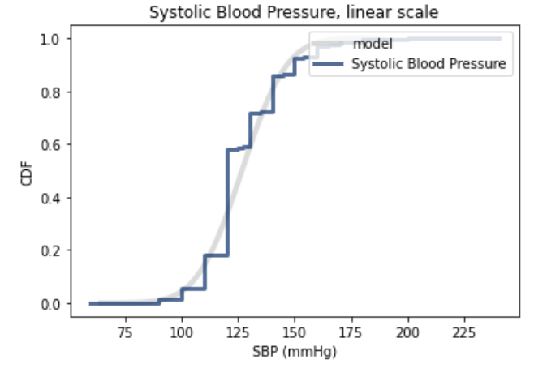
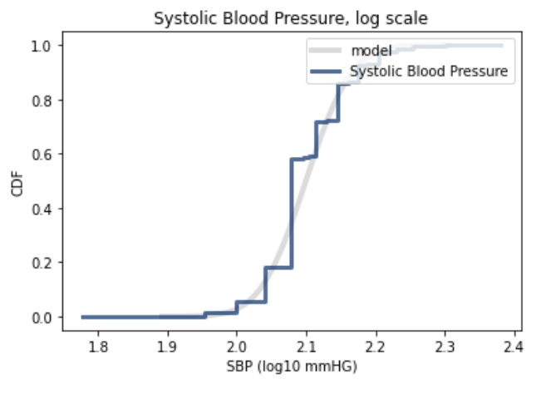
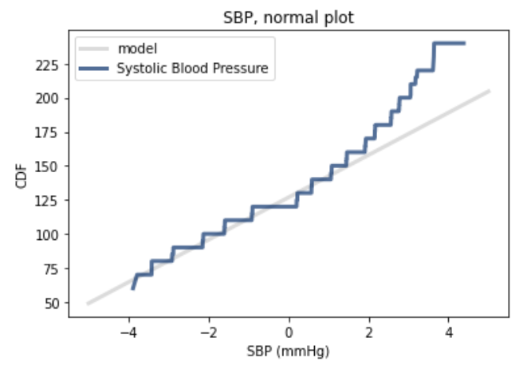
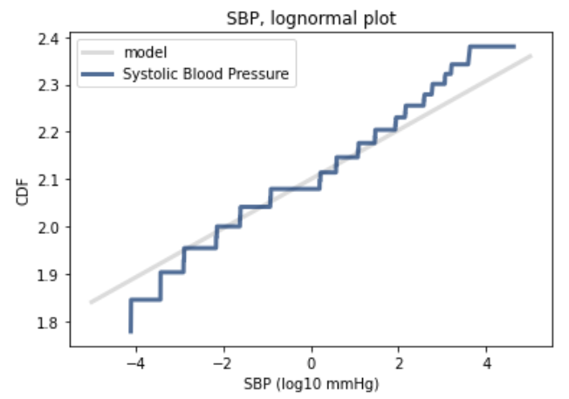
Linear vs Lognormal Distribution

Slide 11
Linear vs Lognormal Distribution
Distribution of systolic blood pressure is approximately lognormal in comparison to a linear distribution
Linear distribution appears to be better for lower SBP readings
Non linear model more appropriate when predicting SBP

Slide 12
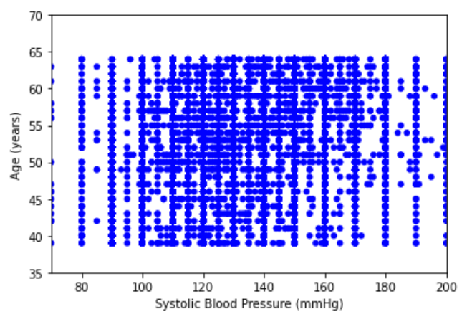
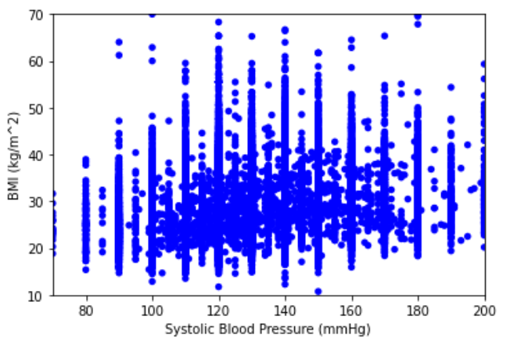


Scatter Plots
Both age and BMI have a positive correlation with SBP, both affects are weak with a spearman’s correlation of 0.22 and 0.28 respectively. BMI has a stronger relation than age as those with a higher BMI tend to have higher SBPs

Slide 13
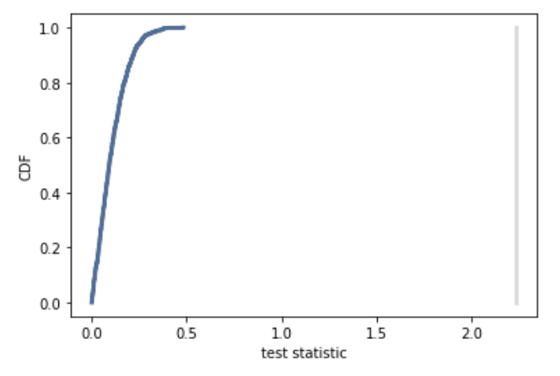
Hypothesis test:
Compute the p-value of the observed difference in systolic blood pressure means in men and women
P < .01 and so we can reject the NULL hypothesis

Slide 14
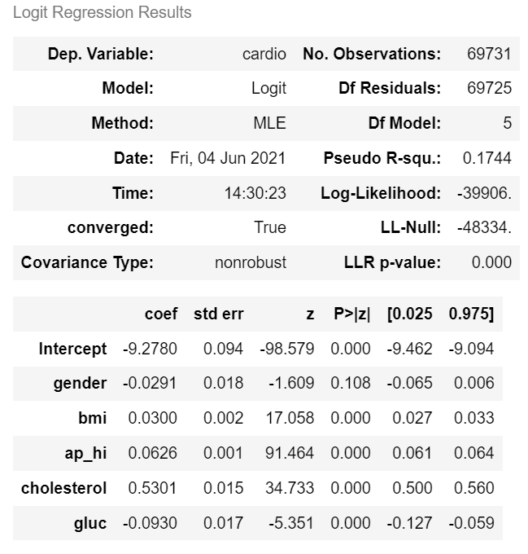
Regression Analysis
Create a model at predicting those with cardiovascular diseases (CVDs)
Cholesterol seems to be the best predictor at presence of CVDs
Logistic regression model is ~50% accurate at predicting CVDs

