Slide 1
RPPOOP MINI PROJECT
CLUB RECOMMANDATION SYSTEM
Team Members
Pratik Patil 112003104
Prerna Tulsiani 112003114

Slide 2
Problem Statement:
To help the students to recommend the clubs and connect them with their seniors who can guide them.
Tech Stacks Used MERN

Slide 3
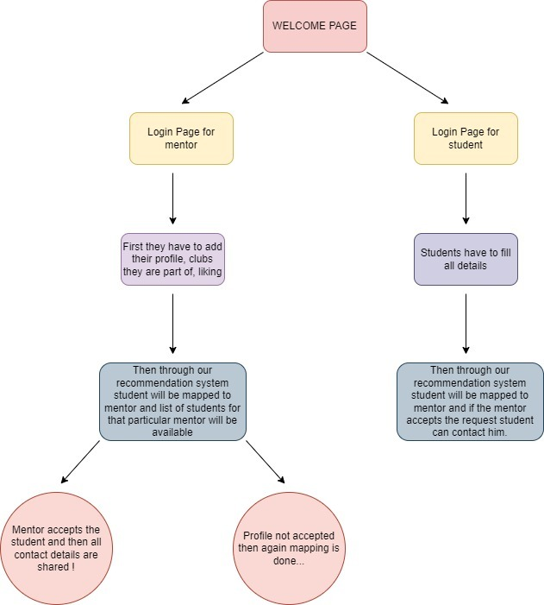
Central Idea

