Slide 1
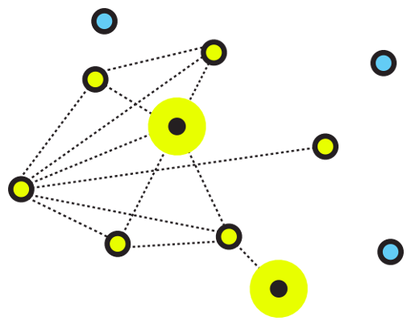
NLTK Toolkit Using C
112003104 Pratik Patil
COMP DIV-2
DSA Mini Project

Slide 2
Introduction
The Porter stemming algorithm (‘Porter stemmer’) is the process of reducing inflection in words to their root forms such as mapping a group of words to the same stem
E.g. program is a stem word which is extended further
Programmers ➔ program
Programming ➔ program
Programs ➔ program
WordNET is a lexical database of words in which we have words grouped differently into a set of its root word(Stem word) where each word in the database is expressing its distinct concept.

Slide 3
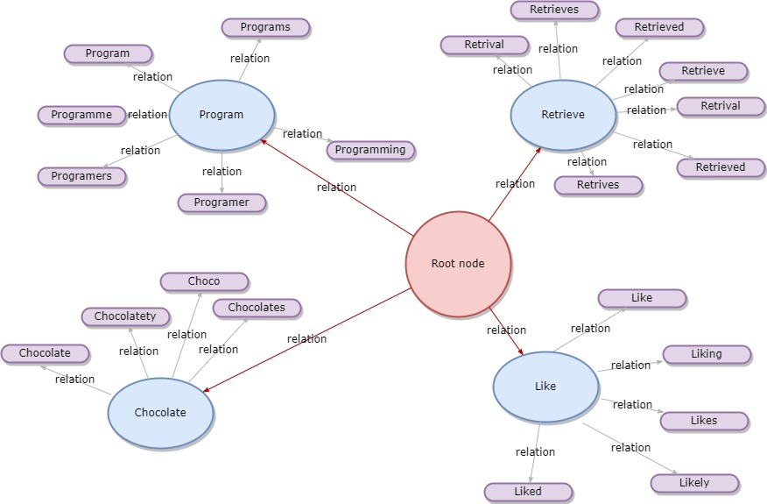

Slide 4
Conclusion
Concepts used:
Graphs for creating a dense network
Regular Expression
Applications
Stemming is most common text pre-processing techniques in NLP used to clean the data which makes it easier to process it further
WordNet is a kind of dictionary which is used to map the relations between different set of words having same common background

