Slide 1
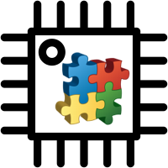
Arduino Component Programmer
ACP
component-oriented event-driven programming

Slide 2
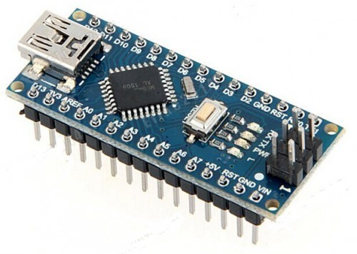
Why smarter microcontrollers?
Cloud
Internet
Local processing
Local communication
Sensors & actuators
IoT - shift happens:
fog/edge computing
local processing = more complex local code (e.g. firmware in MCU)

Slide 3
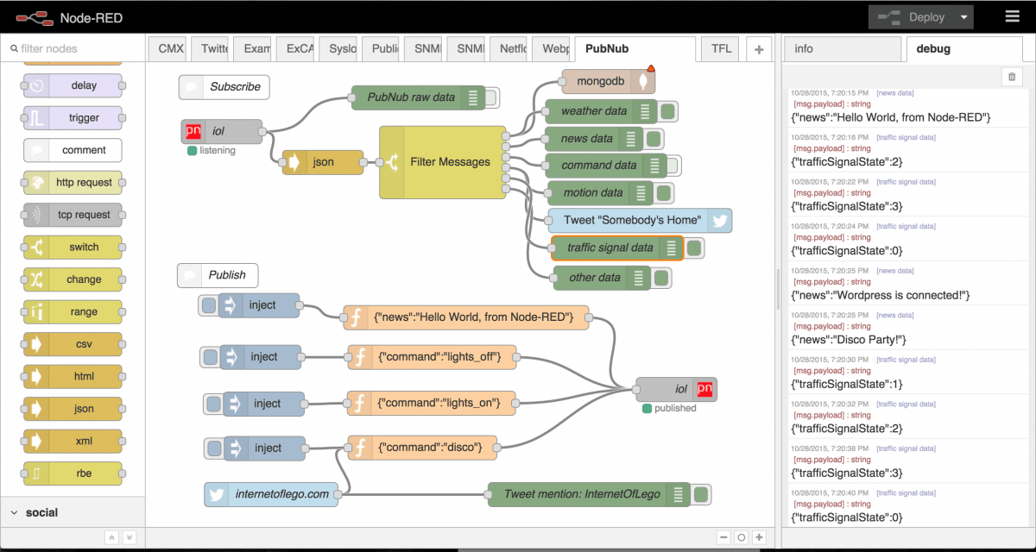
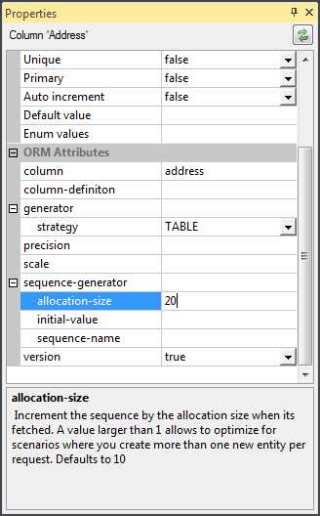
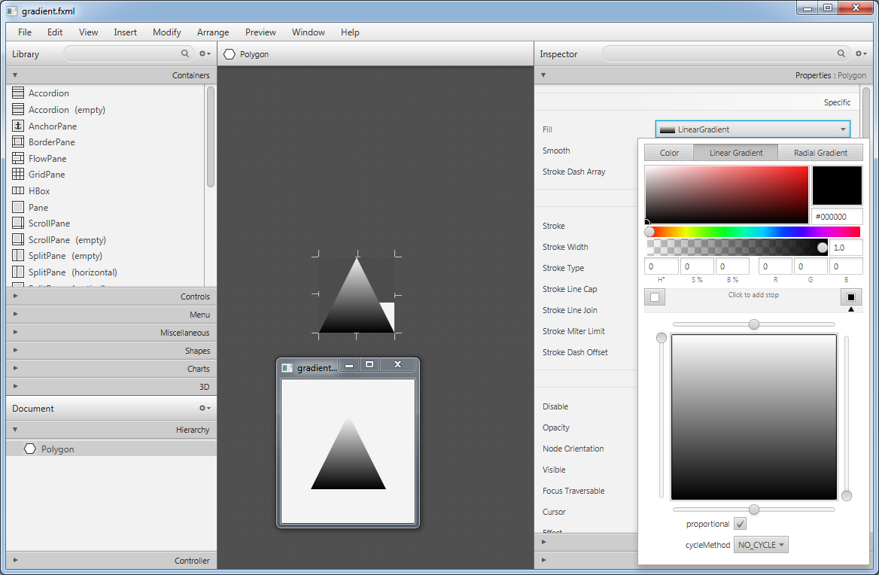
Complex code? No problem in 2018
IDE support
Visual editors for everything:
configurations
window forms
scenes/activities
IoT flows
Click, configure, generate (application)

Slide 4
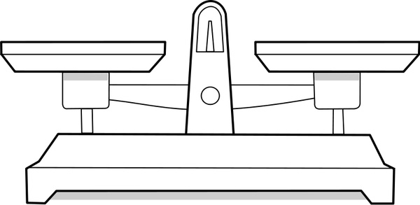


Trade-offs
General and non-optimized code, difficult tuning
Flash Memory | 32 KB of which 2 KB used by bootloader
SRAM | 2 KB
Clock Speed | 16 MHz
Easy development
Effort, Time, Reusability
MCU winner: old-school C/C++ programming
Clear winner in „big world“
but

Slide 5
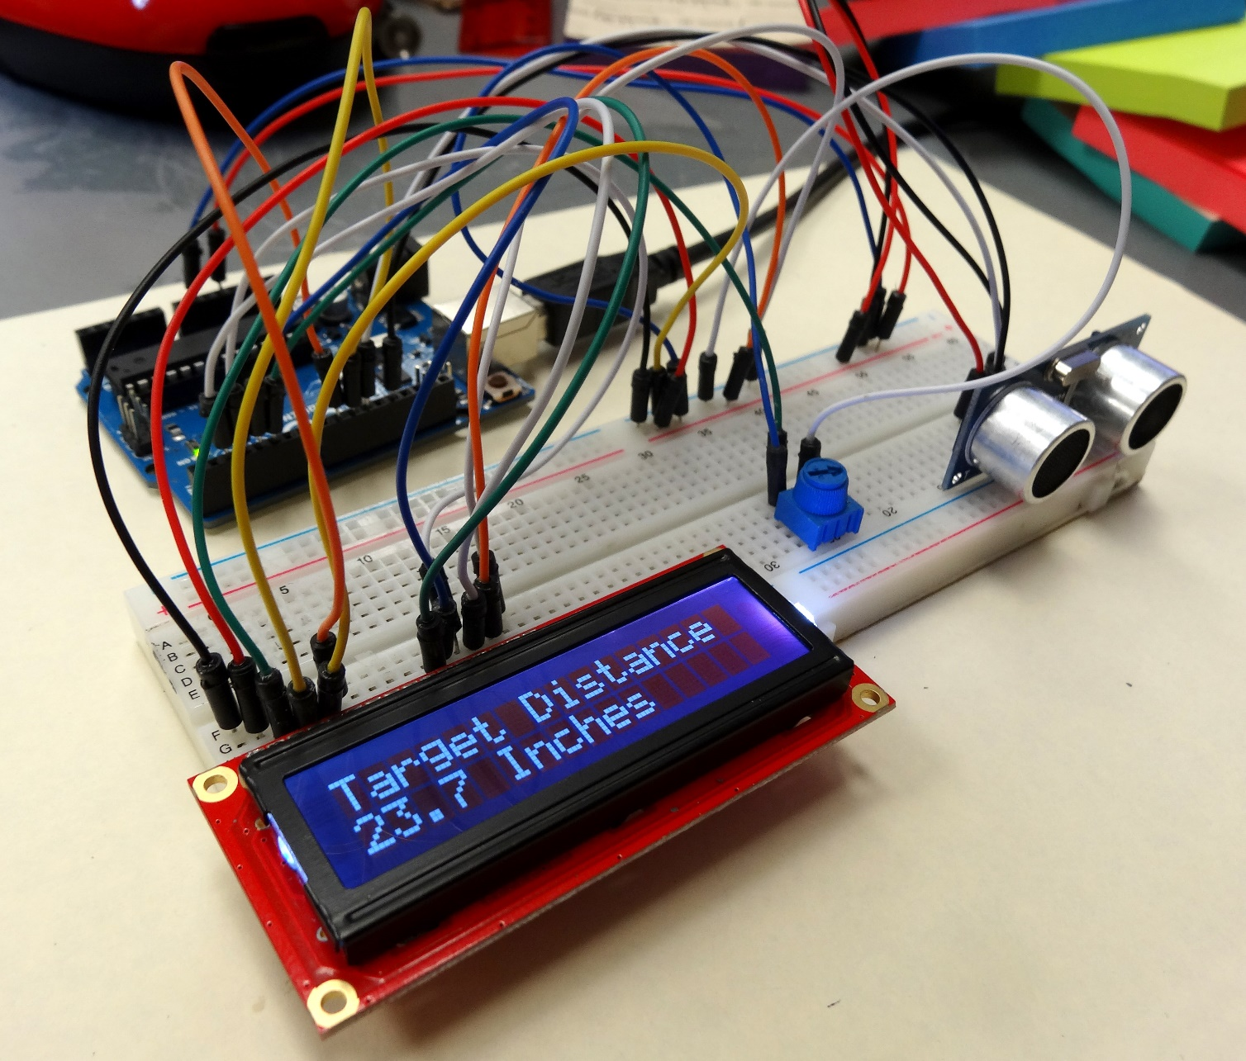
No pins, no loops, no interrupts – only components
Device = Component (of a Type)
=
(Properties + Events + Methods)
ACP project
=
Configuration + C/C++ event handlers

Slide 6
ACP suite
Code generator
compile ACP project and use the Arduino IDE to code handlers/deploy
lightweight and optimized (generated) application core with simple API
verified in several IoT projects
IDE - all in one
visual configuration (D&D), intelligent code editor, deployment
simple but powerful – for beginners and advanced IoT creators
Component library – „Maven for ACP“
make your own components: only file structure + xml config + C/C++ code

Slide 7
ACP:
new way of Arduino prototyping
Thank you for attention.

