Slide 1
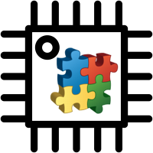
Arduino Component Programmer
ACP
component-oriented event-driven programming
ŠVK 2018 – Patrik Pekarčík

Slide 2




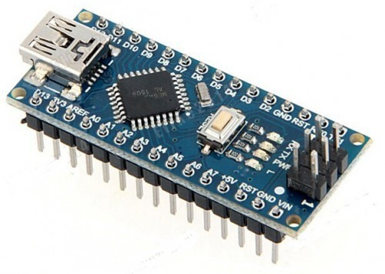



Why smarter microcontrollers?
Cloud
Internet
Local processing
Local communication
Sensors & actuators
IoT - shift happens:
fog/edge computing
local processing = more complex local code (e.g. firmware in MCU)

Slide 3
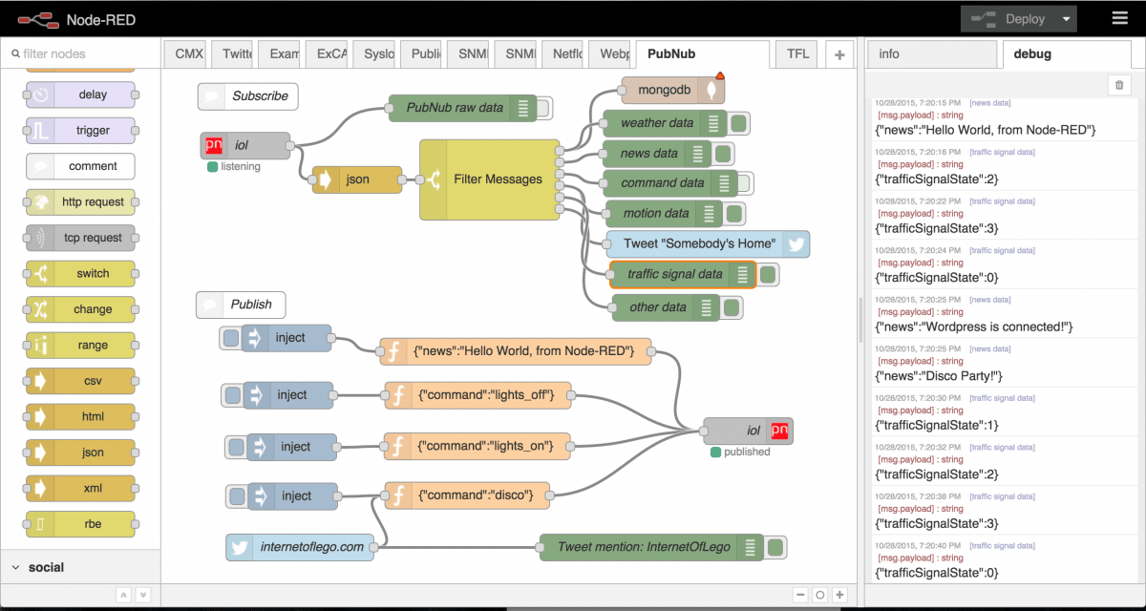
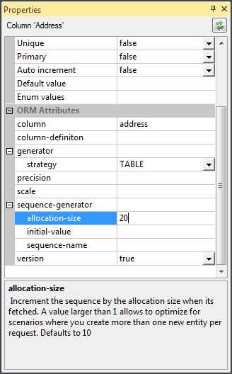
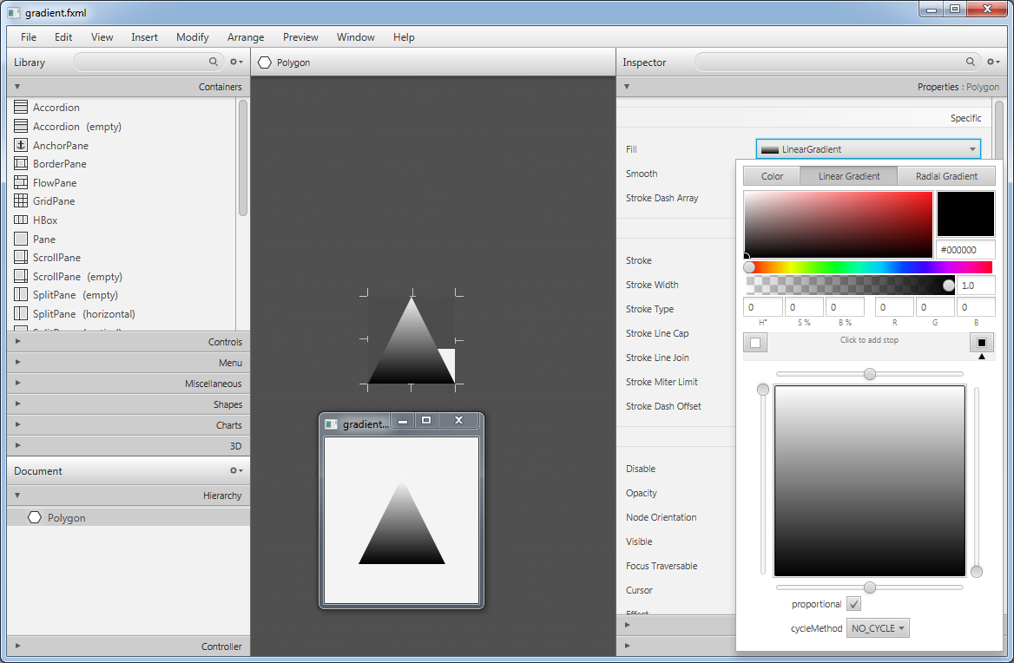
Complex code? No problem in 2018
IDE support
Visual editors for everything:
configurations
window forms
scenes/activities
IoT flows
Click, configure, generate (application)

Slide 4
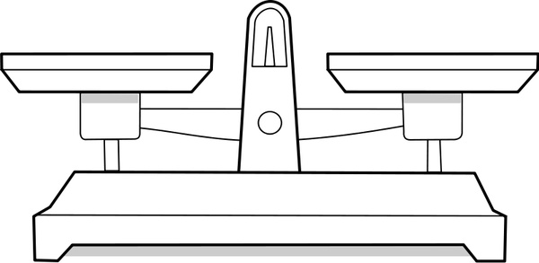


Trade-offs
Flash memory | 32 KB of which 2 KB used by bootloader
SRAM | 2 KB
Clock speed | 16 MHz
Easy development
Effort, Time, Reusability
General and non-optimized code, difficult tuning
MCU winner: old-school C/C++ programming
Clear winner in „big world“
but

Slide 5
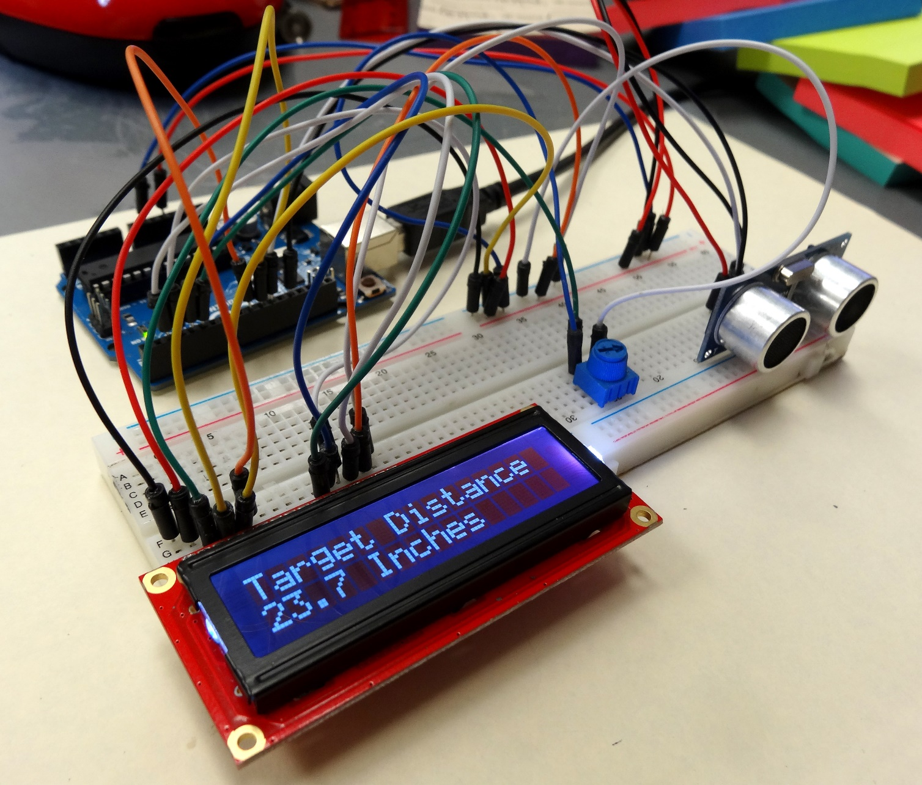
No pins, no loops, no interrupts – only components
Device = Component (of a Type)
=
(Properties + Events + Methods)
ACP project
=
Configuration + C/C++ event handlers

Slide 6

ACP suite
Code generator
compile ACP project and use the Arduino IDE to code handlers/deploy
lightweight and optimized (generated) application core with simple API
verified in several IoT projects
IDE - all in one
visual configuration (D&D), intelligent code editor, deployment
simple but powerful – for beginners and advanced IoT creators
Component library – „Maven for ACP“
make your own components: only file structure + xml config + C/C++ code

Slide 7
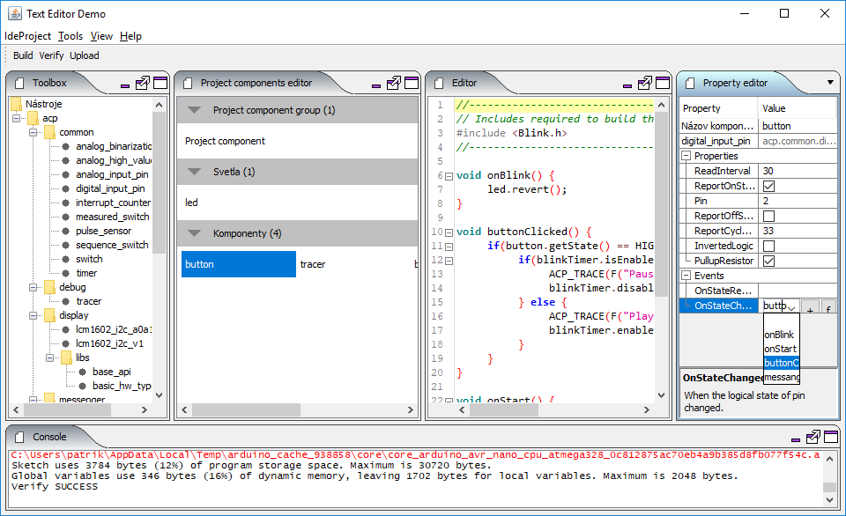
ACP IDE (video)

Slide 8

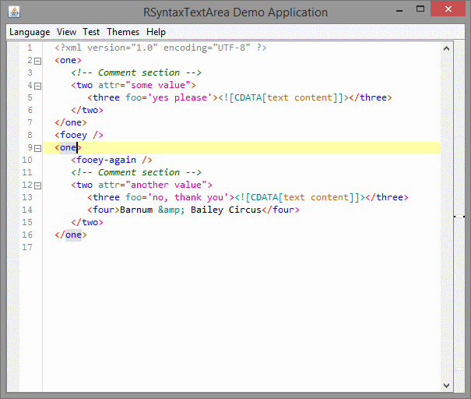


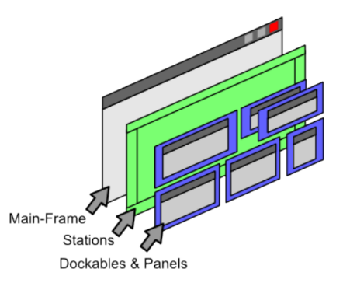

Technologies
+ Java Swing
RSyntaxTextArea
IDE & Compiler
JFlex
DockingFrames

Slide 9
Abstract syntax tree

Slide 10
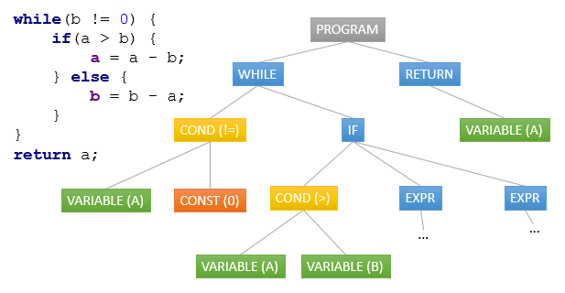
Abstract syntax tree
C++ language grammar
Lexical analysis
Source code validation
terminal WHILE, LPAR, RPAR, SEMICOLON;
...
non-terminal condition, statement, iterationStatement;
...
iterationStatement
::= WHILE LPAR condition RPAR statement
| DO statement WHILE LPAR condition RPAR SEMICOLON
;
condition
::= postfixExpr
;
...

Slide 11

Not only tree - Metadata
Functions
Variables
Includes
and much more ...

Slide 12
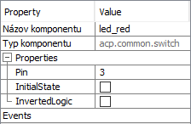
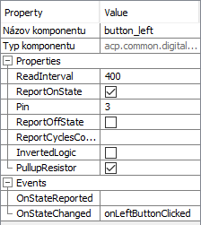

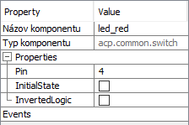
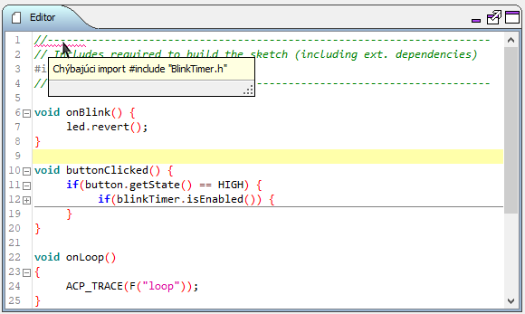
Benefits of AST
Same name usage
Same hardware device usage
Missing import #include <BlinkTimer.h>
Source code verification
Event implementation parameters check
Check properties pairing
Missing imports
Autocomplete
Searching implementations

Slide 13
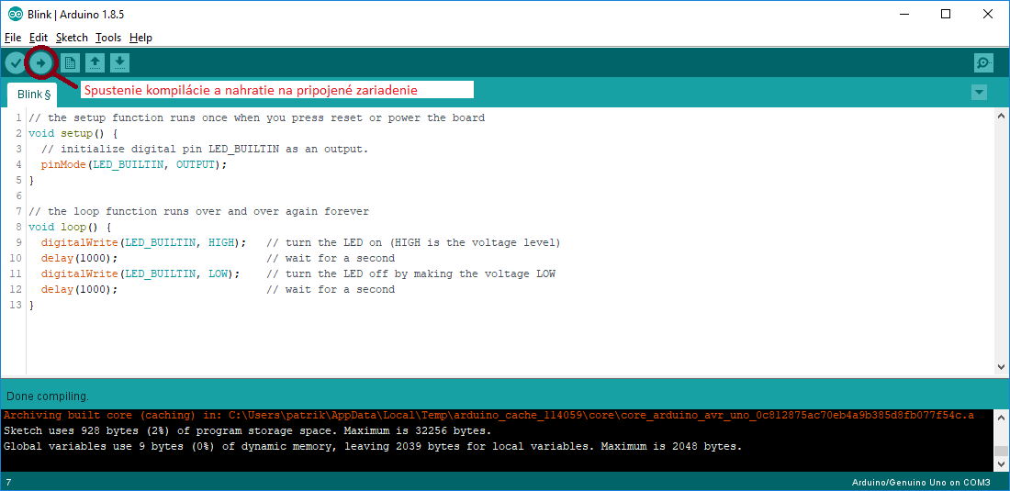

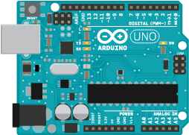
Deployment – inter-process communication
Starting
deployment
Deployment
finished
stdout
stderr
stdout
exitcode: 0
Deployment
process
started
Upload
to device
Time

Slide 14
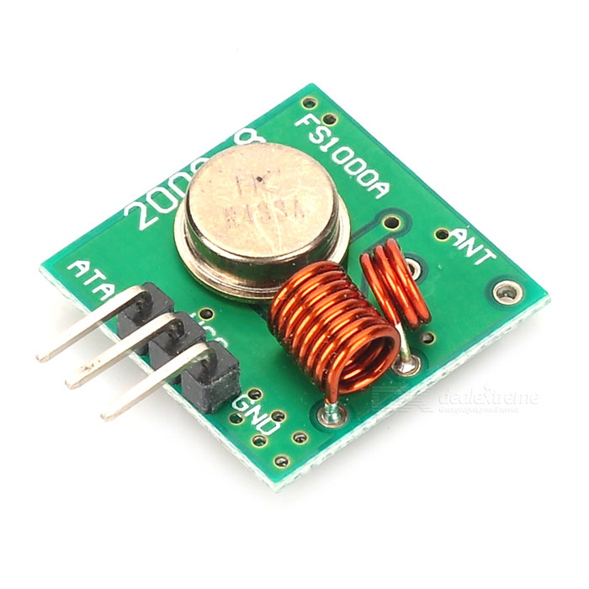
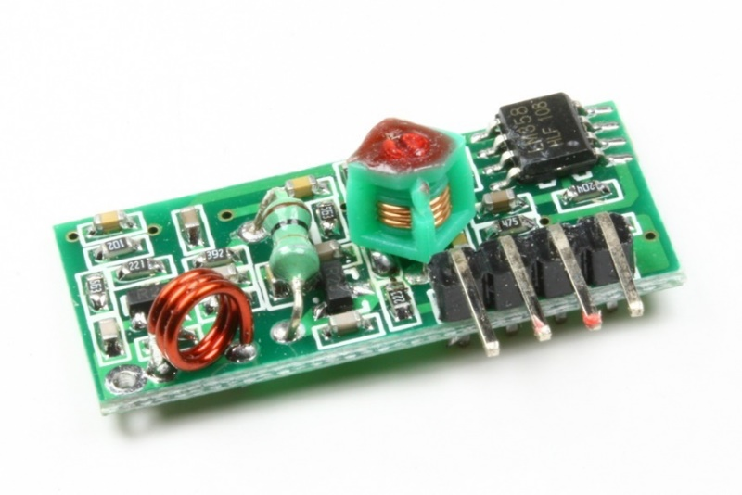
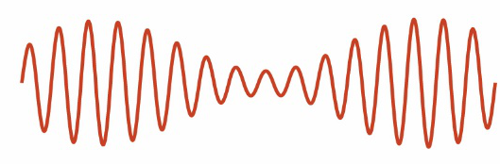
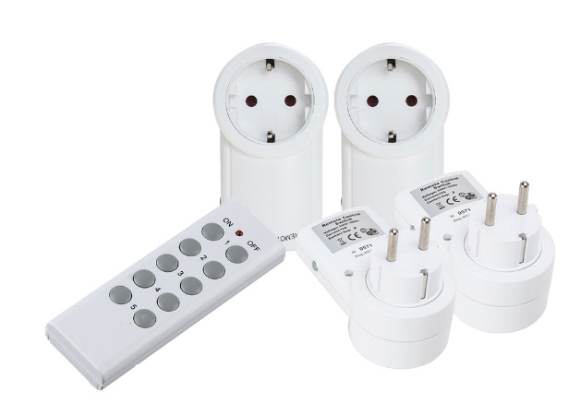
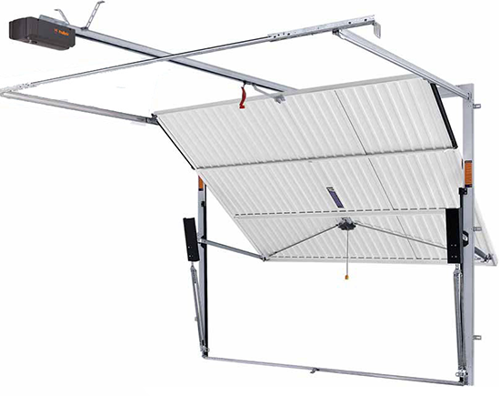

New component to library - RC 433 MHz
Transmitter
Receiver
1
0
1

Slide 15

ACP:
new way of Arduino prototyping
https://github.com/acptools
Thank you for attention.

Slide 16
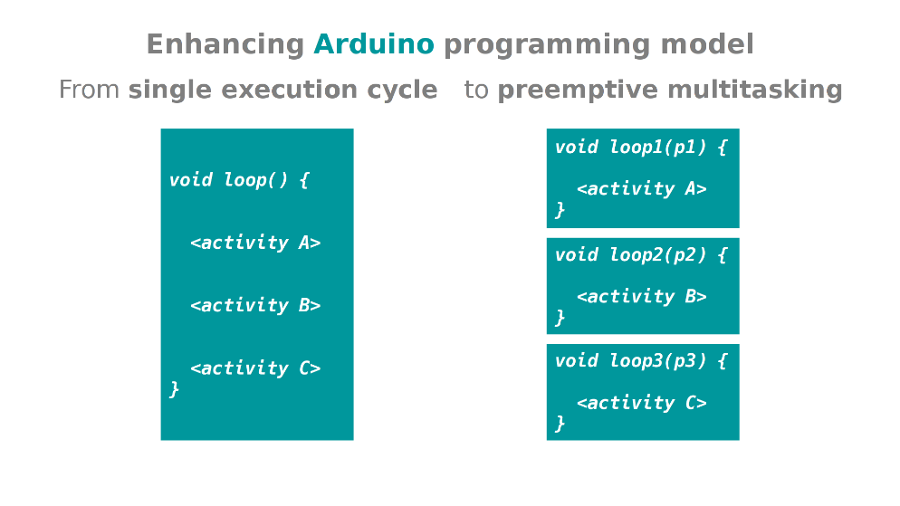

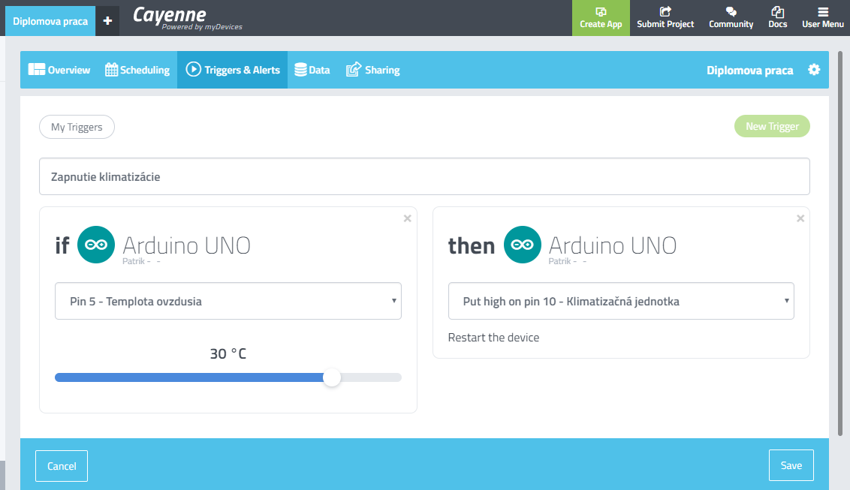
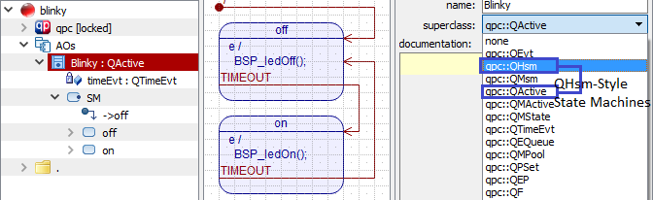

Similar solutions
Arduino EventManager
void setup() {
// Setup
gEM.addListener( EventManager::kEventUser0, listener );
}
void loop() {
// Handle any events that are in the queue
gEM.processEvent();
}

