Slide 1

Computer Networks Technology
NetStore: A Distributed File Storage System using TCP Sockets and Replication
Class: TY CSE(AI)
Group Number:16
Members:
Prathmesh Pattewar(12420193)
Anushree Shekokar(12420022)
Anjali Katpure(12420253)
Ganesh Sonwane(12310515)
Guide:Prof. Nilesh Korade
Date: 10-11-2025

Slide 2
Introduction
NetStore is a distributed file storage system ensuring data reliability and backup.
It uses a main server with two backup servers for automatic file replication.
Users can upload, view, download, and delete files via a Node.js web interface.
The backend uses Python socket programming for real-time data transfer and replication.
Includes user authentication for secure file management.

Slide 3
Objectives
To develop a reliable distributed file storage system.
To ensure data redundancy and fault tolerance using file replication.
To provide an easy-to-use web interface for managing files.
To enable secure access through user authentication.
To support core file operations — upload, view, download, and delete.

Slide 4
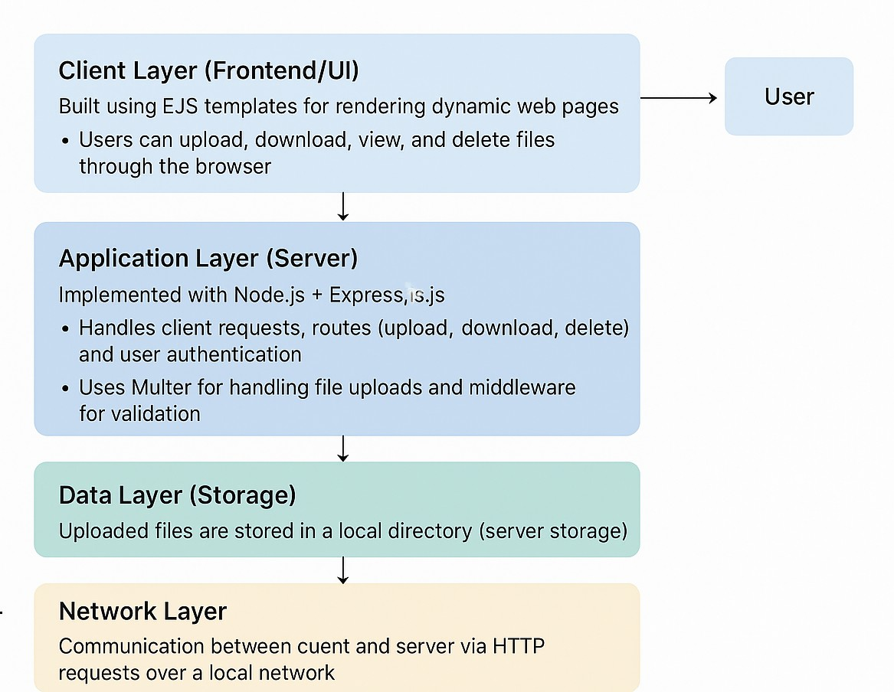
Architecture

Slide 5
Tech Stack
Frontend: HTML, CSS, EJS (Embedded JavaScript Templates)
Backend (UI): Node.js with Express.js
Core Server: Python (Socket Programming, Multithreading)
Database: SQLite (for Authentication)
File Handling: Multer (for uploads) & TCP Sockets (for file transfer)

Slide 6
Limitations
Limited to local network communication (no cloud integration).
Scalability may decrease with increasing file size or number of users.
Basic authentication — no role-based access or encryption.

Slide 7
Future Enhancements
Extend storage and replication to cloud servers (AWS, Azure, GCP) for global accessibility.
Implement load balancing and distributed databases to handle larger files and more concurrent users.
Add role-based authentication, user permissions, and encryption for secure file transfer and access.

Slide 8
Conclusion
NetStore demonstrates the practical use of TCP socket programming and client–server architecture.
Provides reliable file storage through replication across multiple servers.
Enhances understanding of fault tolerance, network communication, and data consistency.
A strong foundation for building scalable and secure distributed storage systems in the future.

Slide 9
References
https://www.geeksforgeeks.org/socket-programming-in-node-js/
https://developer.mozilla.org/en-US/
https://www.npmjs.com/
https://www.rfc-editor.org/rfc/rfc2616

Slide 10
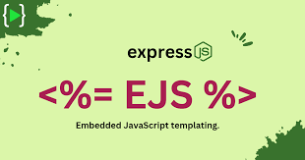

Thank You

