Slide 1
Customized TCP socket for real-time delivery management (Use case: food delivery)
BY GROUP 5
K VARADARAJ KAMATH
PRANATHI ALA
SIVA SAI LAKSHMI GUDUPU
PAVANI DURGA PASUPULETI
LAKSHMI DURGA POTTHURI

Slide 2
INTRODUCTION
A FOOD DELIVERY APP THAT DELIVERS FOOD IN A TIMELY MANNER BY SUPPLYING MEALS FROM EACH WELL-KNOWN RESTAURANT IN YOUR AREA.
A USER CAN PLACE ORDER FROM THEIR FAVOURITE RESTAURANT IN THEIR LOCATION WITHOUT PHYSICALLY BEING AT THE RESTAURANT.
THEY CAN SEARCH, ORDER OR DELETE ITEMS FROM THEIR CART.
THEY CAN USE CUSTOMER SUPPORT SERVICE IN CASE OF ANY QUERIES OR ISSUES.

Slide 3
KEY FEATURES
SIGN UP, LOGIN AND CUSTOMER SUPPORT
LOCATION AND RESTAURANT SELECTION
SEARCH, ORDER ITEM, DELETE FROM CART, PAYMENT OPTIONS FOR USER
SEARCH, ADD MENU ITEM, UPDATE MENU ITEM, DELETE MENU ITEM FOR ADMIN

Slide 4
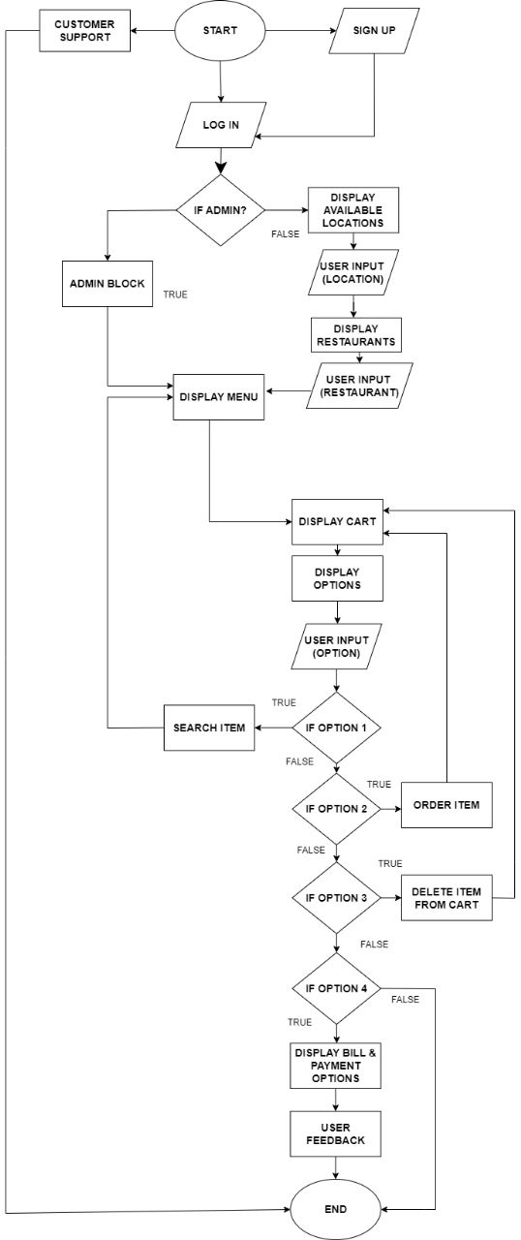
CUSTOMER MODE

Slide 5
CUSTOMER MODE FEATURES
SIGN UP, IF NEW USER.
LOGIN, IF EXISTING USER.
SELECT FROM THE AVAILABLE LOCATIONS.
SELECT FROM AVAILABLE RESTAURANTS.
SEARCH IN MENU.
ORDER ITEM FROM MENU.
DELETE ITEMS FROM CART.
PAYMENT.

Slide 6
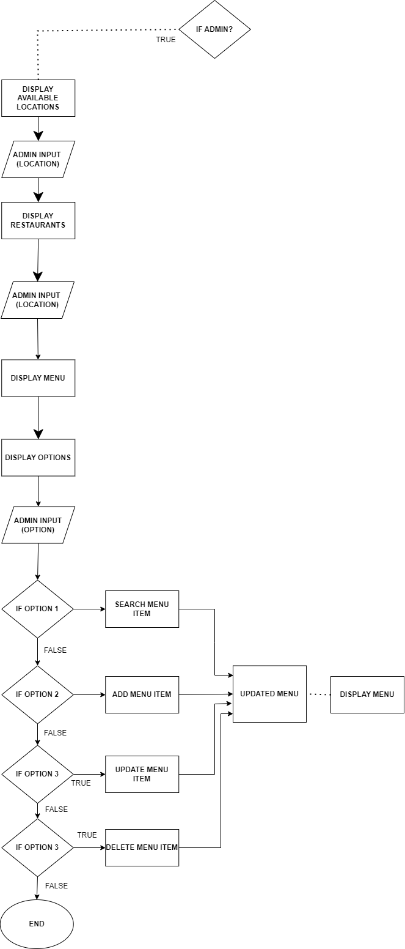
ADMIN MODE

Slide 7
ADMIN MODE FEATURES
LOGIN, IF ADMIN.
SELECT FROM THE AVAILABLE LOCATIONS.
SELECT FROM AVAILABLE RESTAURANTS.
SEARCH IN MENU.
ADD MENU ITEM.
UPDATE MENU ITEM.
DELETE MENU ITEM.

Slide 8
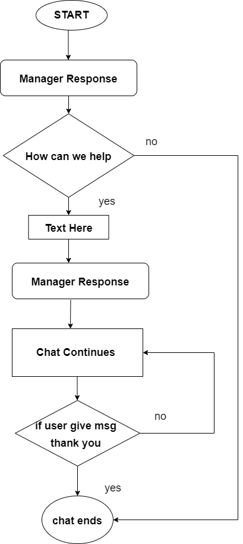
CUSTOMER SUPPORT

Slide 9
CUSTOMER SUPPORT FEATURES
CUSTOMER CAN CONTACT CUSTOMER SUPPORT IN CASE OF ANY QUERIES AND ISSUES.
CUSTOMER SUPPORT IS AVAILABLE 24/7.
WHEN ADMIN SENDS "WELCOME" TEXT TO CUSTOMER AFTER RESOLVING ISSUE, THEN THE CUSTOMER EXITS CONVERSATION WITH ADMIN.

Slide 10
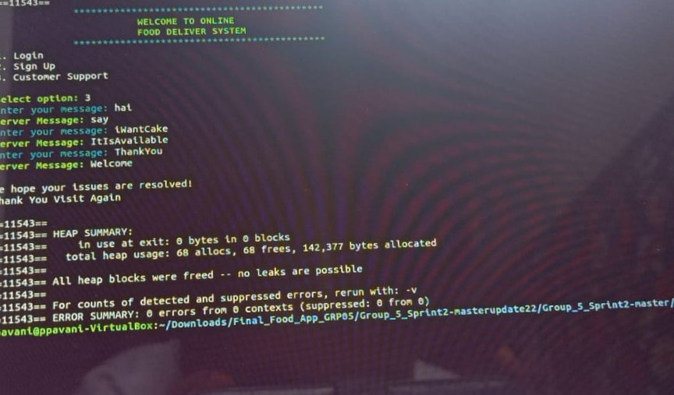
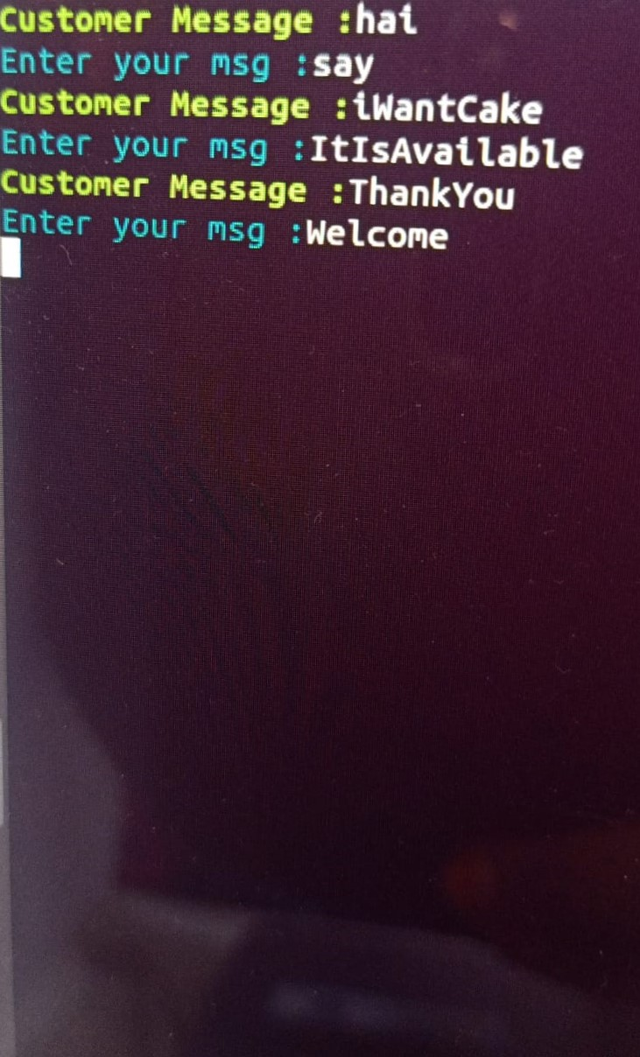
CONSOLE OUTPUT
CUSTOMER SUPPORT: CLIENT SIDE
CUSTOMER SUPPORT: ADMIN SIDE

Slide 11
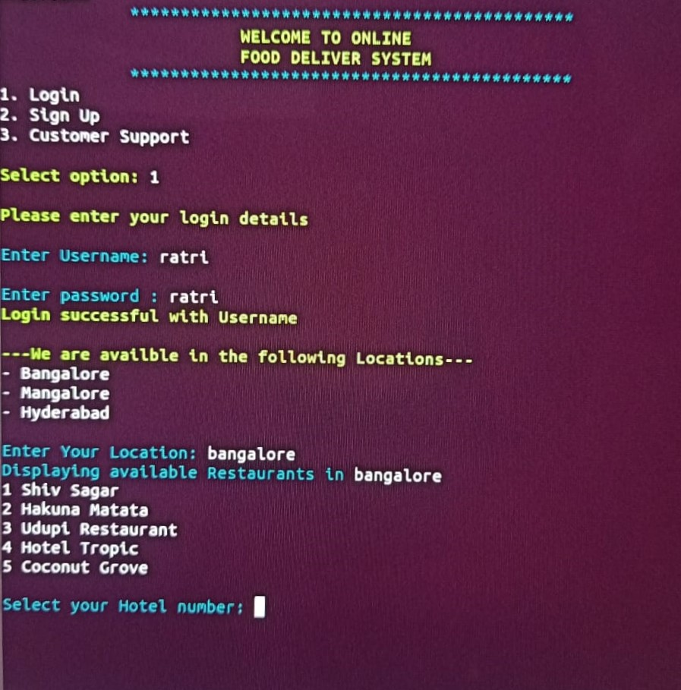
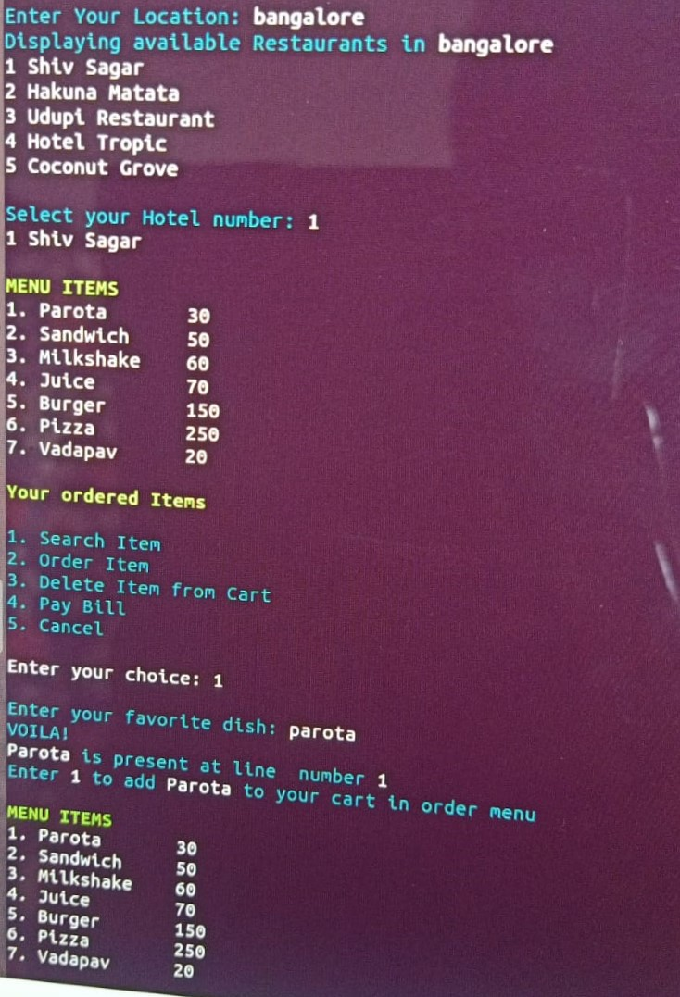
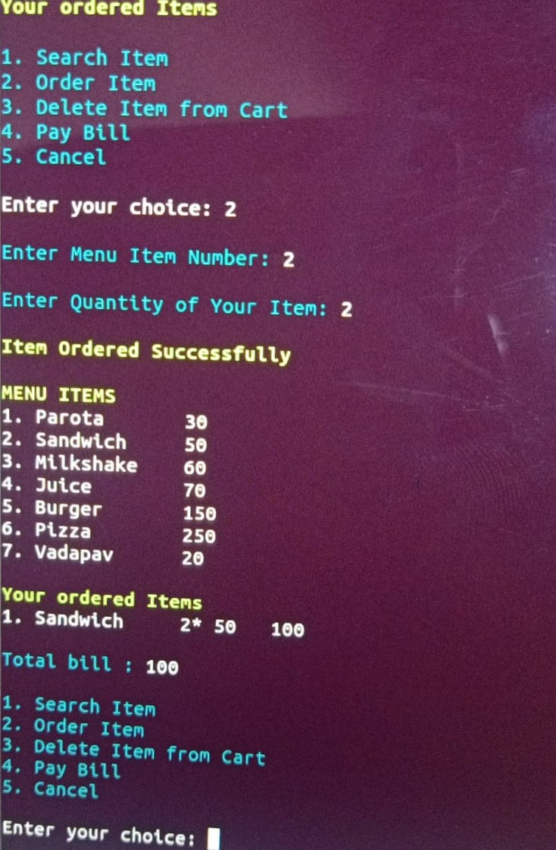
CONSOLE OUTPUT
LOGIN, LOCATIONS AND RESTAURANTS PAGE
RESTAURANTS, MENU AND SEARCH PAGE
MENU AND ORDER ITEM PAGE

Slide 12
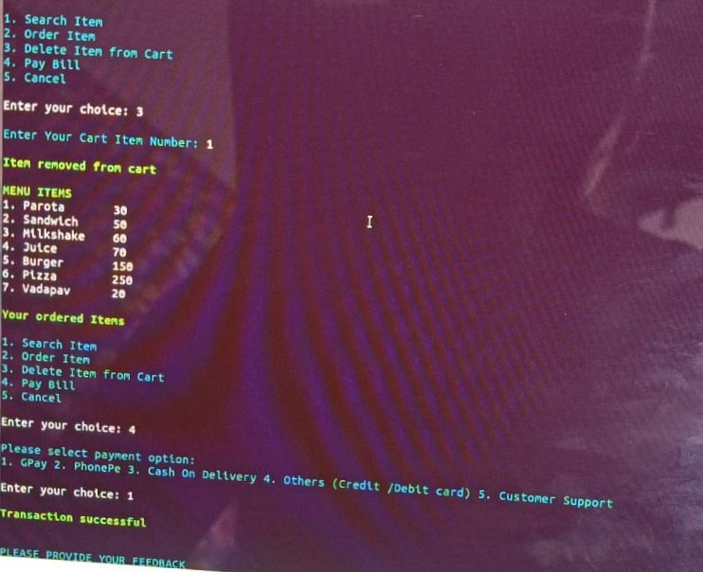
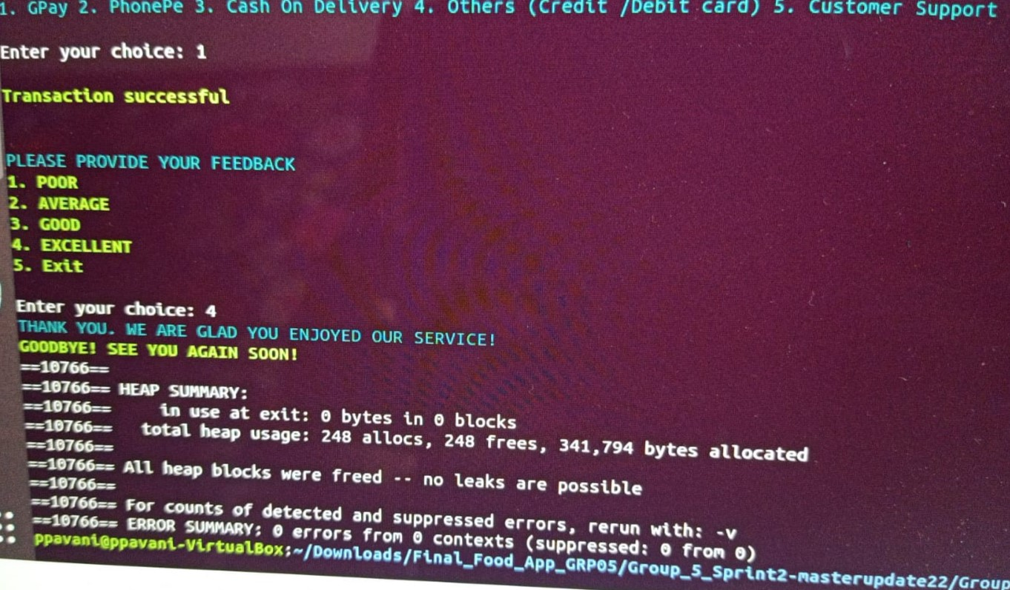
CONSOLE OUTPUT
DELETE ITEM FROM CART AND PAYMENT PAGE
PAYMENT AND FEEDBACK PAGE ALONGWITH VALGRIND RESULT

Slide 13
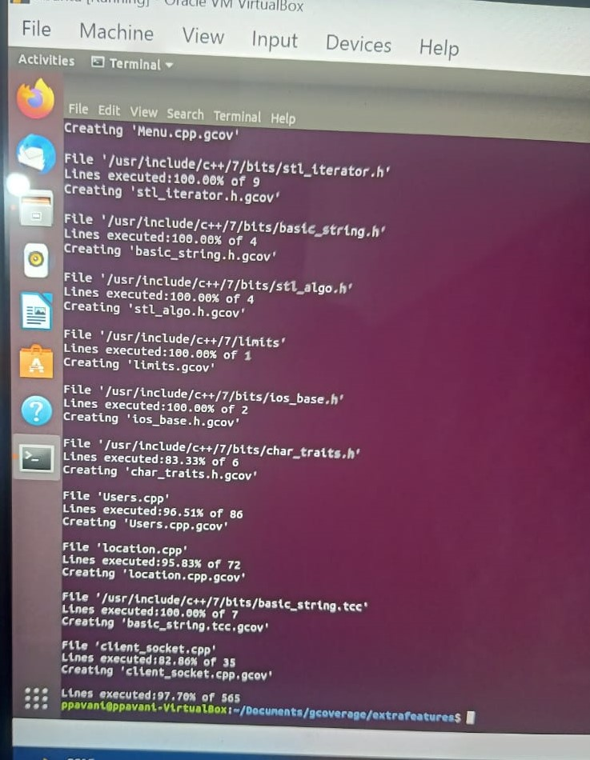
GCOV(97.70%)

Slide 14
THANK YOU

