Slide 1

CODTECH Data Science Internship
RAG-Based AI Teaching Assistant
VIJAYANAGARAM PAVAN KALYAN 23102A041144
Under the Guidance of
Ms. I. Sravani
Assistant Professor, CSE
Department of Computer Science and Engineering
School of Computing
Mohan Babu University
Sree Sainath Nagar, A. Rangampet, Tirupati – 517 102
2026-2027

Slide 2
Table of Contents
Internship Completion Certificate
Abstract
Introduction
1.1 Description of the Company
1.2 Overview of the Project
1.3 Technology Stack
Summary of Experience
Reflection on Learning
Conclusion

Slide 3
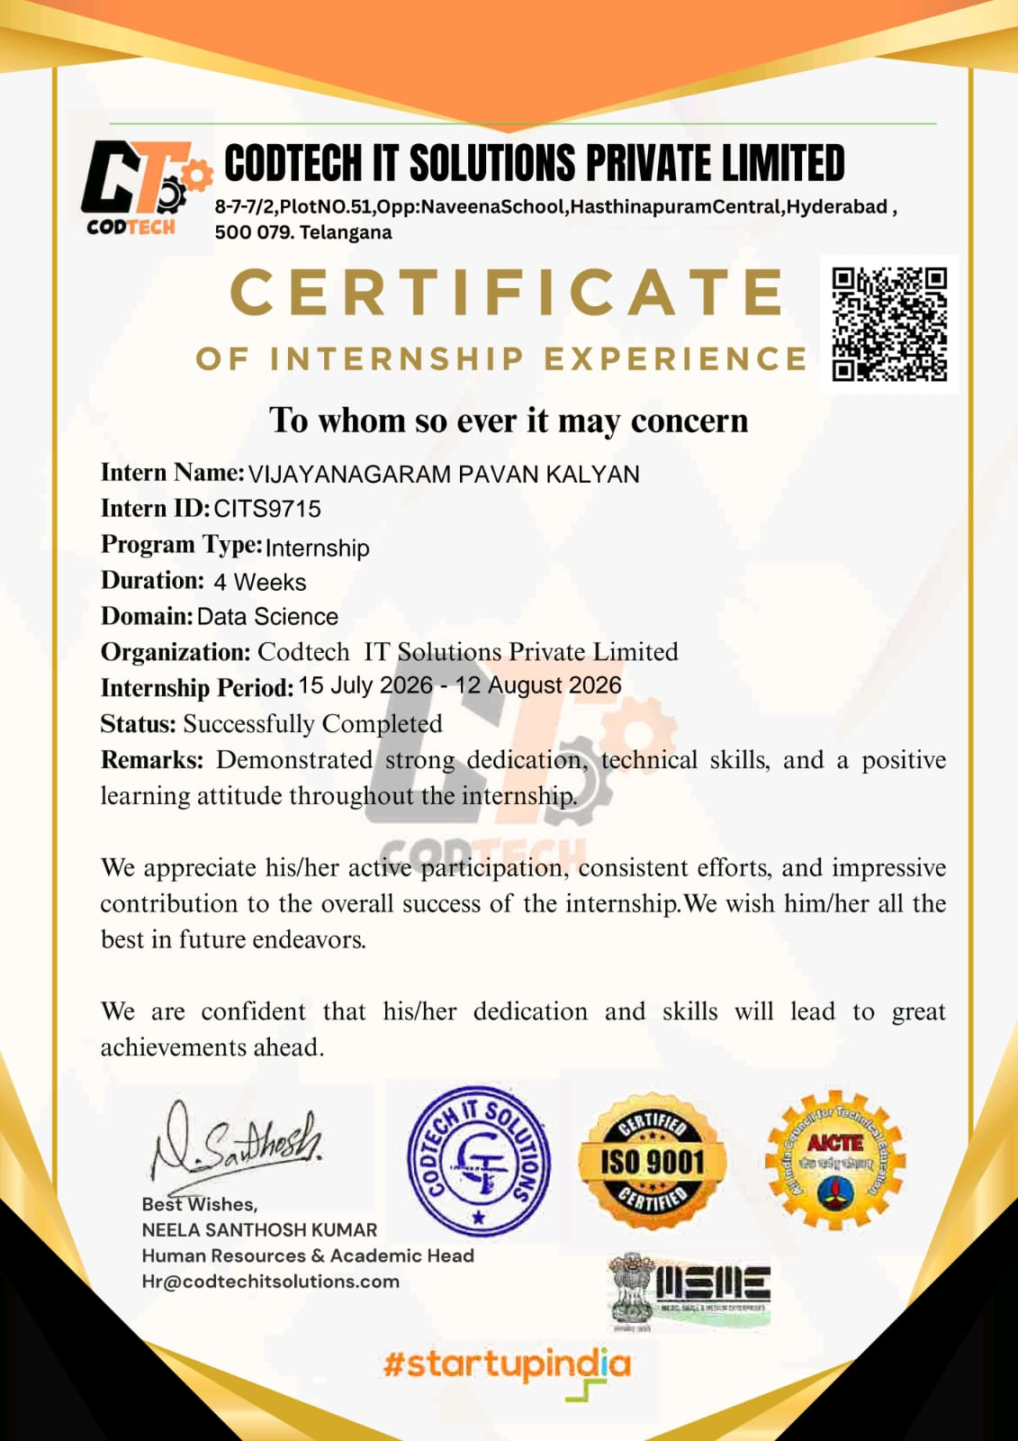
1. Internship Completion Certificate
Intern ID
CITS9715
Domain
Data Science
Duration
4 Weeks (15 July – 12 August 2026)
Status
Successfully Completed
Issued by
CODTECH IT Solutions Private Limited

Slide 4
2. Abstract
This report presents the four-week Data Science internship completed at CODTECH IT Solutions Private Limited from 15 July 2026 to 12 August 2026, as confirmed by the internship experience certificate. The internship built practical awareness of data science and the role of data in analysis, interpretation and informed decision-making, with the RAG-Based AI Teaching Assistant as the project context. The certificate acknowledges dedication, technical skills, a positive learning attitude, active participation and consistent effort. The report covers the project overview, technology stack, learning experience and professional skills developed.
4 Weeks
Duration
Jul–Aug
Internship period
RAG
Project approach
Q&A
Educational use case

Slide 5
3. Introduction
Internship Title
Data Science Internship – RAG-Based AI Teaching Assistant
Learning Objectives
LO1
Understand Retrieval-Augmented Generation
Organization
CODTECH IT Solutions Pvt. Ltd.
LO2
Prepare and chunk educational documents
LO3
Generate text embeddings
Duration
4 Weeks (15 Jul – 12 Aug 2026)
LO4
Retrieve relevant passages by similarity
LO5
Generate context-based answers with an LLM
University Guide
Ms. I. Sravani, Assistant Professor, CSE
LO6
Test and evaluate the application

Slide 6
3.1 Description of the Company
CODTECH IT Solutions Private Limited is a technology-oriented organization that provides digital solutions and promotes technical skill development through its services and internship programs. Its website describes website design, mobile and web application development, industrial training and student internships. This Data Science internship ran from 15 July 2026 to 12 August 2026, as stated in the internship certificate.
CODTECH IT Solutions Pvt. Ltd.
Website Design
Mobile & Web App Development
Industrial Training
Student Internships
Internship domains listed on the company website
Data Science
Data Analytics
Python Programming
Software Development
AI & ML

Slide 7
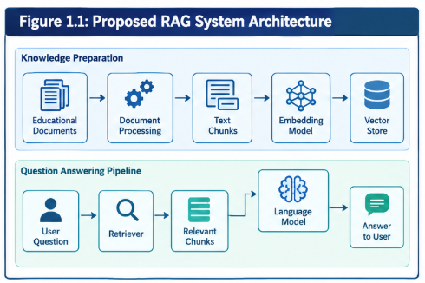
3.2 Overview of the Project
The project “RAG-Based AI Teaching Assistant” answers educational questions using passages retrieved from a collection of learning materials. A RAG system retrieves relevant information from an external knowledge source and supplies it to a language model as context. It works in two stages: knowledge preparation and question answering.
Knowledge Prep
Extract, chunk, embed
Retrieval
Semantic similarity search
Generation
Context-based answers

Slide 8
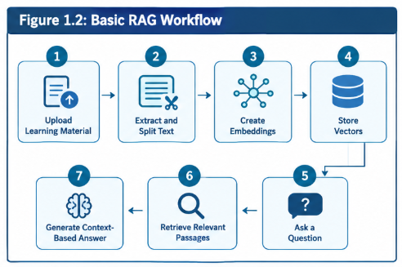
3.2 Overview – RAG Workflow
Figure 1.2 – Basic RAG Workflow
Upload material → extract and split text → create embeddings → store vectors → ask a question → retrieve relevant passages → generate a context-based answer.

Slide 9
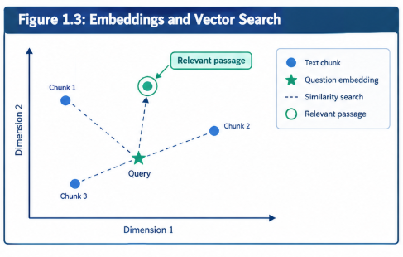
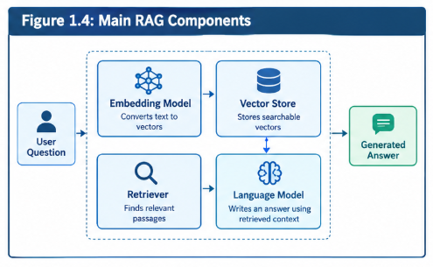
3.2 Embeddings & RAG Components
Figure 1.3 – Vector Search
Text chunks and the question are represented as vectors; similarity search finds the passage closest in meaning.
Figure 1.4 – Main RAG Components
The embedding model, vector store, retriever and language model work together to turn a question into an answer.

Slide 10
3.3 Technology Stack
Language
Python
Document Processing
Text extraction, cleaning and chunking
Text Embeddings
Numerical vectors for semantic similarity
Vector Search
Searchable vector store / index
LLM Integration
Answers generated from retrieved context
User Interface
Simple interface for questions and responses
Development
Programming environment, version control
Scope
Core RAG workflow only

Slide 11
4. Summary of Experience
The four-week Data Science internship at CODTECH IT Solutions Private Limited (15 July – 12 August 2026) strengthened my understanding of data science and its applications. The RAG-Based AI Teaching Assistant project showed how document processing, information retrieval and natural-language generation work together for educational question answering. I learned that information must be prepared before an AI application can use it: dividing text into chunks, representing it as embeddings and retrieving relevant passages. The experience also stressed a systematic process – understanding requirements, splitting a problem into components, selecting tools and examining behaviour – and that AI answers depend on the quality and relevance of the information supplied. Overall, it linked Data Science and AI concepts to a practical project and encouraged structured problem-solving.

Slide 12
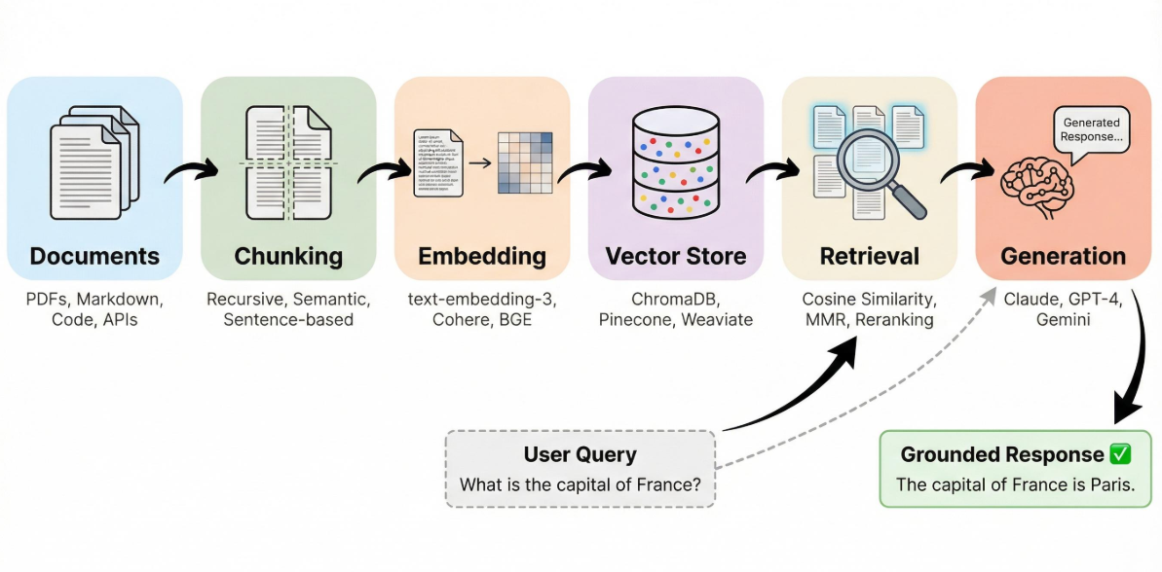
4. Summary – Implementation Workflow
Figure 2.1 – Implementation Workflow

Slide 13
4. Summary – Functional Test Cases
Test ID | Input / condition | Expected behaviour
TC-01 | Submit a question related to the uploaded learning material | A relevant answer is returned using retrieved context
TC-02 | Ask a question not covered by the material | System handles missing context appropriately
TC-03 | Upload or load a supported document | Text is extracted and prepared for retrieval
TC-04 | Submit an empty question | System requests a valid question or handles input safely
TC-05 | Ask a follow-up question | System responds according to the implemented context handling
Observed results and status are recorded after running each test on the final application.

Slide 14
4. Summary – Key Learning Areas
RAG
Retrieval + generation
Context-based answers
Chunking
Split documents
Prepare for retrieval
Embeddings
Text as vectors
Semantic similarity
Retrieval
Find passages
Meaning, not keywords
Testing
Covered questions
Uncovered & follow-ups
Growth
Continuous learning
Structured approach

Slide 15
5. Reflection on Learning
Technical Skills
Retrieval-Augmented Generation, document processing, chunking, embeddings and semantic similarity.
Problem-Solving
Breaking a larger problem into smaller components makes the workflow easier to understand and improve.
Testing & Evaluation
Test covered, uncovered, unclear and follow-up questions, and record observed behaviour carefully.
Application Design
Separating preparation, retrieval, generation and interaction makes problems easier to identify.
Self-Learning
Studying a concept’s purpose, its place in the workflow and simple examples eases implementation.
Professional Growth
Reinforced consistency, patience, responsibility and a positive learning attitude.

Slide 16
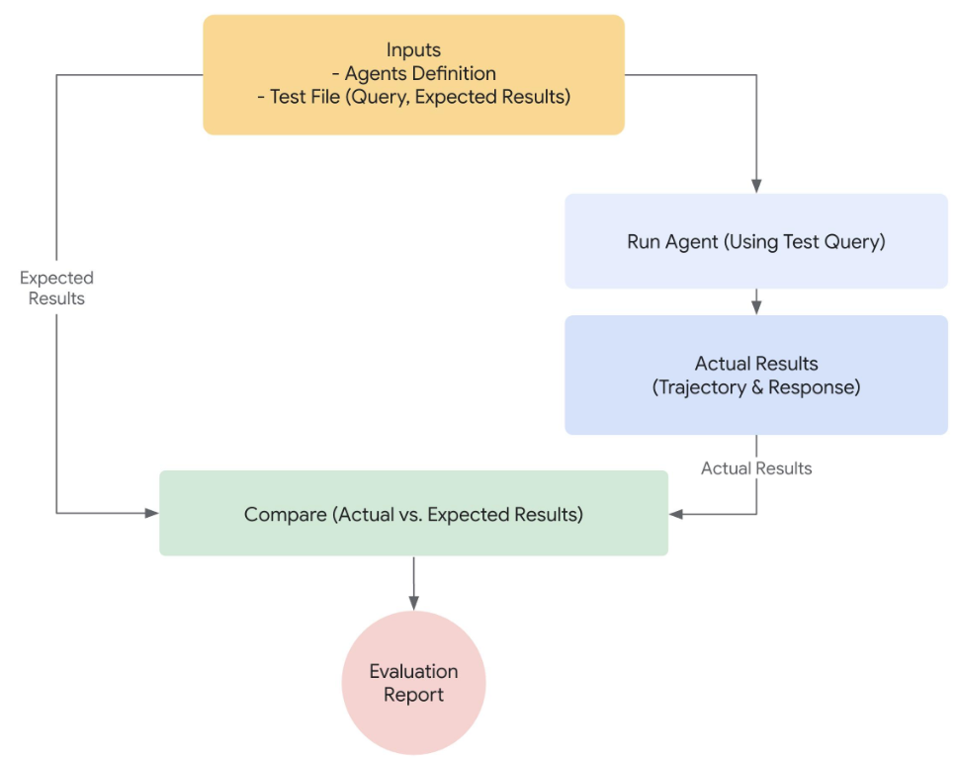
5. Reflection – Testing & Evaluation
Covered questions
Answers drawn from the available learning material
Questions not covered
Handling of missing context
Unclear inputs
Behaviour on vague or empty questions
Follow-up questions
Context handling across questions
Fig 3.1 – Testing and Evaluation Metrics

Slide 17
5. Reflection – Key Concepts Learned
1
Retrieval-Augmented Generation
Retrieval supplies relevant context from an external knowledge source to the language model.
2
Document Chunking
Dividing large documents into smaller sections lets relevant content be retrieved efficiently.
3
Embeddings
Numerical vectors that let the system compare questions with passages by meaning.
4
Testing & Evaluation
Check covered, uncovered, unclear and follow-up questions and record the observed behaviour.
5
Quality of Input
Answer quality depends on the source documents, retrieved passages and the language model.

Slide 18
6. Conclusion – Future Improvements
1
Document Handling
Better handling of the educational source documents.
2
Retrieval
More effective retrieval of relevant passages.
3
Source References
Show the sources used in generated answers.
4
Unsupported Questions
Improved handling of questions not covered by the documents.
5
User Interface
A more user-friendly interface.

Slide 19
6. Conclusion
The four-week Data Science internship at CODTECH IT Solutions Private Limited (15 July – 12 August 2026) strengthened my understanding of data-driven problem-solving and AI applications. The RAG-Based AI Teaching Assistant project shows how document processing, embeddings, retrieval and language-model generation work together for educational question answering. Its usefulness depends on the quality of the source documents, the relevance of retrieved passages and the behaviour of the language model. The internship reinforced continuous learning, analytical thinking and professional discipline, giving a foundation for further work in Data Science, AI and practical software development.
Thank You

