Slide 1
Installing Python + PyCharm
CSE101: Computer Science Principles

Slide 2
Announcements
Acknowledgement: These slides are revised versions of slides prepared by Prof. Arthur Lee, Tony Mione, and Pravin Pawar for earlier CSE 101 classes. Some slides are based on Prof. Kevin McDonald at SBU CSE 101 lecture notes and the textbook by John Conery.

Slide 3
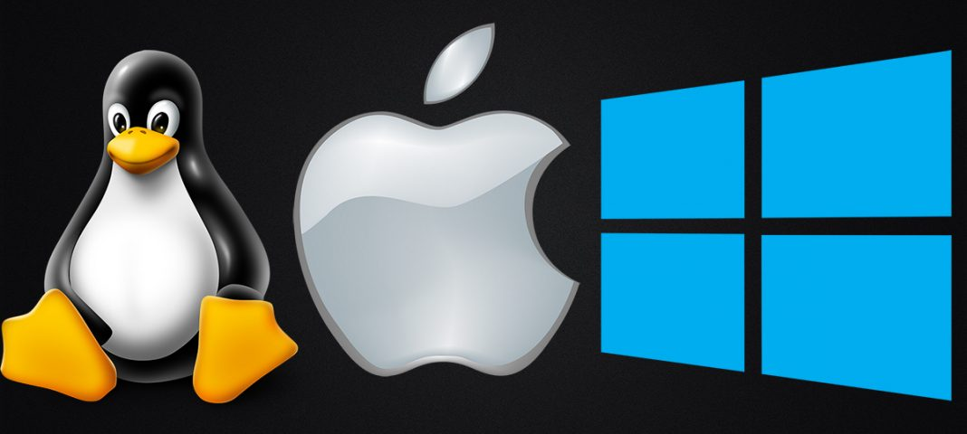
What is an Operating System?
Operating System is a program that manages computer hardware and software resources, and provide common services for computer applications.
For example: Windows, Mac, Linux

Slide 4
What is Python?
Python is a computer programming language
Python can be used to write many types of programs
Programs to do basic calculations
Games
Popular with scientists because they can do complex data analysis by writing short programs
Python can be installed on computers with different operating systems

Slide 5
Installing Python

Slide 6
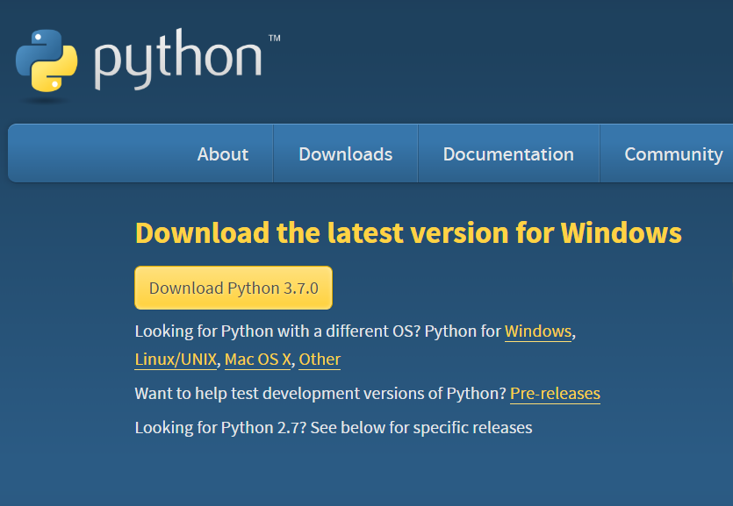
Python Installation on Windows
https://www.python.org/downloads/ – Note Python version is now 3.8.5

Slide 7
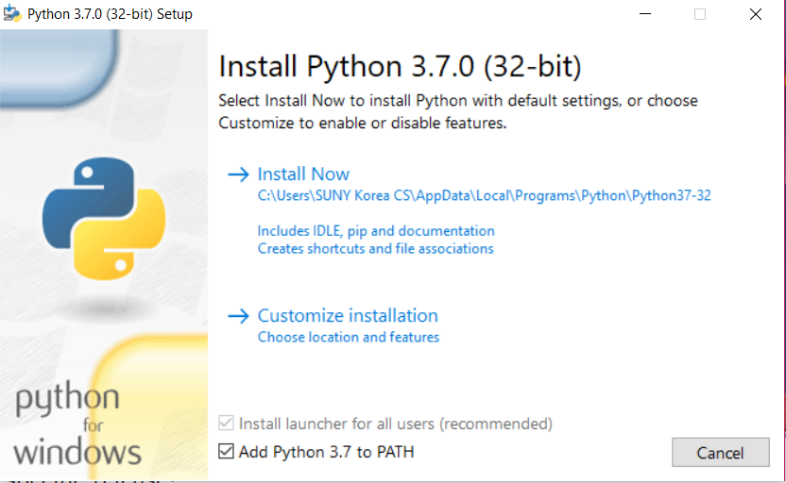
Python Installation on Windows

Slide 8
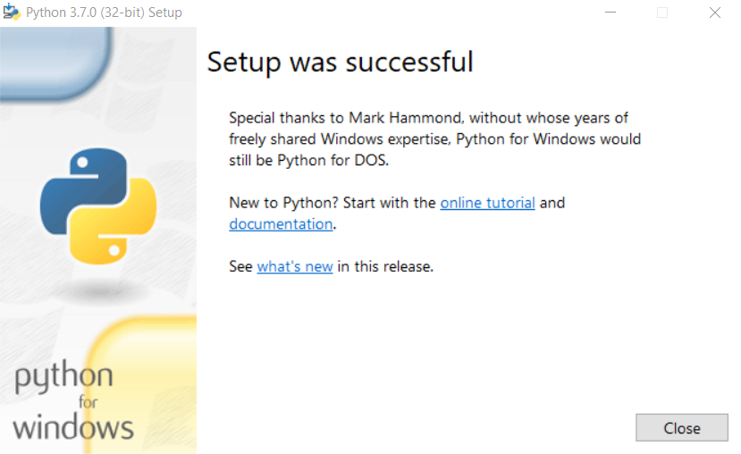
Python Installation on Windows

Slide 9
Python Installation on Mac
Go to https://www.python.org/downloads/
Download Python 3.8.5. It should save a file named "python-3.8.5-macosx10.9.pkg" to your computer.
Double click on the file and run the install with default options and agree with the license. You'll need to type in your password to install it.
Video tutorial at: https://www.youtube.com/watch?v=8BiYGIDCvvA

Slide 10
Trying Out Python

Slide 11
What is a computer program?
A computer program is a sequence of instructions the computer executes to solve a well-defined problem
The instructions or steps the programmer writes constitute the source code of the program
In Python, many of these instructions look like regular, everyday English with some extra punctuation thrown in
There are two basic ways to give commands written in Python to the computer:
Type individual instructions via an interactive shell, a program that executes the commands immediately
Write a complete, stand-alone application that we can run over and over
Notes:
Going to do #1 right now

Slide 12
Python console / interactive shell
The console (or interactive shell) is
A window where a single command or short set of commands can be typed to the computer
The computer tries to execute those commands
Python interpreter
Reads Python instructions typed into the console by the user
The interpreter converts them into a form the computer’s hardware understands
The language that the hardware understands is called machine language
No matter what programming language is used, at some point the source code must be translated into machine language for the computer to execute it

Slide 13
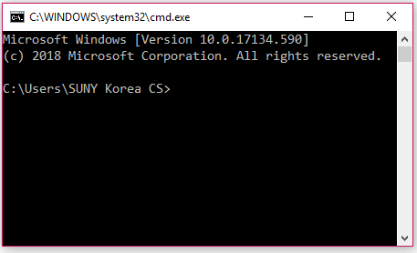
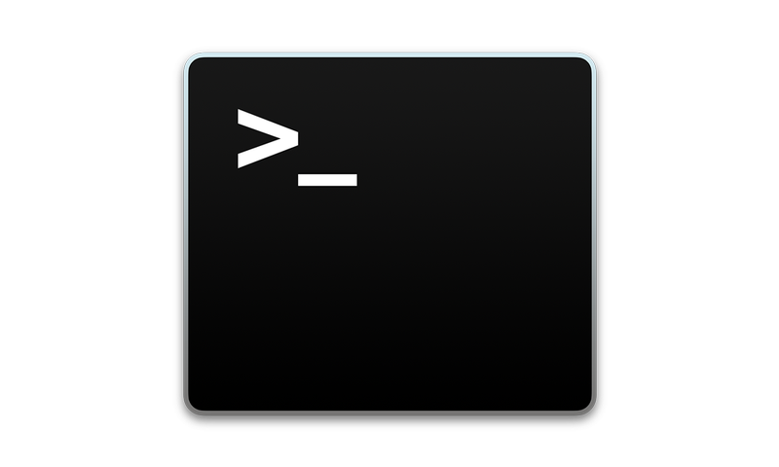
Opening a Terminal (Command Prompt)
Windows
Press "Win-R," type "cmd" and press "Enter" to open a Command Prompt session using just your keyboard.
Mac OS
Finder -> Applications -> Utilities -> Terminal
Notes:
On windows can type “python” in the terminal to begin using it

Slide 14
Start the Python Interpreter
In your Terminal:
On Windows:
Type "python" and press "Enter"
On Mac:
Type "python3" and press "Enter"

Slide 15
Some Python Statements
print("hello world")
1 + 5
a = 1
b = 2
a + b
name = "SUNY"
country = "Korea"
print(name + country)
Pi = 22/7
print(type(name))
print(type(Pi))
Notes:
Note – Mac type "python 3" to run python, whereas windows type python

Slide 16
Installing Jupyter Notebooks

Slide 17
Jupyter Notebooks
Another tool you can use in addition to the command prompt is IPython Jupyter Notebooks
You can learn about the project at https://ipython.org
Jupyter Notebooks are an interactive environment to run Python code and see the results
You may find it easier to use than the command prompt
The installation instructions vary depending on your OS – see next slide.
You can try using it online at: https://jupyter.org/try

Slide 18
Installing Jupyter Notebooks
On Mac:
Open Terminal and type the following commands:
pip3 install --upgrade pip
pip3 install --upgrade ipython jupyter
Note: you may be asked to install command line tools – install them if asked.
On Windows:
Open the Command Prompt and type the following commands:
pip install --upgrade pip
pip install --upgrade ipython jupyter

Slide 19
To Run Jupyter Notebooks
Open the Command Prompt / Terminal
To start the notebook in your current directory type:
jupyter notebook
Once you run the command, the Jupyter Notebook window should appear
You can then get started creating a notebook and writing Python code.

Slide 20
Installing PyCharm

Slide 21
The PyCharm IDE
In this course, we will use an integrated development environment (IDE) called PyCharm
PyCharm is a tool used by professional software developers
Good tool for beginning programmers to use
Go to https://www.jetbrains.com/pycharm/download/ to download and install the free Community Edition of PyCharm.
The next slides have a walkthrough of important steps of the process, though the screens may look a little different on your computer. The screenshots are taken on a Windows machine, though it will be similar on the Mac. There is a summary and video walkthrough for the Mac at the end.

Slide 22
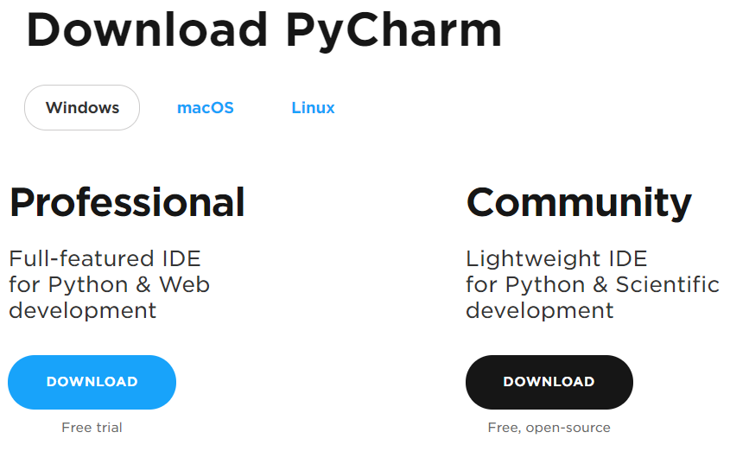
PyCharm Installation
https://www.jetbrains.com/pycharm/download/

Slide 23
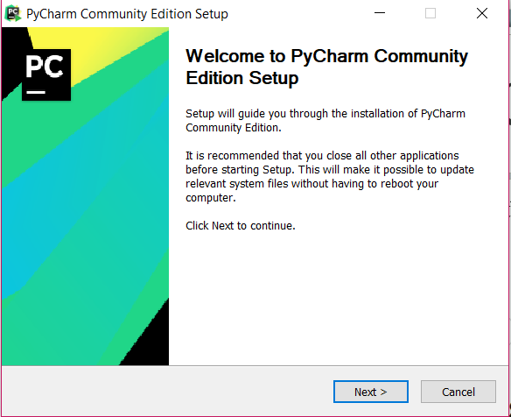
PyCharm Installation

Slide 24
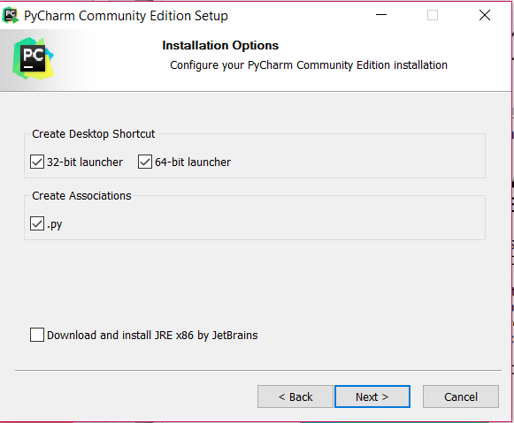
PyCharm Installation

Slide 25
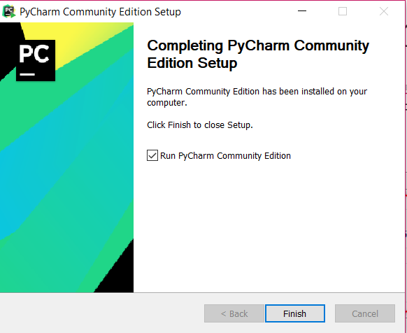
PyCharm Installation

Slide 26
PyCharm Installation on Mac
Go to https://www.jetbrains.com/pycharm/download/ to download and install the free Community Edition of PyCharm.
Now, go to the Applications folder and start PyCharm CE.app. You might want to put it on the dock.
Video tutorial at: https://www.youtube.com/watch?v=wb4HNqQtIlI

Slide 27
Running and configuring PyCharm for the first time

Slide 28
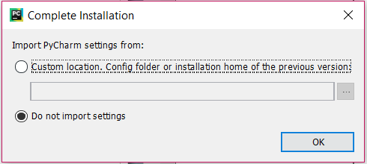
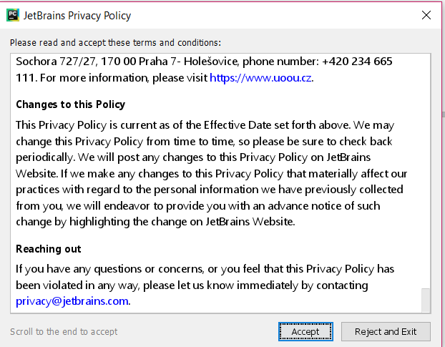
PyCharm Configuration

Slide 29
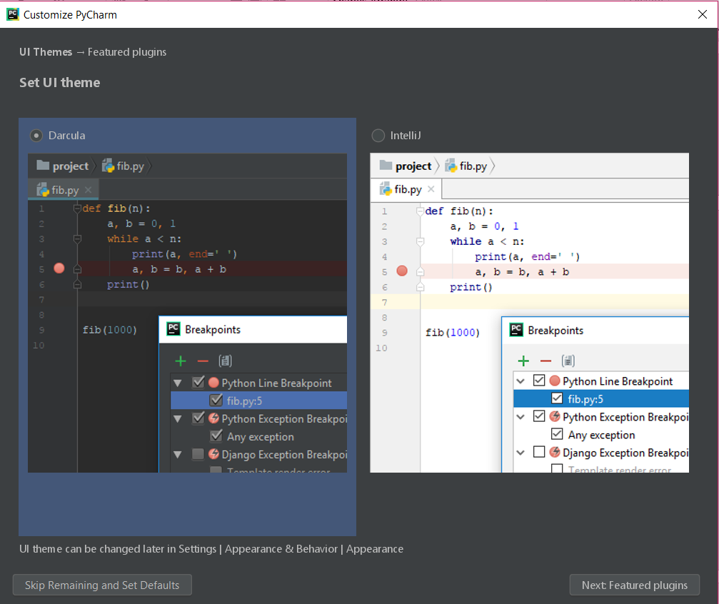
PyCharm Configuration

Slide 30
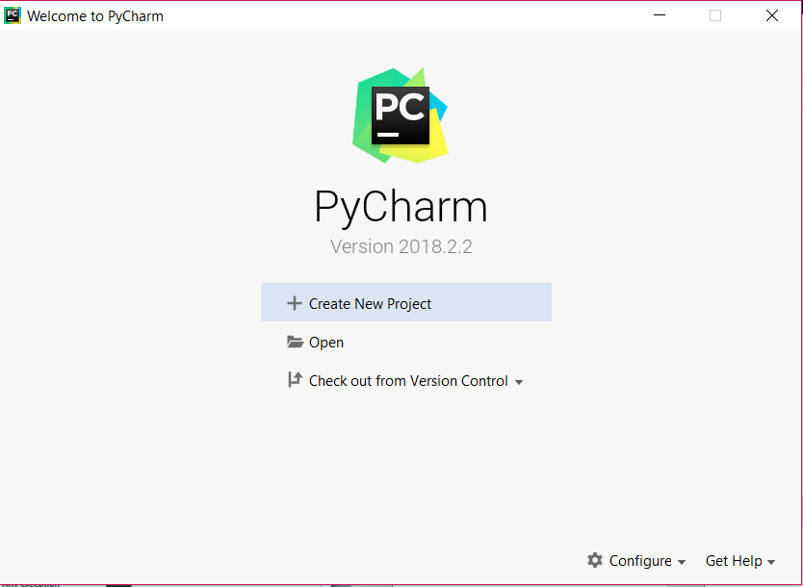
One More Configuration: Setting Default Python Interpreter in PyCharm
Step 1: Select Configure -> Preferences

Slide 31
Setting Default Python Interpreter in PyCharm
Step 2: Find out installation location of Python:
Go to your Terminal window
On Windows terminal, type in this command:
where python
On Mac terminal, type in this command
which python3
Note the path that is printed out. This is where your Python is installed – you will need this next.
The path can be different for each computer.
On my Mac it is:
/Library/Frameworks/Python.framework/Versions/3.8/bin/python3
On my Windows machine:
C:\Users\SUNYCS\AppData\Local\Programs\Python\Python38-32\python.exe

Slide 32
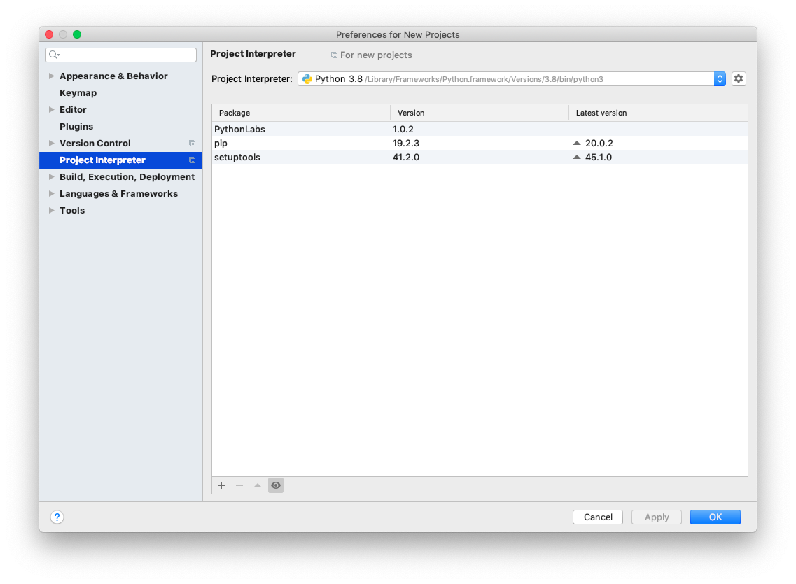
Setting Default Python Interpreter in PyCharm
Step 3: Go back to PyCharm's Configuration Screen. Click on the Project Interpreter tab on the left side. Then click on the "Project Interpreter" box and select or add the Python 3.8 interpreter. This box should have the same path you noted in the last step.

Slide 33
PyCharm Basics

Slide 34
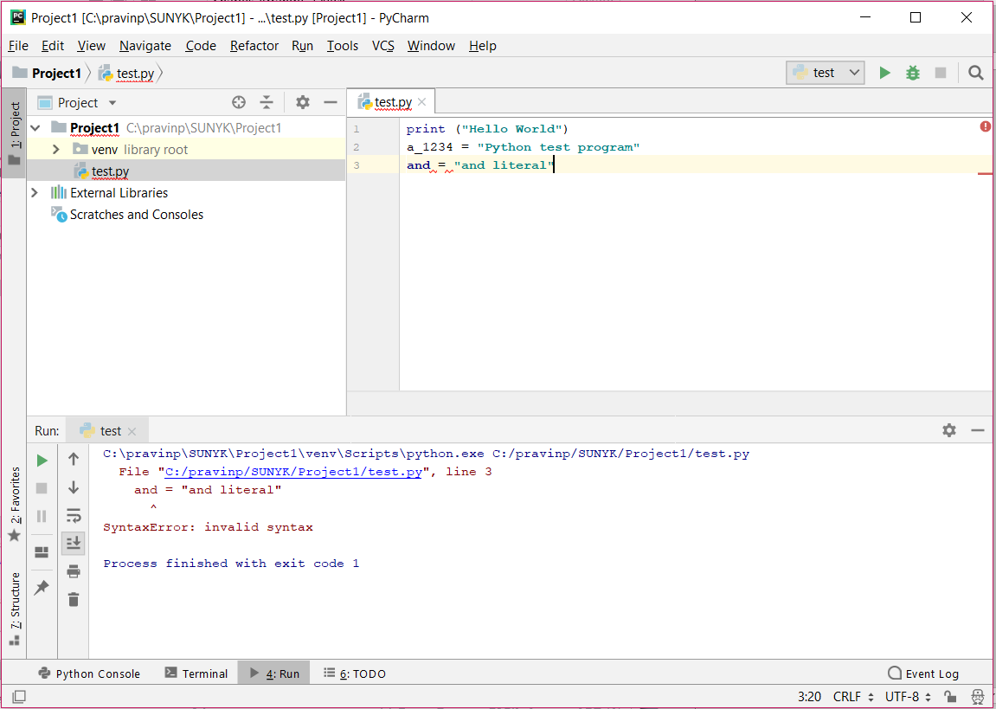
PyCharm IDE

Slide 35
PyCharm basics
To create and run a stand-alone Python program:
Start PyCharm and press the “Create New Project” button.
Pick a “Location” and name for the Project (e.g., “CSE 101”).
Select File Menu > New > Python File and enter the name of the file for the source code (e.g., “test.py”)
Write the program and save the file.
After saving, go to Run Menu > Run.
Select the name of the program file (e.g. "test.py") to run it .
The next time the program is to be run:
Click the green triangle in the lower-left corner of the screen.
Or, right-click the name of the file and choose Run.
Notes:
Mention need .py extension so it knows it is a python file

Slide 36
Questions?

