Slide 1
Audio, Video, and More HTML5

Slide 2
Audio and Video for the Web
Prior to HTML5, there was no standard way to deploy audio or video in a webpage.
Users need to install plug-ins to play different media. It was hard to get media to play correctly on different browsers.
HTML5 introduces the elements audio and video providing an easy way to place standard sound and video in webpages that will work on all platforms.

Slide 3
Digital Audio
An audio signal is naturally a continuous wave of frequency and amplitude. Analog audio must be digitized to play back on a computer.
An analog audio signal is digitized by sampling and quantization. The continuous sound wave is sampled at regular time intervals, and the values at each sampling point are quantized to discrete levels. The resulting data are stored in binary format as a digital audio file.

Slide 4
Audio Encoding Formats
Advances in digital audio bring increasingly sophisticated compression and decompression (codec) schemes to reduce audio files size while preserving sound quality.
Filename Suffix, Format Type
aif(f), AIFF AIFC
mid, MIDI
mp3
ra or rm, Real Audio
amr
ogg or oga Vorbis
wav, WAVE
wma, Windows Media Audio
audio/x-aiff audio/midi audio/mpeg audio/x-realaudio audio/amr audio/ogg
audio/x-wav audio/x-wma

Slide 5
The audio Element
<audio attributes src="url"></audio>
<audio src="files/Bob_sinclar_love_generation.mp3" controls="controls" autoplay="autoplay"></audio>
Demo: Ex: Audio
Audio formats supported depend on the browser. But .ogg, .mp3, and .wav are likely to be supported. You can include alternative formats with the source element:
<audio attributes > <source src=" file.ogg" />
<source src=" file.mp3" /> ...
</audio>
A browser will play the 1st supported format.

Slide 6
Playing Video
A video is a sequence of images displayed in rapid succession that is usually also played in synchrony with a sound stream.
For smooth motion, a frame rate close to 30 fps is needed.
Digital video formats include DVD, Blu-ray , HDTV, DVCPRO/HD, DVCAM/HDCAM, and so on.
A video file for the Web usually supplies video tracks, audio tracks, and metadata. Tracks in a video file can also be organized into chapters that
can be accessed and played directly. Such files are known as video containers and they follow well-designed container formats, which govern the internal organization of a video file.
TM

Slide 7
Video Containers
MPEG 4—A suite of standard audio and video compression formats from the Moving Pictures Experts Group (content type video/mp4; file suffix mp4, mpg4).
Mobile phone video—A 3GPP-defined container format used for video for mobile phones (content type video/3gpp; file suffix 3pg).
AVI—Audio Video Interleaved format from Microsoft (content type video/x-msvideo; file suffix avi).
RealVideo—An audio and video format by Real Networks. For historical reasons, it uses the seemingly incorrect content type audio/x-pn-realaudio and the file suffix rm.

Slide 8
The video Element
<video attributes src=" url">
</video>
<video controls="controls" autoplay="autoplay" src="files/Jai_ho.mp4"></video>
Demo: Ex: Video

Slide 9
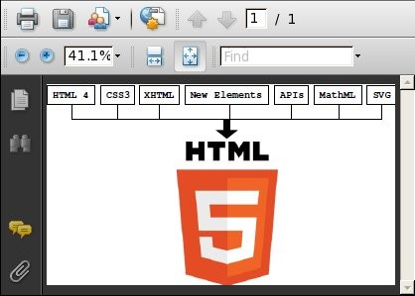
Embedded PDF

Slide 10
<object style="border: thin solid black" type="application/pdf" data="html5.pdf"
width="420" height="300">
<a href="files/ICTExpressPaper.pdf">Paper.pdf</a>
</object>
Demo: Ex: PDF

Slide 11
HTML Tables
Present tabular data such as an order receipt
Organize entries in fill-out forms for user input

Slide 12
Table Basics
<table border="1">
<caption>My Contacts</caption>
<tbody>
<tr><th>Name</th><th>email</th>
<th>phone</th></tr>
<tr><td>Joe Smith</td><td>jsmith@cnn.com</td>
<td>432-555-1000</td></tr>
<tr><td>Mary Jane</td><td>mjane@ibm.com</td>
<td>123-555-3020</td></tr>
</tbody></table>
Demo: Ex: SimpleTable

Slide 13
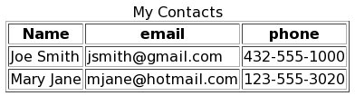
A Basic Table and more examples
Demo: | Collapse
Demo: | Spacing
Demo: | ImgComp

Slide 14
The table Structure
A table element contains the following child elements in order:
An optional caption
An optional colgroup for grouping together columns of the table
An optional thead for grouping together rows for the table header
One or more tbody elements containing rows for the table
An optional tfoot element for grouping together rows for the table footer

Slide 15
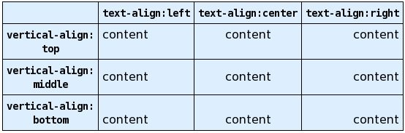
Cell Content Alignments
Demo: Ex: Align

Slide 16
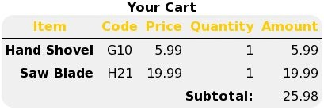
Sample Shopping Cart Table
Demo: Ex: Cart

Slide 17
Centering Tables
<table style="margin-left: auto;
margin-right: auto">
Demo: Ex: CenteredTable

Slide 18

Table Layout
style="width:
wd "—Sets the width of the element to wd,
which can be a fixed length or a percentage of the available horizontal space.
style="height:
fixed length ht.
ht "—Sets the height of the element to a
Demo: Ex: TableWidth

Slide 19
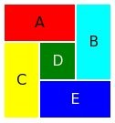
Row and Column Spans

Slide 20
<table style="width: 120px; text-align: center">
<tbody>
<tr><td colspan="2"
style="background-color:red; height:40px">A</td>
<td rowspan="2"
style="background-color: cyan">B</td></tr>
<tr><td rowspan="2"
style="background-color: yellow">C</td>
<td style="background-color: green; color: white; height: 40px">D</td></tr>
<tr><td colspan="2" style="background-color: blue;
color: white; height: 40px">E</td></tr>
</tbody></table>
Demo: Ex: Spans

Slide 21
Rules between Cells
The border="1" attribute of the table element gives rules separating all cells.
For only vertical rules, only horizontal rules, or some other design for a table, use the border style property on individual cells to piece together the desired rules in a table.

Slide 22
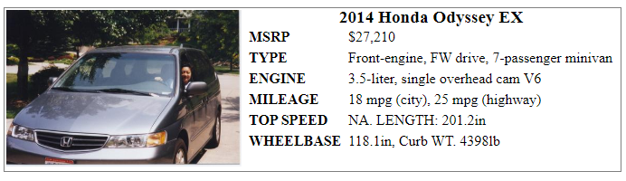
Table Nesting
Demo: Ex:TableNest

Slide 23
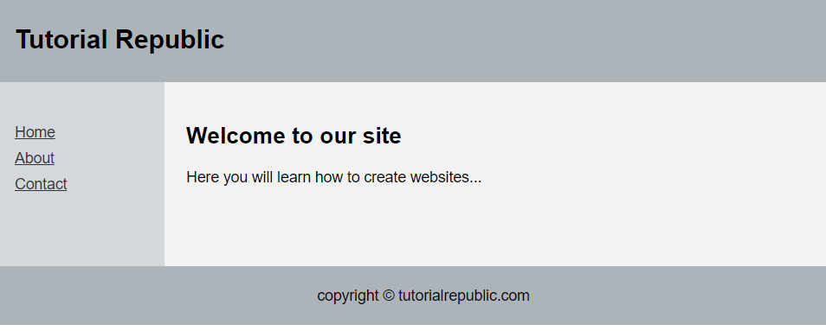
Table Based Layout
Demo: Ex:TableLayout

Slide 24
Webpage Character Encoding
ASCII, supported by regular English keyboards, contains only 128 characters.
HTML uses Universal Character Set (UCS), or Unicode, defined in ISO10646.
UCS contains characters from most known languages arranged into a linear sequence. Each character has a code position. ASCII characters are assigned positions 0–127.
An HTML document containing UCS characters can be encoded in different ways when stored as a file or transmitted over the Internet.
UTF-8 is a byte-oriented Unicode transformation format that is popular because of its ASCII preserving quality.

Slide 25
UTF-8 Encoding
UTF-8 represents
ASCII characters (code positions 0–127) with the lower 7 bits of 1 byte (single-byte code)
Code positions 128–2047 with 2 bytes
Code positions 2048–65536 with 3 bytes
UTF-8 is the recommended encoding for webpages.
<meta charset="utf-8" />

Slide 26
Numeric and Named Character References
On a computer, it is harder to enter non-ASCII characters into a document.
With alternative input methods, and some learning, character from different languages and UNICODE characters can be entered into documents.
HTML Numeric and Named Character References provide a character-set-independent way to use UNICODE characters.
A numeric character reference specifies the code position with the notation
&#decimal; or &#xhex;

Slide 27
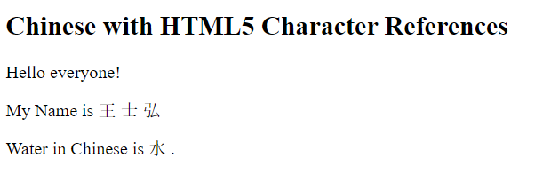
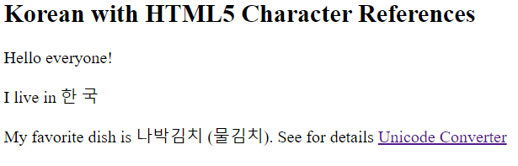
Numeric Character Reference Display
Demo: Ex: Chinese
Demo: Ex: Korean

Slide 28
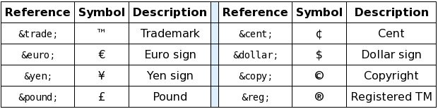
Commercial Symbols
Demo: Ex: Symbols

Slide 29
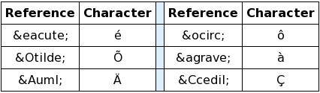
Character Accents
Demo: Ex: Accents

Slide 30
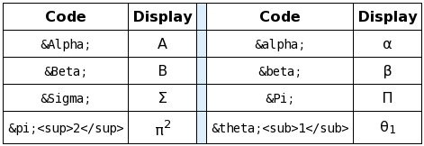
Greek Characters
Demo: Ex: Greek

Slide 31
Metadata and Head Elements
base—for page location
style—for in-page style sheet
link—for links to related documents such as favicons or external style sheets
script—for in-page or external scripts such as a JavaScript program
meta—for various page-related information such as character encoding, keywords, and a summary description
<meta name="some name" content="some text” />

Slide 32
Link Targets
The target attribute can be used in any element that provides a link url. If the target is the name of an iframe, then the referenced document is destined to that iframe. In the parent page or a child page, the link
<a href="index.html" target="f_one">homepage</a>
displays index.html in an iframe named f_one when clicked.
Without an explicit target, the default target for a link is the page or iframe containing the link. The target attribute in the base element can set the default target for all untargeted links in a page.

Slide 33
Pre-defined Targets
In addition to named frames, there are also known targets:
_blank—a new, unnamed top-level window
_self—the same iframe or page containing the link, overriding any base-specified target
_parent—the immediate parent of the iframe
_top—the full, original window

