Slide 1
Chapter 11: Functional Languages
CSE 216 –Programming Abstractions
https://ppawar.github.io/CSE216-S19/index.html

Slide 2
Historical Origins
The imperative and functional models grew out of work undertaken Alan Turing, Alonzo Church, Stephen Kleene, Emil Post, etc. ~1930s
Turing’s model of computing was the Turing machine a sort of pushdown automaton using an unbounded storage “tape”
the Turing machine computes in an imperative way, by changing the values in cells of its tape – like variables just as a high level imperative program computes by changing the values of variables
https://www.youtube.com/watch?v=gJQTFhkhwPA

Slide 3
Historical Origins
Church-Turing thesis
A function on the natural numbers is computable by a human being following an algorithm, ignoring resource limitations, if and only if it is computable by a Turing machine.
Church’s model of computing is called the lambda calculus (also written as λ-calculus)
is a formal system in mathematical logic for expressing computation based on function abstraction and application using variable binding and substitution
based on the notion of parameterized expressions (with each parameter introduced by an occurrence of the letter λ—hence the notation’s name)

Slide 4
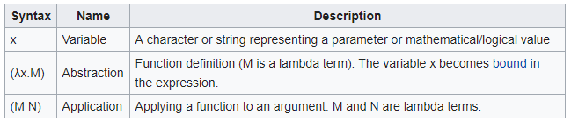
λ-calculus
Terms are built using only the following rules producing expressions such as: producing expressions such as: (λx.λy.(λz.(λx.z x) (λy.z y)) (x y))
alpha equivalence: λa.a = λb.b
beta substitution: (λa.aa) b = bb
https://www.youtube.com/watch?v=eis11j_iGMs

Slide 5
Functional Programming Concepts
Functional languages such as Lisp, Scheme, FP, ML, Miranda, and Haskell are an attempt to realize Church's lambda calculus in practical form as a programming language
The key idea: do everything by composing functions
So how do you get anything done in a functional language?
Recursion takes the place of iteration
First-call functions take value inputs
Higher-order functions take a function as input

Slide 6
Functional Programming Concepts
So how do you get anything done in a functional language?
Recursion (especially tail recursion which uses accumulator) takes the place of iteration
In general, you can get the effect of a series of assignments x := 0 ... x := expr1 ... x := expr2 ... from f3(f2(f1(0))), where each f expects the value of x as an argument, f1 returns expr1, and f2 returns expr2

Slide 7
Functional Programming Concepts
Recursion even does a nifty job of replacing looping
x := 0; i := 1; j := 100; while i < j do x := x + i*j; i := i + 1; j := j - 1 end while return x
becomes f(0,1,100), where
f(x,i,j) == if i < j then f (x+i*j, i+1, j-1) else x

Slide 8
Functional Programming Concepts
Necessary features, many of which are missing in some imperative languages
1st class and high-order functions
Extensive polymorphism – use function on as general a class of arguments
powerful list facilities
structured function returns – return structured types such as arrays from functions
garbage collection

Slide 9
LISP languages
All of them use (symbolic) s-expression syntax: (+ 1 2).
LISP is old - dates back to 1958 - only Fortran is older.
Anything in parentheses is a function call (unless quoted)
(+ 1 2) evaluates to 3
(* 5 (+ 7 3)) evaluates to 50.
((+ 1 2)) <- error, since 3 is not a function.
by default, s-expressions are evaluated. We can use the quote special form to stop that: (quote (+ 1 2))
Short form: ‘(+ 1 2) is a list containing +, 1, 2

Slide 10
Functional Programming Concepts
Scheme is a particularly elegant Lisp
Other functional languages
ML
Miranda
Haskell
FP
Haskell is the leading language for research in functional programming

Slide 11
Evaluation Order
applicative order:
evaluates arguments before passing them to a function:
((lambda (x) (* x x)) (+ 1 2))
((lambda (x) (* x x) 3)
(* 3 3)
9
normal order:
passes in arguments before evaluating them:
((lambda (x) (* x x)) (+ 1 2))
(* (+ 1 2) (+ 1 2))
(* 3 3)
9
Note: we might want normal order in some code.
(if-tuesday (do-tuesday)) // do-tuesday might print something and we want it only if it’s Tuesday

Slide 12
Evaluation Order Example
((lambda (x y) (if x (+ y y) 0) t (* 10 10))
Applicative order:
((lambda (x y) (if x (+ y y) 0) t 100)
(if t (+ 100 100) 0)
(+ 100 100)
200
(four steps !)
Normal Order:
(if t (+ (* 10 10) (* 10 10)) 0)
(+ (* 10 10) (* 10 10))
(+ 100 (* 10 10))
(+ 100 100)
200
(five steps !)

Slide 13
High-Order Functions
Higher-order functions
Take a function as argument, or return a function as a result
Great for building things
Currying (after Haskell Curry, the same guy Haskell is named after)
For details see Lambda calculus on CD
ML, Miranda, OCaml, and Haskell have especially nice syntax for curried functions

Slide 14
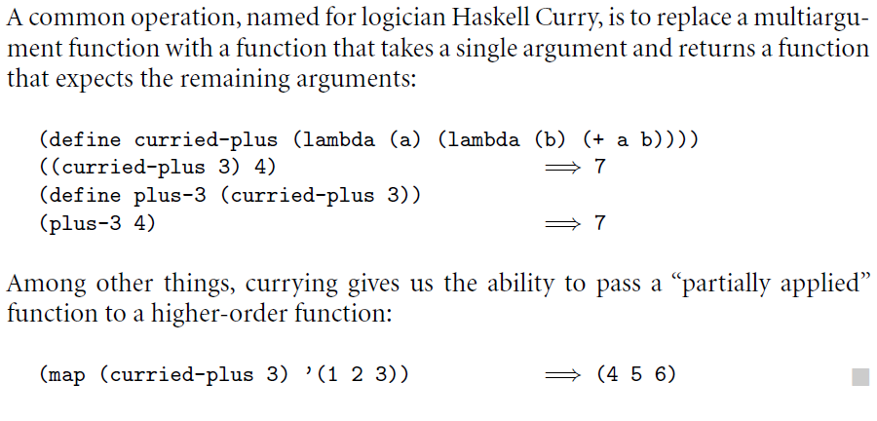
Currying
Some languages use currying as their main function-calling semantics (ML): fun add a b : int = a + b; ML's calling conventions make this easier to work with: add 1
add 1 2 (There's no need to delimit arguments.)

Slide 15
Pattern Matching
It's common for FP languages to include pattern matching operations:
matching on value,
matching on type,
matching on structure (useful for lists).
ML example:
fun sum_even l =
case l of
nil => 0
| b :: nil => 0
| a :: b :: t => h + sum_even t;

Slide 16
Functional Programming in Perspective
Advantages of functional languages
lack of side effects makes programs easier to understand
lack of explicit evaluation order (in some languages) offers possibility of parallel evaluation (e.g. MultiLisp)
lack of side effects and explicit evaluation order simplifies some things for a compiler (provided you don't blow it in other ways)
programs are often surprisingly short
language can be extremely small and yet powerful

Slide 17
Functional Programming in Perspective
Problems
difficult (but not impossible!) to implement efficiently on von Neumann machines
lots of copying of data through parameters
frequent procedure calls
heavy space use for recursion
requires garbage collection
requires a different mode of thinking by the programmer
difficult to integrate I/O into purely functional model

