Slide 1
CSE 307 – Principles of Programming Languages Course Information
Fall 2018
SUNY Korea
Instructor: Dr. Pravin Pawar
https://sunyk.cs.stonybrook.edu/~cse307
Slides courtesy: Prof. Paul Fodor (http://www3.cs.stonybrook.edu/~pfodor/)

Slide 2
Course Description
“Presents examples of important programming languages and paradigms such as LISP, ALGOL, ADA , ML, Prolog, and C++. Students write sample programs in some of the languages studied. The languages are used to illustrate programming language constructs such as binding, binding times, data types and implementation, operations (assignment data-type creation, pattern matching), data control, storage management, parameter passing, and operating environment. The suitability of these various languages for particular programming tasks is also covered.”
Prerequisites: CSE 219 or CSE 260, and CSE 220 and the CSE major or permission of instructor.

Slide 3
Official Course Outcomes
The following are the official course goals agreed upon by the faculty for this course:
Knowledge of, and ability to use, language features used in current programming languages.
An ability to program in different language paradigms and evaluate their relative benefits.
An understanding of the key concepts in the implementation of common features of programming languages.

Slide 4
Topics
Major Topics Covered in Course:
Principles of Language Design
Specification of Language Syntax
Survey of Procedural and OO Languages
Intro. to Functional Programming
Intro. to Logic Programming
Programming Language Semantics
Values; Bindings; Types;
Programming Language Constructs
Expressions; Statements
Procedures and Environments
Parameter Passing

Slide 5
Instructor
Pravin Pawar
Office: B424
Email: pravin.pawar@sunykorea.ac.kr
Phone: +82-032-626-1227
Office Hours: Mon: 3:00-5:00PM, Wed: 10:30-12:30PM, 3:00-5:00PM

Slide 6
General Information
Meeting Information:
Lectures: TuTh 2:00-3:20PM, C107.
Course Web page: https://sunyk.cs.stonybrook.edu/~cse307
Blackboard will be used for assignments, grades and course material

Slide 7
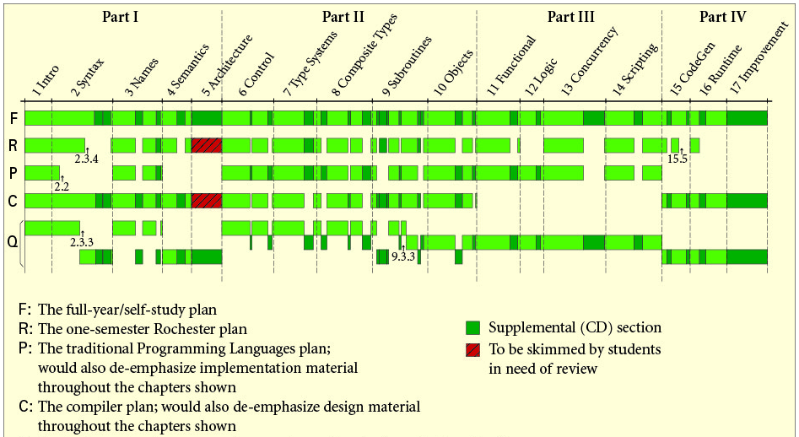
Textbook
Programming Language Pragmatics by Michael Scott. Fourth Edition, Morgan Kaufmann Publishers, 2015.

Slide 8
Class Schedule
Week | Lecture Topics
1 | Introduction to Programming Languages
2 | Python
3 | SML
4 | Programming language syntax
5 | Programming language syntax
6 | Names, Scopes, and Bindings
7 | Names, Scopes, and Bindings
8 | Semantic Analysis
9 | Semantic Analysis
10 | Control Flow, Data Types
11 | Control Flow, Data Types
12 | Subroutines and Control Abstraction
13 | Data Abstraction and Object Orientation, Functional Languages
14 | Logic Languages
15 | Logic Languages, Concurrency

Slide 9
Compiler vs. Interpreter
The main difference between a compiler and an interpreter is when they execute the code.
With an interpreter, the code is executed right away with the interpreting passing the interpreted code to the computer.
In comparison, a compiler writes the finished code into the disk.
•An interpreter directly executes the code while a compiler does not.
•An interpreter needs to be available in the target machine while a compiler is not.
•An interpreted program will run on multiple platforms while a compiled program won’t.
•An interpreted program will run slower than a compiled program.

Slide 10
Python
Python is an interpreted high-level programming language for general-purpose programming.
It provides constructs that enable clear programming on both small and large scales.
Python features a dynamic type system and automatic memory management.
It supports multiple programming paradigms, including object-oriented, imperative, functional and procedural.
Python has a large and comprehensive standard library.

Slide 11
SML
Standard ML (SML; "Standard Meta Language") is a general-purpose, modular, functional programming language with compile-time type checking and type inference.
It is popular among compiler writers and programming language researchers, as well as in the development of theorem provers.

Slide 12
Programming Language Syntax
The syntax of a computer language is the set of rules that defines the combinations of symbols that are considered to be a correctly structured document or fragment in that language.
This applies both to programming languages, where the document represents source code, and markup languages, where the document represents data.
Text-based computer languages are based on sequences of characters, while visual programming languages are based on the spatial layout and connections between symbols (which may be textual or graphical).
Documents that are syntactically invalid are said to have a syntax error.

Slide 13
Names, Scopes and Bindings
Name: Identifiers that allow us to refer to variables, constants, functions, types, operations, and so on
Binding: An association of a name with an object
Static binding is any binding that occurs prior to run-time (either compiler or link time) - associated with faster code
Dynamic binding is any binding that occurs at run-time (either load or run time) - associated with more flexible code
Scope: The lifetime of a binding of a name to an object
Static Scope: Scope can be determined at compile-time, typically by finding a matching declaration in the most closely enclosing block.
Dynamic Scope: Scope cannot be determined until run-time, typically by following stack frames until a matching declaration is found.

Slide 14
Semantic Analysis
Semantics are the meaning of various elements in the program (or whatever).
int width, numberOfChildren; -> Both of these variables are integers. From the compiler's point of view, they are exactly the same. However, judging by the names, one is the width of something, while the other is a count of some other things.
numberOfChildren = width; -> Syntactically, this is 100% okay, since you can assign integers to each other. However, semantically, this is totally wrong, since the width and the number of children (probably) don't have any relationship. In this case, we'd say that this is semantically incorrect, even if the compiler permits it.

Slide 15
Control Flow and Data Types
Control flow (or flow of control) is the order in which individual statements, instructions or function calls of an imperative program are executed or evaluated.
A data type or simply type is a classification of data which tells the compiler or interpreter how the programmer intends to use the data.
Most programming languages support various types of data, for example: real, integer or Boolean. A data type provides a set of values from which an expression (i.e. variable, function...) may take its values.

Slide 16
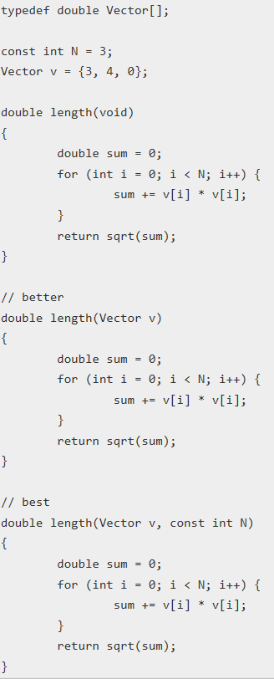
Subroutines and control abstraction
Subroutines are the basis of procedural abstraction: the abstraction of computations.
The first version can only compute the length of the vector stored in the global variable v.
The second version can compute the length of any vector, as long as it has only three component values.
The third version generalizes the vector length computation so that it can compute the length of any vector in any number of dimensions.
As we can see, one of the keys to procedural abstraction is the ability to use parameters to allow the computation to be performed with varying data values.

Slide 17
Data abstraction
Abstraction means displaying only essential information and hiding the details.
Class helps us to group data members and member functions using available access specifiers. A Class can decide which data member will be visible to outside world and which is not.
Members declared as public in a class, can be accessed from anywhere in the program.
Members declared as private in a class, can be accessed only from within the class. They are not allowed to be accessed from any part of code outside the class.

Slide 18
Functional Languages
Functional programming languages are specially designed to handle symbolic computation and list processing applications. Functional programming is based on mathematical functions.
Some of the popular functional programming languages include: Lisp, Python, Erlang, Haskell, Clojure, etc.

Slide 19
Logic languages
Logic programming is a type of programming paradigm which is largely based on formal logic. Any program written in a logic programming language is a set of sentences in logical form, expressing facts and rules about some problem domain. Major logic programming language families include Prolog, Answer set programming (ASP) and Datalog. In all of these languages, rules are written in the form of clauses:
H :- B1, …, Bn.
and are read declaratively as logical implications:
H if B1 and … and Bn.
H is called the head of the rule and B1, …, Bn is called the body.

Slide 20
Concurrent Logic Programming
Multi-processor machines such as parallel and distributed computer systems provide benefits such as increased processing power.
A concurrent logic programming was necessary to allow parallelism so that parallel and distributed systems could also be used to benefit logic programming.
Parlog and Concurrent Prolog are examples of concurrent logic programming languages.
Both concurrent logic programming languages support committed-choice indeterminacy which allow guards within procedures to be executed in parallel when more than one procedure is called.
The guard is a part of the body of a procedure which is specified by the programmer.

Slide 21
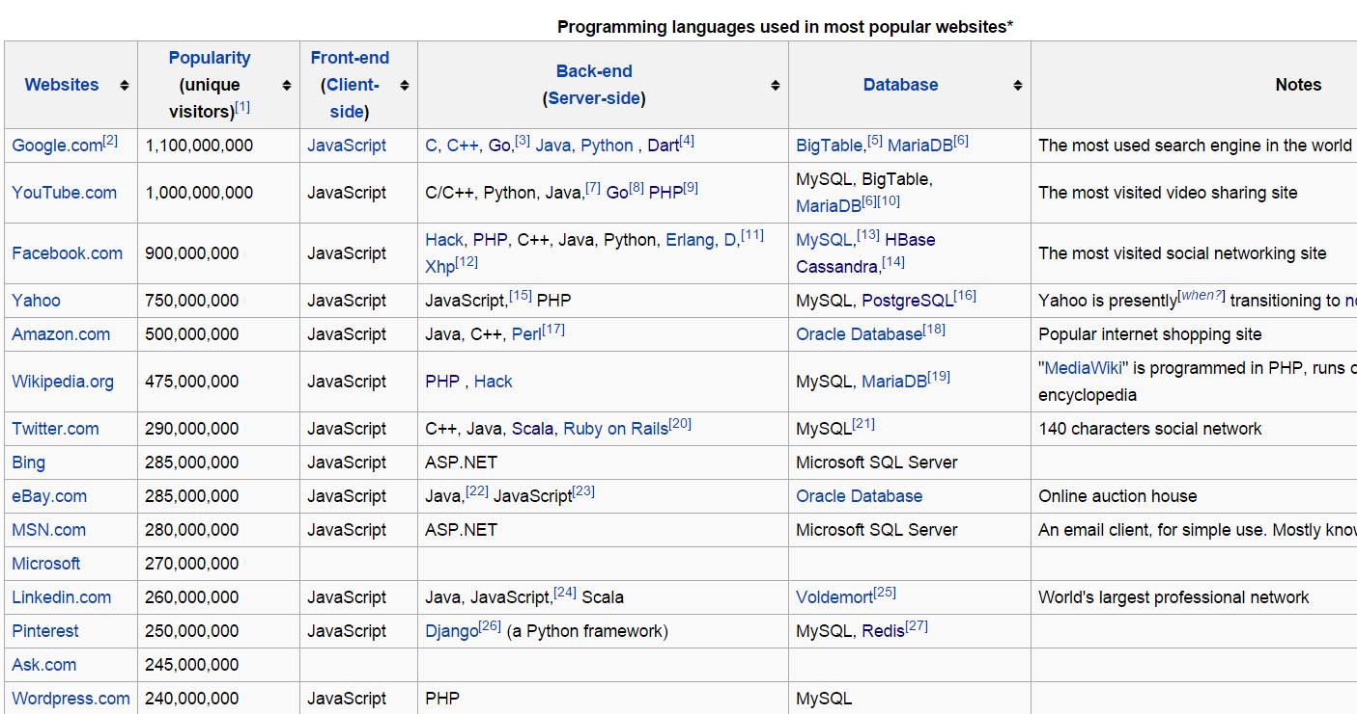
https://en.wikipedia.org/wiki/Programming_languages_used_in_most_popular_websites

Slide 22
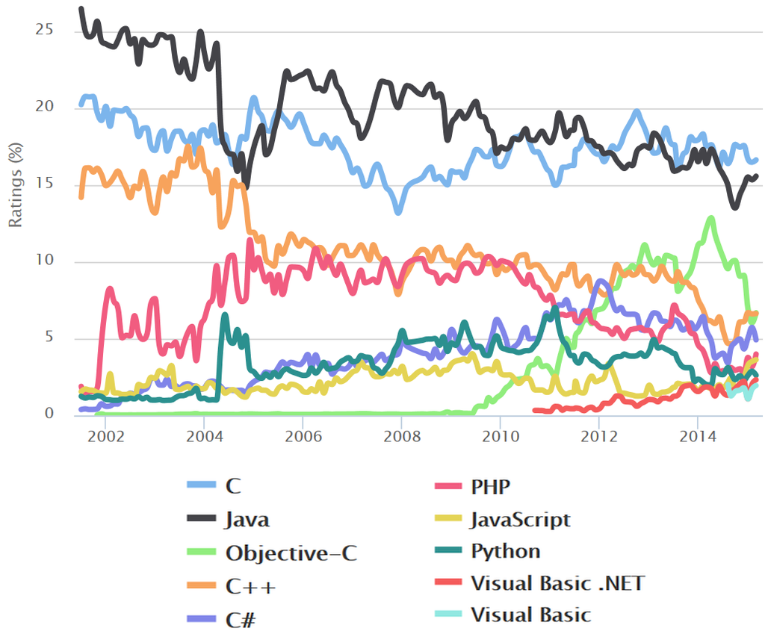
https://en.wikipedia.org/wiki/Measuring_programming_language_popularity

Slide 23
Grading Schema
Homework assignments = 20%
Quizzes = 5%
Midterm exam 1 = 25%
Midterm exam 2 = 25%
Final exam = 25%
Do not miss the exams. Make-up exams will be given only in extenuating circumstances (e.g., doctor's note stating that you were ill and unfit to take the exam). Students who miss an exam for a valid reason may need to take a make-up exam; specific arrangements will be made on a case-by-case basis.

Slide 24
Exam dates
Midterm exam 1:Thursday 20 Sep, classtime, in classroom.
Midterm exam 2:Tuesday 6 Nov, 2018, classtime, in classroom.
Final exam: See Final Exams University Schedule.

Slide 25
Grading Schema
The Pass/No Credit (P/NC) option is not available for this course.
This policy applies to all CSE/ISE undergraduate courses used to satisfy the graduation requirements for the major.

Slide 26
Grading
The final grade you receive in this class will reflect, as far as possible, the extent to which you have mastered the concepts and their applications.
How much someone needs a grade, or how close they are to the next higher grade, will have no effect on grade.
As the instructor, I want everyone to do well in this course, and will make every reasonable effort to help you understand the material taught.
However, the grades provided at the end of the semester are final.

Slide 27
Regrading of Homework/Exams
Please meet with a TA or the instructor and arrange for regrading.
You have one week from the day grades are posted or mailed or announced
Late requests will not be entertained

Slide 28
Assignments
There will be regular programming assignments which must be submitted electronically on Blackboard (http://blackboard.stonybrook.edu) by the announced due date and time.
no late submission is permitted
All assignments should be submitted electronically
Blackboard
All code must compile. Code that does not compile will not be graded.
Assignments will be graded based on program performance and documentation.
Submissions that are no submitted as requested in the assignment will not receive any credit (e.g., a Test.java file cannot be test.java, test.txt, johnSmith.java or anything else but Test.java; same for method arity)

Slide 29
Lecture Notes
I encourage you to print the slides, so you can focus on just listening in class.
There are a lot of example code in the lecture notes and I will add more every week, but I will prioritize on the most important aspects and leave the extras for reference.
I know they say that writing notes would help us learn better, but personally I cannot write and still completely hear everything that someone says.
I process someone's statement, start writing while half listening, get through half of what I was supposed to write, and then blank out, thereby forgetting what I was supposed to write and what I had heard while I was writing (it might just be sleep deprivation, but it could probably be partially attributed to the density of the lessons).

Slide 30
Disability Support Services
If you have a physical, psychological, medical or learning disability, contact the DSS office at Room 128 ECC. Phone 632-6748/TDD
If you are planning to take an exam at DSS office, you need to tell me ahead of time for every exam.
All documentation of disability is confidential.

Slide 31
Academic Integrity
The following rules are posted in every course syllabus: "Each student must pursue his or her academic goals honestly and be personally accountable for all submitted work. Representing another person's work as your own is always wrong. Any suspected instance of academic dishonesty will be reported to the Academic Judiciary. For more comprehensive information on academic integrity, including categories of academic dishonesty, please refer to the academic judiciary website at http://www.stonybrook.edu/commcms/academic_integrity/"

Slide 32
Welcome
and Enjoy!

