Slide 1
Introduction to Computational and Algorithmic Thinking
Lecture 10 – Data Representation and compression

Slide 2
Announcements
This lecture: Data Representation and Compression
Reading: Read Chapter 8 of Conery
Acknowledgement: Some of this lecture slides are based on CSE 101 lecture notes by Prof. Kevin McDonald at SBU

Slide 3
Data and Computers
Computers are multimedia devices, dealing with a vast array of information categories
Information is data (basic values, facts) that has been organized or processed into useful form
Computers store, present and help us modify various kinds of data: numbers, text, audio, images and graphics, video
Information can be represented in one of two ways: analog or digital
Analog data: a continuous representation, analogous to the actual information it represents
Digital data: a discrete representation that breaks the information up into separate elements

Slide 4
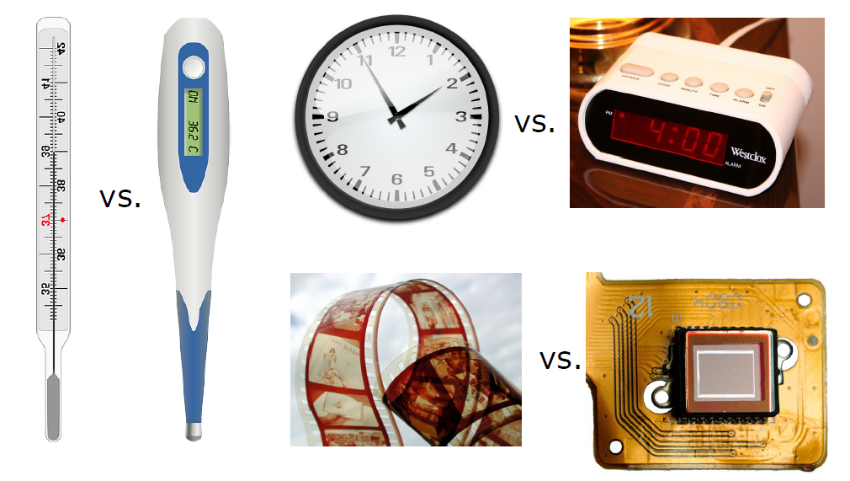
Analog vs. Digital

Slide 5
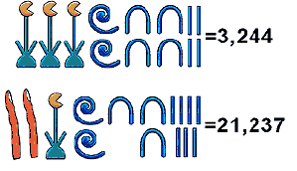
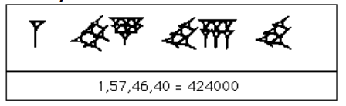
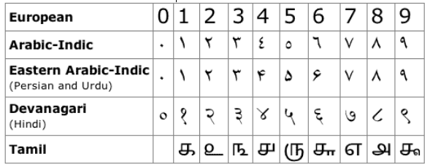
Representing Numbers
Human beings have contrived a wide variety of ways to represent the digits that make up numbers
Egyptian hieroglyphs:
Babylonian numerals:
Roman numerals:
MMXVII = 2017
Many others!
References:
http://goo.gl/BSrWTH
http://goo.gl/r8NcKF
Wikipedia

Slide 6
Positional Notation
The modern Western style and some other styles of writing numbers use positional notation
The position of a digit determines how much it contributes to the number’s value
With decimal (base 10), place-values are powers of 10:
…, 10³, 10², 10¹, 10⁰, 10⁻¹ , 10⁻², 10⁻³, …
…, 1000s, 100, 10s, 1/10 s, 1/100 s, 1/1000 s, …
642.15 really means (6 x 10²) + (4 x 10¹) + (2 x 10⁰) + (1 x 10⁻¹) + (5 x 10⁻²)
Early computers represented numbers with base 10, but they were very unreliable. It was too hard to make the computer maintain 10 distinct voltages for the 10 digits.

Slide 7
Binary Numbers
Modern digital computers use binary digits (base-2 numbers: 0 and 1)
The word bit is short for binary digit
The hardware determines how bits are stored
Hard drive: magnetized spots on surface of disk
Flash drive: presence/absence of electrons in a memory cell
Optical disc (CD/DVD): pits and lands (flat spots)
As computational thinkers, we do not need to worry so much about how the bits are stored
Instead, we will concern ourselves about what bits are stored

Slide 8
Binary Numbers
With binary we have just two digits, 0 and 1, and the place-values are powers o 2:
…, 2³, 2², 2¹, 2⁰, 2⁻¹, 2⁻², 2⁻³, …
..., 8s, 4s, 2s, 1s, 1/2s, 1/4s, 1/8s, …
The number 1011.011₂ written in decimal is:
(1 x 2³) + (0 x 2²) + (1 x 2¹) + (0 x 2⁰) + (0 x 2⁻¹) + (1 x 2⁻²) + (1 x 2⁻³)
= 8 + 0 + 2 + 1 + 0 + 1/4 + 1/8 = 11.375₁₀
Important observation: 1011.011₂ and 11.375₁₀ are two different representations of the same quantity
All data in a modern machine is stored using binary numbers

Slide 9
Decimal ➔ Binary Conversion
To convert a decimal number to binary, perform these steps:
Repeatedly divide the decimal number by 2.
Set aside the remainder of each division.
Use the quotient for the next round of division.
When the quotient reaches 0, write down all of the remainders in order from last to first. This value is your answer.
This algorithm is most easily understood by seeing some examples

Slide 10
Decimal ➔ Binary Example #1
Convert 123₁₀ to binary
123 / 2 = 61 rem. 1
61 / 2 = 30 rem. 1
30 / 2 = 15 rem. 0
15 / 2 = 7 rem. 1
7 / 2 = 3 rem. 1
3 / 2 = 1 rem. 1
1 / 2 = 0 rem. 1
Answer: 1111011₂
Note that we write the remainders in the reverse
order of how they are generated

Slide 11
The Function dec2bin()
Let’s see a function dec2bin() that returns a string of 0s and 1s giving the binary representation of an integer
def dec2bin(decimal):
binary = ""
while decimal > 0:
remainder = decimal % 2
binary = str(remainder) + binary
decimal = decimal // 2
return binary
print(dec2bin(23)) # "10111"
print(dec2bin(100)) # "1100100"
data_rep.py

Slide 12
Encoding Data (next)
To store information in a computer’s memory we have to encode it somehow: an encoding is a pattern of 0s and 1s
The pattern is a representation of some real-world object, like a letter, number, sound clip, or video
Encoding is not the same as encryption
Both use codes, but in this slide set we will explore standard ways of representing data, not hiding data
A set of k bits can represent up to 2^{k} items. Let’s see why.
Each bit can be 0 or 1 (two options)
With 2 bits, we can represent 2² = 4 items
With 3 bits, we can represent 2³ = 8 items
…
With k bits, we can represent 2^{k} items

Slide 13
Representing Characters
ASCII (American Standard Code for Information Interchange) includes 7-bit and 8-bit schemes for representing characters used in the English language
Each letter, number, punctuation mark, etc. is mapped to a 7-bit number
See ASCII.txt
Examples: capital letter “A” is 65; lowercase letter “a” is 97
A newer scheme called Unicode includes codes for 135 alphabets
Modern languages (Greek, Cyrillic, Arabic, Hebrew, Korean, Chinese, Japanese, ...) and ancient languages (hieroglyphics, runes, ...)
Also include technical symbols, emoji, and other symbols

Slide 14
Representing Characters
Here are three ways to include a Unicode symbol in a Python string:
Copy and paste text from an e-mail, a web page, etc.
Use a function named chr (short for “character”)
Pass it a code number. It will return a one-letter string containing that symbol. Example: chr(9829) gives '♥'
Find code numbers at www.charbase.com or similar websites that have lists of Unicode symbols
Use an escape sequence ‘\uXXXX’ where XXXX is the 4-digit hexadecimal (base 16) code number
'I \u2665 cats' is 'I ♥ cats’
See data_rep.py for more examples

Slide 15
Hexadecimal Numbers
In some software development it’s more natural to write numbers in base 16, called hexadecimal
With hexadecimal we have 16 digits: 0, 1, 2, 3, 4, 5, 6, 7, 8, 9, and the letters A through F for ten through fifteen
Place-values in hexadecimal are powers of 16:
…, 16³, 16², 16¹, 16⁰, 16⁻¹, 16⁻², 16⁻³, …
51E₁₆ = (5 × 16²) + (1 × 16¹) + (14 × 16⁰) = 1,310₁₀
FAD₁₆ = (15 × 16²) + (10 × 16¹) + (13 × 16⁰) = 4,013₁₀
Changing the base of a number doesn’t change the magnitude (value) of a number
The representation for a number gets longer as the base decreases.

Slide 16
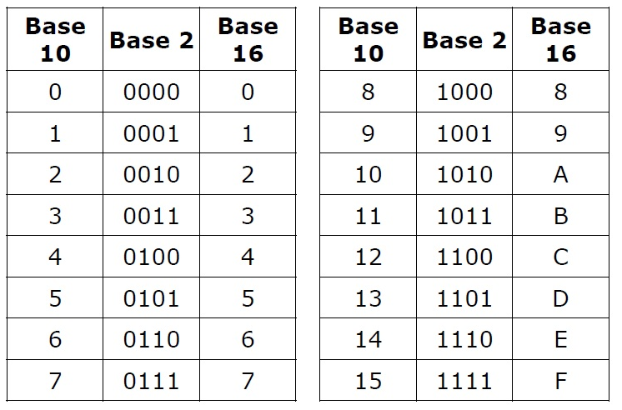
Same Value, Different Base

Slide 17
Hexadecimal Numbers
Hexadecimal is used widely in web design for giving colors
You can use it with Python too, as we just saw
When giving the Unicode for a character as an escape sequence with \u, we always use hexadecimal
In contrast, the chr() function expects the decimal representation
For the heart symbol above, we used 9829 (base 10) for chr(), but 2665 (base 16) for the escape sequence
The related ord() function returns the Unicode value of a character:
ord('A') returns 65 and ord('x') returns 120
See data_rep.py for more examples

Slide 18
Hexadecimal Numbers
The binary representation for a string can be hard to read:
01001001 00100111 01101101 00100000 01100001
01100110 01110010 01100001 01101001 01100100
00100000 01101111 01100110 00100000 01100011
01101111 01110111 01110011 00101110
It’s a little easier to deal with codes in hexadecimal:
49 27 6D 20 61 66 72 61 69 64 20 6F 66 20 63 6F 77 73 2E
Recall that in hexadecimal we have 16 digits: 0, 1, 2, 3, 4, 5, 6, 7, 8, 9, and the letters A through F for ten through fifteen
Note that each hexadecimal digit corresponds with four binary digits (bits)

Slide 19
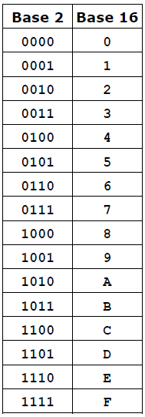
Binary ↔ Hexadecimal
To convert a hexadecimal number to a binary number, simply convert each digit in the hexadecimal number into a four-digit binary number.
For example:
D2B5₁₆ = 1101001010110101₂
To convert a binary number to a hexadecimal, convert every four binary digits from right to left in the binary number into a hexadecimal digit.
For example: 010001111110₂ = 47E₁₆

Slide 20
Groups of Bits
A byte is a collection of 8 bits
A 7-bit ASCII value fits in single byte
A 32-bit integer requires 4 bytes (32 ÷ 8 = 4)
A central processing unit (CPU) operates on several bytes at a time, called a word
A word is a collection of two or more bytes
Typical word size are 32 bits (4 bytes) and 64 bits (8 bytes)
Memory capacity is often described in terms of megabytes or gigabytes

Slide 21
Error Detection
Errors in values can be caused by circumstances beyond our control
The storage medium itself has a flaw or is deteriorating
Data can be corrupted by interference during transfer over wires or wirelessly
Even solar activity itself can affect electronic devices and disrupt electronic communication
The general method for detecting errors is to add extra information to the data
Add extra data to a document before storing it in a file
Append error checking data to a message while sending it

Slide 22
Error Detection
The basic procedure for enabling error-free communication:
Sender adds error-checking information
After receiving the message, the receiver analyzes the message along with the extra data to see if an error occurred
If an error occurred, the receiver will ask the sender to send the message again
A simple method for error-checking is to use a parity bit
Add one extra bit to the end of the text
Here, “text” means any string: an entire message or a single character

Slide 23
Error Detection
The value of the extra bit should make the total number of '1' bits an even number
This property is called even parity
Example: parity bits for 8-bit ASCII characters
A = 01000001. There are two 1 bits, so attach a 0 as the parity bit (the total # of 1s remains two)
C = 01000011. There are three 1 bits, so attach a 1 as the parity bit (bringing the total # of 1s to four)
Example: parity bit for a piece of DNA (using ASCII)
ATG = 01000001 01010100 01000111 + 1
The binary code for the entire string contains 9 1's, so we add one more 1 bit to make an even number of 1s

Slide 24
Error Detection
The receiver treats the parity bit like any other bit in the incoming message
It is included in the count of the number of 1 bits
To get the message contents, the receiver discards the last bit
Example: when sending an 8-bit ASCII 'C', the bit stream is 010000111: the digits in the code for 'C' plus a parity bit
The receiver reads 9 bits and sees there was an even number of 1 bits; no error detected
The receiver discards the 9th bit
The remaining bits are the contents of the message: 01000011, which is the ASCII code for 'C’
Note: It is a very simple scheme. It can only be used to detect single or any other odd number (i.e., three, five, etc.) of errors in the output. An even number of flipped bits (errors) will make the parity bit appear correct even though the data is erroneous.

Slide 25
Aside: Communication Protocols
For this error-checking plan to work, the sender and receiver both have to agree on a communication protocol
The protocol defines a message structure and also specifies what actions are taken during the transmission or receipt of a message
In our simple protocol, the sender and receiver agree in advance the parity bit is the last bit
Two of the most important protocols used today are Transmission Control Protocol (TCP) and Internet Protocol (IP)
Used extensively in Internet communication, including the Web and online video games

Slide 26
Computing Parity Bits
How can we write a function that computes the parity bit for a message?
Deciding whether to attach a 1 or a 0 to the end of a code is simple using a logic function called “exclusive or”, abbreviated as XOR
Normally, a or b is true if either a or b is true, or if both of a and b are true
The XOR of variables a and b is true if either one of them is true, but not if both are true
XOR in Python is denoted using the caret, ^

Slide 27
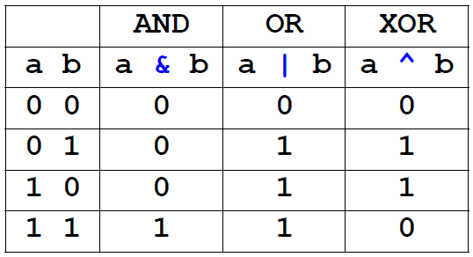
Computing Parity Bits
It is uncommon in programming to use XOR in Boolean expressions (True/False expressions)
Rather, XOR is used (almost) exclusively in bitwise operations, which are expressions that involve 0s and 1s
In Python, bitwise-and is denoted by the ampersand, &, and bitwise or is denoted by the vertical bar, or pipe, |

Slide 28
Computing Parity Bits
Let’s consider a function that computes a parity bit. Here’s the algorithm:
Initialize the return value p to 0.
Iterate over all the bits in the input code, updating p using the XOR operator: p = p ^ bit
If a bit is 0, it won’t change p.
But if it's a 1, it sets p to the opposite value.
Here’s why this works. We start with p = 0. Every time we see a 1, we “flip” the parity bit by replacing p with
p XOR 1.
For example, if the data contain three 1s, then p will flip three times: p = 0 ➔1 ➔ 0 ➔ 1, so the parity bit will be 1

Slide 29
The parity() Function
Given a string containing only 0s and 1s, the parity() function computes the parity bit
def parity(bits):
p = 0
for bit in bits :
p = p ^ int(bit)
return p
Examples:
parity(‘1000001’) # returns 0
parity(‘1000011’) # returns 1
See data_rep.py

Slide 30
Groups of Bits
We can define our own encoding schemes for objects
Suppose we wanted to encode DNA sequences, which are strings containing the letters A, C, G, and T
We need only 2 bits to represent 4 different things
We could create a dictionary to map a letter to a 2-bit code
Example: “A” ➔ 00
“C” ➔ 01
“G” ➔ 10
“T” ➔ 11
We will now look at a famous algorithm for compressing data which produces a new, original binary encoding scheme for a given input data-set

Slide 31
Text Compression
Data compression algorithms reduce in the amount of space needed to store a piece of data
A data compression technique can be:
Lossless (no information lost)
Lossy (information lost)
There are many algorithms for compressing files (including photos, images and other types of data) but we’ll focus on a lossless technique for text compression called Huffman coding
We will first need to explore a few data structures before we can understand how Huffman coding works

Slide 32
Binary Trees (next)
In mathematics and computer science, a tree consists of data values stored at nodes, which are connected to each other in a hierarchical manner by edges
Like a family tree, a tree shows parent-child relationships
Each node in the tree, except for a special node called the root, has exactly one parent node
Nodes can be connected to 0 or more child nodes immediately beneath them in the tree
A node with at least one child is called an interior node (colored ‘w’hite in the figure on the next slide)
Towards the bottom of a tree we find nodes with no children; such nodes are called leaves (shaded ‘g’ray in the figure on the next slide)

Slide 33
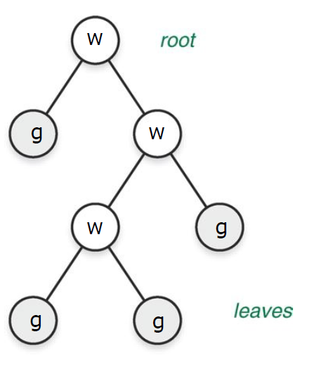
Binary Trees
In a binary tree, every node has either 0, 1 or 2 children
Used in this context, the word “binary” refers to the maximum number of children that a node can have. It does not refer to bits.

Slide 34
Huffman Coding
Huffman coding is a scheme for encoding letters based on the idea of using shorter codes for more commonly used letters
ASCII uses 7 or 8 bits to store every letter, regardless of how often that letter is used in real text
Imagine if we could find a way to store commonly used letters like R, S, T, N, L, E, etc. using fewer bits
For large data-sets consisting only of characters, the potential savings is huge
This is what Huffman coding accomplishes

Slide 35
Huffman Coding
A Huffman tree is a binary tree that is at the heart of Huffman coding
Inside of each node of a Huffman tree we store (i) a letter and (ii) the frequency of how often that letter appears in words

Slide 36
The Hawaiian Alphabet
We will use the Hawaiian alphabet as part of a running example to understand how Huffman coding works
Hawaiian words are spelled with the five vowels A, E, I, O, and U, and only the seven consonants H, K, L, M, N, P, and W
The ' symbol, called the okina, is used between two vowels when they should be pronounced as separate syllables
Example: “a’a” is pronounced “ah-ah”

Slide 37
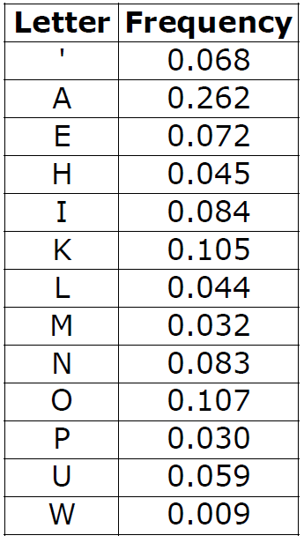
The Hawaiian Alphabet
The table to the right shows the frequency of each letter in Hawaiian words
We will exploit this knowledge to find an efficient encoding of the 13 symbols

Slide 38
Data Structures for Huffman Coding
In an earlier lecture we learned about a special kind of list called a priority queue
Every item inserted into a priority queue has a corresponding numerical priority
The priority queue always makes sure that the item with highest priority is at the front of the list
The PriorityQueue class in the SpamLab implements the priority queue concept
The insert() method adds an item to the priority queue
The pop() method removes the item at the front of the list, which is guaranteed to be the item of highest priority

Slide 39
Data Structures for Huffman Coding
We will use a priority queue to help us build a Huffman tree
In the BitLab lab there is a class called Node we can use to build Huffman trees
When creating a Node object, we give the letter and the letter’s frequency, as in this example:
from PythonLabs.BitLab import Node
leaf = Node('M', 0.032)
The above Node object creates a leaf node
The Huffman coding algorithm will take a set of such nodes, one per letter, and insert them into a priority queue

Slide 40
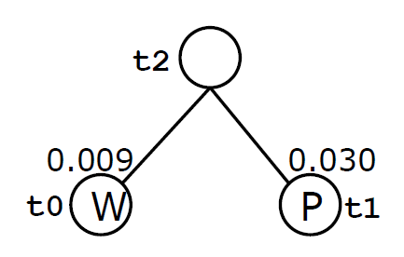
Data Structures for Huffman Coding
The priority queue will put the node with lowest frequency at the front of the list
In other words, a letter’s frequency will serve as its “priority”, with high-frequency letters having the lowest priority
If we want to create an interior node, which has one or two children, we have to “tell” the Node object which nodes are its children, as in this example:
t0 = Node('W', 0.009)
t1 = Node('P', 0.030)
t2 = Node(t0, t1)

Slide 41
Huffman Coding: The Algorithm
Make leaf nodes for every symbol in the alphabet
Put these nodes into a priority queue
Remove the first two nodes from the queue
Create a new interior node using these two nodes
Insert the new node back into the queue.
If there are still two more nodes in the queue, go to step 3
Otherwise, stop
Let’s see how this would work if we consider only the vowels (to make the example simpler)

Slide 42
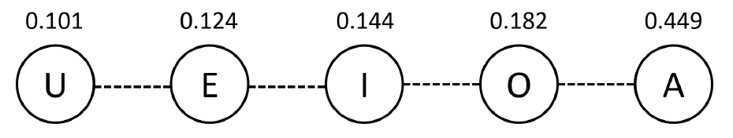
Huffman Coding: Example #1
Below is the priority queue that would be created, with the front of the queue on the left:
We see that U and E are the two front nodes
So, we remove them from the queue, create a new interior node, and insert the new node into the queue, as we’ll see on the next slide

Slide 43
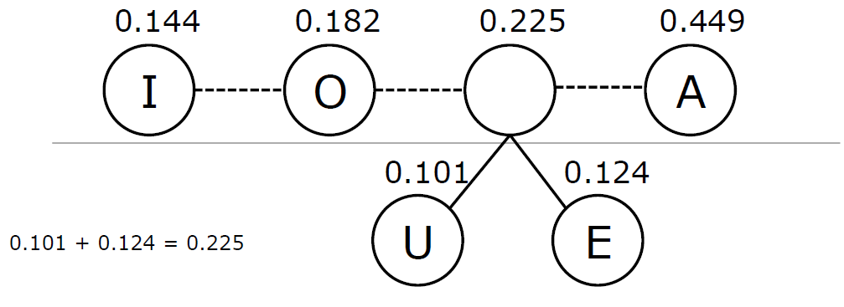
Huffman Coding: Example #1
Above the horizontal line is the content of the priority queue
Note how the queue has one fewer entry in it now
Next we’ll remove the nodes for I and O, create a new node with these two nodes as children and add the new node back into the queue

Slide 44
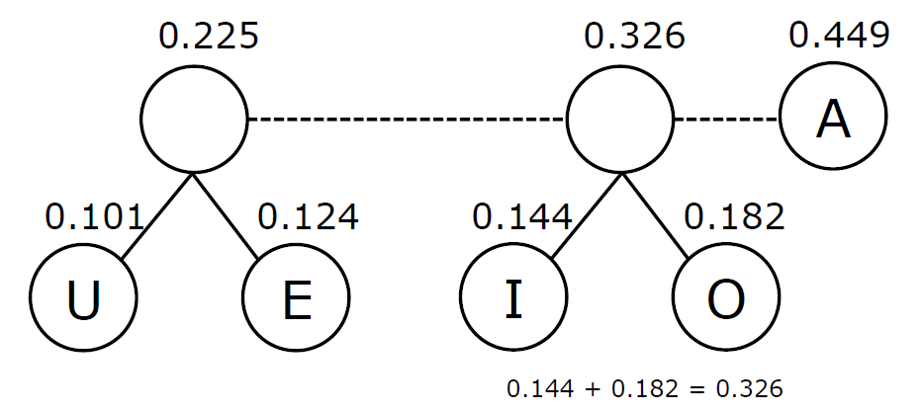
Huffman Coding: Example #1
Next we’ll remove the nodes with the weights 0.225 and 0.326, and combine them into a new interior node

Slide 45
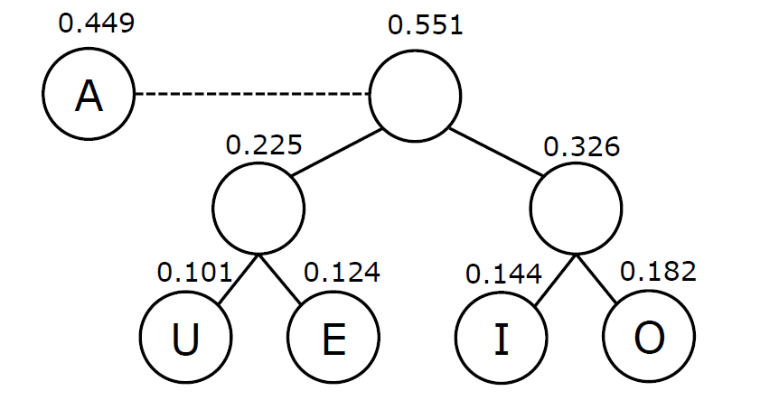
Huffman Coding: Example #1
Finally, we have only two nodes left, so we remove them both, and combine them into a new interior node
This last node we create becomes the root of the binary tree

Slide 46
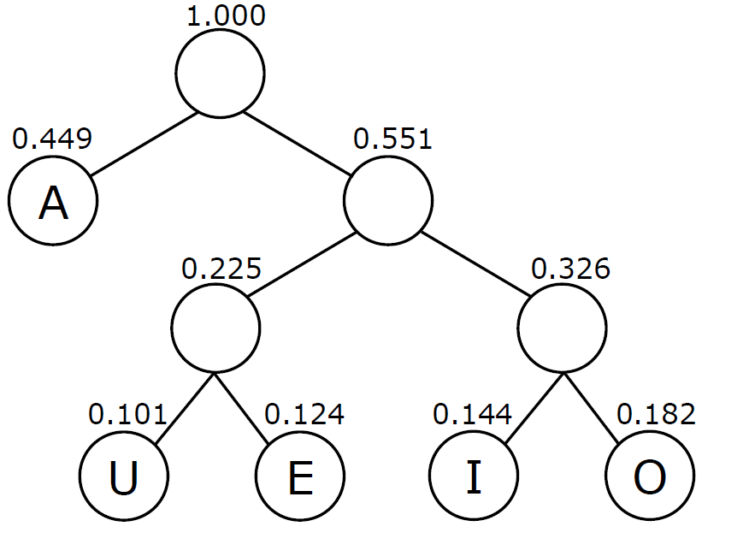
Huffman Coding: Example #1

Slide 47
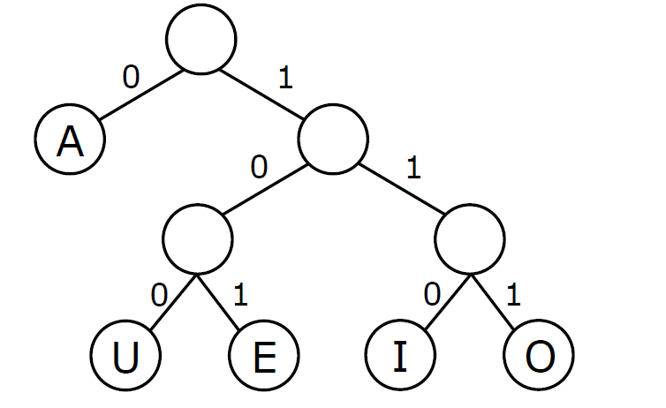
Huffman Coding: Example #1
With the tree completed, we now attach 0’s and 1’s to the edges connected to the left child and right child of each node, respectively

Slide 48
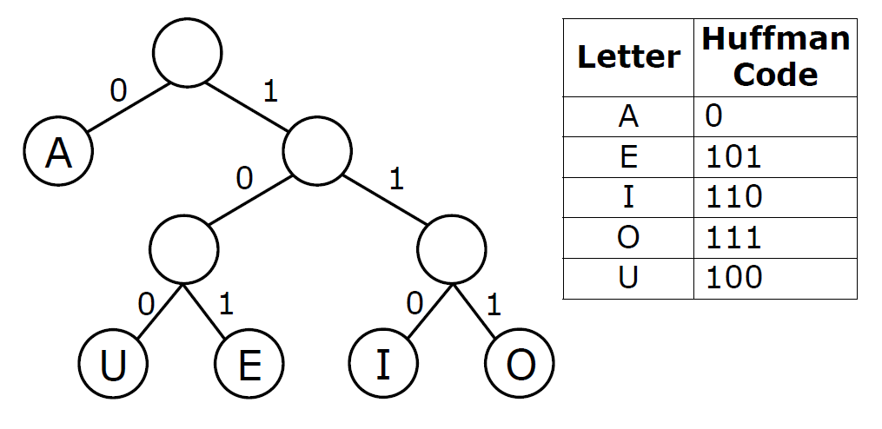
Huffman Coding: Example #1
Starting at the root, we trace the path from the root to each node to generate the codes for each letter:

Slide 49
The build_tree() Function
We can now implement a function build_tree() that will build a Huffman tree from the list of frequencies
The function read_frequencies() from the BitLab module will load the frequencies stored from a file into a dictionary
The build_tree() function then adds the frequencies into Node objects, which are in turn added into the priority queue
Finally, a while-loop assembles the Huffman tree by removing items two at a time from the priority queue and re-inserts the resulting “merged” pairs back into the queue

Slide 50
The build_tree() Function
from PythonLabs.BitLab import Node, read_frequencies, init_queue
def build_tree(filename):
pq = init_queue(read_frequencies(filename))
while len(pq) > 1:
n1 = pq.pop() # remove 1st element
n2 = pq.pop() # remove 2nd element
pq.insert(Node(n1,n2))
return pq[0]
See huffman.py

Slide 51
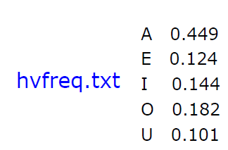
Huffman Coding: Example #1
Let’s try the function with the vowel frequencies:
vt = build_tree('hvfreq.txt')
print(vt)
# hvfreq.txt is in PythonLabs/data/huffman/
Output:
( 1.000 ( A: 0.449 ) ( 0.551 ( 0.225
( U: 0.101 ) ( E: 0.124 ) ) ( 0.326 ( I: 0.144 )
( O: 0.182 ) ) ) )
Although it may not seem like it, this is actually our tree
Let’s reformat it a little (see next slide)

Slide 52
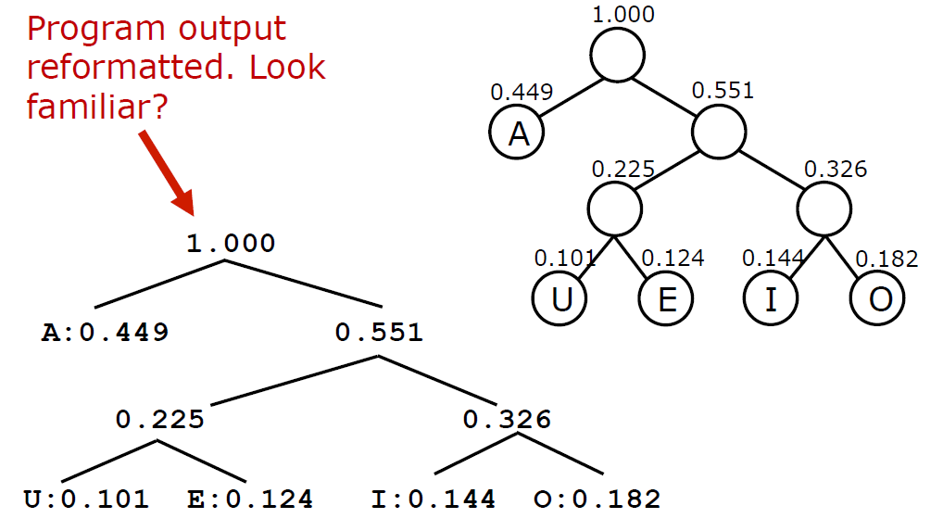
Huffman Coding: Example #1

Slide 53
Huffman Coding: Example #1
Finally, the recursive function assign_codes() from BitLab assembled the Huffman codes from the Huffman tree:
from PythonLabs.BitLab import assign_codes
codes = assign_codes(vt)
print(codes)
Output:
{'A': 0, 'E': 101, 'I': 110, 'O': 111, 'U': 100}

Slide 54
Huffman Coding: Example #2
The file hafreq.txt contains the frequencies for all letters in the Hawaiian alphabet
Let’s build the Huffman tree from the frequencies:
at = build_tree('hafreq.txt')
Then assign the codes:
codes = assign_codes(at)
Result: {
"'": 0111, 'A': 10, 'E': 1101,
'H': 0001, 'I': 1111, 'K': 001,
'L': 0000, 'M': 11000, 'N': 1110,
'O': 010, 'P': 110011, 'U': 0110,
'W': 110010 }

Slide 55
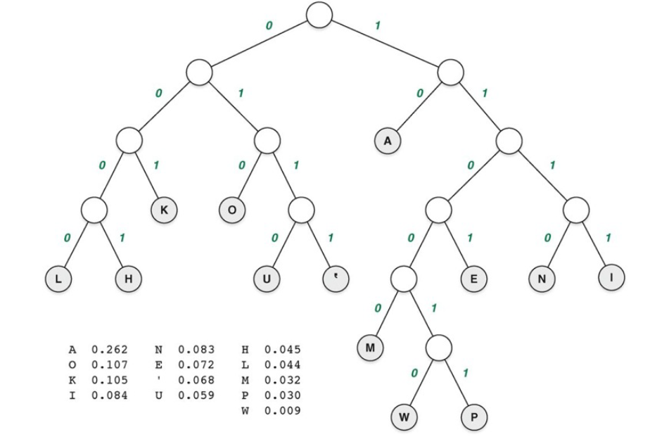
Huffman Coding: Example #2

Slide 56
Huffman Coding: Example #2
What we find is that the most-frequently appearing letters have short codes, while the less-frequently appearing letters have longer code
Also of note: no code is the prefix of another code
For example, the code for A is 10. No other code begins with 10.
This fact is important when we want to decode a message
Let’s see now how we decode a message (next slide)

Slide 57
Huffman Coding: Example #2
Suppose we have the message 110001001101111
We scan the digits from left to right
The first five digits, 11000, form the code for “M”
The next two digits, 10, form the code for “A”
The next four digits, 0110, form the code for “U”
Finally, the last four digits, 1111, form the code for “I”
So, the original encoded word was “MAUI”
There is no other way to decode that string of bits to generate a different word

Slide 58
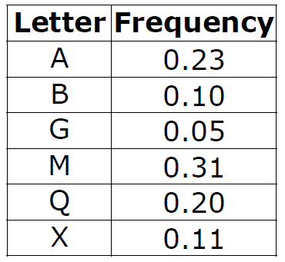
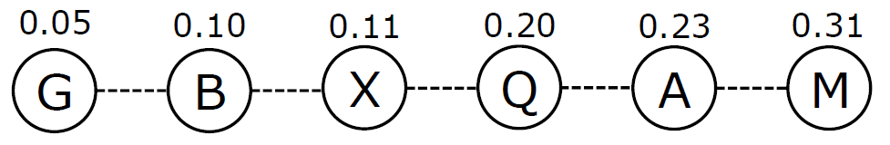
Huffman Coding: Example #3
Given the following letter frequencies, let’s compute the Huffman coding for the letters
We begin by inserting the letters into a priority queue:
Now merge the 2irst two elements in the queue until the tree is assembled (see few next slides)

Slide 59
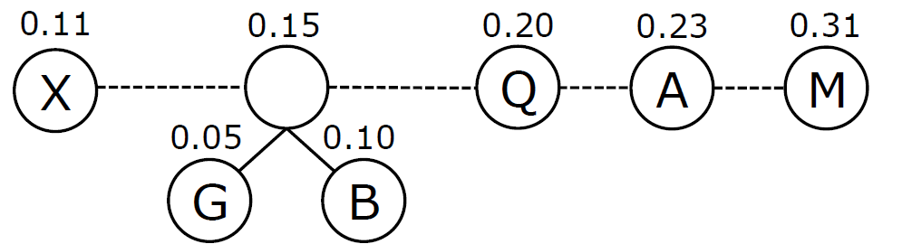
Huffman Coding: Example #3

Slide 60
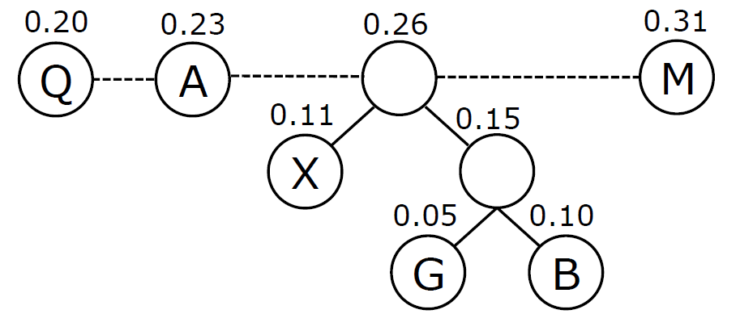
Huffman Coding: Example #3

Slide 61
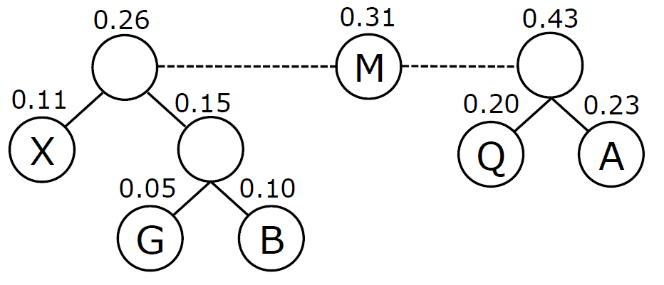
Huffman Coding: Example #3

Slide 62
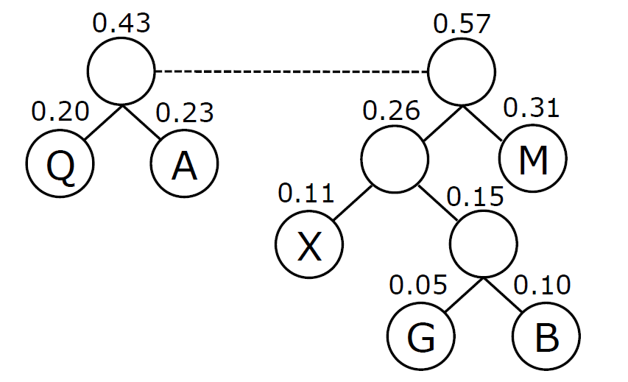
Huffman Coding: Example #3

Slide 63
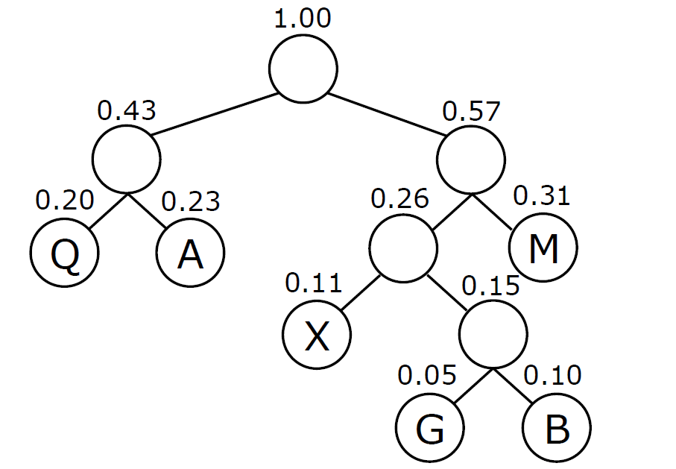
Huffman Coding: Example #3

Slide 64
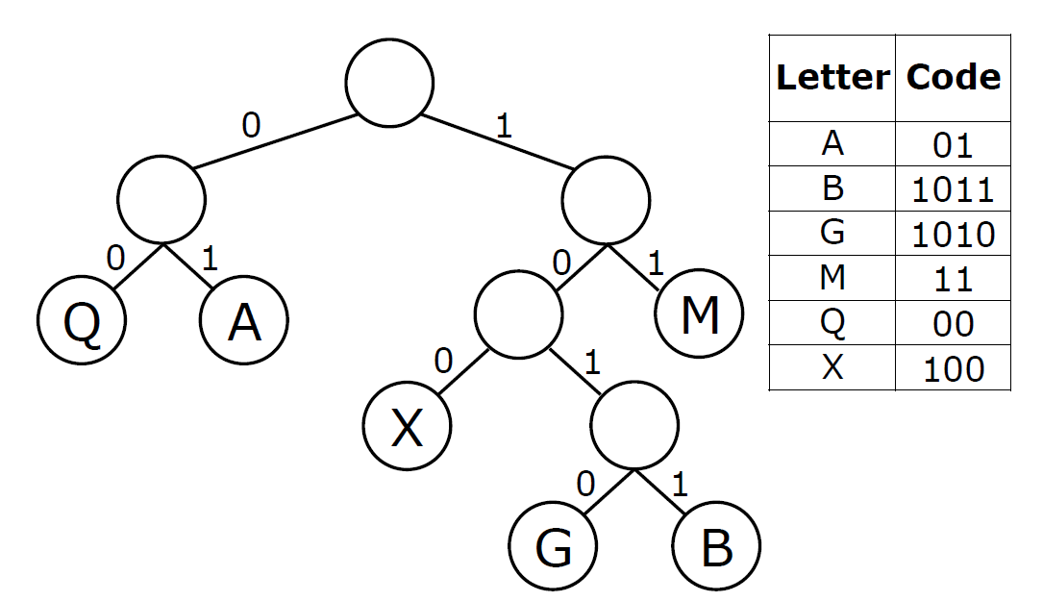
Huffman Coding: Example #3

Slide 65
encode()/decode()
With the dictionary for a Huffman coding assembled, it becomes very easy to encode strings:
huffman_codes = {
"'": '0111', 'A': '10', 'E': '1101’,
'H': '0001', 'I': '1111', 'K': '001’,
'L': '0000', 'M': '11000', 'N': '1110’,
'O': '010', 'P': '110011', 'U': '0110’,
'W': '110010’}
def encode(word, encodings):
result = ‘’
for letter in word:
result += encodings[letter]
return result
encode(‘MAUI’, huffman_codes) # sample call

Slide 66
encode()/decode()
Decoding strings is a little trickier because the dictionary’s key/value pairs are reversed from what we need
The dictionary maps letters to codes, which is suitable for encoding
For decoding we need to map codes to letters
Similar to list comprehensions, a dictionary comprehension lets you create a new dictionary from an existing one
Here’s the code we need. It maps a value from the huffman_codes dictionary back to its key:
reversed_codes = { huffman_codes[key]: key
for key in huffman_codes.keys()}
Would this work if values are not unique in huffman_codes?

Slide 67
encode()/decode()
We can now write the decode() function, where a “reversed” dictionary is given as decodings :
def decode(encoded, decodings):
result = ‘’
while len(encoded) > 0:
for i in range(1, len(encoded) + 1):
if encoded[:i] in decodings.keys():
result += decodings[encoded[:i]]
encoded = encoded[i:]
break
return result
decode(‘110001001101111’, reversed_codes) # sample call
See huffman.py for this code and examples

Slide 68
Questions?

