Slide 1
Introduction to Computational and Algorithmic Thinking
Lecture 2 – Computer programming fundamentals

Slide 2
Announcements
This lecture: Computer Programming Fundamentals
Reading: Read Chapter 2 of Conery

Slide 3
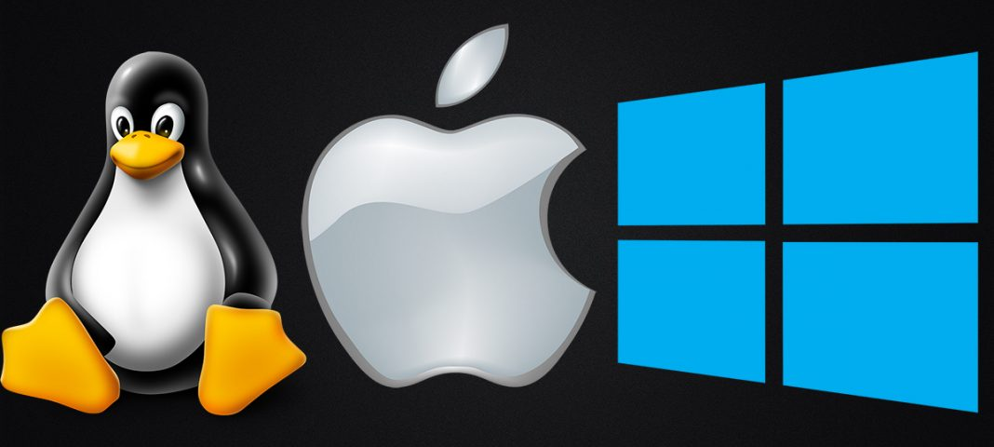
What is an Operating System?
Operating System is a program that manages computer hardware and software resources, and provide common services for computer applications.

Slide 4
What is Python?
Python is a computer programming language
Relatively simple syntax (set of rules programmers must follow when writing programs)
Python can be used to write simple programs that do basic calculations or very complicated ones
Can write basic games!
Python is popular with scientists because they can do complex data analysis by writing short programs
Python can be installed on a wide variety of computer types and operating systems

Slide 5
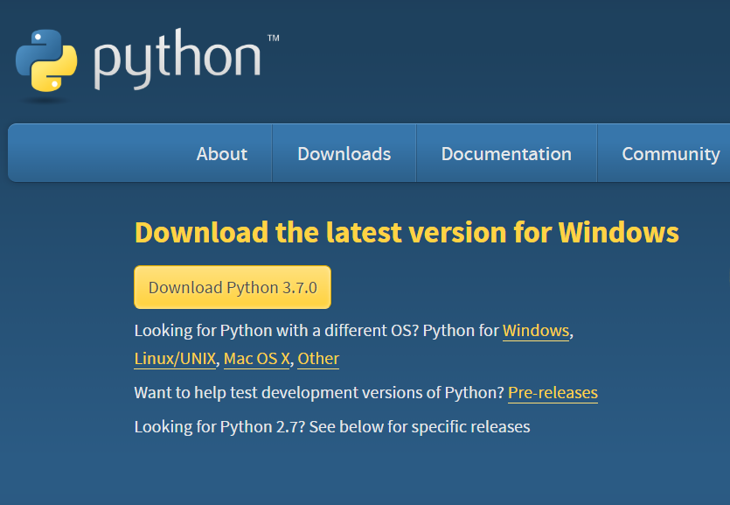
Python Installation on Windows
https://www.python.org/downloads/

Slide 6
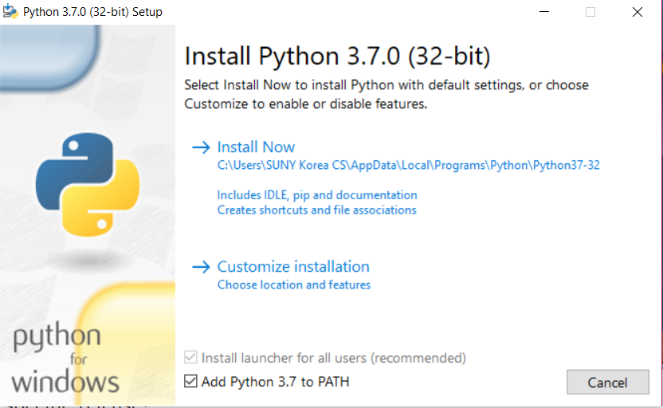
Python Installation on Windows
https://www.python.org/downloads/

Slide 7
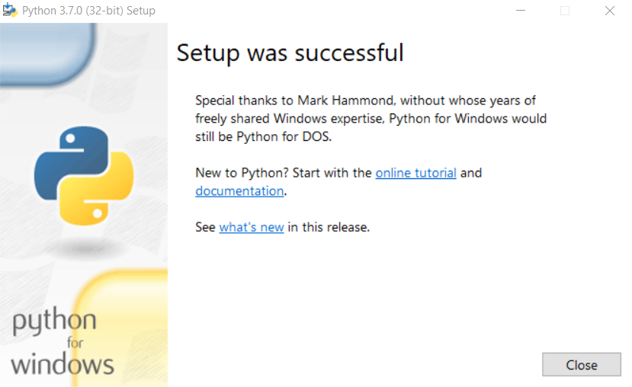
Python Installation on Windows

Slide 8
Python Installation on MacBook
https://www.youtube.com/watch?v=8BiYGIDCvvA

Slide 9
What is a computer program?
A computer program is a sequence of instructions the computer executes to solve a well-defined problem
The instructions or steps the programmer writes constitute the source code of the program
In Python, many of these instructions look like regular, everyday English with some extra punctuation thrown in
There are two basic ways to give commands written in Python to the computer:
Type individual instructions via a shell, an interactive program that executes the commands
Write a complete, stand-alone application that we can run over and over

Slide 10
Python console / interactive shell
The console (or interactive shell) is
a window where a single command or short set of commands can be typed to the computer
the computer tries to execute those command
Python interpreter
Reads Python instructions typed into the console by the user
The interpreter converts them into a form the computer’s hardware understands
The language that the hardware understands is called machine language
No matter what language is used, at some point the source code must be translated into machine code for the computer to execute it

Slide 11
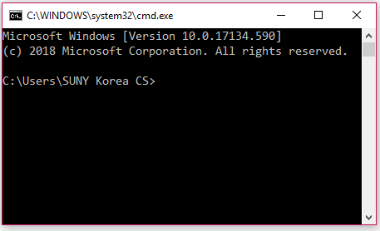
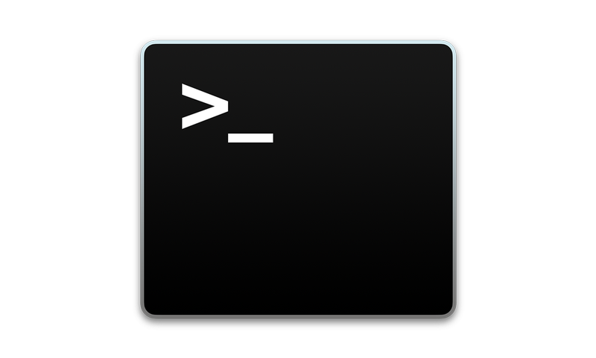
Opening a Terminal
Windows
Press "Win-R," type "cmd" and press "Enter" to open a Command Prompt session using just your keyboard.
Mac OS
Finder -> Applications -> Utilities -> Terminal

Slide 12
Some Python Statements
print (“helloworld”)
1 + 1
a = 1;
b = 2;
a + b
name = “SUNY”
country = “Korea”
print (name + country)
Pi = 22/7
print (type(name))
print (type(Pi))

Slide 13
The PyCharm IDE
In this course, an integrated development environment (IDE) called PyCharm will be used
PyCharm is industry-grade software used by professional software developers
still easy enough for novice programmers to use
First download and install Python from www.python.org
Go to www.jetbrains.com/pycharm to download and install the free Community Edition of PyCharm

Slide 14
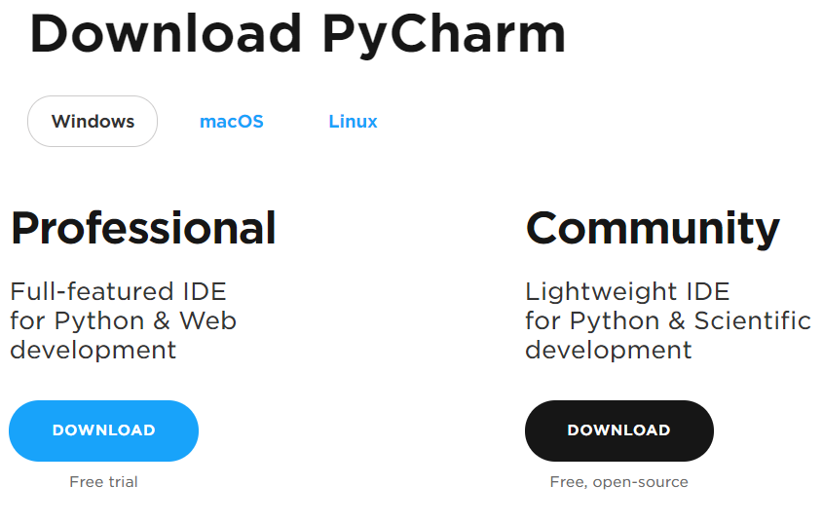
PyCharm Installation
https://www.jetbrains.com/pycharm/download/#section=windows

Slide 15
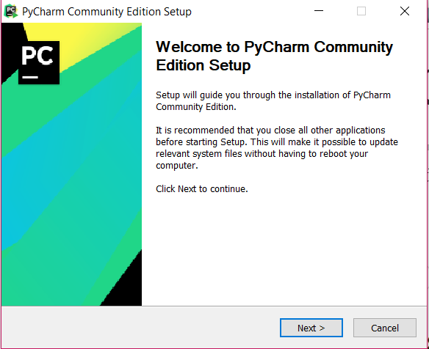
PyCharm Installation

Slide 16
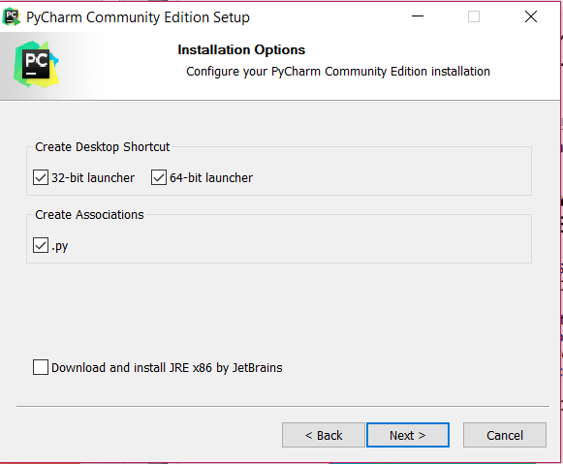
PyCharm Installation

Slide 17
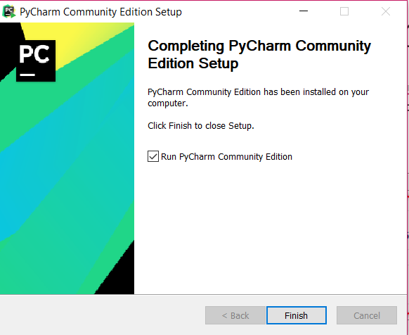
PyCharm Installation

Slide 18
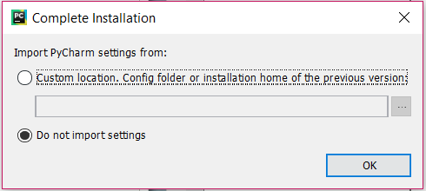
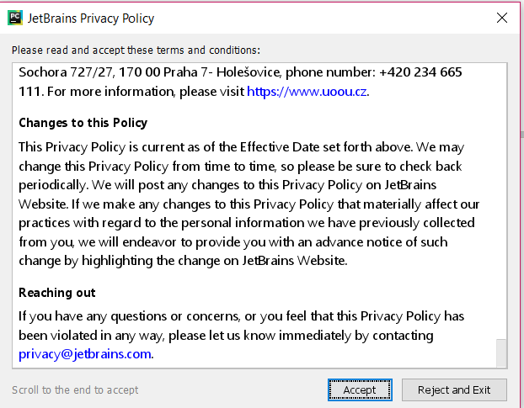
PyCharm Installation

Slide 19
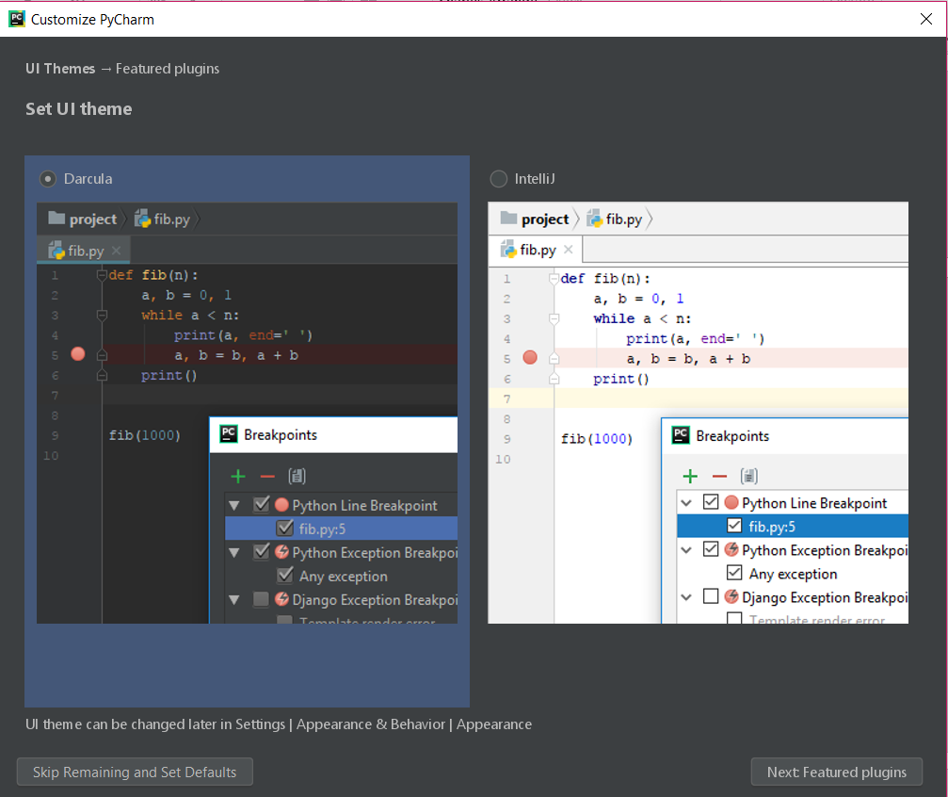
PyCharm Installation

Slide 20
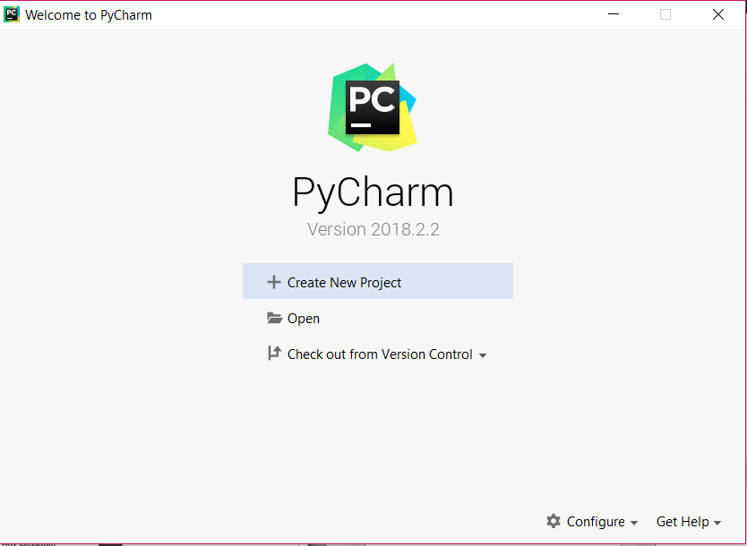
PyCharm Project

Slide 21
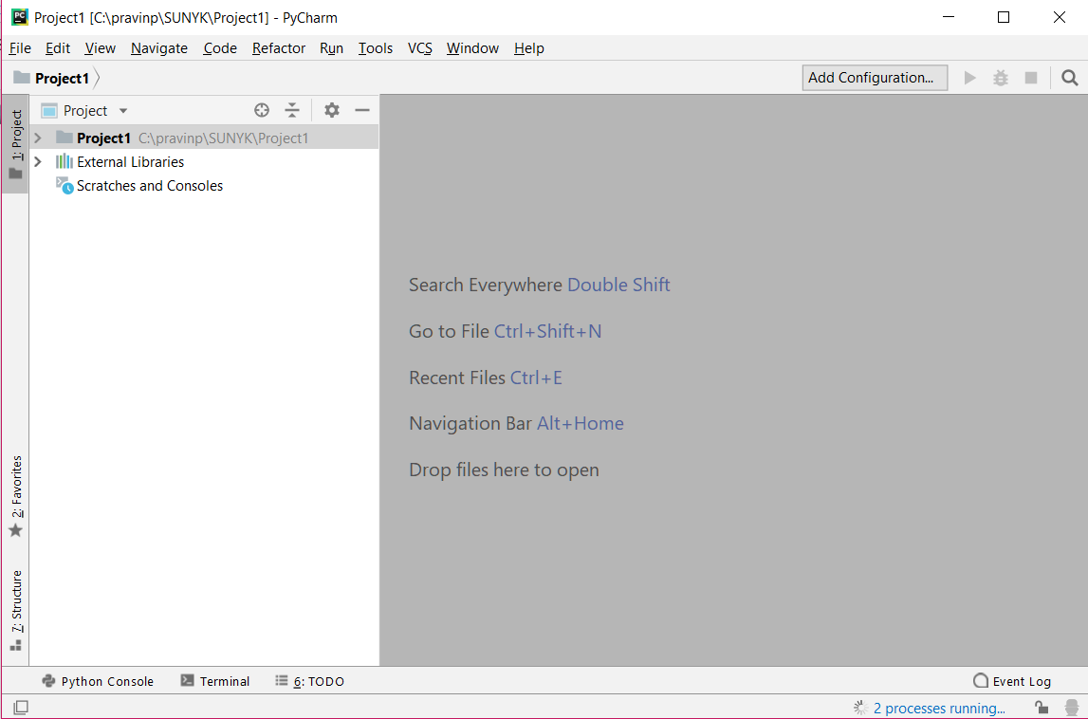
PyCharm IDE

Slide 22
PyCharm Installation on Mac
https://www.youtube.com/watch?v=wb4HNqQtIlI

Slide 23
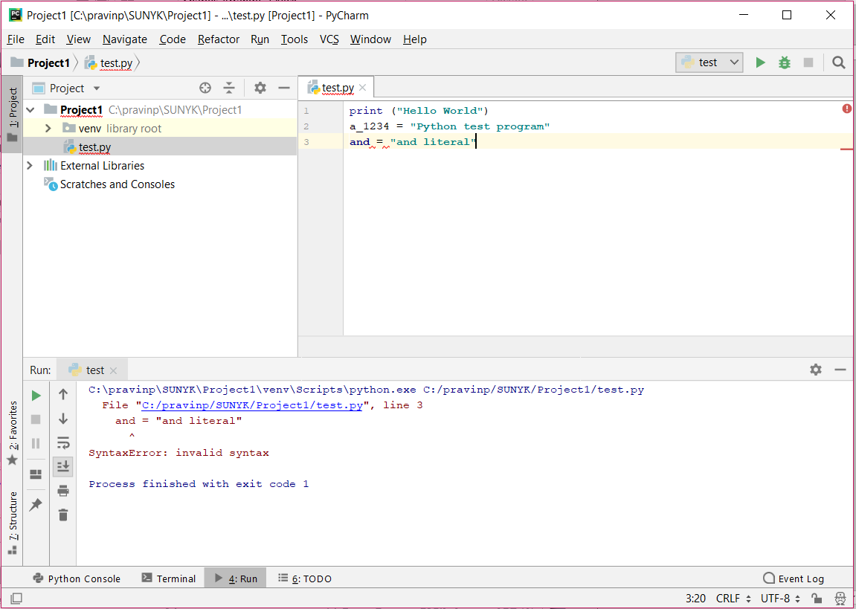
PyCharm IDE

Slide 24
Setting Default Python Interpreter in PyCharm
Step 1: Find out installation location of Python program:
Windows terminal command
where python
Mac terminal command
which python3
Note down the paths of python installation.

Slide 25
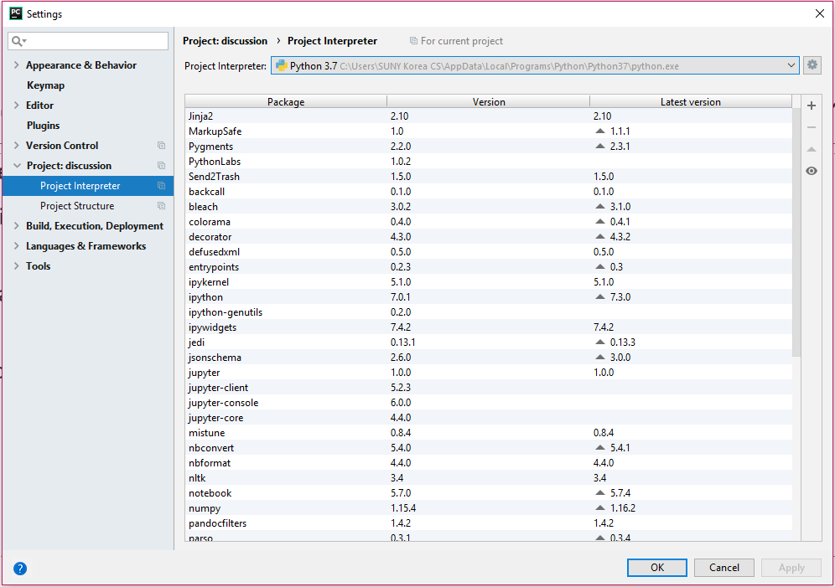
Setting Default Python Interpreter in PyCharm
Step 2: Change project settings (and New Project Settings) in PyCharm:

Slide 26
PyCharm basics
To create and run a stand-alone Python program:
Start PyCharm and press the “Create New Project” button.
Pick a “Location” and name for the Project (e.g., “CSE 101”).
Select File Menu > New > Python File and enter the name of the file for the source code.
Write the program and save the file.
After saving, go to Run Menu > Run.
Select the name of the program file to run it.
The next time the program is to be run:
Hit the green triangle in the lower-left corner of the screen.
Or, right-click the name of the file and choose Run.

Slide 27
Expressions
Expression represent something like a number, string or value
'Hello, world!' is an expression
It has a value
In this case, it’s a string (a sequence of characters)
Numbers are also expressions
5 is an integer expression
recall that an integer is zero, or a positive or negative whole number with no fractional part
12.36 is a floating-point expression
floating-point is a format that computers use to represent real numbers
recall that a real number is zero, or a positive or negative number that might have a fractional part

Slide 28
Expressions
An expression may consists of operators and operands
2 * 9 is an expression and represents a multiplication
Python also has Boolean expressions, which are expressions that can be True or False
Boolean expressions allow programs to change their behavior from one run to the next. (More soon).
So there are least three kinds of data in Python programming:
Strings
Numbers
true/false (Boolean) values
In computer programming, there is a wide variety of data because there is a wide variety of problems that computers can help to solve

Slide 29
Arithmetic in Python
Some of the simplest statements in Python involve arithmetic expressions, which contain numbers (operands) and mathematical operators
Arithmetic in Python follows the PEMDAS rule:
First, evaluate all expressions in parentheses (P)
Then, perform exponentiations (E)
Next, perform multiplications (M) and divisions (D) in left-to-right order
Finally, perform additions (A) and subtractions (S) in left-to-right order

Slide 30
Arithmetic in Python
The symbols used for operators are commonly used in other languages and applications (e.g., spreadsheets)
add: +
subtract: -
multiplication: *
division for real numbers: /
division for integers: // (when a remainder is not needed or desired)
remainder: % (gives the remainder of an integer division)
exponentiation: **

Slide 31
Examples of arithmetic in Python
11 + 5 ➔ 16
11 – 5 ➔ 6
11 * 5 ➔ 55
11 / 5 ➔ 2.2
11 // 5 ➔ 2
This example shows integer division. Any remainder is discarded.
11 % 5 ➔ 1
The computer divides 11 by 5 and returns the remainder (which is 1) instead of the quotient (which is 2).
Use the remainder operator only with integers.

Slide 32
Arithmetic in Python
The ** operator does exponentiation or raises a number to a power
For example, 2 ** 5 would be 32 because 2⁵ = 32
Recall raising a number to the power ½ is the same as taking a square root
So 16 ** 0.5 would be the same as √16 which is 4

Slide 33
Arithmetic in Python
The constant π is built into Python
First the programmer must make it available by importing the math module:
import math
Then the expression math.pi can be used in expressions
math.pi * 2 + 1
A Python module is a file consisting of Python source code that are all related somehow
For example, the math module contains code pertaining to mathematical functions and constants

Slide 34
Variables
A variable in computer programming is similar to the concept of a variable in mathematics
A name for some value or quantity of interest in a given problem
In a program, variables can store a person’s age, GPA, name, or almost any other kind of information
Value is temporarily stored in the main memory (RAM) of the computer while the program is running
A variable is a kind of identifier because it identifies (names) something in source code
It is important to choose identifiers (e.g., variable names) that are informative and helpful
Example: first_name would be a good variable to store a person’s first name, whereas fn would not be as good because it’s less informative
Note how the underscore is used to separate words that define the identifier
Spaces are not allowed in variable names

Slide 35
Variables
A Python variable name may contain lowercase letters, uppercase letters, digits and underscores
First character must be a letter or underscore
Lowercase and uppercase letters are treated as completely different characters
Because of this we say that Python is a case-sensitive language
First_Name, first_name and FIRST_NAME would all be treated as different identifiers
There are a number of keywords built into the Python language that have pre-defined meanings
Predefined keywords may not be used as variables

Slide 36
Assignment statements
To give a value to a variable, write an assignment statement
An assignment statement consists of a variable name, the equals sign, and a value or expression
Examples:
count = 3 (“count is 3” or “count becomes 3”)
total = 3.85 + 12.9
firstName = ‘Susan’
These examples show three different data types: an integer, a real number, and a string

Slide 37
Assignment statements
After assigning a value to a variable, you can change the value of the variable with another assignment statement:
total = 5 + 8 + 3
… other code here …
total = 17 + 6
… etc. …
Variables can also appear on the right-hand side (RHS) of an assignment statement:
next_year = this_year + 1
total_bill = subtotal + tax + tip

Slide 38
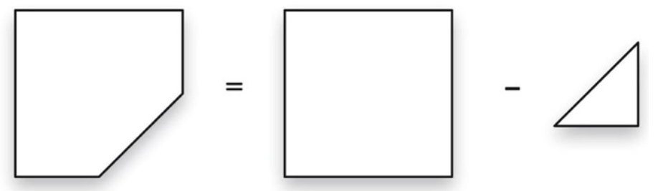
Example: Area calculation
Want to compute the area of a square countertop with one corner cut off, as shown here

Slide 39
Example: Area calculation
Assume that the triangular cut-out begins halfway along each edge
If the computation is needed only once, say for a 100cm-long countertop, can write a statement like this:
area = 100**2 - 50*50/2
Note that this code has a few issues with it:
It’s just a formula of sorts with no explanation of what the numbers mean
The code works only for countertops exactly 100 cm long. What if we had countertops of other sizes?

Slide 40
Example: Area calculation
Consider the first issue: lack of clarity
# area = area of square - area of triangle
# area of triangle is 1/2 base*height
area = 100**2 - 50*50/2
The lines beginning with the # symbol are called comments
Comments are notes that the programmer writes to explain what the program does
Comments do not affect the input or output of the program or anything about how it runs

Slide 41
Example: Area calculation
Now let’s address the other issue: lack of generality
side = 100
square = side**2
triangle = (side/2)**2 / 2
area = square – triangle
To compute the area for a countertop of a different size, simply change the first line:
side = 100
This code is also more readable; comments aren’t needed
This is an example of self-documenting code
The spacing in between variables, numbers, and operator is optional, but is included here to make the formulas easier to read

Slide 42
Aside: input statements
To improve the code further, make it interactive so that the user can provide the value for side
Do this by writing an input statement
An input statement reads a string from the keyboard
As part of an input statement, the programmer must give a prompt message that tells the user what they should enter
Example: name = input(’What is your name? ’)
The person’s name will be assigned to the name variable
You could also say that we are saving the person’s name in the name variable

Slide 43
Example: Area calculation
In the case of the area calculation, the user should enter a number, not a string
Use the following:
side = int(input(‘Enter side length:’))
To collect a floating-point number, use:
side = float(input(‘Enter side length:’))
The type chosen – int vs. float – depends on the application
For this program, read in a float so the user could enter a fraction of a centimeter if desired
The last piece of the puzzle is how to display the final result on the computer screen

Slide 44
Aside: print statements
print is a Python command
It tells Python to display some text on the screen
All Python commands are lowercase
The syntax to print a basic message is just this:
print(‘Hello, world!’)
Any text printed with additional print commands will appear on a new line
For Python to print the next output on the same line, do this instead:
print(‘Hello, world!’, end=‘’) # for python3
This means print this message, but do not automatically go to the next line

Slide 45
Aside: print statements
To print a number, it must first be converted into a string, like so:
print(‘The area is ’ + str(area))
The assumption here is that area is a variable that contains the value we want to print
When used in this fashion, the + symbol performs string concatenation
This simply means Python will join the two strings together into one

Slide 46
Example: countertop.py
# This program prints the area of a
# countertop formed by cutting the
# corner off a square piece of material
# (e.g., granite).
side = float(input('Enter side length: '))
square = side**2
triangle = (side/2)**2 / 2
area = square - triangle
print('The area is ' + str(area))

Slide 47
Example: coins.py
Here is an example of the remainder operator in integer division
Given a total number of cents, the computer should print how many dimes, nickels, and pennies are needed to make that change while minimizing the number of coins
The code will make good use of variables
It will use the str command to print variables containing numbers to the screen
Recall that str converts a number to a string so that it can be concatenated with other strings

Slide 48
Example: coins.py
cents = int(input("Enter the number of cents: "))
dimes = cents // 10
cents = cents % 10
nickels = cents // 5
cents = cents % 5
pennies = cents
print("That number of cents is equal to " +
str(dimes) + " dimes, " + str(nickels) + "
nickels and " + str(pennies) + " pennies.")

Slide 49
Escape sequences
Escape sequences in programming languages like Python allow printing characters (symbols) on the screen that perform special functions
In Python, some of the escape sequences are:
\t shifts the text to the right by one tab stop
\n prints a newline
\” prints a double quotation mark
\’ prints a single quotation mark
A lone backslash character is called the line-continuation character (it’s not really an escape sequence, though)
This symbol is a signal to Python that the current statement spans two or more lines of a file

Slide 50
Example: limerick.py
Source code:
print(‘There was an old man with a beard\n\
Who said, \"It\'s just how I feared!\"\n\
\tTwo owls and a hen\n\
\tFour larks and a wren\n\
Have all built their nests in my beard.’)
Output:
There was an old man with a beard
Who said, "It's just how I feared!"
Two owls and a hen
Four larks and a wren
Have all built their nests in my beard.

Slide 51
Questions?

