Slide 1

Spring 2019 CSE 216 : Programming Abstractions
TOPIC 4 – subroutines

Slide 2
Outline
Introduction to subroutines
Review of stack layout
Inline expansion
Parameter passing
Generic subroutines and modules
Exception handling
Coroutines
Events

Slide 3
Subroutines
Why use subroutines?
Give a name to a task.
We no longer care how the task is done.
The subroutine call is an expression
Subroutines take arguments (in the formal parameters)
Values are placed into variables (actual parameters/arguments), and
A value is (usually) returned
Activation record or stack frames is a means to manage the space for local variables allocated to each subroutine call

Slide 4
Review Of Memory Layout
Memory allocation strategies
Static (compile time)
Code
Globals
Own variables
Explicit constants (including strings, sets, other aggregates)
Stack (run time)
parameters
local variables
temporaries
bookkeeping information
Heap
dynamic allocation

Slide 5
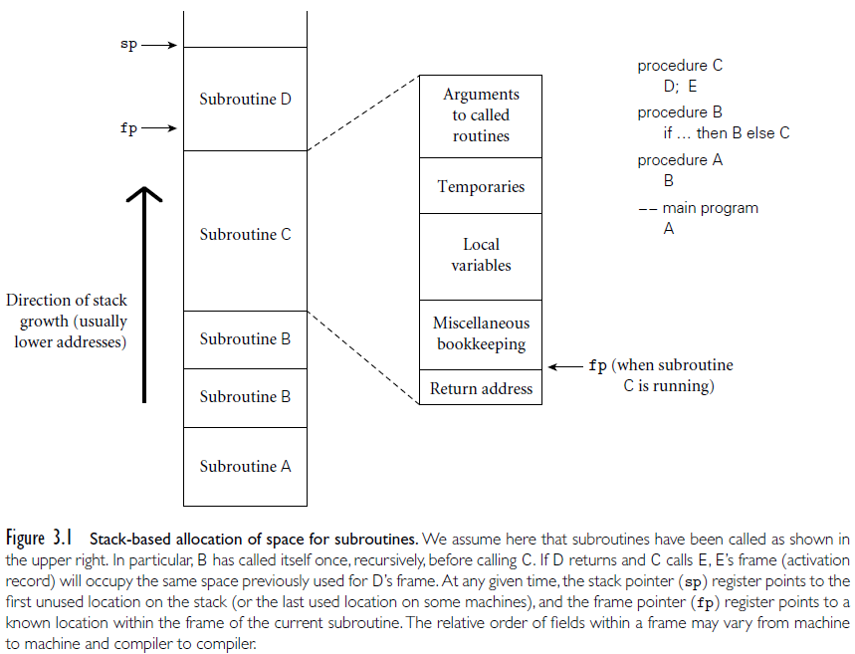
Stack based allocation of space for subroutines

Slide 6
In-line expansion
Alternative to stack-based calling conventions.
During compile time, the compiler replaces a subroutine call with the code of the subroutine.
Without inline functions, the compiler decides which functions to inline.
The programmer has little or no control over which functions are inlined and which are not.

Slide 7
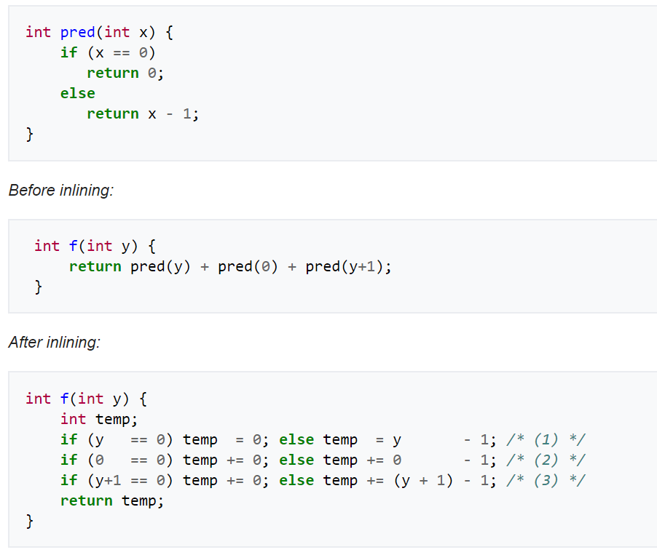
In-line expansion by hand - C Example

Slide 8
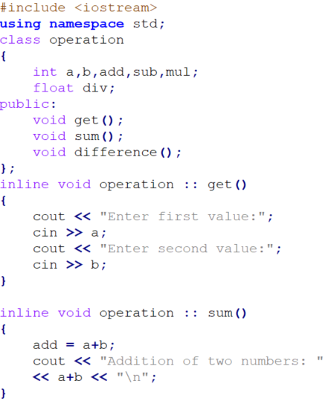
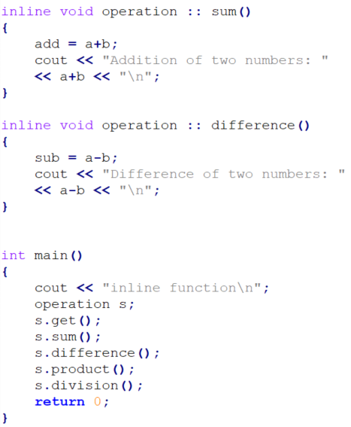
In-line functions in C++

Slide 9
In-line expansion
Advantages:
Avoids overhead associated with subroutine calls; faster code.
Encourages building abstractions in the form of many small subroutines.
Related to but cleaner than macros.
Inline functions are parsed by the compiler whereas, the macros in a program are expanded by preprocessor.
Disadvantages:
Code bloating.
Cannot be used for recursive subroutines.
Code profiling becomes more difficult.

Slide 10
Parameter Passing
Two distinct modes of passing parameters to functions.
Pass by value:
A copy of the argument’s value is made and passed to the called function.
Changes to the copy do not affect the original variable’s value in the caller.
Pass by reference:
The caller passes the address of its data.
The caller gives the called function to access the caller’s data directly and to modify it if the called function chooses to do so.

Slide 11
Parameter Passing
C/C++ functions
parameters passed by value (C)
parameters passed by reference can be simulated with pointers (C)
void proc(int* x,int y){*x = *x+y } …
proc(&a,b);
or directly passed by reference (C++)
void proc(int& x, int y) {x = x + y }
proc(a,b);

Slide 12
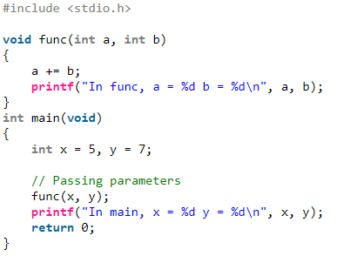
Parameter Passing – by Value in C
https://www.geeksforgeeks.org/parameter-passing-techniques-in-c-cpp/

Slide 13
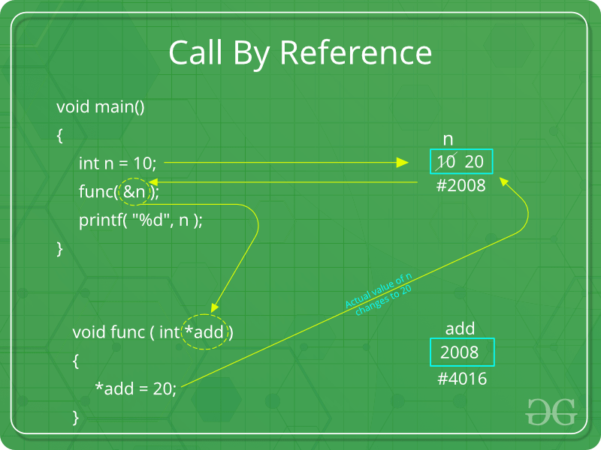
Parameter Passing – by Reference in C
https://www.geeksforgeeks.org/parameter-passing-techniques-in-c-cpp/

Slide 14
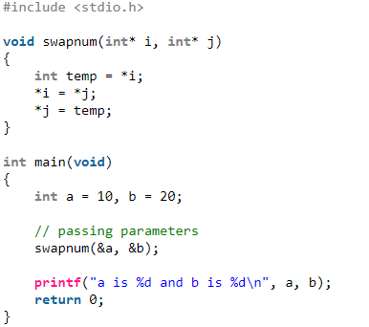
Parameter Passing – by Reference in C
https://www.geeksforgeeks.org/parameter-passing-techniques-in-c-cpp/

Slide 15
Parameter Passing
Java
Java uses call-by-value for variables of built-in type (all of which are values)
Call-by-sharing for variables of user-defined class types (all of which are references)
https://dzone.com/articles/pass-by-value-vs-reference-in-java

Slide 16
Parameter Passing Named Parameters
The values are passed by associating each one with a parameter name.
E.g.,in Objective-C:
[window addNewControlWithTitle:@"Title"
xPosition:20
yPosition:50
width:100
height:50
drawingNow:YES];
E.g.,in Python:
window.addNewControl(title="Title",
xPosition=20,
yPosition=50,
width=100,
height=50,
drawingNow=true)

Slide 17
Parameter Passing Default Parameters
Default parameters: default values are provided to the function
C++ example:
void PrintValues(int nValue1, int nValue2=10){
using namespace std;
cout << "1st value: " << nValue1 << endl;
cout << "2nd value: " << nValue2 << endl;
}
int main(){
PrintValues(1);
// nValue2 will use default parameter of 10
PrintValues(3, 4);
// override default value for nValue2
}

Slide 18
Parameter Passing Variadic functions
functions of indefinite arity – one which accepts variable number of arguments
Java
public class Program {
private static void printArgs(String... strings) {
for (int i = 0; i < strings.length; i++) {
String string = strings[i];
System.out.printf("Argument %d: %s", i, string);
}
}
public static void main(String[] args) {
printArgs("hello", "world");
}
}
https://www.tutorialspoint.com/What-are-variadic-functions-in-Java

Slide 19
Returning from a function
Different ways of returning a value from a function.
Return statement
return expression (causes immediate termination of function)
Avoid termination
rtn := expression
...
return rtn
ML, its descendants, and several scripting languages allow a Multi-value returns
In Python, for example, we might write
def foo():
return 2, 3
...
i, j = foo()

Slide 20
Generic subroutines and modules
Generic modules or classes are particularly valuable for creating containers: data abstractions that hold a collection of objects
When defining a function, we don't need to give all the types
When we invoke the class or function we specify the type: parametric polymorphism
Generic subroutines (methods) are needed in generic modules (classes), and may also be useful in their own right
public static <T extends Comparable<T>> void sort(T A[]) {
...
if (A[i].compareTo(A[j]) >= 0) {
...
}
...
}
Integer[] myArray = new Integer[50];
sort(myArray);

Slide 21
Exception Handling
What is an exception?
a hardware-detected run-time error or unusual condition detected by software
Examples
arithmetic overflow
end-of-file on input
wrong type for input data
user-defined conditions, not necessarily errors
Raising exceptions:
Automatically by the run-time system as a result of an abnormal condition
(e.g., division by zero)
throw/raise statement to raise exceptions manually
Most languages allow exceptions to be handled locally and propagate unhandled exceptions up the dynamic chain.

Slide 22
Exception Handling
What is an exception handler?
code executed when exception occurs
may need a different handler for each type of exception
Why design in exception handling facilities?
allow user to explicitly handle errors in a uniform manner
allow user to handle errors without having to check these conditions explicitly in the program everywhere they might occur

Slide 23
Exception Handling
Java:
throw throws an exception.
try encloses a protected block.
catch defines an exception handler.
finally defines block of clean-up code to execute no matter what.
Only Throwable objects can be thrown.
Must declare uncaught checked exceptions.
C++:
throw, try, and catch as in Java
No finally block
Any object can be thrown.
Exception declarations on functions not required
try {
...
throw ...
...
}
catch (SomeException e1) {
...
}
catch (SomeException e2) {
...
}
finally {
...
}

Slide 24
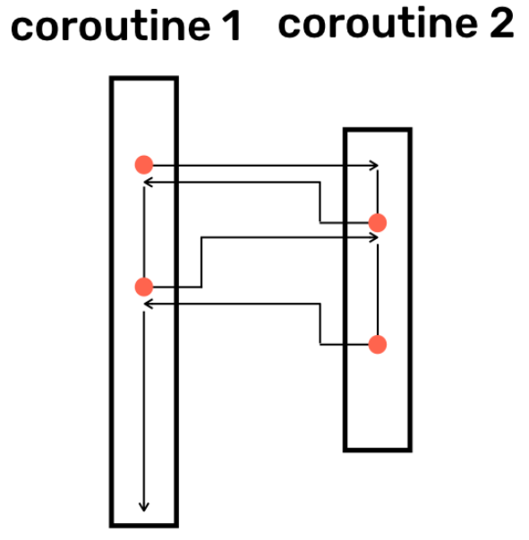
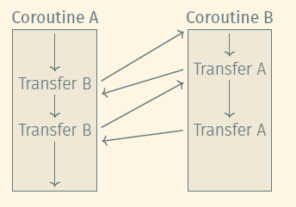
Coroutines
Coroutines are execution contexts that exist concurrently, but that execute one at a time, and that transfer control to each other voluntarily and explicitly, by name
Coroutines can be used to implement
iterators
threads
Because they are concurrent (i.e., simultaneously started but not completed), coroutines cannot share a single stack

Slide 25
Coroutines
As a simple application, consider a “screen-saver” program, which paints a mostly black picture on the screen of an inactive workstation, and which keeps the picture moving (to avoid phosphor or liquid-crystal “burn-in”), and also performs “sanity checks” on the file system in the background, looking for corrupted files
We could write a loop which does screen update and check in one block, but this mixes tasks
Better: use coroutines
coroutine check file system
for all files …
coroutine update screen
loop
update screen

Slide 26
Event types
An event is something to which a running program (a process) needs to respond, but which occurs outside the program, at an unpredictable time.
The most common events are inputs to a graphical user interface (GUI) system: keystrokes, mouse motions, button clicks.
They may also be network operations or other asynchronous I/O activity: the arrival of a message, the completion of a previously requested disk operation
A handler—a special subroutine— is invoked when a given event occurs.
Thread-Based Handlers:
In modern programming languages and run-time systems, events are often handled by a separate thread of control, rather than by spontaneous subroutine calls

Slide 27
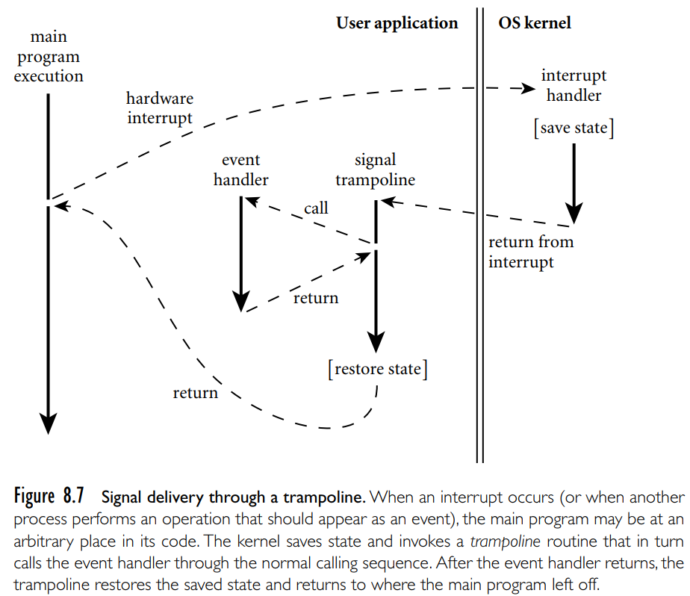
Event types

Slide 28
Questions?

