Slide 1
Introduction to Functional Programming and ML

Slide 2
Features of ML
A pure functional language
serious programs can be written without using variables
Widely accepted
reasonable performance (claimed)

Slide 3
Functional Programming
Function evaluation is the basic concept for a programming paradigm that has been implemented in functional programming languages.

Slide 4
SML
The language ML (“Meta Language”) was originally introduced in the 1970’s as part of a theorem proving system, and was intended for describing and implementing proof strategies in the Logic for Computable Functions (LCF) theorem prover.
Standard ML of New Jersey (SML) is an implementation of ML.
The basic mode of computation in SML is the use of the definition and application of functions.

Slide 5
Install Standard ML
Download from:
http://www.smlnj.org
Start Standard ML:
Type sml from the shell (run command line in Windows)
Exit Standard ML:
Ctrl-Z under Windows
Ctrl-D under Unix/Mac
Mac: /usr/local/smlnj/bin

Slide 6
Standard ML
The basic cycle of SML activity has three parts:
read input from the user,
evaluate it,
print the computed value (or an error message).

Slide 7
Hello, world in SML
Standard ML of New Jersey,
- print("Hello world\n");
Hello world
val it = () : unit
-

Slide 8
Arithmetic in ML
Copy and paste the following text into a Standard ML window
2+2; (* note semicolon at end*)
3*4;
4/3; (* an error! *)
6 div 2; (* integer division *)
7 div 3;

Slide 9
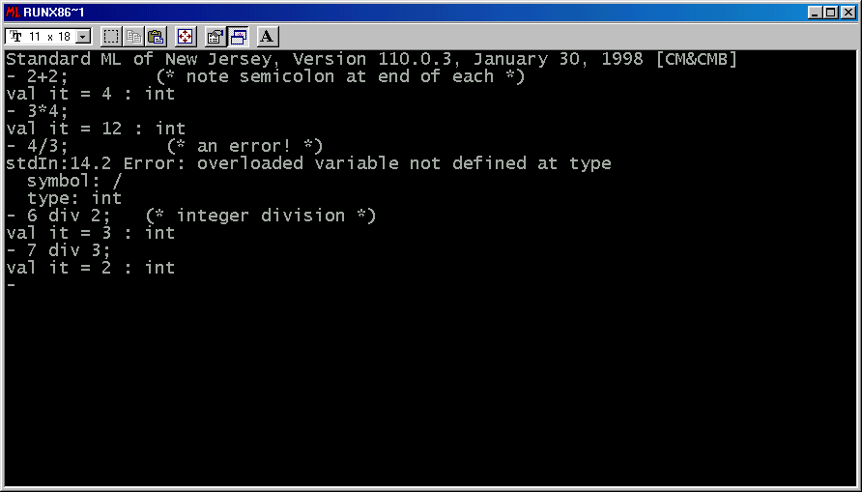
It should look like this

Slide 10
Declaring Constants
Constants are not exactly the same as variables
once set, they can’t be modified
they can be redefined, but existings uses of that constant (e.g. in functions) aren’t affected by such redefinition
val freezingFahr = 32;

Slide 11
Declaring Functions
A function takes an input value and returns an output value
ML will figure out the types
fun fahrToCelsius f = (f -freezingFahr) * 5 div 9;
fun celsiusToFahr c = c * 9 div 5 + freezingFahr;

Slide 12
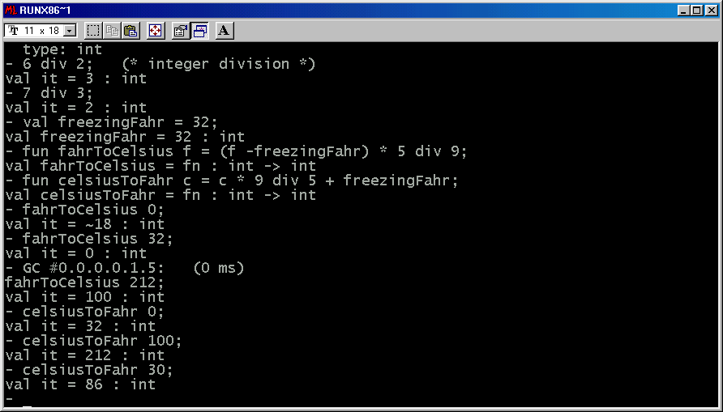

Slide 13
Notes
ML is picky about not mixing types, such as int and real, in expressions
The value of “it” is always the last value computed
Function arguments don’t always need parentheses, but it doesn’t hurt to use them

Slide 14
Types of arguments and results
ML figures out the input and/or output types for simple expressions, constant declarations, and function declarations
If the default isn’t what you want, you can specify the input and output types, e.g.
fun divBy2 x:int = x div 2 : int;
fun divideBy2 (y : real) = y / 2.0;
divBy2 (5);
divideBy2 (5.0);

Slide 15
Two similar divide functions
- fun divBy2 x:int = x div 2 : int;
val divBy2 = fn : int -> int
- fun divideBy2 (y : real) = y / 2.0;
val divideBy2 = fn : real -> real
- divBy2 (5);
val it = 2 : int
- divideBy2 (5.0);
val it = 2.5 : real
-

Slide 16
Ints and Reals
Note ~ is unary minus
min and max take just two input arguments, but that can be fixed!
Real converts ints to real
Parens can sometimes be omitted
Int.abs ~3;
Int.sign ~3;
Int.max (4, 7);
Int.min (~2, 2);
real(freezingFahr);
Math.sqrt real(2);
Math.sqrt(real(2));
Math.sqrt(real 3);

Slide 17
- Int.abs ~3;
val it = 3 : int
- Int.sign ~3;
val it = ~1 : int
- Int.max (4, 7);
val it = 7 : int
- Int.min (~2, 2);
val it = ~2 : int
- real(freezingFahr);
val it = 32.0 : real
- Math.sqrt real(2);
stdIn:57.1-57.18 Error: operator and operand don't agree [tycon mismatch]
operator domain: real
operand: int -> real
in expression:
Math.sqrt real
- Math.sqrt(real(2));
val it = 1.41421356237 : real
- Math.sqrt(real 3);
val it = 1.73205080757 : real
-

Slide 18
Strings
Delimited by double quotes
the caret mark ^ is used for string concatenation, e.g. “house”^”cat”
\n is used for newline, as in C and C++

Slide 19
Lists in ML
Objects in a list must be of the same type
[1,2,3];
[“dog”, “cat”, “moose”];
The empty list is written [] or nil

Slide 20
Making Lists
The @ operator is used to concatenate two lists of the same type
The functions hd and tl give the first element of the list, and the rest of the list, respectively

Slide 21
List Operations
- val list1 = [1,2,3];
val list1 = [1,2,3] : int list
- val list2 = [3,4,5];
val list2 = [3,4,5] : int list
- list1@list2;
val it = [1,2,3,3,4,5] : int list
- hd list1;
val it = 1 : int
- tl list2;
val it = [4,5] : int list

Slide 22
Strings and Lists
The explode function converts a string into a list of characters
The implode function converts a list of characters into a string
Examples:
- explode("foo");
val it = [#"f",#"o",#"o"] : char list
- implode [#"c",#"a",#"t"];
val it = "cat" : string
-

Slide 23
Heads and Tails
The cons operator :: takes an element and prepends it to a list of that same type.
For example, the expression 1::[2,3] results in the list [1,2,3]
What’s the value of [1,2]::[ [3,4], [5,6]] ?

Slide 24
Functions and Patterns
Recall that min and max take just two arguments
However, using the fact that, for example,
min(a, b, c) = min(a, min(b, c))

