Slide 1
JavaScript basics
SLIDES COURTESY:
DENNIS HIGGINS
STATE COLLEGE AT ONEONTA
EXAMPLES ARE IN A DIRECTORY MOSTLY LINKED AT HTTP://EMPLOYEES.ONEONTA.EDU/HIGGINDM/JAVASCRIPT/SCRIPTEXAMPLES.HTML

Slide 2
Useful Resources and Interesting Examples
JavaScript Tutorials
  http://www.w3schools.com/
  Some examples from W3Schools
    JavaScript Examples http://www.w3schools.com/js/js_examples.asp
    JavaScript Object Examples http://www.w3schools.com/js/js_examples_2.asp
    JavaScript HTML DOM Examples http://www.w3schools.com/js/js_examples_3.asp
  More examples
    http://employees.oneonta.edu/higgindm/javascript/scriptexamples.html
JavaScript DHTML GUI Components
  http://www.java2s.com/Code/JavaScript/GUI-Components/CatalogGUI-Components.htm
  Javascript info
  https://javascript.info/

Slide 3
Introduction
Introduction to HTML and DOM
What is it?
How does it work?
What is Java?
Learning JavaScript
  JavaScript Statements
  JavaScript and HTML forms
Notes:
This talk aims to give an overview of JavaScript - introducing the concepts and explaining the potential and possible uses.
The talk moves on to describe the basics behind the language, how and where it operates and how it is included in a web page.
A number of real examples of JavaScript are provided to demonstrate some of the features and syntax of the language, and to identify key concepts. As part of this, a quick refresher on the HTML form tags is given as this is crucial to many of the exercises in the accompanying hands-on document.
A comparison with Java is given to clear up any confusion surrounding the connection between the two languages.

Slide 4
HTML Background
Many “markup” languages in the past
SGML: Standard Generalized Markup Language
  HTML (Hypertext Markup Language) based on SGML
XML (eXtensible Markup Language) “replaces” SGML
  XHTML is replacing HTML

Slide 5
Tags and Elements
Example of an element:
<name attr1=“attrval”>content</name>
Begin and end tags set off a section of a document
  Has a semantic property by tag-name
  Modified by attributes
“content” can contain other elements
  Elements nest, don’t “overlap”
Empty-elements: no end tag
  <br /> <img … />
  Note space before />

Slide 6
Basic HTML Structure
Comments:
<!-- … -->
Example:
<html>
<head>
…
</head>
<body>
….
</body>
</html>
<--- title, meta-tags, etc. (not displayed)
<--- main content (displayed)

Slide 7
Larger Example
<html>
<head>
<title>An Example</title>
</head>
<body>
<h3><hr>An Example</h3>
<p align="left">
<font face="Comic Sans MS" size="4"><b>
Hello World!</b></font>
</p>
<p align="right">
<font size="5"><u>I am 21.</u></font>
</p>
<!-- see next column -->
<p>
<ol type="I" start=7>
<li><font color=#00FF00>Green</font></li>
<li>Yellow</li>
<ul type=square>
<li>John</li>
<li>Mike</li>
</ul>
</ol>
</p>
</body>
</html>

Slide 8
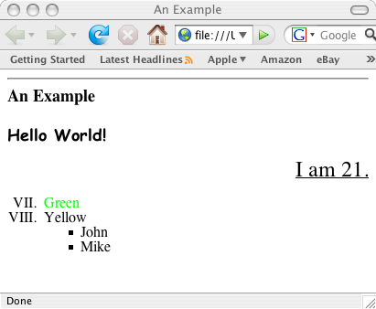
Displays As…

Slide 9
More HTML
Learn on your own
You may never code in “raw” HTML
You may need to tweak HTML files created by a tool
You will need to understand HTML to code in JavaScript etc.
You will need to understand HTML to know limitations on how docs on the web can be structured

Slide 10
Question:
You’re writing software to process an HTML page
  A web-browser engine, for example
What data structure would best represent an HTML document?
  Why?

Slide 11
Document Object Model (DOM)
An model for describing HTML documents (and XML documents)
  A standard (ok, standards)
  Independent of browser, language
    (ok, mostly)
  A common set of properties/methods to access everything in a web document
APIs in JavaScript, for Java, etc.

Slide 12
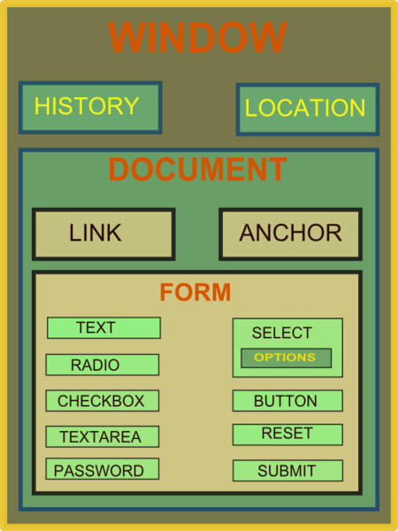
DOM
You get
anything you
want from…
More info: http://en.wikipedia.org/wiki/Document_Object_Model

Slide 13
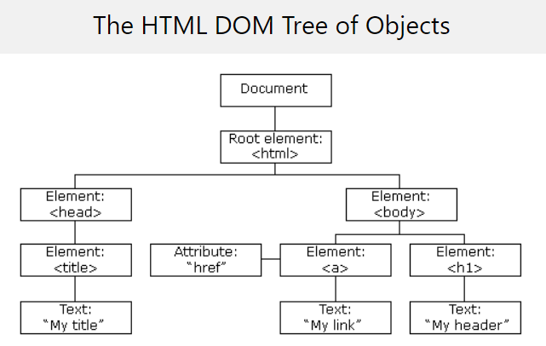

Slide 14
Background
JavaScript was originally called LiveScript (pre-’95) and was developed by Netscape.
It changed its name to JavaScript and became a joint venture with Sun.
ECMA developed a standard for JavaScript in the late 90s which is also an ISO standard and the official name of the language is ECMAScript.
ECMA is at version 3 which corresponds to Netscape’s 1.5.

Slide 15
What is JavaScript?
Browsers have limited functionality
  Text, images, tables, frames
JavaScript allows for interactivity
Browser/page manipulation
  Reacting to user actions
A type of programming language
  Easy to learn
  Developed by Netscape
  Now a standard exists –
  www.ecma-international.org/publications/
  standards/ECMA-262.HTM
Notes:
When the web was conceived, browsers were limited to text and image - later tables and frames. The extent to which they provided interactivity with the user was very limited. JavaScript was developed by Netscape as a simple programming language (often referred to as a scripting language). It is easy to learn and small sections of JavaScript can be added to a web page rather than needing to develop complicated programs. It was specially designed for web page interaction and manipulating the web browser and page elements. It is often used to respond to user actions such as mouse clicks.
Although developed by Netscape, and other variants exist, such as Jscript from Microsoft, a standard has been developed by the European Computer Manufacturers Association. It is known as ECMAScript, using the standard ECMA262, which can be found fully documented at the address on the slide.

Slide 16
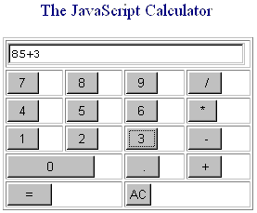
JavaScript Allows Interactivity
Improve appearance
  Especially graphics
  Visual feedback
Site navigation
Perform calculations
Validation of input
Other technologies
Notes:
Examples should be shown which demonstrate different uses of JavaScript. For example, try the calculator example at the address shown.
JavaScript can provide interactivity and/or enhance pages in several ways. It is particularly good at manipulating browser elements and images to improve page presentation and navigation.
As a programming language it can handle quite complex calculations and control the behaviour of embedded content including images.
A useful function is input validation - checking form responses BEFORE the form is sent for processing to a server. In this way it can be quicker and more user friendly, providing immediate feedback to the user.
JavaScript can be combined with other technologies such as Java applets or plug-ins, but this is beyond the scope of this presentation.

Slide 17
How Does It Work?
Embedded within HTML page
  View source
Executes on client
  Fast, no connection needed once loaded
Simple programming statements combined with HTML tags
Interpreted (not compiled)
  No special tools required
Notes:
JavaScript is embedded/included within HTML. You can often see JavaScript in the source of a web page or it is provided for information on the page as with the calculator example.
JavaScript is mainly used as a client-side language - it downloads with the web page. Once the page has downloaded and is on the users' machine, it is actually the web browser which then interprets the JavaScript instructions. JavaScript pages run quickly, you are not relying on an internet connection to a web server. Short pieces of JavaScript can be combined with HTML without the need to develop a fully blown program.
There are two types of computer language, compiled and interpreted. To write or edit a compiled language requires a special piece of software called a compiler. JavaScript belongs to the other category, called interpreted. In the case of JavaScript, this interpretation is done by the browser software at run-time. Because JavaScript is interpreted, this means that no special tools are required to write or edit JavaScript, just a normal text editor. JavaScript web pages can be platform independent i.e. they will run on different browsers and computers (as long as the browser is JavaScript enabled). If you see a JavaScript web page that you like, you may be able to take that JavaScript and use it for your own purposes. (Remember to acknowledge the original author!)

Slide 18
Java vs. JavaScript
Requires the JDK to create the applet
Requires a Java virtual machine to run the applet
Applet files are distinct from the XHTML code
Source code is hidden from the user
Programs must be saved as separate files and compiled before they can be run
Programs run on the server side
Requires a text editor
Required a browser that can interpret JavaScript code
JavaScript can be placed within HTML and XHTML
Source code is made accessible to the user
Programs cannot write content to the hard disk
Programs run on the client side

Slide 19
Learning JavaScript
Special syntax to learn
Learn the basics and then use available code (lots of free sites)
Write it in a text editor, view results in browser
You need to revise your HTML
You need patience and good eyesight!
Examples:
http://employees.oneonta.edu/higgindm/javascript/scriptexamples.html
Notes:
To learn JavaScript you will need to learn some of its language syntax.
However, a good strategy is to learn the basics, and then use and adapt other people's JavaScript. There are plenty of sites on the internet offering free JavaScript (see slide 4) with the calculator example. Other useful addresses are provided in the notes of last slide.
As with HTML, JavaScript can be written in a text editor and viewed in a browser. As it is a programming language the syntax is quite strict (compared to HTML). It is also a good idea to make sure your HTML is up to scratch as this will save you time. The hands-on exercises contain an refresher exercise on HTML forms.

Slide 20
JavaScript Statements
<html>
<head><title>My Page</title></head>
<body>
<script language="JavaScript">
document.write('This is my first →
JavaScript Page');
</script>
</body>
</html>
Note the symbol for
line continuation
Notes:
JavaScript can be contained either in the header section of an HTML page or in the body. This JavaScript statement is shown as a pure JavaScript statement within SCRIPT tags.
Notice that there is no HTML in the body of this page at all. (Demonstrate what this JavaScript looks like in a web browser).
This statement writes a line of text on a web page.
The command document.write is a standard function in JavaScript to write text to the page. The following is a more technical explanation for background information only:
document.write is derived from the JavaScript object model (not covered in detail here). It works on the principle that all document and browser elements have an object name (document, window, image etc) and can each has various properties that can be manipulated. The object hierarchy means that individual elements can be uniquely identified i.e. document.myform.mytext would refer to the text entry named mytext within the form called myform within the current page (document).
The arrow symbol '→' is used in these slides and in the workbook to indicate where a JavaScript statement should be typed on one line without a break. A line break in the wrong place will stop JavaScript from working.e.g.
document.write('This is my first →
JavaScript Page');
should actually be typed:
document.write('This is my first JavaScript Page');

Slide 21
JavaScript Statements
<html>
<head><title>My Page</title></head>
<body>
<script language=“JavaScript">
document.write('<h1>This is my first →
JavaScript Page</h1>');
</script>
</body>
</html>
HTML written
inside JavaScript
Notes:
This example demonstrates that anything included within the quotes in the document.write statement is printed to the screen, and this includes HTML tags. The <h1> tag is delivered to the browser along with the text, and the browser would interpret it as a normal HTML file, displaying the text in the Heading 1 style.
IMPORTANT NOTE:
This example shows a JavaScript statement in the <body> of the web page.
It is possible to include JavaScript statements in the <head> section of a web page but care must be taken that they do not try to access items that don't exist until the page has loaded (e.g. form elements, links, images). The web browser parses (reads through and executes) any script commands as it displays the page.
In most cases it is common sense that dictates where a statement should be placed.
If, in the above example, document.write was placed in the <head> of the page, the text "This is my first JavaScript Page" would appear in the <head> of the finished page – this would be incorrect – although modern browsers will let you get away with it!
In some circumstances you may wish to use document.write in the <head> - for example to dynamically generate <meta> or <title> tags. Such uses are not considered here.
JavaScript functions are typically defined in the <head> section of a web page as they do not normally execute until they have been triggered elsewhere. The use of functions in JavaScript is covered in the Netskills Training Module: "Further JavaScript (Enhancing JavaScript with Functions and Events)"

Slide 22
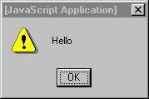
JavaScript Statements
<html>
<head><title>My Page</title></head>
<body>
<p>
<a href="myfile.html">My Page</a>
<br />
<a href="myfile.html"
onMouseover="window.alert('Hello');">
My Page</A>
</p>
</body>
</html>
An Event
JavaScript written
inside HTML
Notes:
Compare this example with the previous one. This time the JavaScript is written inside the HTML tags and there are no <script> tags.
In this case if the browser is JavaScript-enabled it will process the commands when it needs to. If the browser doesn't understand JavaScript it will ignore the extra code (it should see it as an HTML attribute that it cannot process and therefore ignores, although very old browsers my throw an error)
This example demonstrates an HTML hyperlink, but notice the JavaScript enclosed within the <a href.. tag of the second link.
onMouseOver is referring to an event. That is, this JavaScript will happen in response to something that the user does e.g click a button, or in this case, when they move the mouse over the link (this will not happen if you move your mouse over the first link!).
window.alert will display what is called an alert box on the screen containing the text specified, in this case, "hello".
The first link will behave normally.
(See separate Netskills Training Module for more details on Functions and Events in JavaScript.)

Slide 23
Example Statements
<script language="JavaScript">
window.prompt('Enter your name:','');
</script>
<form>
<input type="button" Value="Press" onClick="window.alert('Hello');">
</form>
Another event
Note quotes: " and '
Notes:
This example shows two separate statements. The first is some pure JavaScript so must be contained within <script> tags. It displays a pop up box with the message "Enter your name" and a space to type in text. This occurs immediately when the page loads.
The second statement is within an HTML form. The <input> tag includes some JavaScript within it. The tag creates a form element (a button) and associates with it some JavaScript. The JavaScript responds to the mouse click event (onClick) on the button by producing a pop up alert box with the text 'Hello' in. This only occurs when the user triggers the event by clicking on the button.
JavaScript makes use of both single and double quotes. They are used in this example to have a text string 'Hello' contained within another string which defines the code to be carried out in response to the onClick event. It is important that the quotes should match - if they don't, your JavaScript will not work!

Slide 24
HTML Forms and JavaScript
JavaScript is very good at processing user input in the web browser
HTML <form> elements receive input
Forms and form elements have unique names
  Each unique element can be identified
  Uses JavaScript Document Object Model (DOM)
Notes:
JavaScript is very useful for processing and manipulating user input and form elements.
A common way of obtaining input is via the HTML <form> elements which can provide text entry boxes, selection boxes, menus and buttons. Form elements can be named and hence uniquely identified within the JavaScript object model.

Slide 25

Naming Form Elements in HTML
  <form name="addressform">
  Name: <input name="yourname"><br />
  Phone: <input name="phone"><br />
  Email: <input name="email"><br />
  </form>
Notes:
This example shows a simple form. Notice the name attribute is used at all points - to name the form, and to name each element within the form.
How JavaScript uses the name attribute is described next.

Slide 26
Forms and JavaScript
document.formname.elementname.value
Thus:
document.addressform.yourname.value
document.addressform.phone.value
document.addressform.email.value
Notes:
To refer to the value that a user has typed in a text box, you use the following naming system:
document.formname.elementname.value
This is a naming convention derived from the JavaScript object model:
document refers to the page displayed in the browser.
formname is supplied by the page author as the name attribute of the <form> tag - in the example it is addressform and refers to the whole form.
elementname is supplied by the page author using the name attribute of the <input> tag.
value is a predefined term which refers to the text typed in by the user.

Slide 27
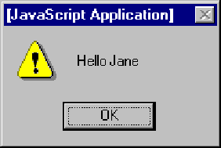

Using Form Data
Personalising an alert box
<form name="alertform">
Enter your name:
<input type="text" name="yourname">
<input type="button" value= "Go" onClick="window.alert('Hello ' + → document.alertform.yourname.value);">
</form>
Notes:
This simple code creates a form called alertform.
The JavaScript is activated when 'Go' button is pressed (an onClick event - see separate Netskills Training Module for more details on Functions and Events in JavaScript). The current value of the element yourname would be displayed in a an alert box.

Slide 28
Parts of JavaScript
Core: operators, expressions, statements and subprograms
Client-side: browser control and user interaction (ie., mouse-clicks, input)
Server-side: language features for use on a server – not covered in this text.

Slide 29
Client-side JavaScript
XHTML-embedded scripting language.
Client-side JavaScript can substitute for some server-side functionality – especially things like checking form data to make sure phone numbers have an area code or ss numbers have the right format.
The browser interprets the JavaScript.
Client-side JavaScript cannot substitute for server-side file networking and database operations.

Slide 30
Interaction
Mouseclicks and form data can trigger java script functions.
DOM allows JavaScript to access and modify the CSS properties and content of any element of a displayed XHTML – enabling dynamic presentation.

Slide 31
Interpreter
Browsers use their JavaScript interpreters to process scripts embedded in html.
Client-side input data checking is an important role for JavaScript. Without this, form information goes to the server, which must locate errors and relay them back to the client.

Slide 32
Placement in head or body of html
Typically function definitions or code for handling events is placed in the head (and accessed if/as needed).
Script meant to be processed just once as part of document content goes in the body. Scripts in the head are cataloged but not interpreted at that time. Scripts in the body are processed as encountered.

Slide 33
Reserved words
break | delete | function | Return | typeof
case | do | if | switch | var
catch | else | in | this | void
continue | finally | instanceof | throw | while
default | for | new | try | with

Slide 34
More about reserved words
Look at http://www.ecma.ch to see a list of future reserved words.
Also some predefined words: alert, open, self, java
// on a line signals comment to end
C++/Java multiline comment syntax: /*…*/
Most browsers now do recognize JavaScript so placing script in special comments is less important, except it may cause validation problems for XHTML validators if the JavaScript includes recognized tags like <br/>

Slide 35
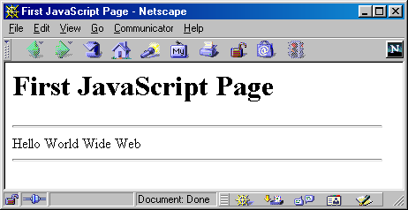
A Simple Script
<html>
<head><title>First JavaScript Page</title></head>
<body>
<h1>First JavaScript Page</h1>
<script type="text/javascript">
document.write("<hr>");
document.write("Hello World Wide Web");
document.write("<hr>");
</script>
</body>
</html>

Slide 36
Embedding JavaScript
<html>
<head><title>First JavaScript Program</title></head>
<body>
<script type="text/javascript"
src="your_source_file.js"></script>
</body>
</html>
Inside your_source_file.js
document.write("<hr>");
document.write("Hello World Wide Web");
document.write("<hr>");
Use the src attribute to include JavaScript codes from an external file.
The included code is inserted in place.

Slide 37
Embedding JavaScript
The scripts inside an HTML document is interpreted in the order they appear in the document.
  Scripts in a function is interpreted when the function is called.
So where you place the <script> tag matters.

Slide 38
Hiding JavaScript from Incompatible Browsers
<script type="text/javascript">
<!–
document.writeln("Hello, WWW");
// -->
</script>
<noscript>
Your browser does not support JavaScript.
</noscript>

Slide 39
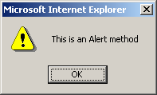
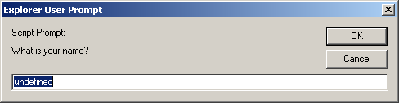
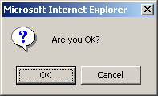
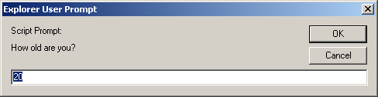
alert(), confirm(), and prompt()
<script type="text/javascript">
alert("This is an Alert method");
confirm("Are you OK?");
prompt("What is your name?");
prompt("How old are you?","20");
</script>

Slide 40
alert() and confirm()
alert("Text to be displayed");
Display a message in a dialog box.
The dialog box will block the browser.
var answer = confirm("Are you sure?");
Display a message in a dialog box with two buttons: "OK" or "Cancel".
confirm() returns true if the user click "OK". Otherwise it returns false.

Slide 41
prompt()
prompt("What is your student id number?");
prompt("What is your name?”, "No name");
Display a message and allow the user to enter a value
The second argument is the "default value" to be displayed in the input textfield.
Without the default value, "undefined" is shown in the input textfield.
If the user click the "OK" button, prompt() returns the value in the input textfield as a string.
If the user click the "Cancel" button, prompt() returns null.

Slide 42
Identifier
Same as Java/C++ except that it allows an additional character – '$'.
Contains only 'A' – 'Z', 'a' – 'z', '0' – '9', '_', '$'
First character cannot be a digit
Case-sensitive
Cannot be reserved words or keywords

Slide 43
Variable and Variable Declaration
<head><script type="text/javascript">
// We are in the default scope – the "window" object.
x = 3; // same as "window.x = 3"
var y = 4; // same as "y = 4" or "window.y = 4"
{ // Introduce a block to create a local scope
x = 0; // Same as "window.x = 0"
var y = 1; // This is a local variable y
}
alert("x=" + x + ", y=" + y); // Print x=0, y=4
</script></head>
Local variable is declared using the keyword 'var'.
Dynamic binding – a variable can hold any type of value
If a variable is used without being declared, the variable is created automatically.
  If you misspell a variable name, program will still run (but works incorrectly)

Slide 44
Data Types
Primitive data types
  Number: integer & floating-point numbers
  Boolean: true or false
  String: a sequence of alphanumeric characters
Composite data types (or Complex data types)
  Object: a named collection of data
  Array: a sequence of values (an array is actually a predefined object)
Special data types
  Null: the only value is "null" – to represent nothing.
  Undefined: the only value is "undefined" – to represent the value of an unintialized variable

Slide 45
Strings
A string variable can store a sequence of alphanumeric characters, spaces and special characters.
Each character is represented using 16 bit
  You can store Chinese characters in a string.
A string can be enclosed by a pair of single quotes (') or double quote (").
Use escaped character sequence to represent special character (e.g.: \", \n, \t)

Slide 46
typeof operator
var x = "hello", y;
alert("Variable x value is " + typeof x );
alert("Variable y value is " + typeof y );
alert("Variable x value is " + typeof z );
An unary operator that tells the type of its operand.
  Returns a string which can be "number", "string", "boolean", "object", "function", "undefined", and "null"
  An array is internally represented as an object.

Slide 47
Object
An object is a collection of properties.
Properties can be variables (Fields) or Functions (Methods)
There is no "Class" in JavaScript.

Slide 48
Array
An array is represented by the Array object. To create an array of N elements, you can write
  var myArray = new Array(N);
Index of array runs from 0 to N-1.
Can store values of different types
Property "length" tells the # of elements in the array.
Consists of various methods to manipulate its elements. e.g., reverse(), push(), concat(), etc

Slide 49
Array Examples
var Car = new Array(3);
Car[0] = "Ford";
Car[1] = "Toyota";
Car[2] = "Honda";
// Create an array of three elements with initial
// values
var Car2 = new Array("Ford", "Toyota", "Honda");
// Create an array of three elements with initial
// values
var Car3 = ["Ford", "Toyota", "Honda"];

Slide 50
// An array of 3 elements, each element is undefined
var tmp1 = new Array(3);
// An array of 3 elements with initial values
var tmp2 = new Array(10, 100, -3);
// An array of 3 elements with initial values
// of different types
var tmp3 = new Array(1, "a", true);
// Makes tmp3 an array of 10 elements
tmp3.length = 10; // tmp[3] to tmp[9] are undefined.
// Makes tmp3 an array of 100 elements
tmp3[99] = "Something";
// tmp[3] to tmp[98] are undefined.

Slide 51
Null & Undefined
An undefined value is represented by the keyword "undefined".
  It represents the value of an uninitialized variable
The keyword "null" is used to represent “nothing”
  Declare and define a variable as “null” if you want the variable to hold nothing.
  Avoid leaving a variable undefined.

Slide 52
Weakly Typed Language
JavaScript is considered a "weakly typed" or "untyped" language.
JavaScript will figure out what type of data you have and make the necessary adjustments so that you don't have to redefine your different types of data.
For example, Performing calculations involving money requires floating-point numbers.
However, as soon as a dollar sign is added to the number, it becomes a string variable.
In strongly typed languages, you need to convert the floating-point number to a string and then concatenate it with the dollar sign.

Slide 53
Weaklytype.html
<html>
<head>
<script language="JavaScript">
var apples=1.43;
var oranges=2.33;
var pears=4.32;
var tax=.04;
var shipping=2.75;
var subtotal=apples + oranges + pears;
var total=subtotal + (subtotal * tax) + shipping;
var message="Your total is $";
var deliver= message + total +".";
document.write(deliver);
</script>
</head>
<body bgcolor="indianred">
</body>
</html>

Slide 54
Type Conversion (To Boolean)
The following values are treated as false
  null
  undefined
  +0, -0, NaN (numbers)
  "" (empty string)

Slide 55
Type Conversion
Converting a value to a number
  var numberVar = someVariable – 0;
Converting a value to a string
  var stringVar = someVariable + "";
Converting a value to a boolean
  var boolVar = !!someVariable;

Slide 56
Operators
Arithmetic operators
  +, -, *, /, %
Post/pre increment/decrement
  ++, --
Comparison operators
  ==, !=, >, >=, <, <=
  ===, !== (Strictly equals and strictly not equals)
    i.e., Type and value of operand must match / must not match

Slide 57
== vs ===
// Type conversion is performed before comparison
var v1 = ("5" == 5); // true
// No implicit type conversion.
// True if only if both types and values are equal
var v2 = ("5" === 5); // false
var v3 = (5 === 5.0); // true
var v4 = (true == 1); // true (true is converted to 1)
var v5 = (true == 2); // false (true is converted to 1)
var v6 = (true == "1") // true

Slide 58
Logical Operators
! – Logical NOT
&& – Logical AND
  OP1 && OP2
  If OP1 is true, expression evaluates to the value of OP2.
  Otherwise the expression evaluates to the value of OP1.
  Results may not be a boolean value.
|| – Logical OR
  OP1 || OP2
  If OP1 is true, expression evaluates to the value of OP1. Otherwise the expression evaluates to the value of OP2.

Slide 59
var tmp1 = null && 1000; // tmp1 is null
var tmp2 = 1000 && 500; // tmp2 is 500
var tmp3 = false || 500; // tmp3 is 500
var tmp4 = "" || null; // tmp4 is null
var tmp5 = 1000 || false; // tmp5 is 1000
// If foo is null, undefined, false, zero, NaN,
// or an empty string, then set foo to 100.
foo = foo || 100;

Slide 60
Operators (continue)
String concatenation operator
  +
  If one of the operand is a string, the other operand is automatically converted to its equivalent string value.
Assignment operators
  =, +=, -=, *=, /=, %=
Bitwise operators
  &, |, ^, >>, <<, >>>

Slide 61
Conditional Statements
“if” statement
“if … else” statement
"? :" ternary conditional statement
“switch” statement
The syntax of these statements are similar to those found in C and Java.

Slide 62
Looping Statement
“for” Loops
“for/in” Loops
“while” Loops
“do … while” Loops
“break” statement
“continue” statement
All except "for/in" loop statements have the same syntax as those found in C and Java.

Slide 63
“for/in” statement
for (var variable in object) {
statements;
}
To iterate through all the properties in "object".
"variable" takes the name of each property in "object"
Can be used to iterate all the elements in an Array object.

Slide 64
var keys = "", values = "";
var mylist = new Array("Chinese", "English", "Jap");
mylist.newField1 = "Something";
for (var key in booklist) {
keys += key + " ";
values += booklist[counter] + " ";
}
// keys becomes "0 1 2 newField1"
// values becomes "Chinese English Jap Something"

Slide 65
var obj = new Object(); // Creating an object
// Adding three properties to obj
obj.prop1 = 123;
obj.prop2 = "456";
obj["prop3"] = true; // same as obj.prop3 = true
var keys = "", values = "";
for (var p in obj) {
keys += p + " ";
values += obj[p] + " ";
}
alert(keys);
// Show "prop1 prop2 pro3 "
alert(values);
// Show "123 456 true "
Example: Using for … in loop with object

Slide 66
Functions (Return Values)
// A function can return value of any type using the
// keyword "return".
// The same function can possibly return values
// of different types
function foo (p1) {
if (typeof(p1) == "number")
return 0; // Return a number
else
if (typeof(p1) == "string")
return "zero"; // Return a string
// If no value being explicitly returned
// "undefined" is returned.
}
foo(1); // returns 0
foo("abc"); // returns "zero"
foo(); // returns undefined

Slide 67
Variable Arguments
// "arguments" is a local variable (an array) available
// in every function
// You can either access the arguments through parameters
// or through the "arguments" array.
function sum ()
{
var s = 0;
for (var i = 0; i < arguments.length; i++)
s += arguments[i];
return s;
}
sum(1, 2, 3); // returns 6
sum(1, 2, 3, 4, 5); // returns 15
sum(1, 2, "3", 4, 5); // returns ?

Slide 68
Built-In Functions
eval(expr)
  evaluates an expression or statement
    eval("3 + 4"); // Returns 7 (Number)
    eval("alert('Hello')"); // Calls the function alert('Hello')
isFinite(x)
  Determines if a number is finite
isNaN(x)
  Determines whether a value is “Not a Number”

Slide 69
Built-In Functions
parseInt(s)
parseInt(s, radix)
  Converts string literals to integers
  Parses up to any character that is not part of a valid integer
    parseInt("3 chances") // returns 3
    parseInt(" 5 alive") // returns 5
    parseInt("How are you") // returns NaN
    parseInt("17", 8) // returns 15
parseFloat(s)
  Finds a floating-point value at the beginning of a string.
    parseFloat("3e-1 xyz") // returns 0.3
    parseFloat("13.5 abc") // returns 13.5

Slide 70
OO
javaScript is not OO, but Object based. There are no classes, polymorphism or object inheritance.
However, documents and elements are modeled with objects and so there is an object-sense to JavaScript.
JavaScript objects are collections of properties, roughly corresponding to C++ or Java objects. Each is a data or method property. Data properties may be primitives or references, although in JavaScript the latter are themselves usually called Objects.
The text will usually use properties to mean data properties and methods to mean method properties.

Slide 71
Creating Objects
JavaScript is not an OOP language.
"prototype" is the closest thing to "class" in JavaScript.
Next few slides show several ways to create objects
It is also possible to emulate "inheritance" in JavasScript.
  See JavaScript and Object Oriented Programming (OOP)
  (http://www.javascriptkit.com/javatutors/oopjs.shtml)

Slide 72
Creating objects using new Object()
var person = new Object();
// Assign fields to object "person"
person.firstName = "John";
person.lastName = "Doe";
// Assign a method to object "person"
person.sayHi = function() {
alert("Hi! " + this.firstName + " " + this.lastName);
}
person.sayHi(); // Call the method in "person"

Slide 73
Creating objects using Literal Notation
var person = {
// Declare fields
// (Note: Use comma to separate fields)
firstName : "John",
lastName : "Doe",
// Assign a method to object "person"
sayHi : function() {
alert("Hi! " + this.firstName + " " +
this.lastName);
}
}
person.sayHi(); // Call the method in "person"

Slide 74
Creating objects using Literal Notation
(Nested notation is possible)
var triangle = {
// Declare fields (each as an object of two fields)
p1 : { x : 0, y : 3 },
p2 : { x : 1, y : 4 },
p3 : { x : 2, y : 5 }
}
alert(triangle.p1.y); // Show 3

Slide 75
Object Constructor and prototyping
function Person(fname, lname) {
// Define and initialize fields
this.firstName = fname;
this.lastName = lname;
// Define a method
this.sayHi = function() {
alert("Hi! " + this.firstName + " " +
this.lastName);
}
}
var p1 = new Person("John", "Doe");
var p2 = new Person("Jane", "Dow");
p1.sayHi(); // Show "Hi! John Doe"
p2.sayHi(); // Show "Hi! Jane Dow"

Slide 76
Adding methods to objects using prototype
// Suppose we have defined the constructor "Person"
// (as in the previous slide).
var p1 = new Person("John", "Doe");
var p2 = new Person("Jane", "Dow");
// Aattaching a new method to all instances of Person
Person.prototype.sayHello = function() {
alert("Hello! " + this.firstName + " " +
this.lastName);
}
// We can also introduce new fields via "prototype"
p1.sayHello(); // Show "Hello! John Doe"
p2.sayHello(); // Show "Hello! Jane Dow"

Slide 77
Events
An event occurs as a result of some activity
  e.g.:
    A user clicks on a link in a page
    Page finished loaded
    Mouse cursor enter an area
    A preset amount of time elapses
    A form is being submitted

Slide 78
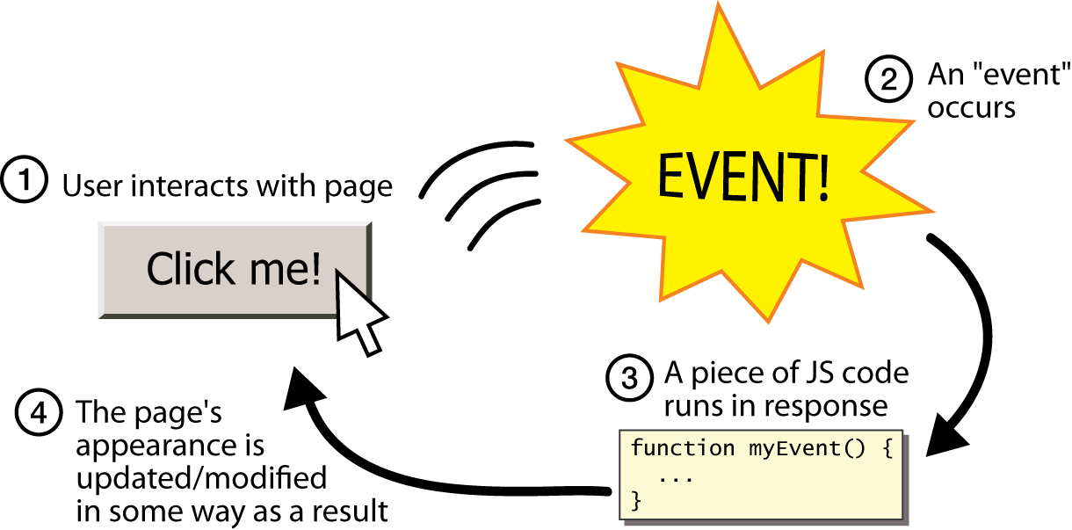
Event-driven programming
CS380

Slide 79
Event-driven programming
you are used to programs start with a main method (or implicit main like in PHP)
JavaScript programs instead wait for user actions called events and respond to them
event-driven programming: writing programs driven by user events
Let's write a page with a clickable button that pops up a "Hello, World" window...
CS380

Slide 80
Event Handlers
Event Handler – a segment of codes (usually a function) to be executed when an event occurs
We can specify event handlers as attributes in the HTML tags.
The attribute names typically take the form "onXXX" where XXX is the event name.
  e.g.:
<a href="…" onClick="alert('Bye')">Other Website</a>

Slide 81
Buttons
<button>Click me!</button> HTML
button's text appears inside tag; can also contain images
To make a responsive button or other UI control:
  choose the control (e.g. button) and event (e.g. mouse 1. click) of interest
  write a JavaScript function to run when the event occurs
  attach the function to the event on the control
CS380
Notes:
Reset is not working here! Debug! test1.html

Slide 82
JavaScript functions
function name() {
statement ;
statement ;
...
statement ;
} JS
function myFunction() {
alert("Hello!");
alert("How are you?");
} JS
the above could be the contents of example.js linked to our HTML page
statements placed into functions can be evaluated in response to user events
CS380

Slide 83
Event handlers
<element attributes onclick="function();">... HTML
<button onclick="myFunction();">Click me!</button> HTML
JavaScript functions can be set as event handlers
  when you interact with the element, the function will execute
onclick is just one of many event HTML attributes we'll use
but popping up an alert window is disruptive and annoying
  A better user experience would be to have the message appear on the page...
CS380

Slide 84
Event Handlers
Event Handlers | Triggered when
onChange | The value of the text field, textarea, or a drop down list is modified
onClick | A link, an image or a form element is clicked once
onDblClick | The element is double-clicked
onMouseDown | The user presses the mouse button
onLoad | A document or an image is loaded
onSubmit | A user submits a form
onReset | The form is reset
onUnLoad | The user closes a document or a frame
onResize | A form is resized by the user
For a complete list, see http://www.w3schools.com/htmldom/dom_obj_event.asp

Slide 85
onClick Event Handler Example
<html>
<head>
<title>onClick Event Handler Example</title>
<script type="text/javascript">
function warnUser() {
return confirm("Are you a student?”);
}
</script>
</head>
<body>
<a href="ref.html" onClick="return warnUser()">
<!--
If onClick event handler returns false, the link
is not followed.
-->
Students access only</a>
</body>
</html>

Slide 86
onLoad Event Handler Example
<html><head>
<title>onLoad and onUnload Event Handler Example</title>
</head>
<body
onLoad="alert('Welcome to this page')"
onUnload="alert('Thanks for visiting this page')"
>
Load and UnLoad event test.
</body>
</html>

Slide 87
onMouseOver & onMouseOut Event Handler
<html>
<head>
<title>onMouseOver / onMouseOut Event Handler Demo</title>
</head>
<body>
<a href="http://www.cuhk.edu.hk"
onMouseOver="window.status='CUHK Home'; return true;"
onMouseOut="status=''"
>CUHK</a>
</body>
</html>
When the mouse cursor is over the link, the browser displays the text "CUHK Home" instead of the URL.
The "return true;" of onMouseOver forces browser not to display the URL.
window.status and window.defaultStatus are disabled in Firefox.

Slide 88
onSubmit Event Handler Example
<html><head>
<title>onSubmit Event Handler Example</title>
<script type="text/javascript">
function validate() {
// If everything is ok, return true
// Otherwise return false
}
</script>
</head>
<body>
<form action="MessageBoard" method="POST"
onSubmit="return validate();"
>
…
</form></body></html>
If onSubmit event handler returns false, data is not submitted.
If onReset event handler returns false, form is not reset

Slide 89
Build-In JavaScript Objects
Object | Description
Array | Creates new array objects
Boolean | Creates new Boolean objects
Date | Retrieves and manipulates dates and times
Error | Returns run-time error information
Function | Creates new function objects
Math | Contains methods and properties for performing mathematical calculations
Number | Contains methods and properties for manipulating numbers.
String | Contains methods and properties for manipulating text strings
See online references for complete list of available methods in these objects: http://javascript-reference.info/

Slide 90
String Object (Some useful methods)
length
  A string property that tells the number of character in the string
charAt(idx)
  Returns the character at location "idx"
toUpperCase(), toLowerCase()
  Returns the same string with all uppercase/lowercase letters
substring(beginIdx)
  Returns a substring started at location "beginIdx"
substring(beginIdx, endIdx)
  Returns a substring started at "beginIdx" until "endIdx" (but not including "endIdx"
indexOf(str)
  Returns the position where "str" first occurs in the string

Slide 91
Error and Exception Handling in JavaScript
Javascript makes no distinction between Error and Exception (Unlike Java)
Handling Exceptions
  The onError event handler
    A method associated with the window object.
    It is called whenever an exception occurs
  The try … catch … finally block
    Similar to Java try … catch … finally block
    For handling exceptions in a code segment
  Use throw statement to throw an exception
    You can throw value of any type
  The Error object
    Default object for representing an exception
    Each Error object has a name and message properties

Slide 92
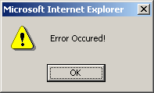
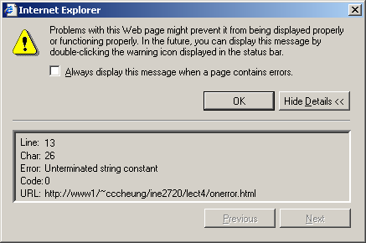
How to use “onError” event handler?
<html>
<head>
<title>onerror event handler example</title>
<script type="text/javascript">
function errorHandler(){
alert("Error Ourred!");
}
// JavaScript is casesensitive
// Don't write onerror!
window.onError = errorHandler;
</script>
</head>
<body>
<script type="text/javascript">
document.write("Hello there;
</script>
</body>
</html>

Slide 93
try … catch … finally
try {
// Contains normal codes that might throw an exception.
// If an exception is thrown, immediately go to
// catch block.
} catch ( errorVariable ) {
// Codes here get executed if an exception is thrown
// in the try block.
// The errorVariable is an Error object.
} finally {
// Executed after the catch or try block finish
// Codes in finally block are always executed
}
// One or both of catch and finally blocks must accompany the try block.

Slide 94
try … catch … finally example
<script type="text/javascript">
try{
document.write("Try block begins<br>");
// create a syntax error
eval ("10 + * 5");
} catch( errVar ) {
document.write("Exception caught<br>");
// errVar is an Error object
// All Error objects have a name and message properties
document.write("Error name: " + errVar.name + "<br>");
document.write("Error message: " + errVar.message +
"<br>");
} finally {
document.write("Finally block reached!");
}
</script>

Slide 95
Throwing Exception
<script type="text/javascript">
try{
var num = prompt("Enter a number (1-2):", "1");
// You can throw exception of any type
if (num == "1")
throw "Some Error Message";
else
if (num == "2")
throw 123;
else
throw new Error ("Invalid input");
} catch( err ) {
alert(typeof(errMsg) + "\n" + err);
// instanceof operator checks if err is an Error object
if (err instanceof Error)
alert("Error Message: " + err.message);
}
</script>

Slide 96
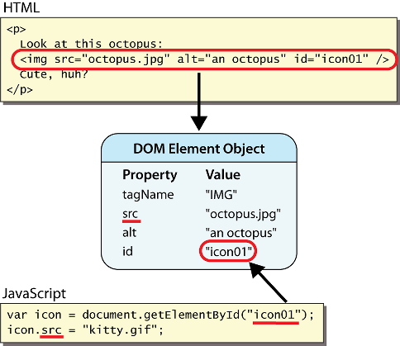
DOM element objects
Notes:
every element on the page has a corresponding DOM object access/modify the attributes of the DOM object with objectName.attributeName

Slide 97
Accessing elements: document.getElementById
var name = document.getElementById("id");
JS
<button onclick="changeText();">Click me!</button>
<span id="output">replace me</span>
<input id="textbox" type="text" /> HTML
function changeText() {
var span = document.getElementById("output");
var textBox = document.getElementById("textbox");
textbox.style.color = "red";
} JS
CS380
Notes:
span.innerHTML = textBox.value;

Slide 98
Accessing elements: document.getElementById
document.getElementById returns the DOM object for an element with a given id
can change the text inside most elements by setting the innerHTML property
can change the text in form controls by setting the value property
CS380

Slide 99
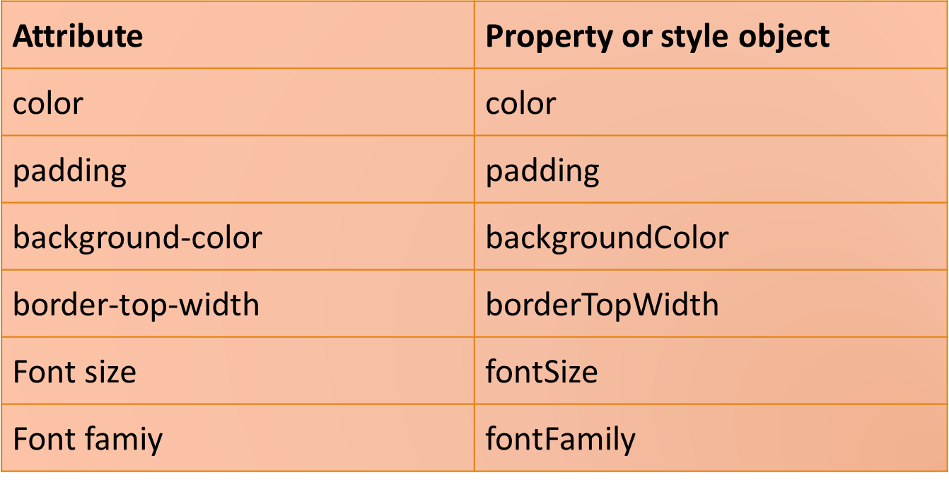
Changing element style: element.style
CS380

Slide 100
Preetify
function changeText() {
//grab or initialize text here
// font styles added by JS:
text.style.fontSize = "13pt";
text.style.fontFamily = "Comic Sans MS";
text.style.color = "red"; // or pink?
} JS
CS380

