Slide 1

Spring 2019 CSE 216 : Programming Abstractions
TOPIC 3 – Data types and Type systems

Slide 2
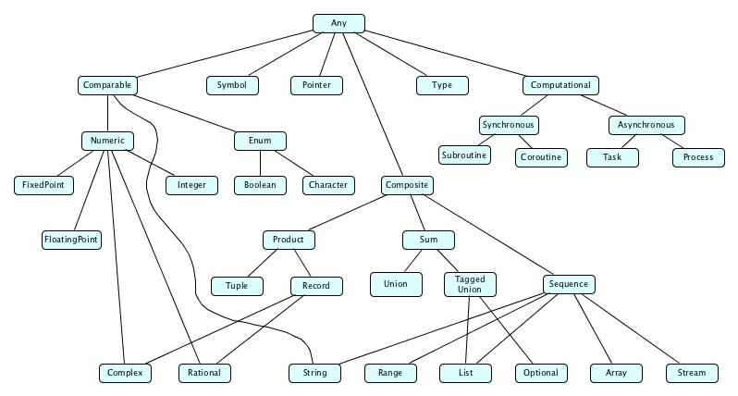
What is a type?
A type consists of set of values and a set of allowable operations.

Slide 3
Classification of Types
What has a type? – Things that have values
Constants, variables, fields, parameters, subroutines, objects
Classification of types:
Constructive: A type is built-in (e.g. Integer, Boolean) or composite (records, arrays).
Denotational: A type is a set or collection of values. (e.g. enum)
Abstraction-based: A type is defined by an interface, the set of operations it supports. (e.g. List)

Slide 4
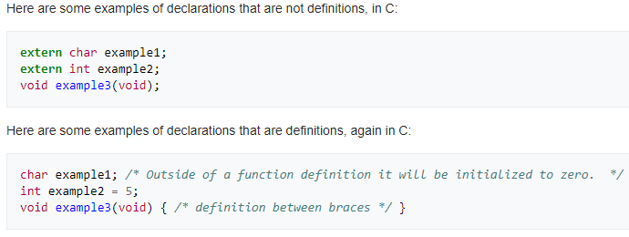
Definition of Types
Defining a type has two parts:
A type’s declaration introduces its name into the current scope.
A type’s definition describes the type (the simpler types it is composed of).

Slide 5
Type System
Mechanism for defining types and associating them with operations that can be performed on objects of each type:
Built-in types with built-in operations
Custom operations for built-in and custom types

Slide 6
Type System
A type system includes rules that specify
Type equivalence: Do two values have the same type? (Structural equivalence vs name equivalence)
Type compatibility: Can a value of a certain type be used in a certain context?
Type inference: How is the type of an expression computed from the types of its parts?

Slide 7
Type Errors
A type error is a program error that results from the incompatible use of differing data types in a program’s construct
int n = "n";
To prevent (or at least discourage) type errors, a programming language puts in rules for type safety.
Type safety contributes to a program’s correctness.
But keep in mind that it does not guarantee complete correctness.
Even if all operations in a program are type safe, there may still be bugs.
E.g., division of one number by another is type safe, but division by zero is unsafe unless the programmer explicitly handles that situation in some other manner.

Slide 8
Type Checking
Type checking is the process of verifying and enforcing the rules of type safety in a program.
This may be done at compile-time, called static typing (and the language is called a statically typed language).
Or, it may be done at runtime, which is known as dynamic typing (and the language is called a dynamically typed language).
Another way to distinguish between the type checking in a language is based on how strongly it enforces the conversion of one data type to another.
If a language generally only allows automatic type conversions that do not lose information, it is called a strongly typed language.
Otherwise, it is called weakly typed.

Slide 9
Common Kinds of Type Systems
Strongly typed
Prohibits the application of an operation to any object not supporting this operation.
Weakly typed
The type of a value depends on how it is used
Statically typed or typed
Strongly typed and type checking is performed at compile time (Pascal, C, Haskell, SML, …)
Dynamically typed or untyped
Strongly typed and type checking is performed at runtime (LISP, Smalltalk, Python, …)

Slide 10
Common Kinds of Type Systems
Programming languages are often classified according to some of the major programming paradigms – procedural, functional, and object oriented.
Within each paradigm, some languages are typed while others are untyped.
Within computer science, “untyped” really means dynamically typed.
That is, a variable or an expression is assigned the type of the corresponding data (i.e., the “value” denoted by the variable or the expression).
Similarly, “typed” typically means statically typed.

Slide 11
Type Systems: Examples
Java is strongly typed, with a non-trivial mix of things that can be checked statically and things that have to be checked dynamically (for instance, for dynamic binding):
String a = 1; //compile-time error
int i = 10.0; //compile-time error
Student s = (Student)(new Object());// runtime
Python is strong dynamic typed:
a = 1;
b = "2";
a + b run-time error
Perl is weak dynamic typed:
$a = 1
$b = "2"
$a + $b no error.

Slide 12
Static and Dynamic Binding in Java
Static binding happens at compile-time while dynamic binding happens at runtime.
Binding of private, static and final methods always happen at compile time since these methods cannot be overridden.
When the method overriding is actually happening and the reference of parent type is assigned to the object of child class type then such binding is resolved during runtime.
Illustrative example

Slide 13
Trade-offs
Strong static type checking (e.g. C)
+ type errors are caught early at compile time
− verbose code
Strong dynamic type checking (e.g. Python)
+ quick prototyping with lesser ‘amount’ of code
− type errors are caught only at runtime
• Weak dynamic type checking (e.g. Perl)
+ least verbose code writing
− type errors are often not caught even at runtime
− unintended program behavior may occur due to implicit type conversion at runtime

Slide 14
Advantages of Type Systems
Documentation/legibility – Typed languages are easier to read and understand since the code itself provides partial documentation of what a variable actually means.
Safety – Typed languages provide early (compile-time) detection of some programming errors, since a type system provides checks for type-incompatible operations.
Efficiency – Typed languages can precisely describe the memory layout of all variables, since every ‘instance’ of an ‘object’ of a certain type will occupy the same amount of space.
Except for dynamically resizing objects like a list.
But even then, we at least know how much memory each ‘cell’ of the list will occupy.
Abstraction – Typed languages force us to be more disciplined programmers. This is especially helpful in the context of large-scale software development.

Slide 15
Type System Rules
A type system has rules for:
type equivalence: when are the types of two values the same?
type compatibility: when can a value of type A be used in a context that expects type B?
type inference: what is the type of an expression, given the types of the operands?
a : int b : int
--------------------
a + b : int

Slide 16
Type Equivalence
The meaning of basic operations such as assignment (denoted by = in C) is specified in a language definition.
Consider the statement:
x = y;
Here the value of object y is copied into the memory locations for variable x.
However, before an operation such as an assignment can be accepted by the translator, usually the types of the two operands must be the same (or perhaps compatible in some other specified way).

Slide 17
Type Equivalence
When do two given expressions have equivalent types?
There are two possible approaches:
1. Name equivalence: two types are equal if and only if they have the same constructor expression (i.e., they are bound to the same name)
2. Structural equivalence: two types are equivalent if and only if they have the same “structure”.

Slide 18
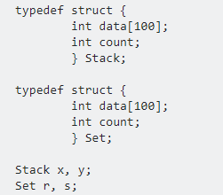
Name Equivalence
Two types are equal if, and only if, they have the same name.
In case of name equivalence, following are valid:
x = y;
r = s;
However, following is invalid:
x = r; 

Slide 19
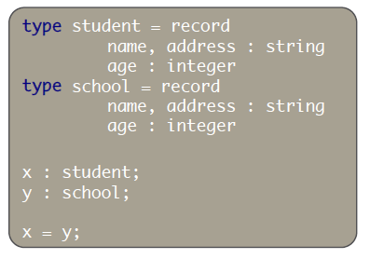
Name Equivalence
Consider the following type definitions:
If this language uses name equivalence, the last line will lead to a type error.
Most modern languages take this approach (e.g., Java, C#).

Slide 20
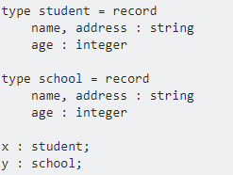
Structural Equivalence
Two types are equal if, and only if, they have the same "structure".
Check equivalence by expanding structures all the way down to basic types
x = y; is valid in structural equivalence
x = y, is not valid in name equivalence 

Slide 21
Structural equivalence
Most languages agree that the format of a declaration should not matter: struct { int b, a; } is the same as the type:
struct {
int a;
int b;
}

Slide 22
Type equivalence
Most modern languages use name equivalence because they assume that
If a programmer has gone through the trouble of repeatedly defining the same structure under different names,
Then s/he probably wants these names to represent different types.
Structural equivalence is a simple in theory, but things get complicated when we get recursive or pointer-based types.

Slide 23
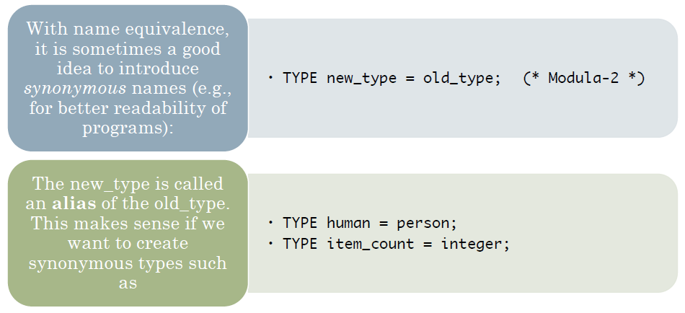
Alias Type

Slide 24
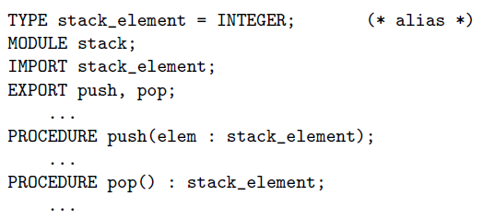
Alias Type
Stack is meant to serve as an abstraction that allows the programmer, to create a stack of any desired type (in this case INTEGER).
If alias types were not considered equivalent, a programmer would have to replace every occurrence of stack_element with INTEGER.

